Slide 1
Manufacturing process 3
الجامعة المستنصرية
كلية الهندسة – قسم الهندسة الميكانيكية
مادة موا هندسية
د. ناظم مجبل فالح

Slide 2
Plastics: Applications
Architectural: electrical and thermal insulation, weather seals, carpets, wall coverings, paint
Aerospace: electrical and thermal insulation, instrument panels,upholstery, seals
Automotive: body panels, instrument panels, upholstery, electrical and thermal insulation, seals, hoses, tires
Consumer Products: toys, sporting goods, appliances, tools, utensils, clothing, shoes, packaging

Slide 3
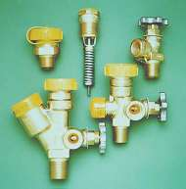
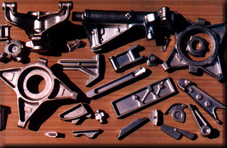
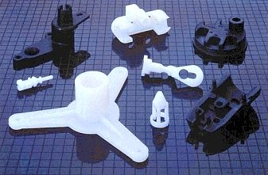
Manufacturing
“The Process of Converting Raw Materials Into Products”

