Slide 1

Engineering Materials 21
الجامعة المستنصرية
كلية الهندسة – قسم الهندسة الميكانيكية
مادة موا هندسية
د. ناظم مجبل فالح

Slide 2
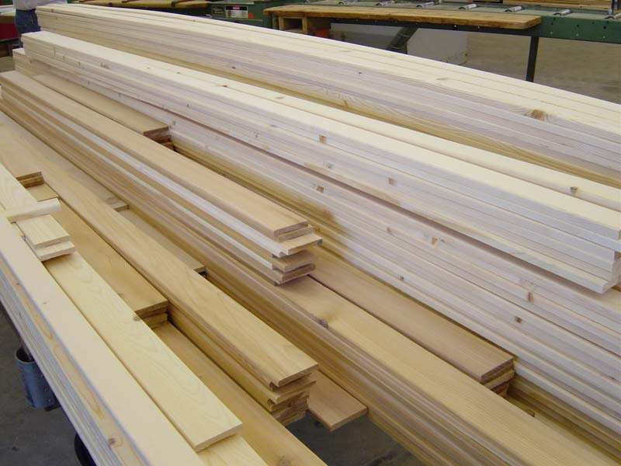
Natural Composites
Hardwood
  Deciduous Trees
Softwood
  Coniferous

Slide 3
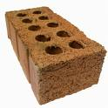

Ceramics
Clay based
  Structural clay-tile, brick
  Porcelain
Refractories
  Heat resistant (fire bricks)
Glasses
Inorganic cements

Slide 4
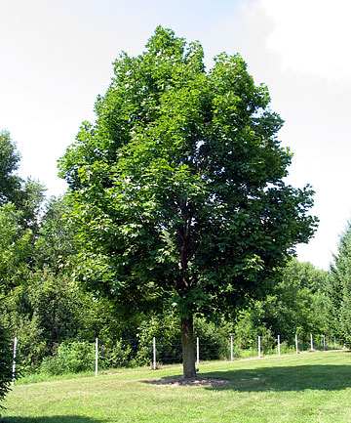
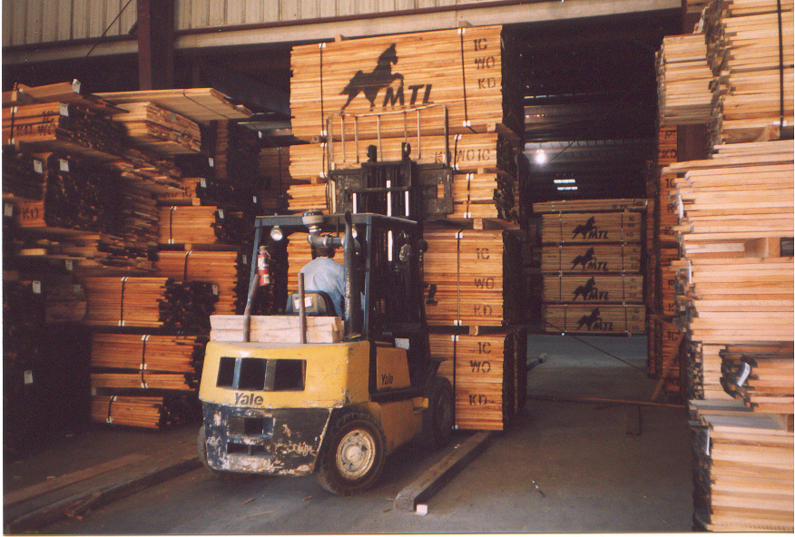
Hardwoods
Ash
Beech
Birch
Cherry
Mahogany
Maple
Oak
Poplar
walnut

Slide 5
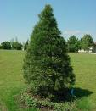
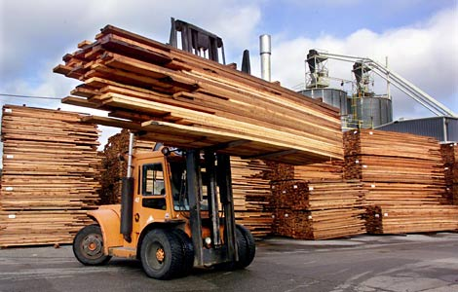
Softwoods
Cedar
Cypress
Fir
Pine
Redwood
Spruce

Slide 6

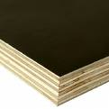
Manufactured Wood
Particle Board
  flake board, particle board
Laminar
  plywood, laminated beams

Slide 7
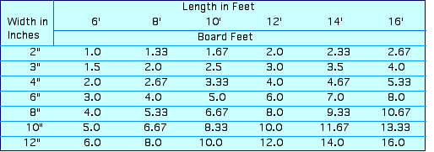
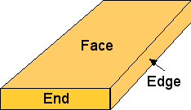
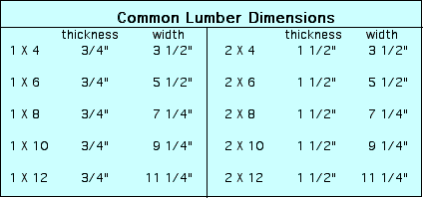
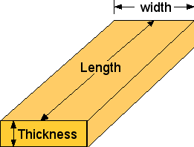
Lumber Facts

