Slide 1
Introduction to C++ Programming Language
Dr. Sawsan M. Mahmoud
Computer Engineering
Faculty of Engineering
Al- Mustansiriyah University
2017-2018

Slide 2
Contact
Name: Sawsan M. Mandalawi
Email: sawsan.mandalawi@yahoo.com
Room: Room 6 in the Department of Computer & Software Engineering
Lecture Time: Tuesday 11:30 - 02:30
Thursday 08:30 - 11:30
Notes: Other office hours are available by an appointment. The contents of this syllabus is not to be changed during the current semester.

Slide 3
What is this Module all about?
This course introduces the basic data structures used in computer software
Understand the data structures
Analyze the algorithms that use them
Know when to apply them
Also, practice design and analysis of data structures and practice using these data structures by writing programs.
On successful completion of this course, you will understand:
What the tools are for storing and processing common data types
Which tools are appropriate
So that you will be able to make good design choices as a developer, project manager, or system customer

Slide 4
Module Content
Introduction C++ programming language
Declaration, Comments, Numbers, Variables, I/O data (cout, cin).
Expressions and Assignments, Increment and Decrement Operator, Combined Operator.
Selection and Switch, If statement Nested If, If else, Switch
Repetition statement, While, Do While For Nested For statement.
One dimensional array I.
One dimensional array II.
Two dimensional array I.
Two dimensional array II.
Structure I
Structure II

Slide 5
Sources of Information
Book
Richard L. Halterman (2017), Fundamentals of Programming C++.
Suggested references
Clifford A. Shaffer, Virginia Tech (2011), Data Structures and Algorithm Analysis.
James F. Korsh,Leonard J.Garrett (2008), Data Structures, Algorithms, and Program style using(c),
Textbook. Michael T. Goodrich, Roberto Tamassia. David M. Mount (2007), Data Structures and Algorithms in C++ .

Slide 6
Assessment C++ Programming Language
Assessment of Learning: The student will be evaluated based on homework, exams, and class participation.
Examination Information: The exams will cover material that has been discussed in class or covered in the book.
Assignments: Homework must be submitted at the beginning of class on the date which it is due. Late homework will be accepted only when special circumstances are approved by the instructor.
Terms examination: 40%
  Term Exams
  Assignments
Final Exam: 60%

Slide 7
Lecture one
Introduction C++ Programming Language

Slide 8
Computer and Development Tools
A computer program is a sequence of instructions that dictate the flow of electrical impulses within a computer system. These impulses affect the computer’s memory and interact with the display screen, keyboard, mouse, and perhaps even other computers across a network in such a way as to permit humans to perform useful tasks, solve high-level problems, and play games.

Slide 9
Computer and Development Tools
Software must be stored in the computer’s memory. These patterns of electronic symbols are best represented as a sequence of zeroes and ones, digits from the binary (base 2) number system. An example of a binary program sequence is: 10001011011000010001000001001110
Software can be represented by printed words and symbols that are easier for humans to manage than binary sequences.
Tools exist that automatically convert a higher-level description of what is to be done into the required lower-level code.

Slide 10
Computer and Development Tools
Higher-level programming languages like C++ allow programmers to express solutions to programming problems in terms that are much closer to a natural language like English.
Some examples of the more popular of the hundreds of higher-level programming languages that have been devised over the past 60 years include FORTRAN, COBOL, Lisp, Haskell, C, Perl, Python, Java, and C#.
A C++ compiler is used to translate the C++ code into machine code. The higher-level language code is called source code. The compiled machine language code is called the target code. The compiler translates the source code into the target machine language.

Slide 11
Computer and Development Tools
An editor allows the user to enter the program source code and save it to files. Most programming editors increase programmer productivity by using colors to highlight language features.
The syntax of a language refers to the way pieces of the language are arranged to make well-formed sentences. programmers must follow strict syntax rules to create well-formed computer programs. Only well-formed programs are acceptable and can be compiled and executed. Some syntax-aware editors can use colors or other special annotations to alert programmers of syntax errors before the program is compiled.

Slide 12
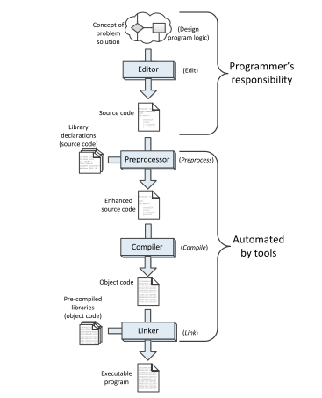
Computer and Development Tools

Slide 13
The Task of Programming
Machine language: language that computers can understand; it consists of 1s and 0s
Interpreter: program that translates programming language instructions one line at a time
Compiler: translates entire program at one time
Run a program by issuing a command to execute the program statements
Test a program by using sample data to determine whether the program results are correct

Slide 14
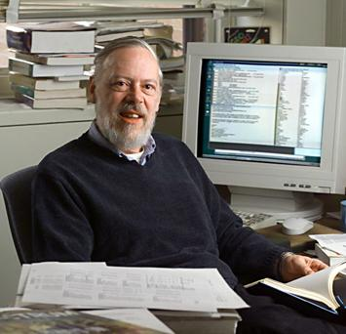
What is C?
Programming languages provide the appropriate formulas to define and use primitive data types.
C is a rather old programming language (1972, Richie, Bell Labs)
Originally designed as a systems software platform (OS and the like)
Procedural, block oriented language (no object-oriented programming)
Dennis Ritchie
Inventor of the
C Programming Language

Slide 15
Why learn C++?
Small, extensible language. Progenitor of many languages.
It is everywhere! (portable)
Many applications and much support due to its age and general use
Many tools written to support C++ development.
Close to the hardware, programmer manages memory
Easy to interface with system devices/assembly routines
Common embedded systems language
Can be fast, efficient (most cited reason)

Slide 16
Why Learn C++?
The following program is written in the C programming language:
#include <iostream.h>
main()
{
/* My first program */
cout<<“Hello World! \n“;
}

Slide 17
C++ Program
C++ is case sensitive. All commands in C must be lowercase.
C++ has a free-form line structure.
End of each statement must be marked with a semicolon. Multiple statements can be on the same line.
White space is ignored. Statements can continue over many lines.

Slide 18
C++ Program
The C program starting point is identified by the word main().
• This informs the computer as to where the program actually starts. The parentheses that follow the keyword main indicate that there are no arguments supplied to this program (this will be examined later on).
• The two braces, { and }, signify the begin and end segments of the program. In general, braces are used throughout C to enclose a block of statements to be treated as a unit. COMMON ERROR: unbalanced number of open and close curly brackets!

Slide 19
C++ Program
The purpose of the statement #include <iostream.h> is to allow the use of the cout statement to provide program output. For each function built into the language, an associated header file must be included.
cout is actually a function (procedure) in C++ that is used for printing variables and text. This has to do with the \ and % characters. These characters are modifiers, and for the present the
\ followed by the n character represents a newline character.

Slide 20
C++ Program
Thus the program prints
Hello World!
And the cursor is set to the beginning of the next line.
Comments can be inserted into C++ programs by bracketing text with the /* and */ delimiters. Comments are useful for a variety of reasons. Primarily they serve as internal documentation for program structure and functionality.

Slide 21
Why Use Comments?
Documentation of variables and functions and their usage
Explaining difficult sections of code
Describes the program, author, date, modification changes, revisions…
** Best programmers comment as they write the code, not after the fact.

Slide 22
Header Files
Header files contain definitions of functions and variables which can be incorporated into any C++ program by using the pre-processor #include statement.
Standard header files are provided with each compiler, and cover a range of areas: string handling, mathematics, data conversion, printing and reading of variables, etc.
For example, to use the function cout in a program, the line #include <iostream.h> • should be at the beginning of the source file, because the declaration for cout is found in the file iostream.h.

Slide 23
Header Files
All header files have the extension .h and generally reside in the /usr/include subdirectory.
#include <string.h>
#include <math.h>
#include "mylib.h“
The use of angle brackets <> informs the compiler to search the compiler’s include directories for the specified file. The use of the double quotes "" around the filename informs the compiler to start the search in the current directory for the specified file.

Slide 24
Header Files
All header files have the extension .h and generally reside in the /usr/include subdirectory.
#include <string.h>
#include <math.h>
#include "mylib.h“
The use of angle brackets <> informs the compiler to search the compiler’s include directories for the specified file. The use of the double quotes "" around the filename informs the compiler to start the search in the current directory for the specified file.

