Slide 1
College of Engineering,
Electrical Engineering Department
Class : Second Year
Subject : Digital Techniques
Boolean Algebra
By:
Asst Lec. Besma Nazar Nadhem
Master of Science in Electrical Engineering
(Electronic and Communication)

Slide 2
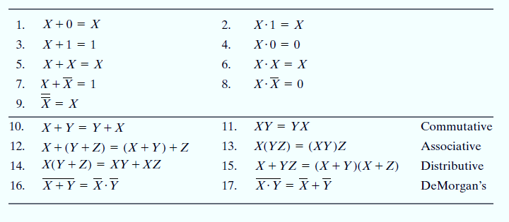
Basic Identities of Boolean Algebra
Table lists the most basic identities of Boolean algebra.

Slide 3
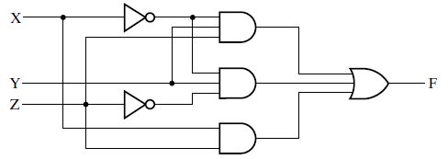
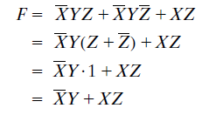
Algebraic Manipulation
Boolean algebra is a useful tool for simplifying digital circuits. Consider, for example,
the Boolean function represented by
The implementation of this equation with logic gates is shown
simplification of the expression for F by applying some of the identities listed in Table
The expression is reduced to only two terms and can be implemented with gates as
shown

Slide 4
Logical Expression in SSOP and SPOS Form (Min and Max Term Form)
Logical expression can be expressed in the following two forms:
(i) standard sum of products (SSOP)
(ii) standard product of sum (SPOS)
1. logical expression is said to be in standard sum of product form If each term contains the entire input variables in product form (either normal form or complemented form or combination of them)
The converting a given logical expression in to SSOP form:
If a particular term is more than once, omit one term.

Slide 5
2. logical function is said to have standard product of sum, if each term contains the sum of all the input variables and the resultant logical expression is the product for such term.
It is a SPOS

Slide 6
$$\sum{\text{and} \prod{\text{Nomenclature} }}$$
Notations are respectively used to represent sum-of-products and product-of-sums Boolean expressions.
1.SOP :
a. Write the expanded sum-of-products
b. Represent un complemented variable by 1 and complemented variable by 0.
c. The decimal equivalent of these terms enclosed in the $\sum{.}$

Slide 7
The different terms represent 0001, 0101, 1000, 1001 and 1111.
F(A,B,C,D)=$\sum{1,5,8,9,15}$
2.POS
a. Write expanded product-of-sums form.
b. The binary numbers represented by the different sum terms are (true and complemented variables here represent 0 and 1 respectively)
c. The decimal equivalent of these terms enclosed in the $\prod{.}$
The different sum terms are 0011, 1011, 1100 and 0111
F=$\prod{3,11,12,7}$

Slide 8
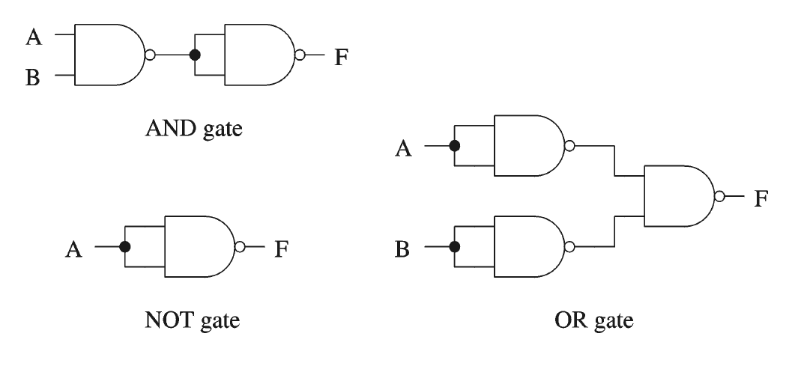
Universal Gates
1.NOR and NAND gates have the property that they individually can be used to hardware implement a logic circuit corresponding to any given Boolean expression.
2. The conversion to NAND or to NOR requires the use of DeMorgan’s theorem.

Slide 9
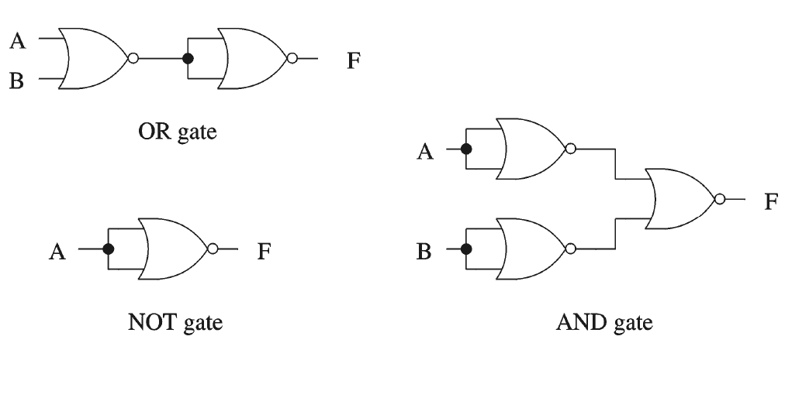

Slide 10
Implementation Using NAND Gates
Get an equivalent expression
Using de Morgan’s law
Majority function

