Slide 1
SURVEYING TOTAL STATION SURVEYING

Slide 2
Basic Principle Classifications – Electro optical system – measuring principle – working principle, Sources of Error – Infrared and Laser total station Instruments. Microwave system , measuring principle, working principle, sources of Errors, Microwave total station instruments,comparision between Electro optical and Microwave system. Care and maintenance of total station Instruments, Modern positioning systems , Traversing and Trilateration.

Slide 3
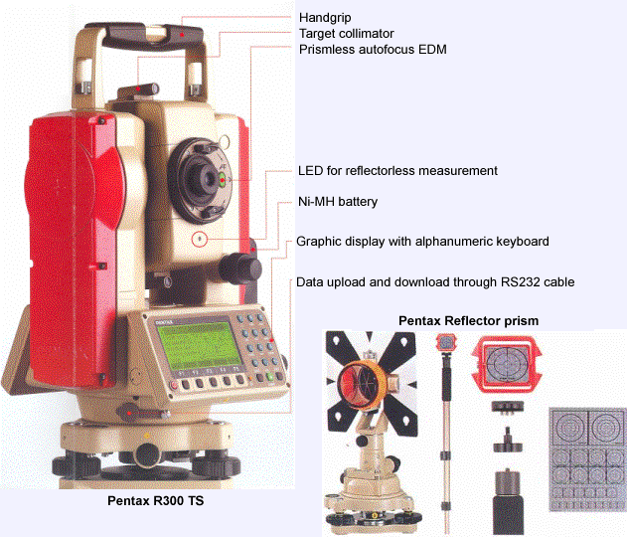

Slide 4
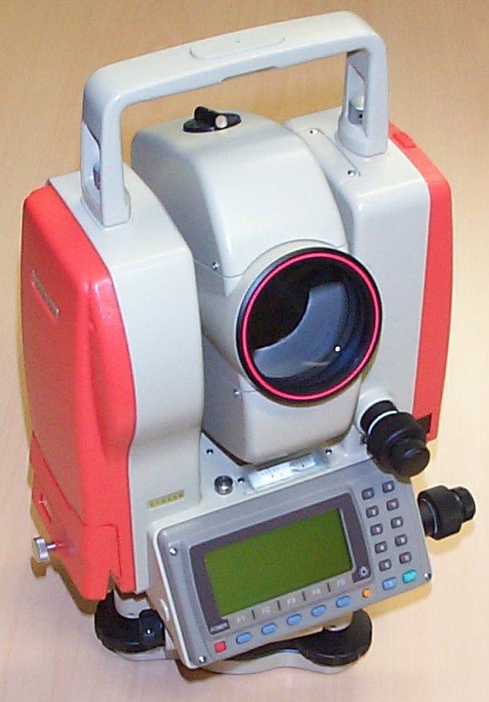

Slide 5
It is Process of determining earthen features and recording its relative position on to the paper

Slide 6
Types of survey
Traverse survey
Triangulation survey
Plane table survey
Which includes:
1. Linear Measurements
2. Angular Measurements
3. Height Measurements

Slide 7
Linear measurements we usually do with:
chain
Tape
Substance bar
EDM (Electronic distance measurement instrument)
GPS (Global Positioning System)
Angular measurements we usually do with:
Compass
Theodolite
Height we usually do with:
Dumpy level
Auto level
Theodolite & Digital leveler

Slide 8
Advantages of Digital levels
Fatigue-free observation as visual staff reading by the observer is not required.
User friendly menus with easy to read, digital display of results.
Measurement of consistent precision and reliability due to automation.
Automatic data storage eliminates booking and its associated errors.
Automatic reduction of data to produce ground levels, thereby eliminating arithmetical errors.

Slide 9
Fast, economic surveys resulting in saving in time (up to 50% less effort has been claimed by manufacturers)
Data on the storage medium of the level can be downloaded to a computer enabling quick data reduction for various purposes.
Digital levels can also be used as conventional levels with the help of dual marked staff (bar coded on one side of the staff for automated reading and conventional graduation on other side of the staff) in case it is difficult to record readings digitally (e.g. for long distances).

Slide 10
Capabilities of Digital levels
measuring elevation
measuring height difference
measuring height difference with multiple instrument positions
levelling
slope setting
setting out with horizontal distance
levelling of ceilings

Slide 12
Total station is a combination of :
EDM
Theodolite
Auto Leveler
Microprocessor with specific memory
Battery/spare
which works about 5 working hours
About 100 models were released till now by different firms.

Slide 14
Basic components of Total station
Prism reflector:
It is a combination of ranging rod, staff and and
optical cuboidal mirror.
having 2/3 lifts with 5cms interval graduations.
adjustable height from 1.5m to 3.75m.
More number of prisms, will give more accuracy.

Slide 15
GUN: data screen LCD
eye piece
telescope 24x to 43x
environmental box
microprocessor with memory card of 1 or 2 GB capacity
1MB can store 800 points.
Tripod: with different material
Aluminum tripod weighs 13 to 14lbs
Wooden tripod will be about 18 lbs.
Optical and Laser plumb bobs.
Battery –as an external attachment
with indicators
1.5hours charged battery can work for 3to 5 hours

Slide 16
ACCURACY OF TOTAL STATION
More accuracy can be achieve by :
1. Careful Centering
2. Accurate pointing target
3. Average of multiple points
4. Better optical lense
5. Strong Tripod
6. Verticality of prism pole
Angular accuracy is from 1 to 20 Sec.
Linear accuracy is from 2mm to 10mm/per KM
Different instruments have different accuracy
 | Angular | Linear
 |  | With 1 Prism | With 3 prisms
NIKON | 1 Sec | + 2 mm | + 1 mm
LIEKA | 1 Sec | + 2 mm | + 1 mm
SOKKIA | 1 Sec | 2 mm | + 1 mm
Accuracy varies with Price
Distance measure with:
Single Prism – up to 2.5 Km
Two prisms - 5 to 7 Km
Three prisms - 10 to 12 Km

Slide 17
Functions of T.S:
1. It simultaneously measures angles & distances and Record
2. Correcting the measured distance with:
1. Prism constant
2. Atmospheric Pr.
3. Temperature
4. Curvature of earth
5. Refraction correction
3. Computing the point elevation
4. Computing the coordinates of every point
5. Remote elevation measurement
6. Remote distance measurement
7. Area calculations
8. Data Transferring facility from instrument to S/W and S/W
to instrument
9. Format of conversion of units

Slide 18
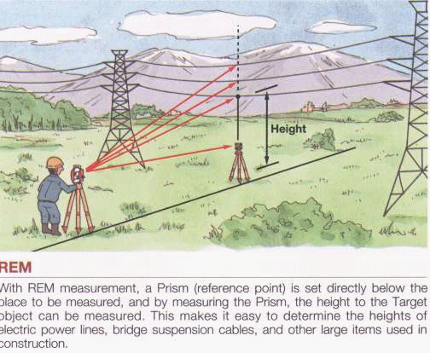
REM Remote Elevation Measurement

Slide 19
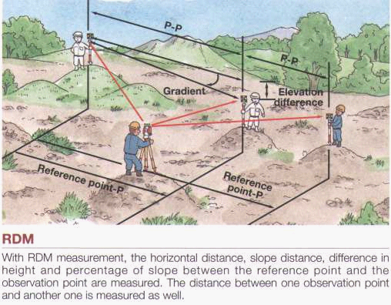
RDM Remote Distance Measurement

Slide 20
Application of Total station:
Updating mapping
Topographic survey
Hydrographic survey
Cadastral survey
Project construction survey
Road, Rail Survey
Mining survey

Slide 21
Operations involved while using Total Stations :
Establishing the site Datum:
a) Selecting the site Datum
b) Establishing North
2. Setting up the Total station:
a) Placing and leveling Tripod on Datum
b) Placing and leveling the Gun on Tripod
c) Linking the data connector to Gun
3. Data collector options and setting
a) Main menu
b) Basic settings

Slide 22
4. Creating and Operating Job files:
a) Creating a new Job file
b) Opening an existing file
5. Shooting points
a) Identifying the important points to shoot
b) shooting points
c) Shooting additional points
d) Noting the special features
6.Post Processing – Data down loading,conversion
7.Plotting/Map generation.

Slide 23
Computer software packages
The following post processing computer software packages are in use for various engineering applications.
1.Arc Pad, arc view, arc info
-conversion from raster to vector form
2.Micro Station - Map generation
3.Erdas – Image processing s/w
4.Surfer, Auto plotter, Civil cad, Pythagarus
– preparation of contours
5. Survey aid – to draw c/s and l/s
The information received is to be analyzed depending on the users requirement.

Slide 24
Limitations:
It is not a Rugged instrument (Sensitive).
Prism verticality is questionable.
Visibility is must.
More Expensive.
Requires calibration at every six months.
Amount of error is greater at short distances.
Height of instrument and prism is to fed.
Awareness on battery maintenance.
To establish north- compass is required.

Slide 25
SAFETY PRECAUTIONS
Focusing directly at the sun, can result - loss of eyesight on the spot. Use a filter when observing the sun.
Never remove the hand grip carelessly. If the grip is loosely or incompletely attached, the instrument could fall and may cause a serious injury.
Make sure not to short the battery terminals. If these are shorted, the resulting high current would not only damage to the battery, but also start a fire.
If the instrument or battery comes in contact with water, wipe it off as quickly as possible and set it in a dry place for a while. When it is completely dry, put it back in the case.
5. Never disassemble the instrument, if you find a problem. Contact the dealer.

Slide 26
HOW TO SUPERVISE THE TOTAL STATION WORK
Have keen observation on the prism boy’s attitude. When high precision is required, use the prism tripod, to avoid human error.
The position of prism shall always be on hard surface instead of soft soil.
Focusing shall be exactly at the centre of prism, with the help of cross hairs and prism plate.
While measuring the instrument height and prism height, enough attention shall be diverted. Also, have keen observation while entering the above data.
Note the location and coordinates of station point and back sight so that specified intermediate points can be checked at later date.
Obtain a soft copy of field work raw data from the survey agency so that the results can be checked at any time.
Obtain more number of points to get an average.

