Slide 1
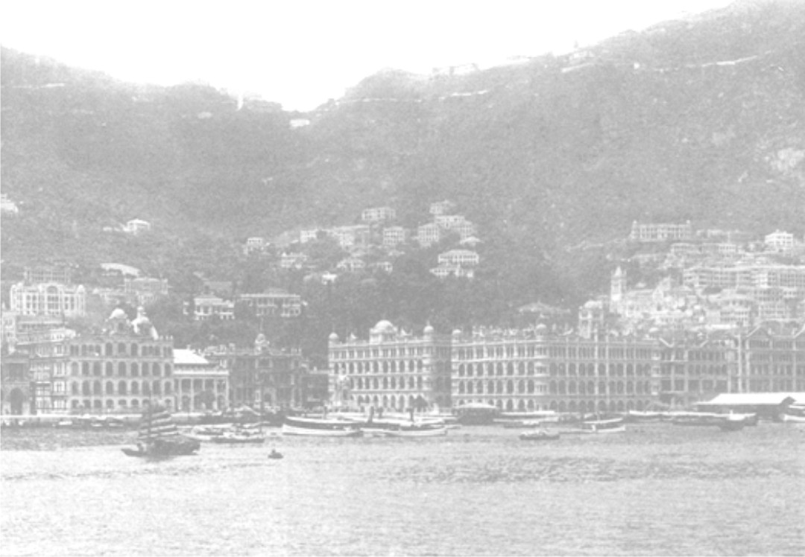
Procedure of Cadastral Surveying

Slide 2
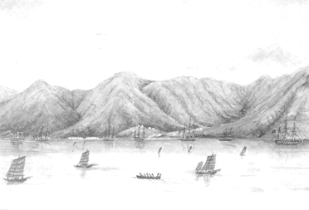
Outline
Introduction
Land Record Search
Site Visit and Planning
Instrumentation Preparation
Field Survey
Data Download and Reduction
Field Checking
Boundary Redefinition
Plan Production and Report Writing
Q&A

Slide 3
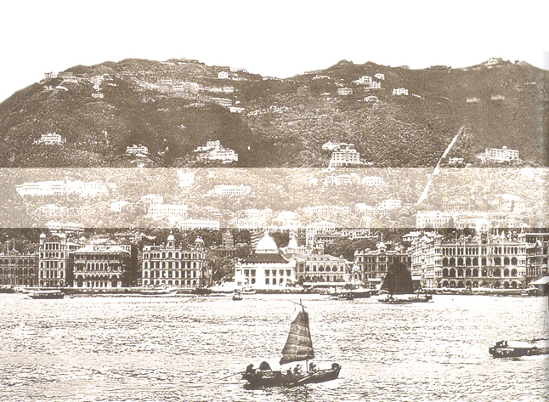
Introduction

Slide 4
Introduction
Cadastral Surveying is one of the critical tasks for land surveyors in Hong Kong.
Due to the increasing number of land boundary cases in the Courts, the land boundaries must be clearly defined without doubt.
In order to avoid creating boundary conflict.

Slide 5
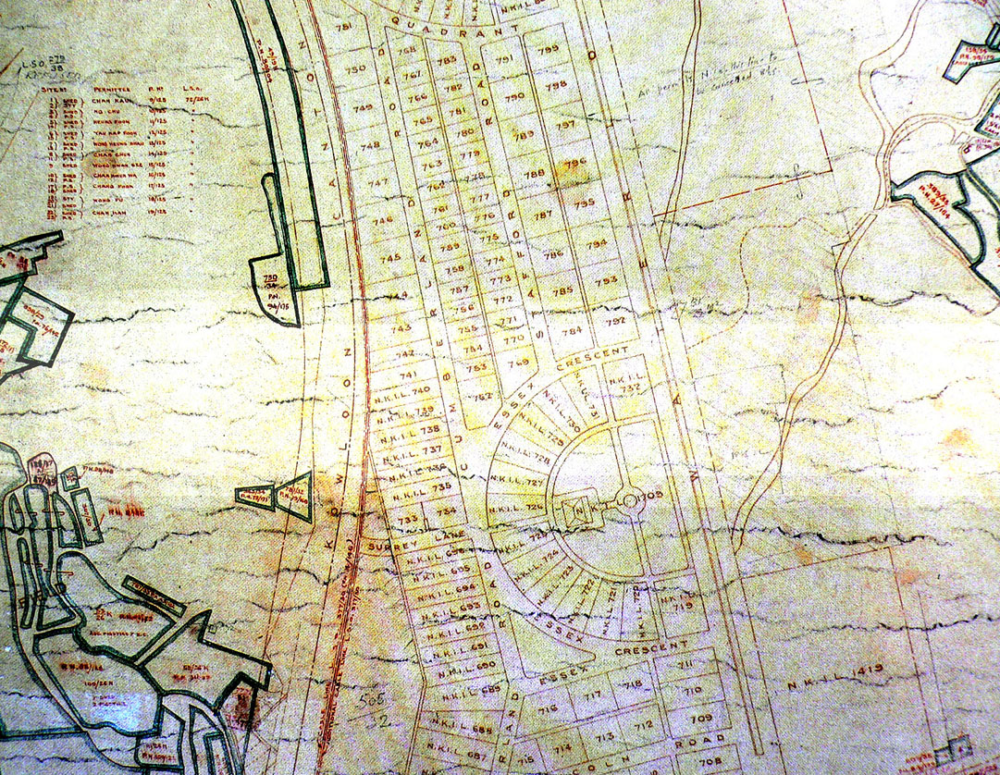
Land Record Search

Slide 6
Land Record Search
The whole cadastral surveying task begins with land record search at the relevant Government Departments and information collection from the lot owners / occupants.
The aim is to acquire all relevant information for the lot under the task and its adjoining and nearby lots for boundary redefinition purposes.
The land record search should be undertaken at, but not limited to, the following departments / correspondences.

Slide 7
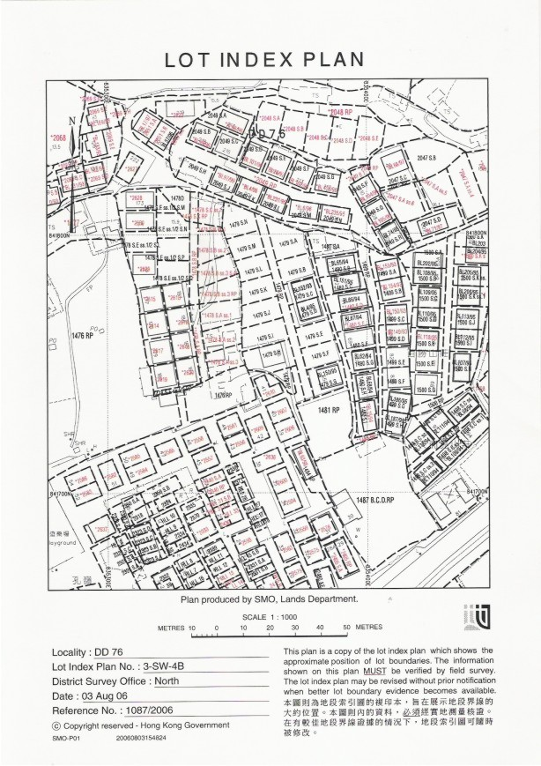
District Survey Office (DSO) / District Land Office (DLO)
Lot Index Plan
Land Record Search

Slide 8
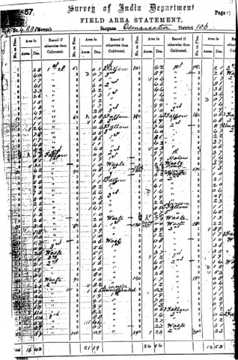
District Survey Office (DSO) / District Land Office (DLO)
Lot Index Plan
Field Area Statements
Land Record Search

Slide 9
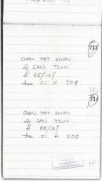
District Survey Office (DSO) / District Land Office (DLO)
Lot Index Plan
Field Area Statements
Lot Record Book
Land Record Search

Slide 10
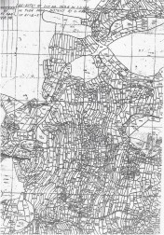
District Survey Office (DSO) / District Land Office (DLO)
Lot Index Plan
Field Area Statements
Lot Record Book
Double Lot Sheet
Land Record Search

Slide 11
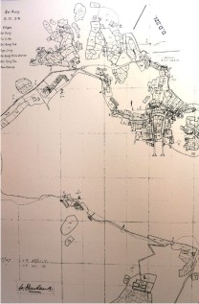
District Survey Office (DSO) / District Land Office (DLO)
Lot Index Plan
Field Area Statements
Lot Record Book
Double Lot Sheet
DD Sheets
Land Record Search

Slide 12
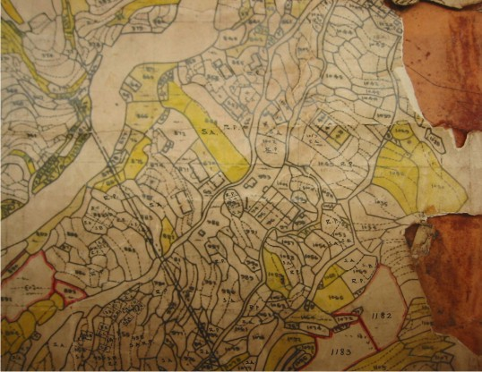
District Survey Office (DSO) / District Land Office (DLO)
Lot Index Plan
Field Area Statements
Lot Record Book
Double Lot Sheet
DD Sheets
DD Control Sheets
Land Record Search

Slide 13
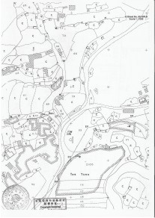
District Survey Office (DSO) / District Land Office (DLO)
Lot Index Plan
Field Area Statements
Lot Record Book
Double Lot Sheet
DD Sheets
DD Control Sheets
A-Sheet
Land Record Search

Slide 14
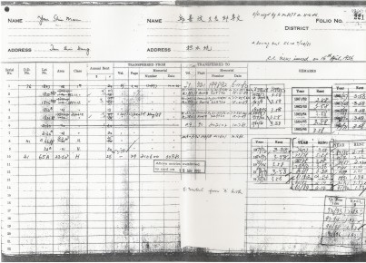
District Survey Office (DSO) / District Land Office (DLO)
A Book (i.e. Government Rent Roll) (Note: required owners’ concern)
Land Record Search

Slide 15
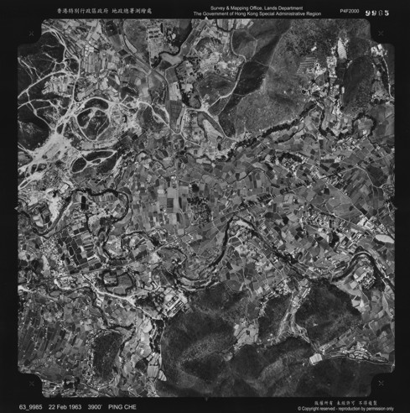
District Survey Office (DSO) / District Land Office (DLO)
A Book (i.e. Government Rent Roll) (Note: required owners’ concern)
Aerial photographs
Land Record Search

Slide 16
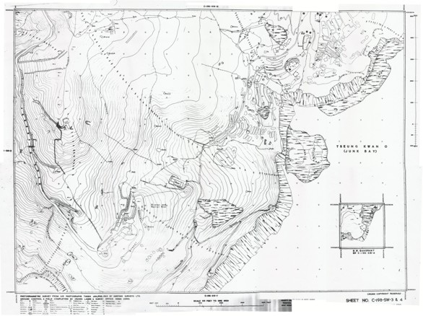
District Survey Office (DSO) / District Land Office (DLO)
A Book (i.e. Government Rent Roll) (Note: required owners’ concern)
Aerial photographs
Survey sheets
Land Record Search

Slide 17
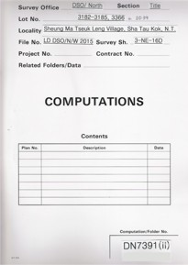
District Survey Office (DSO) / District Land Office(DLO)
A Book (i.e. Government Rent Roll) (Note: required owners’ concern)
Aerial photographs
Survey sheets
DSO Computation folders
Land Record Search

Slide 18
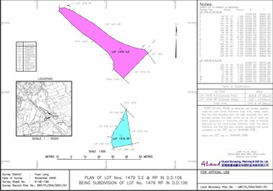
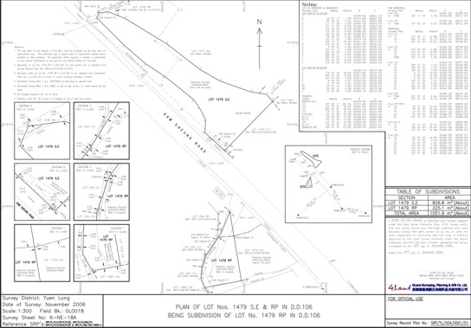
District Survey Office (DSO) / District Land Office (DLO)
A Book (i.e. Government Rent Roll) (Note: required owners’ concern)
Aerial photographs
Survey sheets
DSO Computation folders
Survey Record Plans and Land Boundary Plans
Land Record Search

Slide 19
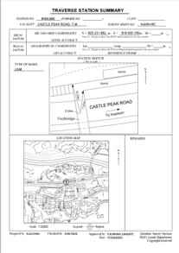
District Survey Office (DSO) / District Land Office (DLO)
A Book (i.e. Government Rent Roll) (Note: required owners’ concern)
Aerial photographs
Survey sheets
DSO Computation folders
Survey Record Plans and Land Boundary Plans
Control Traverse Stations
Land Record Search

Slide 20
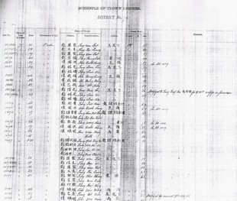
Land Registry
Schedule of Block Government Lease
Land Record Search

Slide 21
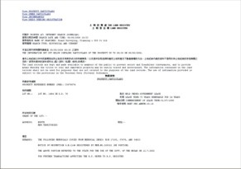
Land Registry
Schedule of Block Government Lease
Land Register
Land Record Search

Slide 22
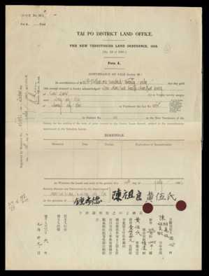
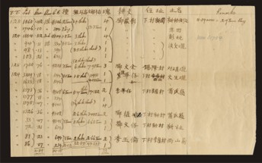
Land Registry
Schedule of Block Government Lease
Land Register
Relevant Memorials
Deeds, division of property
Land Record Search

Slide 23
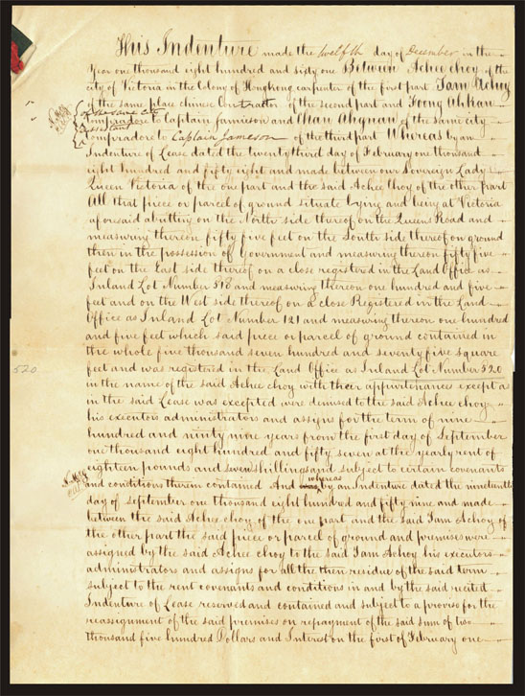
Land Registry
Schedule of Block Government Lease
Land Register
Relevant Memorials
Deeds, division of property
Land Record Search

Slide 24
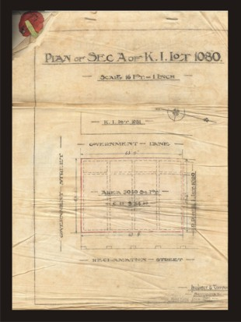
Land Registry
Schedule of Block Government Lease
Land Register
Relevant Memorials
Deeds, division of property
Division/ assignment plans
Land Record Search

Slide 25
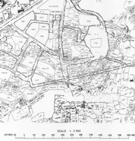
Land Registry
Schedule of Block Government Lease
Land Register
Relevant Memorials
Deeds, division of property
Division/ assignment plans
Resumption plans
Land Record Search

Slide 26
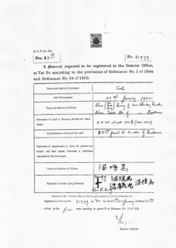
Land Registry
Schedule of Block Government Lease
Land Register
Relevant Memorials
Deeds, division of property
Division/ assignment plans
Resumption plans
Memorial forms
Land Record Search

Slide 27
Land Registry
Schedule of Block Government Lease
Land Register
Relevant Memorials
Deeds, division of property
Division/ assignment plans
Resumption plans
Memorial forms
New Grant Register (for New Grant lots only)
Land Record Search

Slide 28
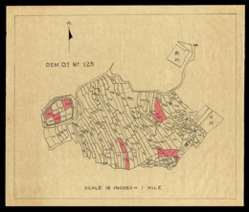
Land Registry
Schedule of Block Government Lease
Land Register
Relevant Memorials
Deeds, division of property
Division/ assignment plans
Resumption plans
Memorial forms
New Grant Register (for New Grant lots only)
Copies of original plans and deeds (e.g. Grant plans)
Land Record Search

Slide 29
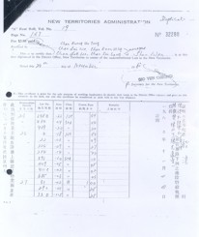
Lot Owner / Occupant
Relevant records
e.g. Government Rent receipt, chap chiu, etc.
Land Record Search

Slide 30
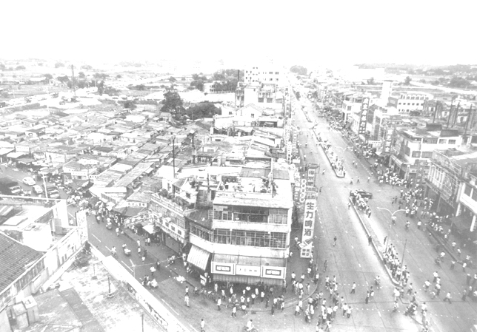
Site Visit and Planning

Slide 31
Site Visit and Planning
Before commencing the field survey, site visit should be undertaken in order to get familiar with the local and nearby areas. This might help to design the control network and the time would be used for the observations.
During the design stage, the route/path of the control traverses, the number and the position of control stations must be considered.
Site Visit and Planning

Slide 32
Instrumentation Preparation

Slide 33
Instrumentation Preparation
The validity of calibration of the surveying instrumentation must be checked before using.
It is also recommended to undertake a quick checking for the instruments on site before taking observations, for example, the consistence between the face left and face right readings of an observed point from the total station.
Instrumentation Preparation

Slide 34
Field Surveying

Slide 35
Traverse Network Establishment
Traverse shall start from geodetic survey stations or survey stations which are the survey marks over which survey observations are made in connection with land boundary surveys submitted to the Land Survey Authority under Land Survey Ordinance or land boundary surveys carried out by the Survey and Mapping Office of Lands Department (i.e. title stations). This is either a trigonometric or traverse station.
Field Surveying

Slide 36
Traverse Network Establishment
Before any traverse begins, the reliability of the survey stations used for an origin should be proved by the surveyor. Closing rays should be considered as second origins. The reliability of the survey stations used for closing rays and coordinates should be proved by using the same methods as for origins.
No unclosed traverses are allowed.
Field Surveying

Slide 37
Observation of Physical Features
All physical features relevant to the lot to be redefined and its adjoining and nearby lots should be observed by total station.
Measuring tape might be used for measurements whenever not observable by Total Station or for checking purposes.
Field Surveying

Slide 38
Observation of Physical Features
The ground features to be surveyed should include but not limited to the following items.
Field bund
Boundary stones
Boundary wall / party wall
Fence / hoarding / Gate
House / Building structures
Root of ruined walls
Vertical Cutting / Channel
Temporary structures, etc.
Field Surveying

Slide 39
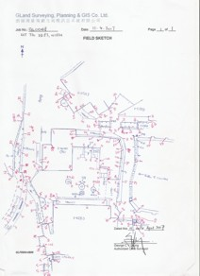
Field Sketchs
Sketch shall clearly show the detailed configuration of the surveyed features with observed point numbers.
Observations by tie measurements, such as width and height of walls, fences, etc. and other relevant information such as age, belongings, etc., shall be clearly indicated on the sketch
Field Surveying

Slide 40
Observation of Physical Features
Photographs should be taken for those critical features for record purposes.
This is important especially along those boundary positions as these features might be changed, removed, disturbed or destroyed.
The photographs taken might become some kind of evidence in case of any boundary conflict in the future
Field Surveying

Slide 41
Local Enquiry
Local enquires should carry out for the owner / occupant of the lot and the nearby areas.
Usually, aged occupants and indigenous villagers may tell the position of the boundaries even there are physical changes to the site.
These collected information might form part of the evidences during the boundary redefinition stage.
Field Surveying

Slide 42
Field Notes
Field notes shall be prepared for all land boundary surveys and should be a complete original record of all field observations and field measurements recorded in the field.
Field Notes shall record the type and serial number of the instruments used for the survey.
The first page shall show the designation of the land parcel, locality or such other reference or legal descriptions. The date of starting and completing the survey shall be recorded.
Field Surveying

Slide 43
Office Reduction

Slide 44
Data Reduction
Traverse(s) must be adjusted by Bowditch Method.
The misclosure of reduced traverse should not exceed the following tolerance.
Angular Misclosure : 30 √ n (seconds)
(where n is the number of survey stations in the traverse)
Linear Misclosure : 10 + 2S / 15 (mm)
(where S is the total length of the traverse in metres)
Office Reduction

Slide 45
Field Checking
Field checking should be undertaken upon the completion of the field works and drafting.
The produced working diagram should be taken onto the field for checking purposes. Any discrepancy found should be marked on the working diagram.
Office Reduction

Slide 46
Boundary Re-definition

Slide 47
Boundary Re-definition
Further to the field survey works and office computations, the boundary of the lot will then be redefined based on the various cadastral records and the surveyed physical features.
Boundary Re-definition

Slide 48
Boundary Re-definition
In case of Old Schedule Lots in the New Territories, correlation exercise must be undertaken for the various cadastral records in order to compare the differences between the records and the up-to-dated Lot Index Plan.
If the lot had been previously subdivided, the history of the lot family must also be investigated in order to check the consistency during the subdivisions.
Boundary Re-definition

Slide 49
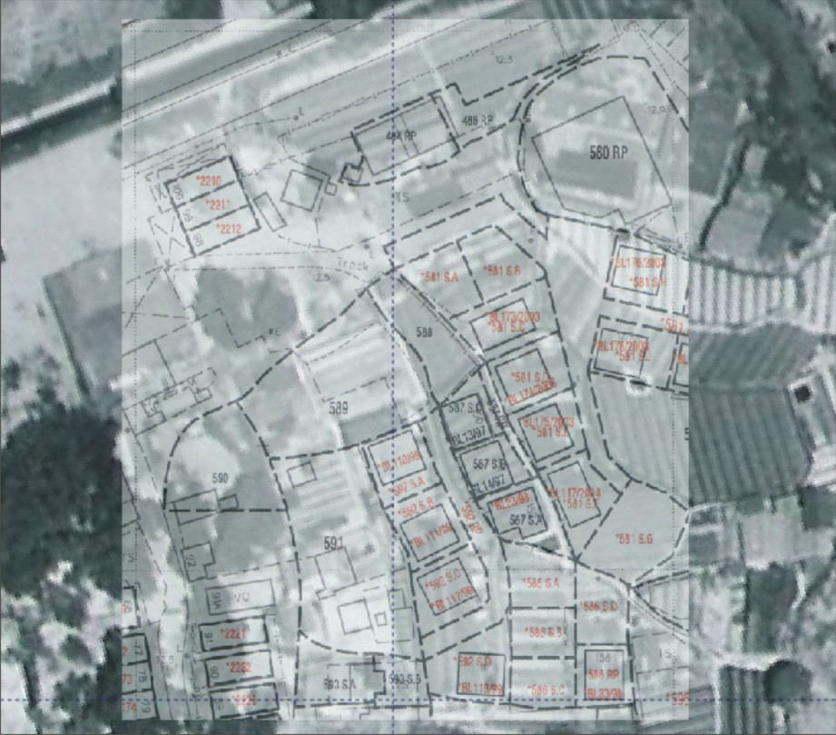
Boundary Re-definition
Correlation Exercise
Boundary Re-definition

Slide 50
Boundary Re-definition
Lot History Diagram
Boundary Re-definition

Slide 51
Registered Area vs. Surveyed Area
The comparison between the registered area and the surveyed area is necessary in order to determine whether the surveyed area is reasonable.
Boundary Re-definition

Slide 52
The following formulas should be used.
Old Schedule Lots
DD Sheet Scale 1:1980 :
± (20 m2 + 5% × Reg. Area)
DD Sheet Scale 1:3960 :
± (20 m2 + 10% × Reg. Area)
Old Schedule House Lots (on DD Sheet):
± 20 m2
Old Schedule House Lots (on House Lot Plan):
± 10 m2
Urban Lots
± 0.1%
Boundary Re-definition

Slide 53
Plan Production
Once the boundary is redefined, the boundary lines might be superimposed onto the produced working diagram.
A “land boundary plan” and “survey record plan” should also be prepared for land record purpose.
Boundary Re-definition

Slide 54
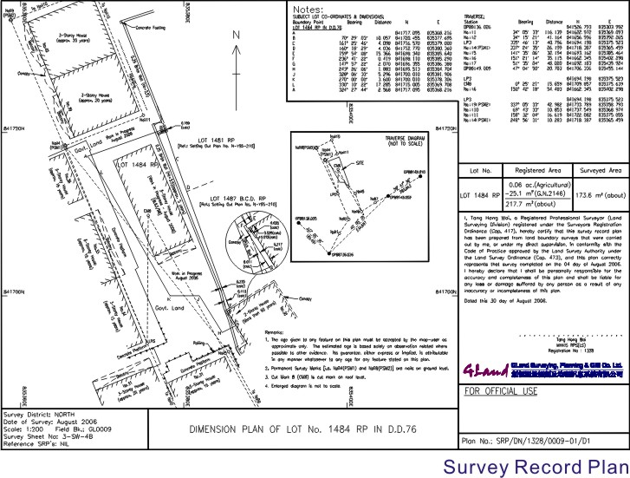
Boundary Re-definition
Survey Record Plan
Boundary Re-definition

Slide 55
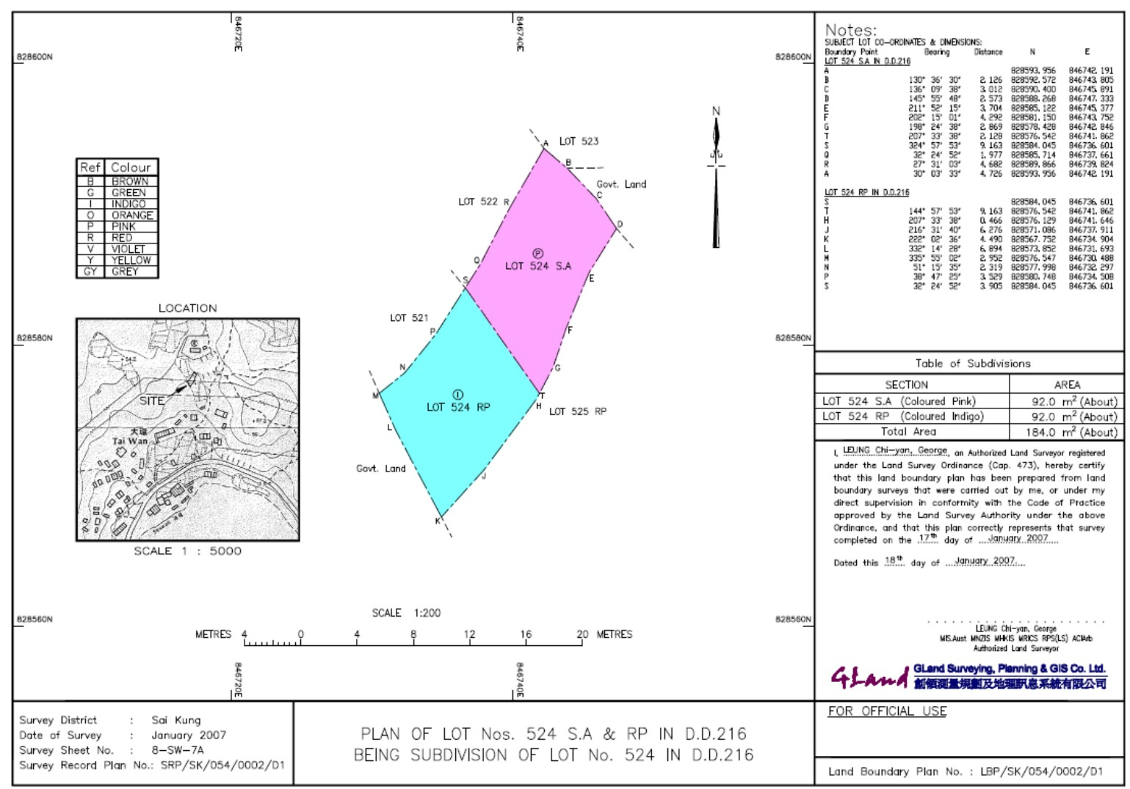
Boundary Re-definition
Land Boundary Plan
Boundary Re-definition

Slide 56
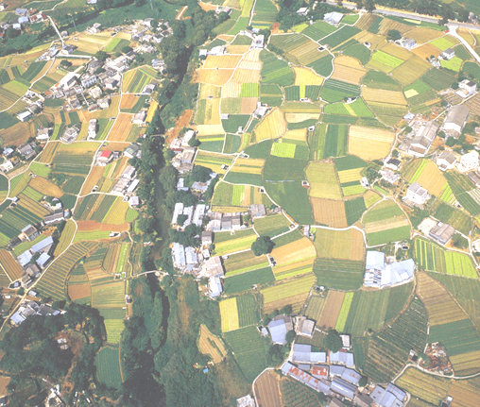
Report Writing
The final step in a land boundary survey exercise was to prepare a land boundary survey report.
The report shall illustrate the reasoning and evidences used in defining the lot boundary.
The report will explain the detailed information which includes the purpose, background, the documentary evidence collected, studied and used, the field survey exercise, the verification of various cadastral records and evidences, the conclusions being made, etc.
Shall bear the certification of the land surveyor.
Boundary Re-definition

