Slide 1
NANOPARTICLES PREPARATION METHODS AND CHARACTERIZATION TECHNIQUES 1
Dr. Raouf Mahmood

Slide 2
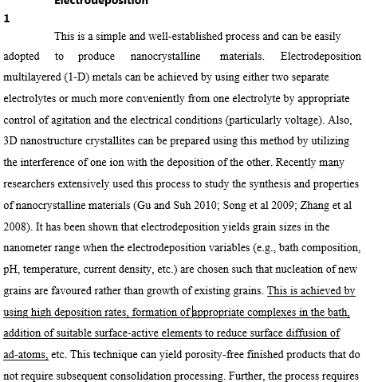
Electrodeposition

Slide 3
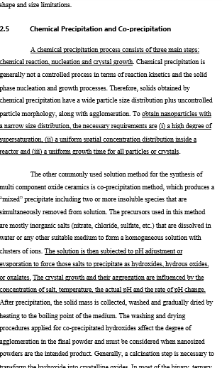

Slide 4
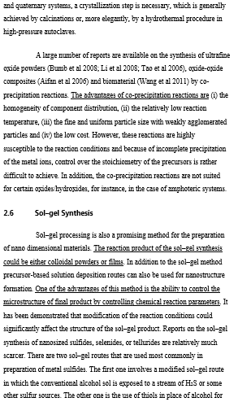

Slide 5
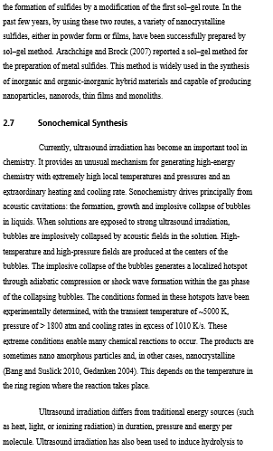

Slide 6
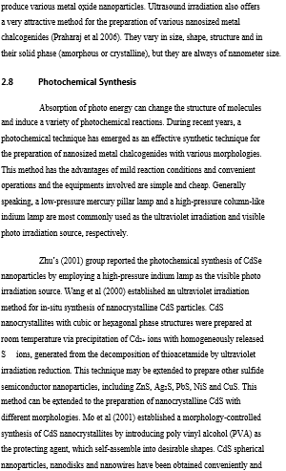

Slide 7
