Slide 1
Classifications of Nanomaterials
Dr. Raouf Mahmood Raouf

Slide 2
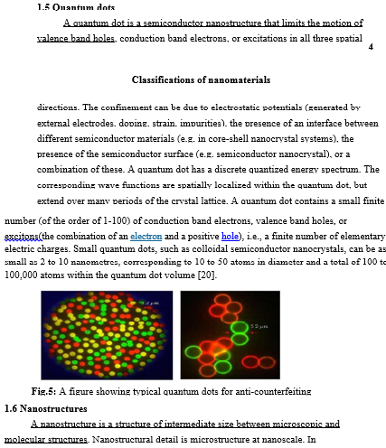

Slide 3
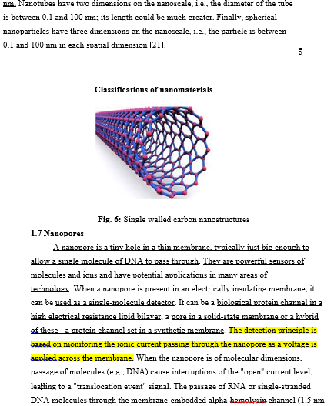

Slide 4
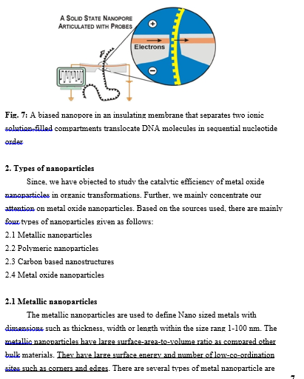

Slide 5
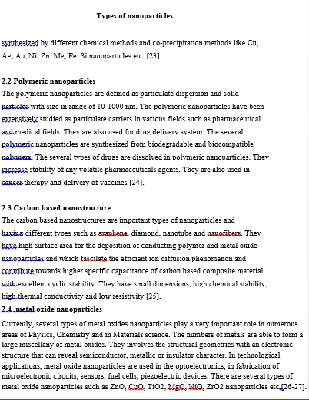

Slide 6
