Slide 1
Classifications of nanomaterials – L4
Dr. Raouf Mahmood Raouf

Slide 2
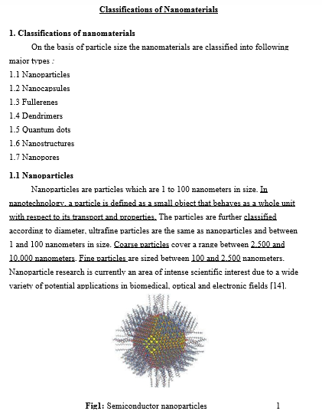

Slide 3
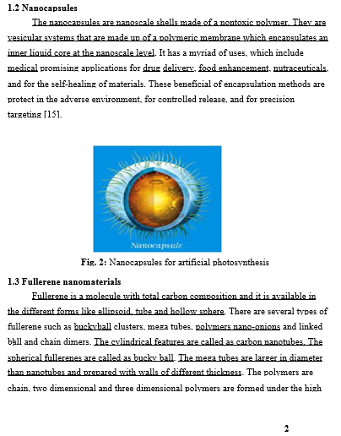

Slide 4
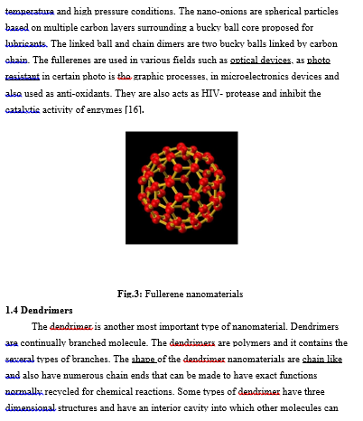

Slide 5
