Slide 2
AL – Mustansiriyah University Faculty of Engineering Electrical Engineering Department Topologies of DC - AC Conversion for Photovoltaic Systems
By
Mustafa A. Fadel

Slide 3
Introduction
Renewable energy is generally defined as the energy that is collected from naturally resources, such as sunlight, wind, rain, tides, waves, and geothermal heat.
The solar energy dominates among them:
Reliability and availability.
Pollution free, no environmental problems.
Noiseless performance.
Absence of fuel.

Slide 4
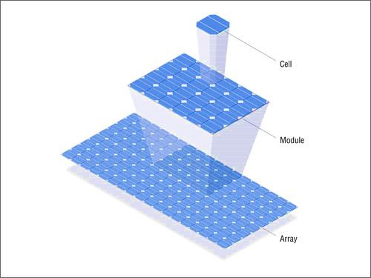
Introduction
Photovoltaic panel is a device use light energy from the sun to generate electricity through photovoltaic effect.
Cell
Panel
Array

Slide 5
Introduction
Obstacles of PV system
To limit these obstacles
low energy conversion efficiency
Operating with MPPT technique
non-linear power source
MPP operates at any conditions
9
$$S=1000W/{m^{2}}$$
270
8
240
$$S=1000W/{m^{2}}$$
7
210
$$S=750W/{m^{2}}$$
$$S=750W/{m^{2}}$$
Power (W)
180
Current (A)
6
$$S=500W/{m^{2}}$$
5
150
$$S=250W/{m^{2}}$$
$$S=500W/{m^{2}}$$
120
4
3
90
2
$$S=250W/{m^{2}}$$
60
1
30
0
0
0
10
20
30
40
0
10
20
30
40
Voltage (V)
Voltage (V)

Slide 6
Maximum Power Point Tracker
The MPPT is a technique used for extract the maximum power from the PV panel due to the sunlight radiation.
The MPPT doesn't mean that the PV panel is moving!
There are many algorithms for MPPT:
Perturb and Observe method.
Incremental conductance.
Direct calculation method.
Voltage control maximum point tracker.

Slide 7
Maximum Power Point Tracker
Perturbation and Observation
(P&O) Method
Start
Measure: V (k), I (k)
Compute: P (k) =V (k)*I (k)
P (k) =P (k-1)?
Yes
No
No
P (k) > P (k-1)?
Yes
V (k) > V (k-1)?
V (k) >V (k-1)?
Yes
No
No
Yes
Decrease
Panel Voltage
Increase
Panel Voltage
Decrease Panel Voltage
Increase
Panel Voltage
V (k-1) =V (k)
P (k-1) =P (k)

Slide 8
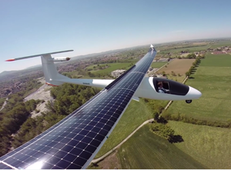
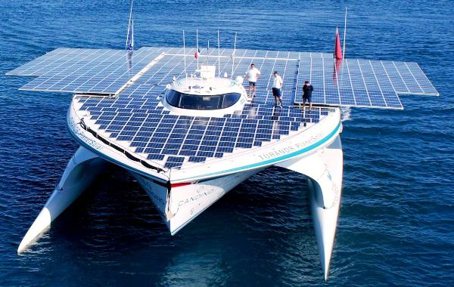
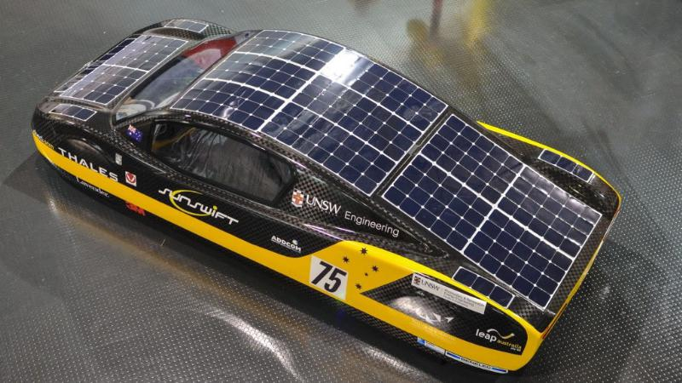
Transporting

Slide 9
Remote locations

Slide 10
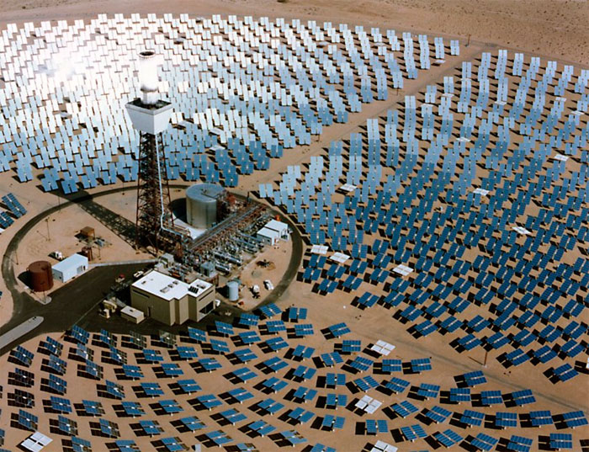
Power Generation

Slide 11
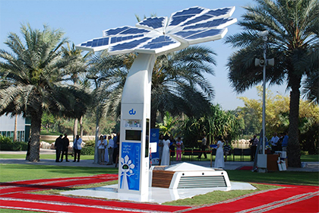
Power Generation

Slide 12
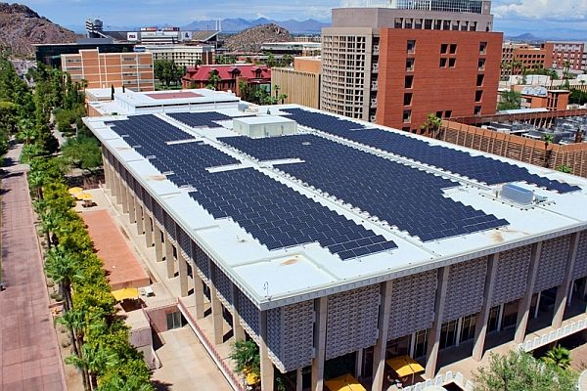
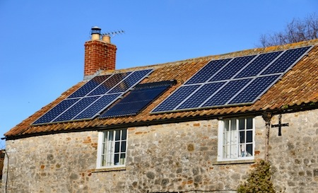
Power Generation

Slide 13
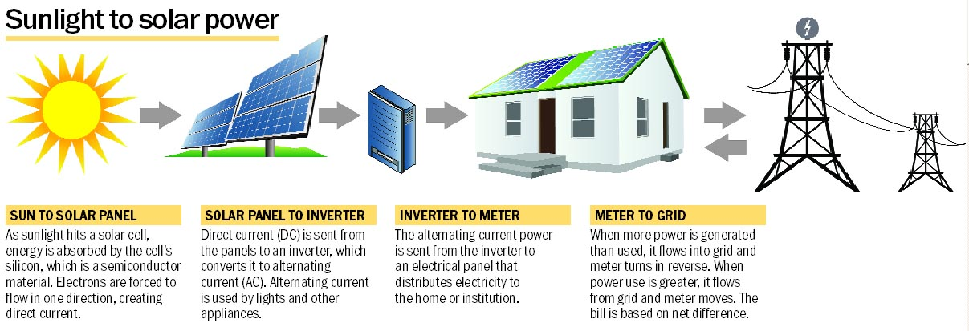
Power Generation

Slide 14
PV system topologies
PV system topologies
Central architecture
Microinverter architecture
String architecture

Slide 15
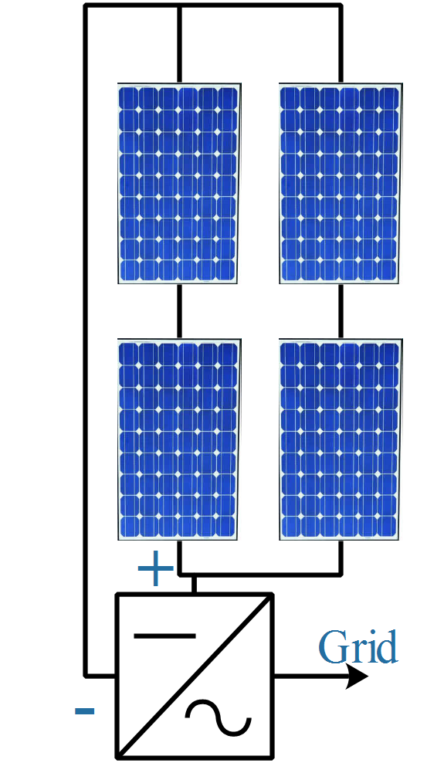
PV system topologies
Central architecture
Advantages
Simple system.
Inexpensive system.
Best solution for high power.
Easy to monitoring.
Disadvantages
low system efficiency.
High transport and installation cost.
Needs cooling chamber.
Suffers from single point failure.
Difficult to maintenance.

Slide 16
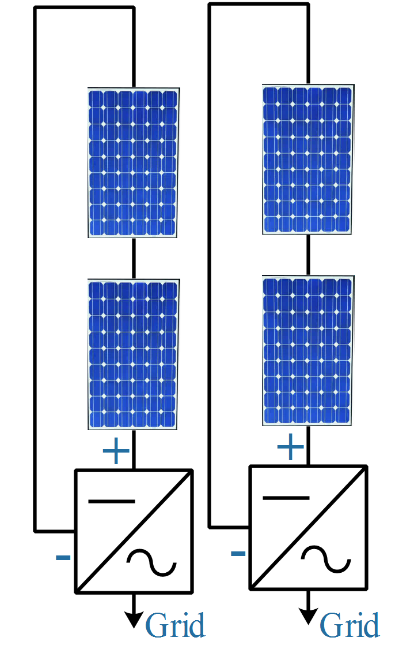
PV system topologies
String architecture
Advantages
Lower installation cost.
No needs for cooling chamber.
Easier to maintenance.
Less effected by single point failure.
Disadvantages
low system efficiency.
High cost system.
Space required.
Needs sophisticated monitoring.

Slide 17
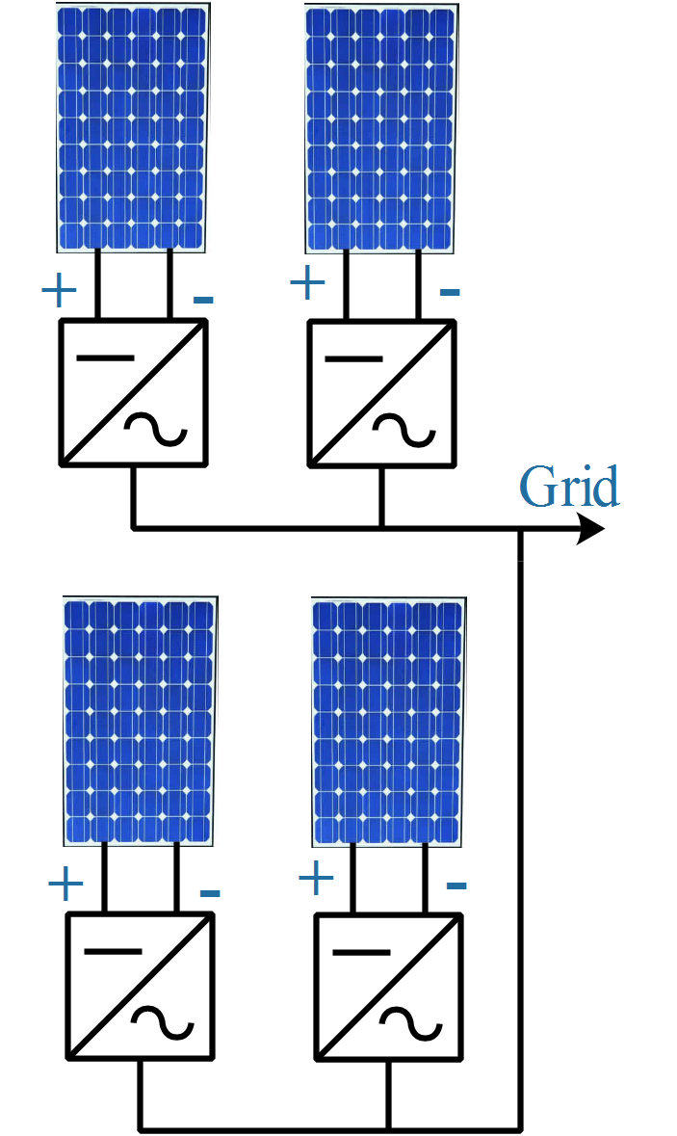
PV system topologies
Microinverter architecture
Advantages
High efficiency.
High design flexibility.
Easy to maintenance.
Avoids single point failure.
Small size and easy to install.
Avoids shading and clouding problems.
Disadvantages
High number of inverters.
High cost system.

Slide 18
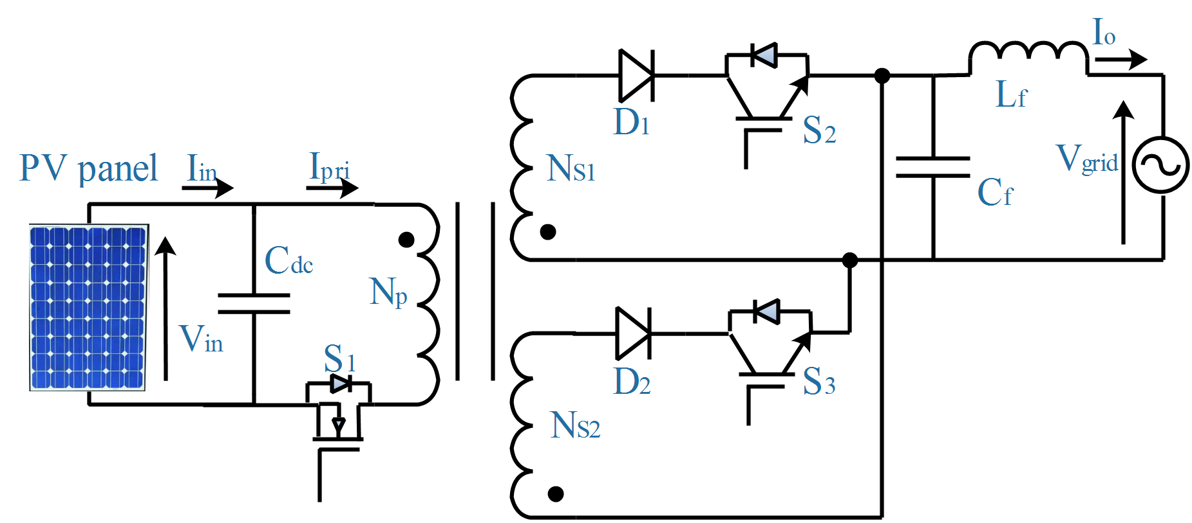
System Modeling
Flyback microinverter modeling
Vin =31 V
Cdc=10000 μF
Cf =3 μF
Lf =2 mH
S1 : APT5015BVR
S2, S3 : G40N150D
D1, D2 : RHRG75120
Vgrid =220 V
Np =17 Turn
NS1=100 Turn
NS2=100 Turn

Slide 19
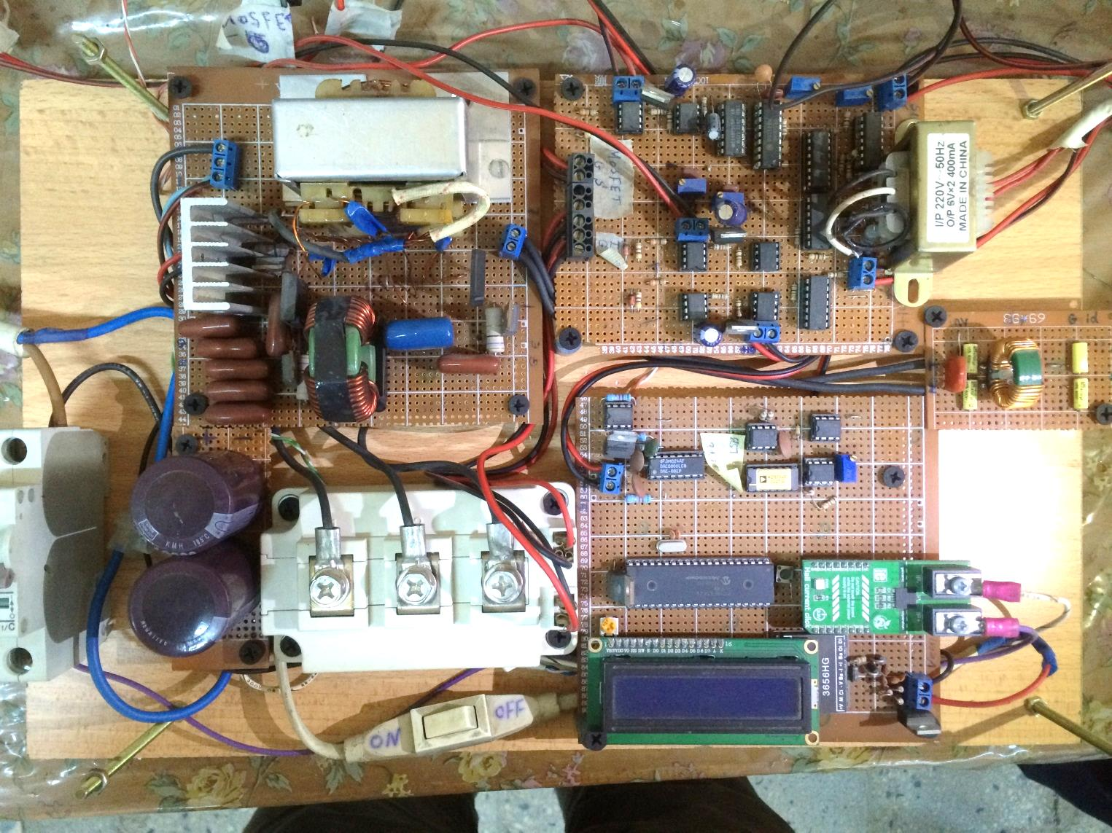
Microinverter Hardware Design
Power Circuit
HF Transformer
G₁
G₂
Control Circuit
S₁
D₂
G₃
D₁
LC Filter
C_{f}
L_{f}
MPPT Control Circuit
EMI Filter
S₂
Current Sensor
C_{dc}
PIC Microcontroller
S₃
Voltage Sensor

Slide 20
Measuring Devices
Environment Measuring Devices for Practical Results
Radiation intensity = 944 $×$ 100Lux
Ambient temperature= 22$℃$
1Lux = 0.0079W/m²

Slide 21
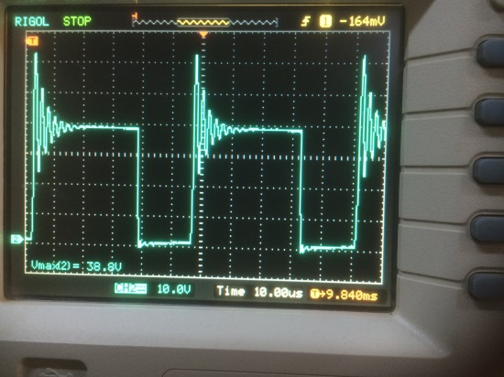
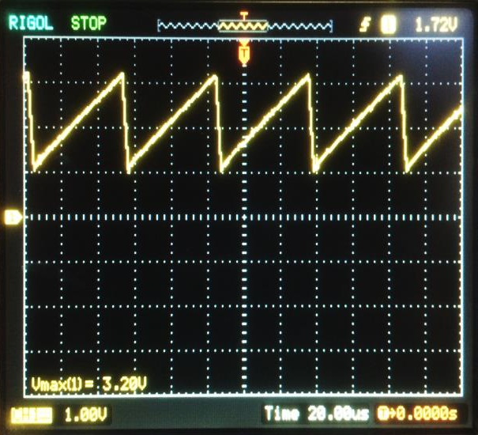
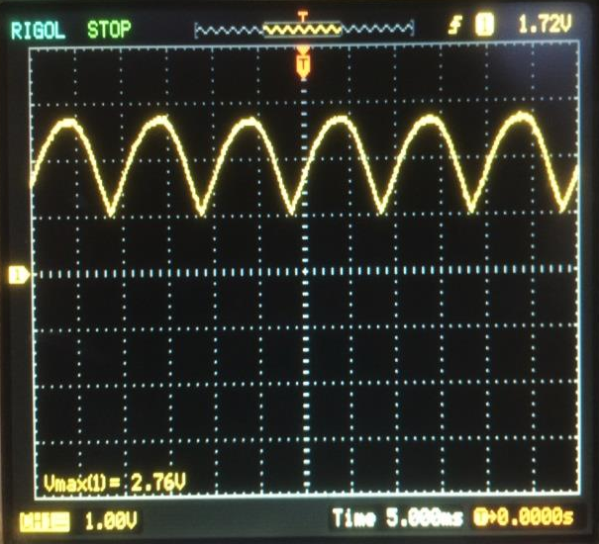
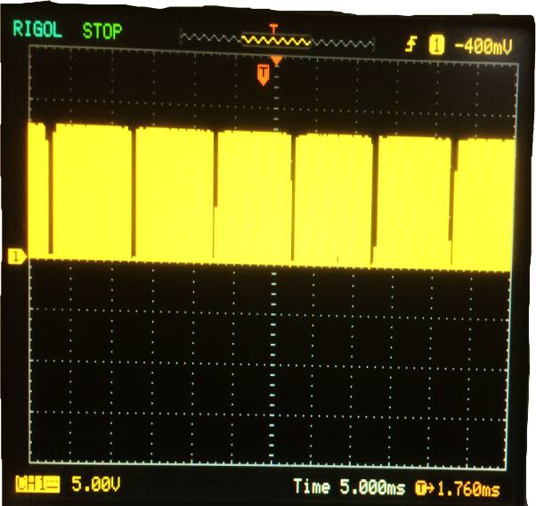
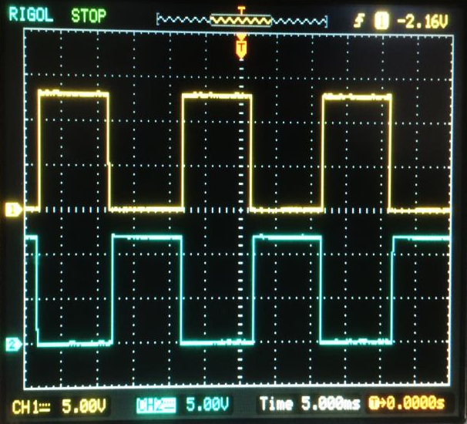
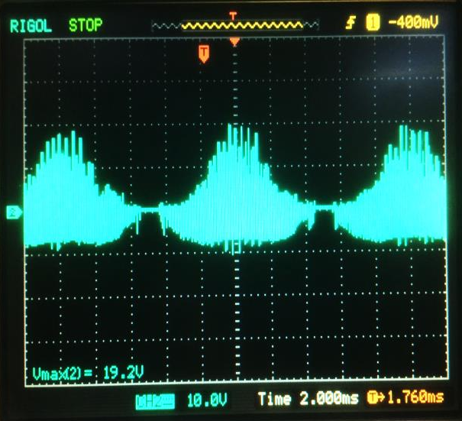
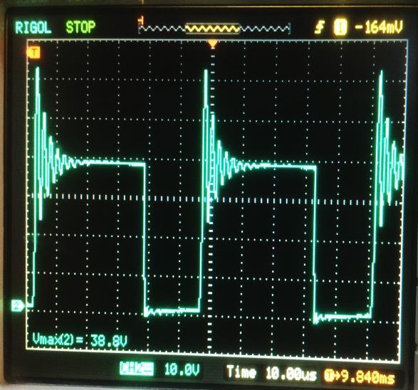
Practical Results
Sawtooth Signal
Rectified Signal
S1 Gate-Source Signal
S2,S3 Gate-Source Signals
Primary Current
Drain-Source Voltage

Slide 22
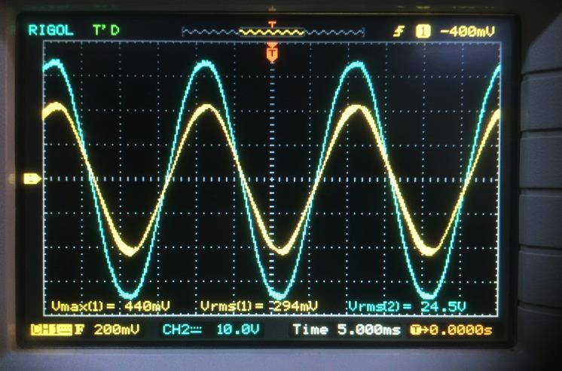
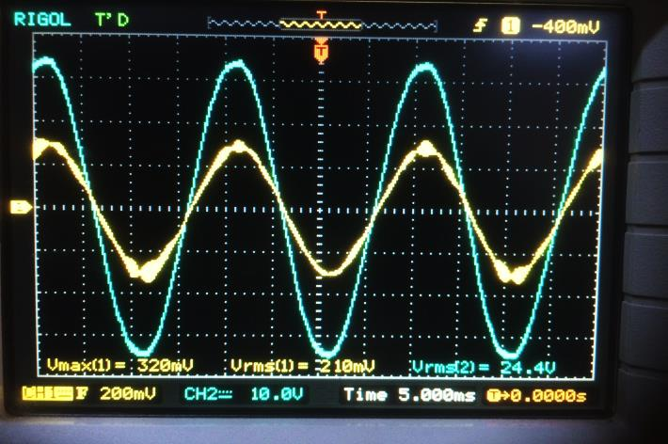
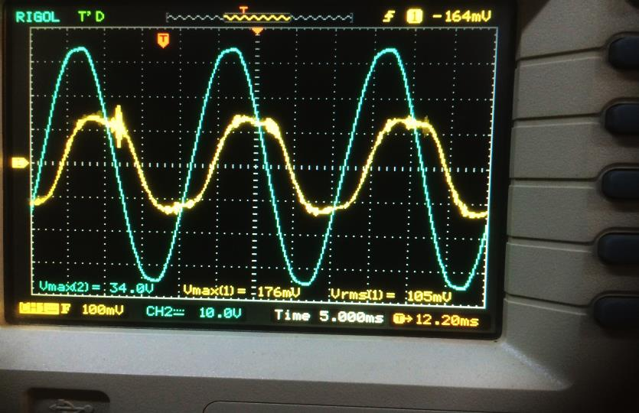
Practical Results
S=357 W/m²
T=25̊ C
P_{in}=69 W
Io_rms=0.294 A
P.F= 0.961
S=257 W/m²
T=25̊ C
P_{in}=49 W
Io_rms=0.21 A
P.F= 0.93
S=109W/m²
T=25̊ C
P_{in}=16.5 W
Io_rms=0.105 A
P.F= 0.579

Slide 23
Thank you

