Slide 1
College of Engineering,
Electrical Engineering Department
Class : Second Year
Subject : Digital Techniques
Conversion between Systems
By:
Asst Lec. Besma Nazar Nadhem
Master of Science in Electrical Engineering
(Electronic and Communication)

Slide 2
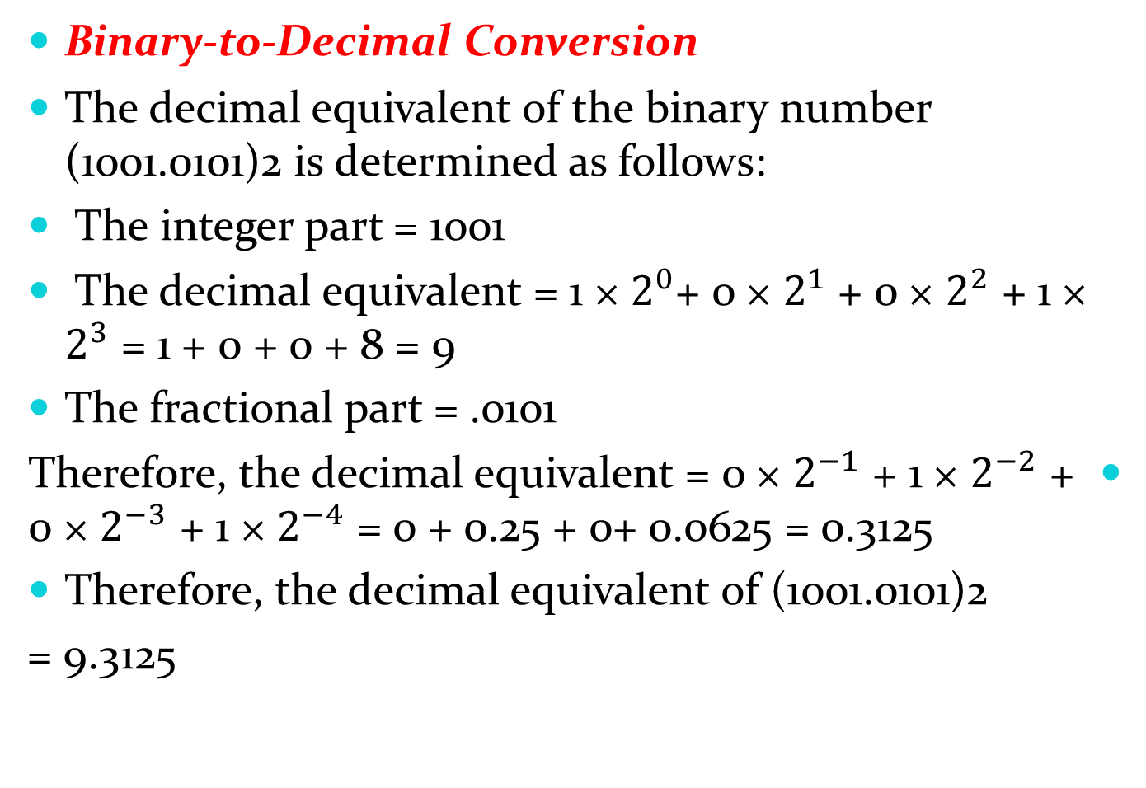
Finding the Decimal Equivalent
Binary-to-Decimal Conversion
The decimal equivalent of the binary number (1001.0101)2 is determined as follows:
The integer part = 1001
The decimal equivalent = 1 × $2^{0}$+ 0 × $2^{1}$ + 0 × $2^{2}$ + 1 × $2^{3}$ = 1 + 0 + 0 + 8 = 9
The fractional part = .0101
Therefore, the decimal equivalent = 0 × $2^{−1}$ + 1 × $2^{−2}$ + 0 × $2^{−3}$ + 1 × $2^{−4}$ = 0 + 0.25 + 0+ 0.0625 = 0.3125
Therefore, the decimal equivalent of (1001.0101)2
= 9.3125

Slide 3
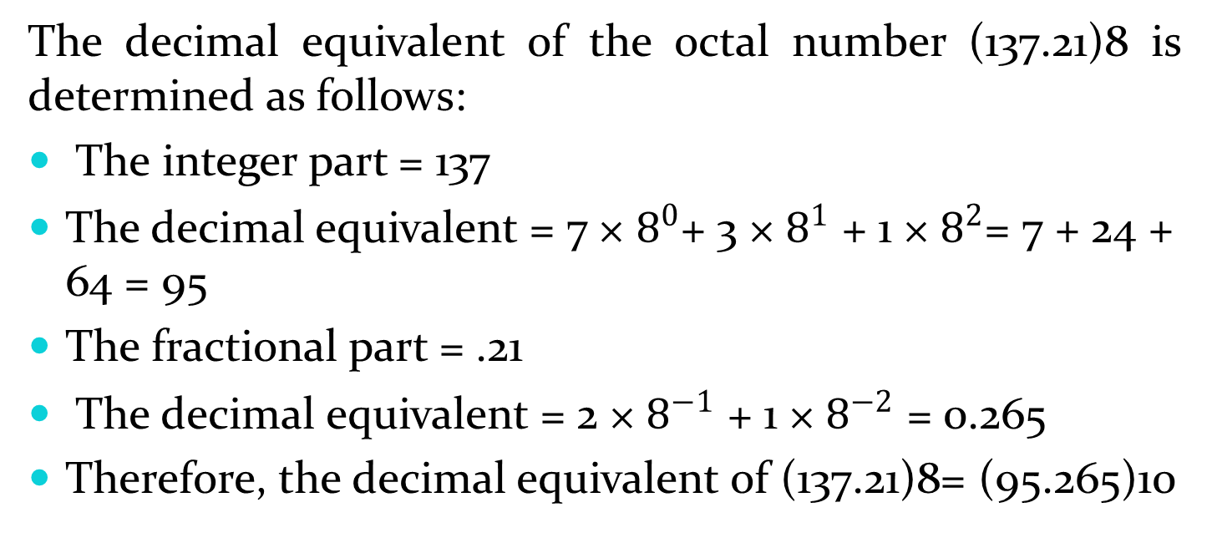
Octal-to-Decimal Conversion
The decimal equivalent of the octal number (137.21)8 is determined as follows:
The integer part = 137
The decimal equivalent = 7 × $8^{0}$+ 3 × $8^{1}$ + 1 × $8^{2}$= 7 + 24 + 64 = 95
The fractional part = .21
The decimal equivalent = 2 × $8^{−1}$ + 1 × $8^{−2}$ = 0.265
Therefore, the decimal equivalent of (137.21)8= (95.265)10

Slide 4
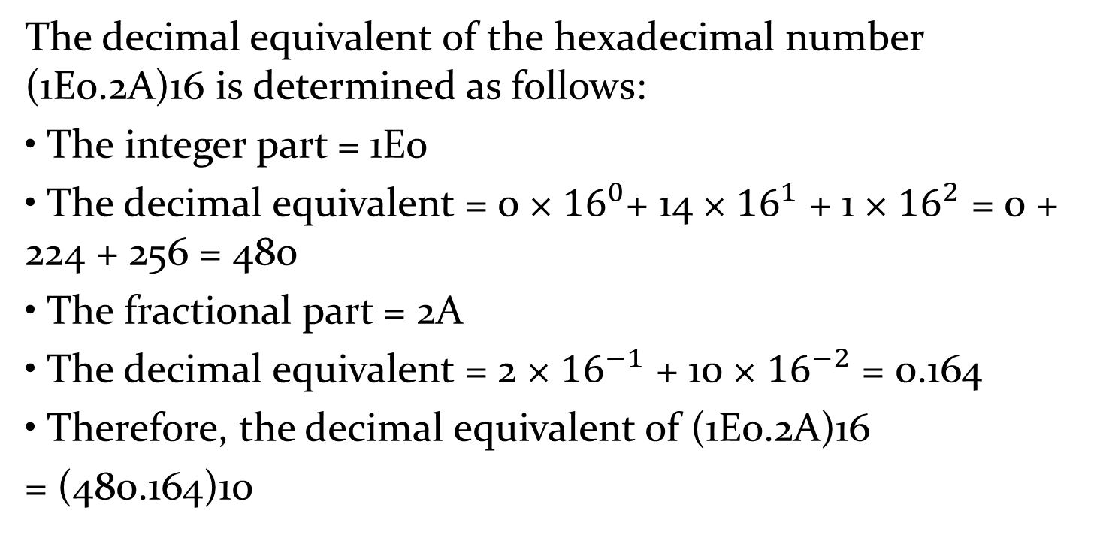
Hexadecimal-to-Decimal Conversion
The decimal equivalent of the hexadecimal number (1E0.2A)16 is determined as follows:
• The integer part = 1E0
• The decimal equivalent = 0 × ${16}^{0}$+ 14 × ${16}^{1}$ + 1 × ${16}^{2}$ = 0 + 224 + 256 = 480
• The fractional part = 2A
• The decimal equivalent = 2 × ${16}^{−1}$ + 10 × ${16}^{−2}$ = 0.164
• Therefore, the decimal equivalent of (1E0.2A)16
= (480.164)10

Slide 5
Decimal-to-Binary Conversion
Find the binary equivalent of (13.375)10.
13
2
1
LSP
6
2
0
3
2
1
1
2
1
0
MSP
The fractional part = .375
• 0.375 × 2 = 0.75 with a carry of 0
• 0.75 × 2 = 0.5 with a carry of 1
• 0.5 × 2 = 0 with a carry of 1
• The binary equivalent of (0.375)10 = (.011)2
• Therefore, the binary equivalent of (13.375)10= (1101.011)2

Slide 6
Decimal-to-Octal Conversion
Find the octal equivalent of (73.75)10
73
8
1
LSP
9
8
1
1
8
1
0
MSP
The octal equivalent of (73)10= (111)8
• The fractional part = 0.75
• 0.75 × 8 = 0 with a carry of 6
• The octal equivalent of (0.75)10= (.6)8
• Therefore, the octal equivalent of (73.75)10 = (111.6)8

Slide 7
Decimal-to-Hexadecimal Conversion
Find the hexadecimal equivalent of(82.25)10
82
16
2
LSP
5
16
5
1
16
0
0
MSP
The hexadecimal equivalent of (82)10 = (52)16
• The fractional part = 0.25
• 0.25 × 16 = 0 with a carry of 4
• Therefore, the hexadecimal equivalent of (82.25)10 =(52.4)16

Slide 8
Binary–Octal and Octal–Binary Conversions
An octal number can be converted into its binary equivalent by replacing each octal digit with its three-bit binary equivalent
A binary number can be converted into an equivalent octal number by splitting the integer and fractional parts into groups of three bits, starting from the binary point on both sides. The 0s can be added to complete the outside groups if needed.
Find the binary equivalent of (374.26)8 and the octal equivalent of (1110100.0100111)2
The given octal number = (374.26)8
The binary equivalent = (011 111 100.010 110)2= (011111100.010110)2
The given binary number = (1110100.0100111)2
• (1110100.0100111)2 = (1 110 100.010 011 1)2= (001 110 100.010 011 100)2= (164.234)8

Slide 9
Hex–Binary and Binary–Hex Conversions
A hexadecimal number can be converted into its binary equivalent by replacing each hex digit with its four-bit binary equivalent.
A given binary number can be converted into an equivalent hexadecimal number by splitting the integer and fractional parts into groups of four bits, starting from the binary point on both sides. The 0s can be added to complete the outside groups if needed.
Find the binary equivalent of (17E.F6)16 and the hex equivalent of (1011001110.011011101)2.
The given hex number = (17E.F6)16
• The binary equivalent = (0001 0111 1110.1111 0110)2= (000101111110.11110110)2= (101111110.1111011)2
The given binary number = (1011001110.011011101)2 = (10 1100 1110.0110 1110 1)2
• The hex equivalent = (0010 1100 1110.0110 1110 1000)2 = (2CE.6E8)16

Slide 10
Hex–Octal and Octal–Hex Conversions
For hexadecimal–octal conversion, the given hex number is firstly converted into its binary equivalent which is further converted into its octal equivalent.
For octal–hexadecimal conversion, the octal number may first be converted into an equivalent binary number and then the binary number transformed into its hex equivalent.
Find the octal equivalent of (2F.C4)16 and the hex equivalent of (762.013)8
The given hex number = (2F.C4)16.
• The binary equivalent = (0010 1111.1100 0100)2= (00101111.11000100)2 = (101111.110001)2 = (101 111.110 001)2 = (57.61)8.
The given octal number = (762.013)8.
• The octal number = (762.013)8 = (111 110 010.000 001 011)2
= (111110010.000001011)2
= (0001 1111 0010.0000 0101 1000)2 = (1F2.058)16.

