Slide 1
College of Engineering,
Electrical Engineering Department
Class : Second Year
Subject : Digital Techniques
Logic Gates
By:
Asst Lec. Besma Nazar Nadhem
Master of Science in Electrical Engineering
(Electronic and Communication)

Slide 2
Logic Gates
The building blocks used to create digital circuits are logic gates
Each gate has its own logic symbol which allows complex functions to be represented by a logic diagram
The function of each gate can be represented by a truth table or using Boolean notation

Slide 3
The NOT gate (or inverter)

Slide 4
The AND gate

Slide 5
The NAND gate

Slide 6
The OR gate

Slide 7
The NOR gate

Slide 8
The Exclusive OR gate

Slide 9
The Exclusive NOR gate

Slide 10
Combinational Logic
combinational logic
where the outputs are determined solely by the current states of the inputs
sequential logic
where the outputs are determined not only by the current inputs but also by the sequence of inputs that led to the current state
In this lecture we will look at combination logic

Slide 11
Example(1) : Implementing a function from a Boolean expression

Slide 12
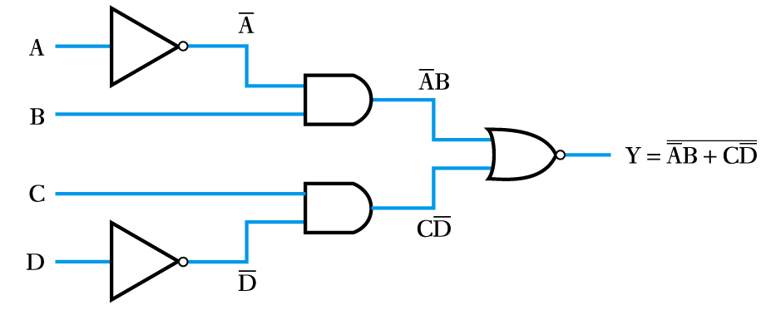
Example(2) :Implementing a function from a Boolean expression

Slide 13
Example (3):Generating a Boolean expression from a logic diagram

Slide 14
HW. (1):Generating a Boolean expression from a logic diagram
HW.(2) :Implementing a function from a Boolean expression

