Slide 1
Belt Drives

Slide 4
Flat Belts

Slide 7
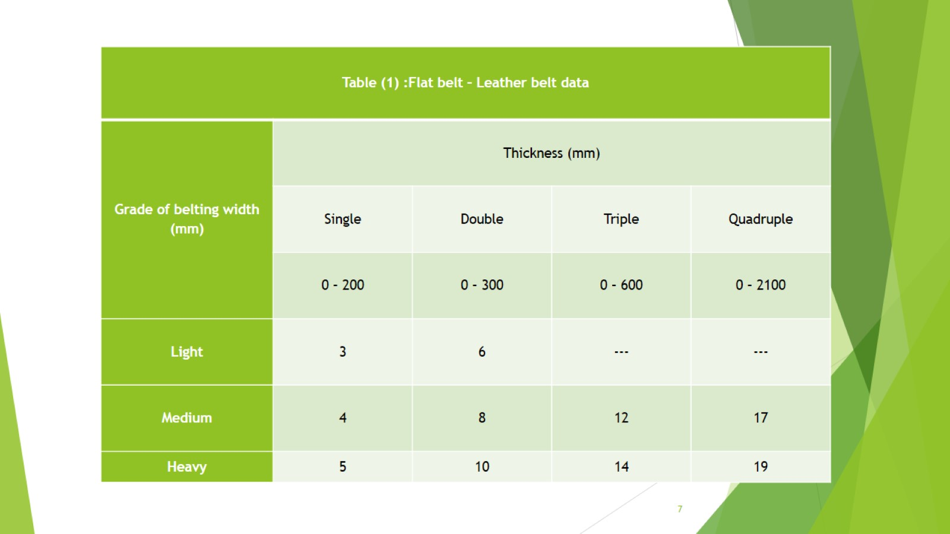

Slide 9
Example 1:

