Slide 1
Digital communication
Main chapters
1-Information theory
2- Detection of digital signals in noise.
3- Source coding of discrete sources
4- Channel coding.
5-Introduction to digital signal processing (DSP)
6-Digital filter design

Slide 2
INFORMATION THEORY : this subject deals with information or data transmission from one point to another
The block diagram for any communication system is :
Source of information
Listener or receptor
encoder
channel
decoder
modulation
demodulation
speaker
TV
computer
typewriter
Audio
Video
Telex
computer
ciphering
deciphering
Error correction
Error detection and correction
compression
decompression
The concept of information is related to probability. Any signal that conveys information must be unpredictable (random), but not visa versa, i.e. not any random signal conveys information.(noise is a random signal conveying no information).

Slide 3
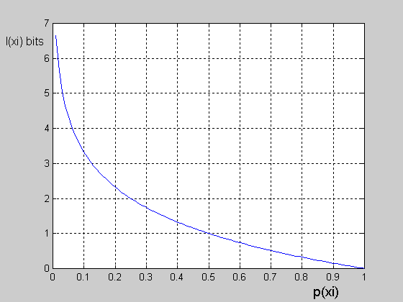
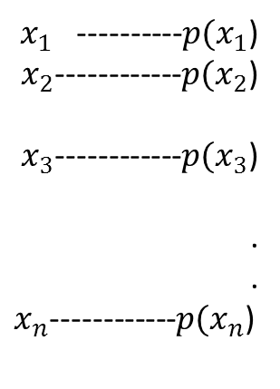
Self Information
$x_{1}$ ----------${p(x}_{1}$)
$x_{2}$------------${p(x}_{2}$)
$x_{3}$------------${p(x}_{3}$)
.
.
$x_{n}$------------${p(x}_{n}$)
Source of information
source produces the message x_{i} is related with p(x_{i}) as follows:
1-information is zero if p(x_{i})=1 (certain event)
2-information increases as p(x_{i}) decreases to zero.
3-information is a +ve quantity.
The function that relates p(x_{i}) with information of x_{i} is
denoted by I(x_{i}) and is called self information of x_{i}.
The log function shown satisfies all previous three points hence:
Where a=2, then the unit of I(x_{i}) is bit

Slide 4
Ex: A fair die is thrown, find the amount of information gained if you are told that 4 will appear.
Solution:
Since fair, die then, p(1)=p(2)=…….=p(6)=1/6, then:
I(4)=-log₂ p(4)=-log₂(1/6)=ln6/ln2=2.5849 bits.
Ex: A biased coin has p(Head)=0.3. Find the amount of information gained if you are told that a tail will appear.
Solution:
P(tail)=1-p(Head)=1-0.3=0.7, then
I(tail)=-log₂(0.7)=-ln0.7/ln2=0.5145 bits.
Ex: Find the amount of information contained in a black & white (B/W) TV picture if we assume that each picture has 2*10⁵ dots (pixels or picture elements) and each pixel has 8 equiprobable and distinguishable levels of brightness.
Solution:
P(each level)=1/8 since equiprobable levels
Information/pixel=-log₂(1/8)=3 bits
Information/picture=Information/pixel * no. of pixels
=3 * 2* 10⁵=600 kbits.
pixel

Slide 5

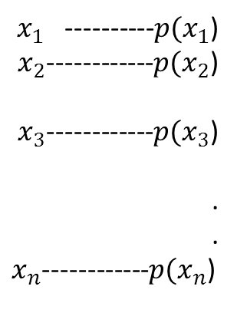
Homework:
Repeat previous example for color TV with 16 equiprobable colors and 8 equiprobable levels of brightness.
Source Entropy
$x_{1}$ ----------${p(x}_{1}$)
$x_{2}$------------${p(x}_{2}$)
$x_{3}$------------${p(x}_{3}$)
.
.
$x_{n}$------------${p(x}_{n}$)
If the source produces not equiprobable messages then I(x_{i}) , i=1,2,…..,n, are different.
Then the statistical average of I(x_{i}) over i will give the average amount of uncertainty associated with the source X. This average is the called source entropy and is denoted by H(X).
Source of information
This H(X) is given by:
or

Slide 6
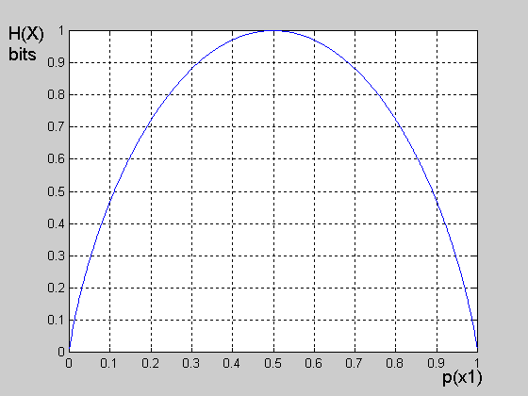
Ex: Find the entropy of the source producing the following messages:
Solution:
H(X)=-[0.25ln0.25+ 0.1ln0.1+ 0.15ln0.15+0.5ln0.5]/ln2
H(X)=1.7427 bits/symbol
Ex: Find and plot the entropy of a binary source.
Solution :
p(0_{T})+p(1_{T})=1, hence:
Binary source
0, p(0_{T})
1, p(1_{T})
H(X)=-[ p(0_{T}) log₂p(0_{T})+ (1- p(0_{T})) log₂(1- p(0_{T}))] bits/symbol
Note that H(X) is maximum equals 1 bit if p(0_{T})=p(1_{T})=0.5

Slide 7



Notes:
1-In general H(X)=H(X)|max=log₂n bits/symbol if all messages are equiprobable, i.e, p(x_{i})=1/n, then :
2-H(X)=0 if one of the messages has the prob of a certain event.
SOURCE ENTROPY RATE
This is the average rate of amount of information produced per second. It is denoted by R(X) and is given by:
R(X)= H(X) * rate of producing the symbols
average time duration of symbols, τ_{i} is the time duration of the symbol x_{i}.

Slide 8
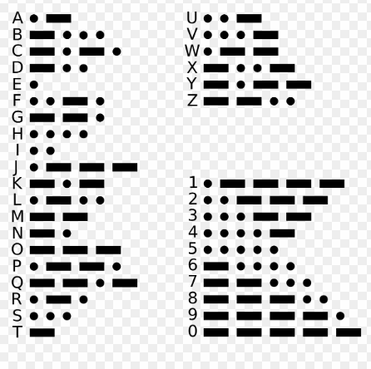
Ex: A source produces dots "." and dashes "—" with p(dot)=0.65. If the time duration of a dot is 200ms and that for a dash is 800ms. Find the average source entropy rate.
Solution:
P(dot)=0.65, then p(dash)=1-p(dot)=1-0.65=0.35.
H(X)=-[0.65 log₂0.65 + 0.35 log₂0.35]=0.934 bits/symbol
τ_{dot}=0.2 sec, τ_{dash}=0.8 sec, then

Slide 9
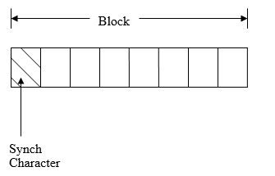
Ex: In a telex link, information is arranged in blocks of 8 characters. The 1st position(character) in each block is always kept the same for synchronization purposes . The remaining 7 places are filled randomly from the English alphabets with equal prob. If the system produces 400 blocks/sec, find the average source entropy rate.
Information/position= - log₂(1/26)=log₂26=4.7 bits
Information/block=7 * 4.7 =32.9 bits, we exclude the 1st character since it has no information having the prob of certain event (contains synch only)
Then:
R(X)=Information/blocks * rate of producing blocks/sec
=32.9 *400=13160 bits/sec
Sheet1: Q1 , Q2, Q3, Q4, Q 5, Q7, Q 8, Q9, Q 11, Q 28, Q 21

Slide 10
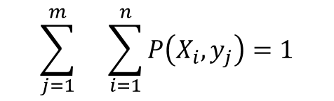
Joint and conditional probabilities:
Left handed
y1
$$\sum_{j=1}^{m}{}\sum_{i=1}^{n}{P\left(X_{i},y_{j}\right)=1}$$
Joint or system probability
Right handed y2
Male (x1)
80
180
0.16
0.36
0.52
Female (x2)
0.26
0.22
0.48
130
110
500
1
0.42
0.58

Slide 11
MUTUAL INFORMATION: The mutual information between two random variables measures the amount of information that one conveys about the other.
x₁, x₂,…..,x_{n}, are the set of symbols that transmitter T_{x} may produce.
receiver R_{x} may receive y₁,y₂,…,y_{m}.
if the noise and jamming is zero, then the set X=set Y and n=m. However, and due to noise and jamming, there will be a conditional probability p(y_{j}/x_{i}):Define
1-p(x_{i}) to be what is called the apriori prob of the symbol x_{i} , which is the prob of selecting x_{i} for transmission.
2-p(x_{i}/y_{j}) to be what is called the aposteriori prob of the symbol x_{i} after the reception of y_{j}.
The amount of information that y_{j} provides about x_{i} is called the mutual information between x_{i} and y_{j}

Slide 12


since p(x_{i}) p(y_{j}/x_{i})=p(y_{j}) p(x_{i}/y_{j})=p(x_{i},y_{j}), then:
the mutual information is symmetric.
Note: p(x_{i}/y_{j})≠p(y_{j}/x_{i}) in general. In fact, p(y_{j}/x_{i}) gives the prob of y_{j} given that x_{i} is transmitted, as if we are at the T_{x} and we transmit x_{i} and we ask about the prob of receiving y_{j} instead. The prob p(x_{i}/y_{j}) is the prob of x_{i} given we receive y_{j} as if we are at the R_{x} and we receive y_{j} and we ask about if it was coming from x_{i}.
Properties of I(x_{i},y_{j}):
1-it is symmetric, i.e. I(x_{i},y_{j})=I(y_{j},x_{i})
2- I(x_{i},y_{j})>0 if aposteriori prob> apriori prob, y_{j} provides +ve information about x_{i}.
3- I(x_{i},y_{j})=0, if aposteriori prob =apriori prob, which is the case of statistical independence when y_{j} provides no information about x_{i}.
4- I(x_{i},y_{j})<0 if aposteriori prob< apriori prob, y_{j} provides -ve information about x_{i}, i.e., y_{j} adds ambiguity.

Slide 13


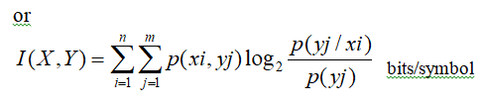
Transformation(average mutual information:
This is the statistical averaging of all the pair I(x_{i},y_{j}), i=1,2,…n, j=1,2,3…m. This is denoted by I(X,Y) and is given by:

Slide 14
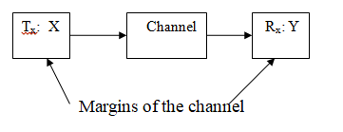

Marginal Entropies
Marginal entropies are a term usually used to denote both source entropy H(X) defined as before and the receiver entropy H(Y) given by:

Slide 15



Joint and conditional entropies:
Joint or system entropy: The average amount of information associated with the pair (x_{i},y_{j}) is called joint or system entropy H(X,Y):
conditional entropies H(Y/X) & H(X/Y):The average amount of information associated with the pairs (y_{j}/x_{i}) & (x_{i}/y_{j})
1) Noise entropy: average amount of uncertainty or information about y that remains if we are first told x
2) Losses entropy: average amount of uncertainty or information that remains about x when y is known

Slide 16
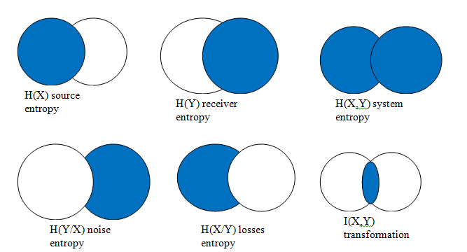
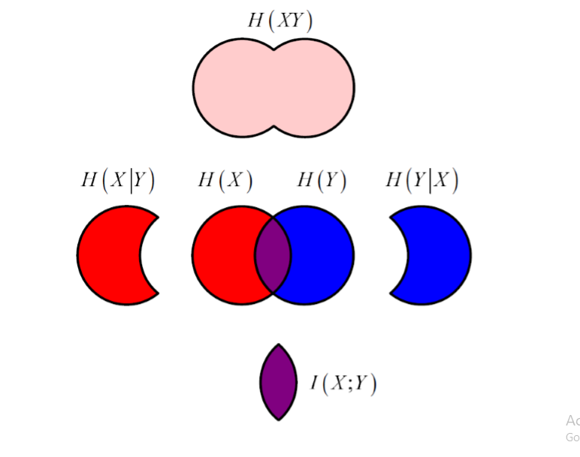
H(X,Y)=H(X)+H(Y/X)
H(X,Y) = H(Y) + H(X/Y)
I(X,Y)= H(X)- H(X/Y)
I(X,Y) = H(Y)- H(Y/X)

Slide 17
Then:
Then:
Note : H(Y/X)≠H(X/Y)
Ex: Show that H(X,Y)=H(X)+H(Y/X)
Solution:
This is a very useful identity to ease calculations in problem solving.
To prove it, then we know that:
But p(x_{i},y_{j})=p(x_{i}) p(y_{j}/x_{i}), putting this inside the log term only, then:
After reversing the order of summation, then

Slide 18





In the above equation, the 1st term is in fact H(X) and the 2nd term with - sign is H(Y/X), then:
H(X,Y)=H(X)+H(Y/X)
Homework:
Show that H(X,Y)=H(Y)+H(X/Y)
Ex: Show that I(X,Y)=H(X)-H(X/Y)

Slide 19
Homework:
Show that I(X,Y)=H(Y)-H(Y/X)
Ex: Show that I(X,Y) is zero for extremely noisy channel.
Solution: For extremely noisy channel, then y_{j} gives no information about x_{i} ( the receiver can not decide anything about x_{i} as if we transmit a deterministic signal x_{i} but the receiver receives noiselike signal y_{j} that is completely has no correlation with x_{i}). Then x_{i} and y_{j} are statistically independent and p(x_{i}/y_{j})=p(x_{i}) and p(y_{j}/x_{i})=p(y_{j}) for all i and j , then:
I(x_{i},y_{j})=log₂1=0 for all i & j , then I(X,Y)=0

Slide 20
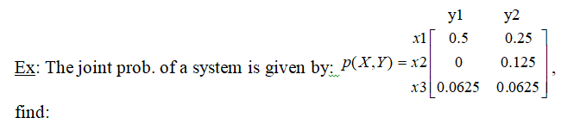
1-marginal entropies.
2-joint entropy.
3-conditional entropies.
4-the mutual information between x₁ and y₂.
5-the transinformation.
6-then draw the channel model.

Slide 21
Homework: For the channel model shown, Find:1-source entropy rate if τ_{x1}=1ms and τ_{x2}=2ms, I(x₁)=2bits.
2-the transinformation

