Slide 1
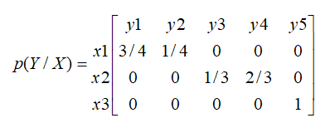
Other special channels:
1-lossless channel: This has only one nonzero element in each column of the transitional matrix p(Y/X). As an example:
This channel has H(X/Y)=0 and I(X,Y)=H(X) with zero losses entropy. (Homework: draw the channel model of this channel).

Slide 2
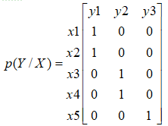
2-Determinstic channel:
This has only one nonzero element in each row of the transitional matrix p(Y/X). As an example:
This has H(Y/X)=0 and I(X,Y)=H(Y) with zero noise entropy. (Homework: draw the channel model of this channel).

Slide 3
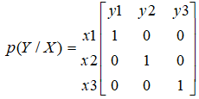
3-Noiseless channel:
This has only one nonzero element in each row and column of the transitional matrix p(Y/X), i.e. it is an identity matrix. As an example:
This has H(X/Y)=H(Y/X)=0, and I(X,Y)=H(X)=H(Y). (Homework: draw the channel model of this channel).

Slide 4
3- extremely noisy channel: x_{i} and y_{j} are statistically independent, so
I(X,Y) =0

