Slide 1
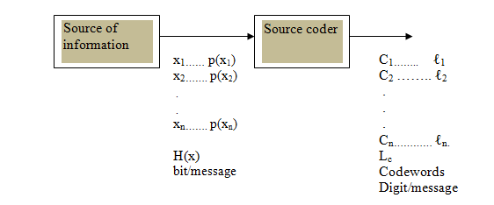
Source Coding of Discrete Sources
The source coder will transform these messages into a finite sequence of digits, called the codeword of the message. If binary digits (bits) are used in this codeword, then we obtain what is called " Binary Source Coding".

Slide 2
The selection of codewords for different messages x_{i}, is done according to the following two considerations:
1- The average code length L_{c} must be as minimum as possible. This average length is given by:
digits/message
Where l_{i} is the length of the codeword for message x_{i} (l_{i} is in bits for binary coding, or in digits for nonbinary coding).
2- The codewords at the receiver must be uniquely decodable. Uniquely decodable means that any codeword for any symbol( or message) must not be the beginning from the left for any other codeword of higher length.

Slide 3
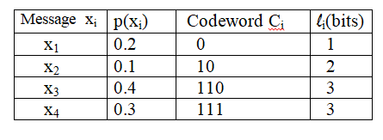

Ex: The code table for a certain binary code is given as:
[1]-Find the average code length, then comment.
=0.2+2*0.1+3*0.4+3*0.3=2.5bits/message
[2]-If the received data stream is 1 0 1 1 0 0 0 1 1 1 1 1 0…….., check if this code is uniquely decodable or not, then comment.
using the given code table, then:
1 0 | 1 1 0 | 0 | 0 | 1 1 1 | 1 1 0 |……..,
x₂ | x₃ | x₁| x₁| x₄ | x₃ |…….,
Hence the code is uniquely decodable, since the receiver get at only one possible message stream.

Slide 4
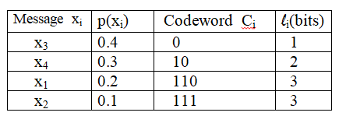
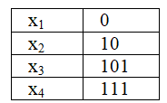
the code is not optimum in terms of L_{c},
This gives L_{c}=0.4+0.3*2+0.2*3+0.1*3=1.9 bits/message which is less than before.
Ex: Check if the following code is uniquely decodable or not:
This code is not uniquely decodable since ''10'' is a codeword for x₂ , while the codeword for x₃ starts with ''10''.

Slide 5
Coding efficiency and redundancy:
A code with average code length L_{c} digits has coding efficiency:
where:
H(x) is source entropy in bits/message,
L_{c} is average code length in digits/message L_{c} has the units of the code size,
( i.e. If D=2 bits/message , if D=3 ternary digits/message and so on…..).
log₂(D) in bits/digits D=coding size ( D=2 for binary coding, D=3 for ternary coding, and so on….).
For binary coding only (D=2), then:
The code redundancy is simply R=1-η.
suppose the source produces M messages, then the amount of information produced at the source output will be M*H(X) bits, while the amount of information at source encoder output is
M*L_{c} digits or M*L_{c}*log₂(D) bits, so the ratio

Slide 6
Source Codes
1]Fixed Length Codes
2]Variable Length Codes
a)- Shannon Code
b)- Shannon Fano Code
c)- Huffman Code

Slide 7

1] Fixed length Codes:
This is used when the source produces almost equiprobable messages, p(x₁)≈p(x₂)≈……..≈p(x_{n}), . This L_{c} is given for D-sized code by:
1- L_{c} = log_{D}(n) if n=D^{r} (r is an integer) (n is the number of messages)
2- L_{c}= Int[log_{D}(n)]+1 if n≠D^{r} . (Int=integer part)
For binary coding , then:
1-L_{c}=log₂(n)=H(X)|max bits/message if n=2,4,8,16,….which gives η=100% .
2- L _{c}=Int[log₂(n)]+1 if n≠2^{r} which gives less η.

Slide 8
Ex. A discrete source has an alphabet of five equiprobable letters. Evaluate the efficiency of a fixed length binary code.
Sol:/
n=5 ≠ 2^{r} (binary D=2)
η=H(X)/L_{c}= 2.32/3 = 77.3 %
L_{c}= Int[log_{D}(n)]+1 = int[log₂(5)]+1 = 3bits/letter
H(X)=log₂(n)= log₂(5)= 2.32 bits/letter
x_{i} | p(x_{i}) | Codeword C_{i}
x₁ | 0.2 | 000
x₂ | 0.2 | 001
x₃ | 0.2 | 010
x₄ | 0.2 | 011
x₅ | 0.2 | 100

Slide 9
Ex: Find the efficiency of a fixed length binary code used to encode messages obtained from throwing (a) one fair die . (b) two fair dice. (c) 3 three fair dice.
(a) n=6, possible equiprobable outputs when throwing one fair die, hence: L_{c}= Int[log₂(6)]+1=3 bits/message
η=H(X)/L_{c}=log₂(6)/3=86.1%
(b)For two dice, then n=6*6=36 equiprobable, hence: :
L_{c}= Int[log₂(36)]+1=6 bits/message
=6 bits/(2-symbols)=3bits/symbol [note that each message consists of 2 symbols].
While H(X)=log₂(6)= bits/symbol, then:
η=H(X)/L_{c}= log₂(6)/3 = 86.1%
(c) For three dice, then n= 6*6*6=216 and :
: L_{c}= Int[log₂(216)]+1=8 bits/message
=8 bits/(3-symbols)
=(8/3) bit/symbol [each message consists of 3 symbols], then:
η=H(X)/L_{c}= log₂(6)/(8/3) = 96.9%
HW: repeat previous example for ternary fixed length code.
Hint ; D=3; L_{c} = log₃(n) if n=3^{r}
Or L_{c}= Int[log₃(n)]+1 if n≠3^{r}

Slide 10
2]Variable Length Codes (minimum redundancy codes ):
When message probabilities are not equal, then we use variable length codes. Three types of these codes are given:
a)- Shannon Code:
For messages x₁, x₂, x₃,…….,x_{n} with prob. p(x₁), p(x₂), p(x₃)……p(x_{n}), then for binary coding (D=2):
Step 1: Arrange the messages in a decreasing order of probabilities,
Step 2: Find the codeword length l_{i} such that:
1- l_{i} = -log₂ p(x_{i}) if p(x_{i}) = (½)^{r} =½,¼,⅛,……
2- l_{i} = Int[-log₂ p(x_{i})]+1 if p(x_{i}) ≠ (½)^{r}
Step 3: Find w_{i}
1 > w_{i}≥ 0.
Step 4: Find the codeword $C_{i}$ by multiplying wi by D and take the integer part until l_{i} times
multiplication

Slide 11
Ex: Develop binary Shannon code for the following set of messages:
x₁ x₂ x₃ x₄ x₅ x₆
p(X) = [ 0.2 0.4 0.15 0.1 0.06 0.09]
then find: [a] coding efficiency and redundancy. [b]p(0) and p(1) at encoder output.
[c]amount of information produced at encoder output if the source produces 1000 message.
sol:/ 1) arrange the message in decreasing order of probability:
p(X) = [ 0.4 0.2 0.15 0.1 0.09 0.06]
2) Find the codeword length l_{i}
l_{i} =Int[-log₂ 0.4]+1=2 bits,
l₂ = Int[-log₂ 0.2]+1=2 = 3 bits,
l₃₌ Int[-log₂ 0.15]+1=3 bits, l₄₌ 4 bits , l5= 4bits , l6 =5bits.
3) To find w_{i :}
W₁ =0
W₂ = w₁ + p(x₁) = 0+0.4=0.4
W₃ =W₂ + p(x₂) = p(x₁) + p(x₂) =0.4+0.2=0.6
W₄ = 0.6+0.15=0.75
W₅ = 0.75+0.1=0.85
W₆ =0.85+0.09=0.94

Slide 12
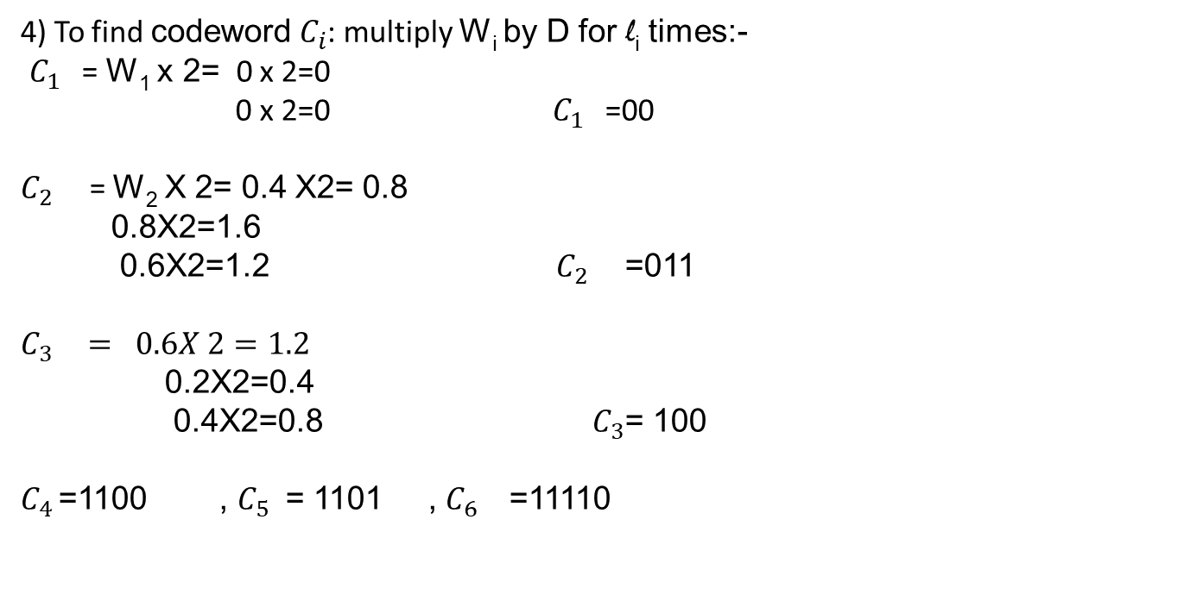
4) To find codeword $C_{i}$: multiply W_{i} by D for l_{i} times:-
$C_{1 }$= W₁ x 2= 0 x 2=0
0 x 2=0 $C_{1 }$=00
$C_{2 }$= W₂ X 2= 0.4 X2= 0.8
0.8X2=1.6
0.6X2=1.2 $C_{2 }$=011
$$C_{3 }= 0.6X 2=1.2$$
0.2X2=0.4
0.4X2=0.8 $C_{3}$= 100
$C_{4 }$=1100 , $C_{5 }$= 1101 , $C_{6 }$=11110
Note that the two considerations are fulfilled ( less L_{i} for higher p(x_{i}) and the code satisfies the uniquely decodable condition).
x_{i} | p(x_{i}) | L_{i} | w_{i} | C_{i} | 0_{i}
x₁ | 0.4 | 2 | 0 | 00 | 2
x₂ | 0.2 | 3 | 0.4 | 011 | 1
x₃ | 0.15 | 3 | 0.6 | 100 | 2
x₄ | 0.1 | 4 | 0.75 | 1100 | 2
x₅ | 0.09 | 4 | 0.85 | 1101 | 1
x₆ | 0.06 | 5 | 0.94 | 11110 | 1

Slide 13

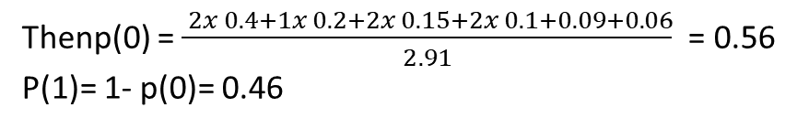
a)-To find code efficiency then
H(X)= 2.29 bits/message, and:
x_{i} | p(x_{i}) | L_{i} | w_{i} | C_{i} | 0_{i}
x₁ | 0.4 | 2 | 0 | 00 | 2
x₂ | 0.2 | 3 | 0.4 | 011 | 1
x₃ | 0.15 | 3 | 0.6 | 100 | 2
x₄ | 0.1 | 4 | 0.75 | 1100 | 2
x₅ | 0.09 | 4 | 0.85 | 1101 | 1
x₆ | 0.06 | 5 | 0.94 | 11110 | 1
L_{c}= 2x 0.4+3x 0.2+3x 0.15+… = 2.91bits/ message
Then: η=H(X)/Lc= 2.29/2.91= 78.6%
Thenp(0) = $\frac{ 2x 0.4+1x 0.2+2x 0.15+2x 0.1+0.09+0.06}{2.91}$ = 0.56
P(1)= 1- p(0)= 0.46
c) The rate of information= rate of message produced x Lc x log₂(D)
= 1000x 2.91x 1=2910bits/sec

Slide 14
b) Shannon-Fano Code ( Fano Code):
The procedure for binary Fano code is given as follows:
Step 1: arrange the messages in a decreasing order of prob.
Step 2: find out a point in the decreasing order such that the sum of probabilities upward is almost equal to the sum of prob downward.
Step 3: assign all messages upward as ''0'' and all messages downward as ''1''.
Step 4: repeat steps 2 & 3 many times on the upward and downward parts until all the messages are separated
Ex: Develop Fano code for the following set of messages:
x₁ x₂ x₃ x₄ x₅
p(X) = [ 0.25 0.4 0.1 0.15 0.1]

