Slide 1
Quantum well, Quantum Wire, Quantum dot
Dr. Raouf Mahmood

Slide 2
Quantum well
It is a two dimensional system
The electron can move in two directions and restricted in one direction.
Quantum Wire
It is a one-dimensional system
The electron can move in one direction and restricted in two directions.
Quantum dot
It is a zero dimensional system
The electron movement was restricted in entire three dimensions

Slide 3
Why called Quantum ?
Because, the electronic property is quantized
The spatial distance is very very small

Slide 4
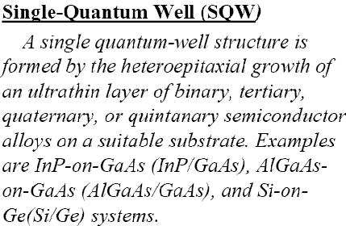
Semiconductor growth (single layer)
substrate

Slide 6
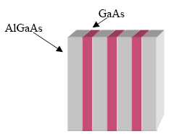

Slide 7
Quantum wire
Quantum wires are ultra fine wires or linear arrays of Nano dots, formed by self-assembly
They can be made from a wide range of materials such as Semiconductor Nanowires made of silicon, gallium nitride and indium phosphide.
Nanowires have potential applications in
In high-density data storage, either as magnetic read heads or as patterned storage media
In electronic and opto-electronic Nanodevices, for metallic interconnects of quantum devices and Nanodevices.
Nanowires can be prepared by growth techniques such as
Chemical Vapour deposition (CVD)
Electroplating

Slide 8
Quantum wire cont…
In quantum wire, Two dimensions are reduced and one dimension remains large
Therefore, the electrical resistivity of quantum wire can be calculated using conventional formula as follows,
We need two dimension to calculate area of conducting material, but not present in quantum wire

Slide 9
General properties of Nanowire
  Diameter – 10s of nanometers
  Single crystal formation -- common crystallographic orientation along the nanowire axis
  Minimal defects within wire
  Minimal irregularities within nanowire arrays
Some example of Nanowire

Slide 10
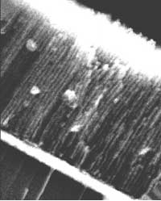
Magnetic nanowires
Example: Cobalt, gold, copper and cobalt-copper nanowire arrays
Important for storage device applications
Electrochemical deposition is the fabrication technique
<20 nm diameter nanowire arrays can be fabricated by electrochemical deposition
Cobalt nanowires on Si substrate
(UMass Amherst, 2000)

Slide 11
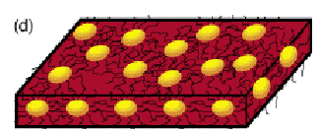
In quantum dot all the three dimensions are reduced to zero
Quantum dot

Slide 12
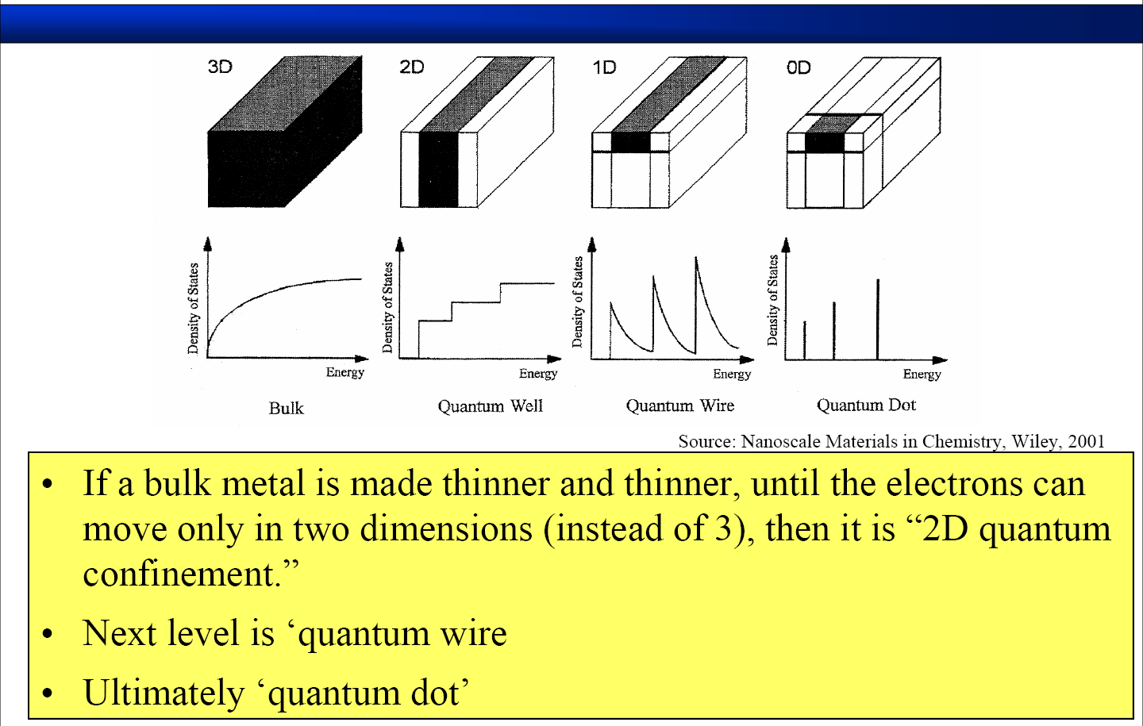
Dimension Variation ⇒

