Slide 1
Properties of Nano Materials
Dr. Raouf Mahmood

Slide 3
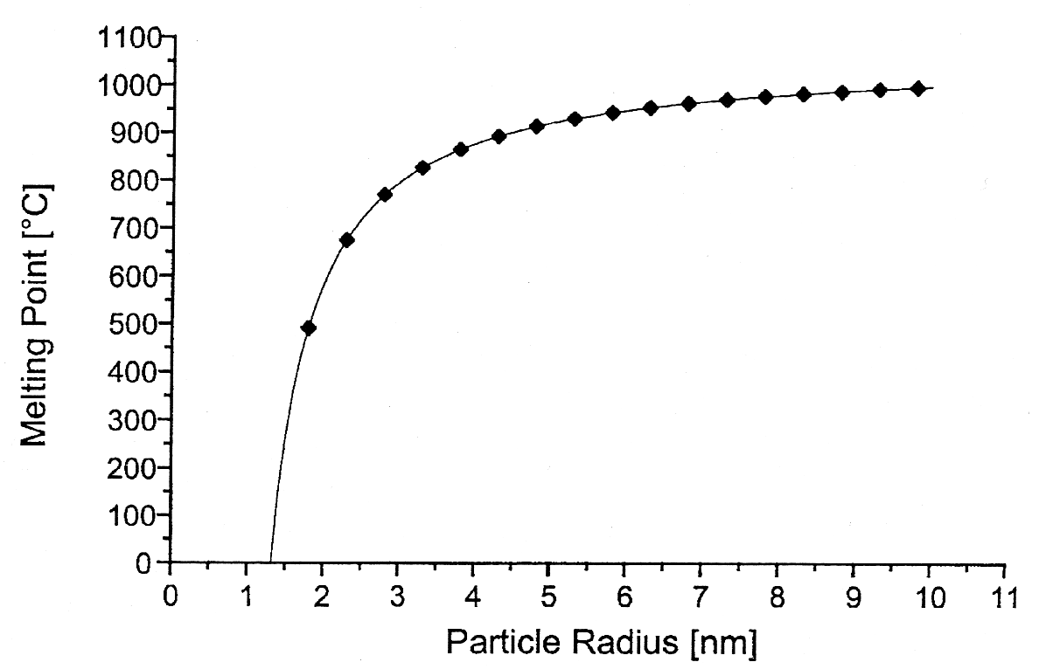
Melting Point
The melting point decreases dramatically as the particle size gets below 5 nm
Source: Nanoscale Materials in Chemistry, Wiley, 2001

Slide 4
Band gap
The band gap is increases with reducing the size of the particles

Slide 5
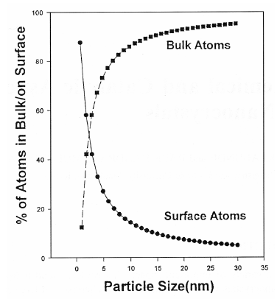
Surface Area
The total surface area (or) the number of surface atom increases with reducing size of the particles

Slide 6
Size-Dependent
Properties of semiconductor and magnetic materials
• For semiconductors such as ZnO, CdS, and Si, the bandgap changes with size
- Bandgap is the energy needed to promote an electron from the valence band to the conduction band
- When the bandgaps lie in the visible spectrum, changing bandgap with size means a change in color
• For magnetic materials such as Fe, Co, Ni, Fe₃O₄, etc., magnetic properties are size dependent
- The ‘coercive force’ (or magnetic memory) needed to reverse an internal magnetic field within the particle is size dependent
- The strength of a particle’s internal magnetic field can be size dependent

Slide 7
