Slide 2
Nano Technology
Dr. Raouf Mahmood

Slide 4
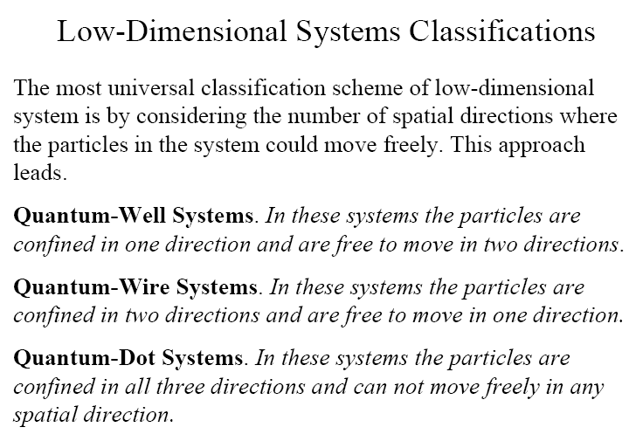

Slide 5
SIZE
A meter is about the distance from the tip of your nose to the end of your hand (1 meter = 3.28 feet).
Millimeter- One thousandth of meter.(10⁻³m)
Micron: a micron is a millionth of a meter (or) one thousandth of millimeter (10⁻⁶m)
Nanometer:
A nanometer is one thousandth of a micron (10^{–9}m)
(or) a billionth of a meter. ie.,one billion nanometers in a meter.

Slide 6

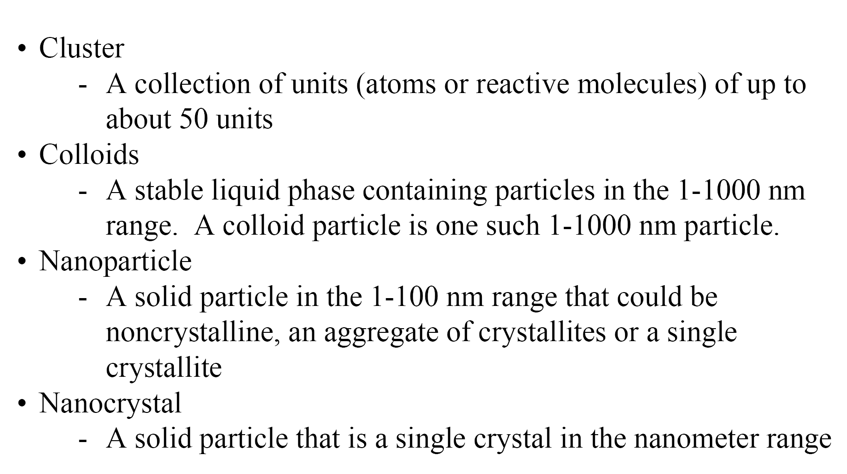

Slide 7
Composites made from particles of nano-size ceramics or metals smaller than 100 nanometers can suddenly become much stronger than predicted by existing materials-science models.
For example, metals with a so-called grain size of around 10 nanometers are as much as seven times harder and tougher than their ordinary counterparts with grain sizes in the micro meter range.
The Nano particles affects many properties such as
  Melting point
  Boiling point
  Band gap
  Optical properties
  Electrical properties
  Magnetic properties
.Even the structure of materials changes with respect to Size

Slide 8
The properties of materials can be different at the Nanoscale for two main reasons:
First, Nanomaterials have a relatively larger surface area when compared to the same mass of material produced in a larger form.
Nano particles can make materials more chemically reactive and affect their strength or electrical properties.
Second, quantum effects can begin to dominate the behaviour of matter at the Nanoscale
Nanoscale materials are divided into three category,
Zero dimension – length , breadth and heights are confined at single point. (for example, Nano dots)
One dimension – It has only one parameter either length (or) breadth (or) height ( example:very thin surface coatings)
Two dimensions- it has only length and breadth (for example, nanowires and nanotubes)
Three dimensions -it has all parameter of length, breadth and height. (for example, Nano Particles).

Slide 9
What do you mean by Nano Particles ?
Nano Particles are the particles of size between 1 nm to 100 nm
1 nm is only three to five atoms wide.
~40,000 times smaller than the width of an average human hair
Nanometer - One billionth (10⁻⁹) of a meter
• The size of Hydrogen atom 0.04 nm
The size of Proteins ~ 1-20 nm
Feature size of computer chips 180 nm
Diameter of human hair ~ 10 µm
At the nanoscale, the physical, chemical, and biological properties of materials differ in fundamental and valuable ways from the properties of individual atoms and molecules or bulk matter

Slide 10
Why Nano Particles ?
Noparticles are of interest because of the new properties (such as chemical reactivity and optical behaviour) that they exhibit compared with larger particles of the same materials.
For example, titanium dioxide and zinc oxide become transparent at the nanoscale and have found application in sunscreens.
Nanoparticles have a range of potential applications:
In the short-term application such as in cosmetics, textiles and paints.
In the longer term applications such as drug delivery where they could be to used deliver drugs to a specific site in the body.
Nanoparticles can also be arranged into layers on surfaces, providing a large surface area and hence enhanced activity, relevant to a range of potential applications such as catalysts.

Slide 11
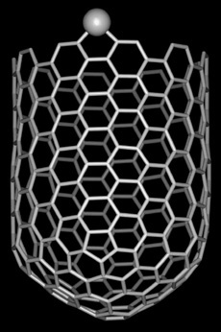
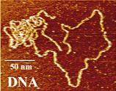
• Examples
- Carbon Nanotubes
- Proteins, DNA
- Single electron transistors
AFM Image of DNA
Carbon Nanotubes

Slide 12
Nanotechnology deals with the creation of USEFUL materials, devices and systems using the particles of nanometer length scale and exploitation of NOVEL properties (physical, chemical, biological) at that length scale

Slide 13
Various Nanomaterials and
Nanotechnologies
Based on the size and shape, the Nano materials are classified as follows
• Nanotubes
• Nanosprings
• Nanobelts
• Quantum dots
• Nanofluidies
• Nanoparticles
• Nanocapsules
• Nanofibers
• Nanowires
• Fullerenes (carbon 60)

