Slide 2
Lecture 11 Traffic Engineering Assistant Lecturer: Areej Muhy

Slide 3
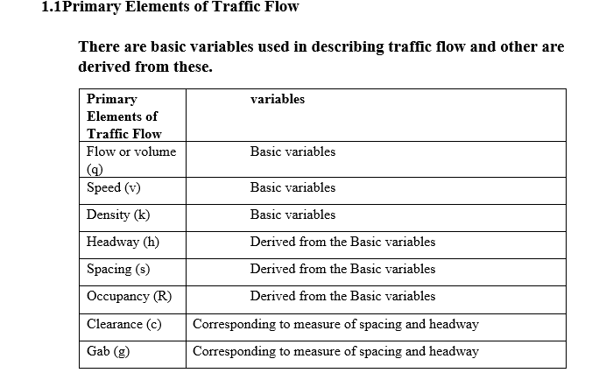
Lecture 11 Traffic Engineering Assistant Lecturer: Areej Muhy

Slide 4
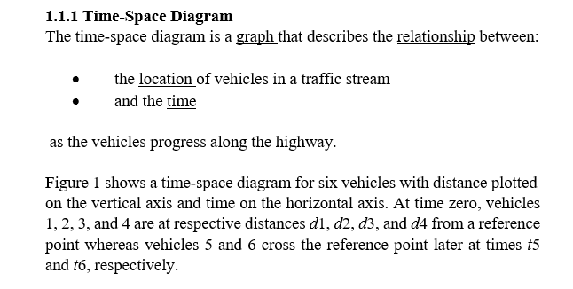
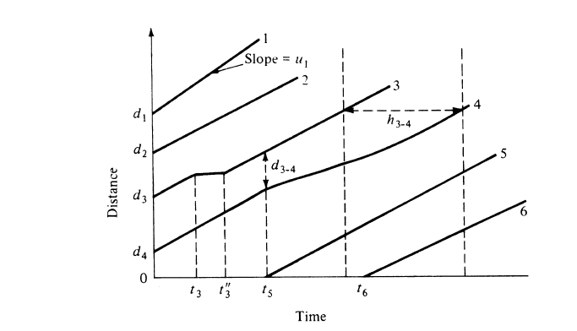
Lecture 11 Traffic Engineering Assistant Lecturer: Areej Muhy
Figure 1 Time-Space Diagram

Slide 5
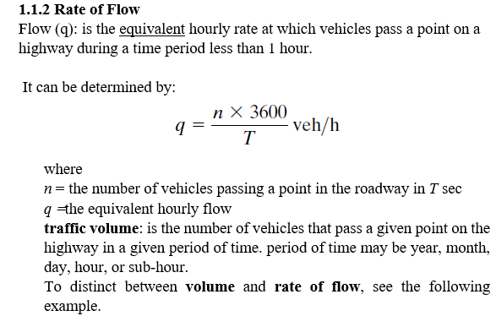
Lecture 11 Traffic Engineering Assistant Lecturer: Areej Muhy

Slide 6
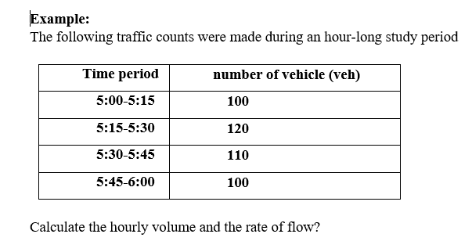
Lecture 11 Traffic Engineering Assistant Lecturer: Areej Muhy

Slide 7
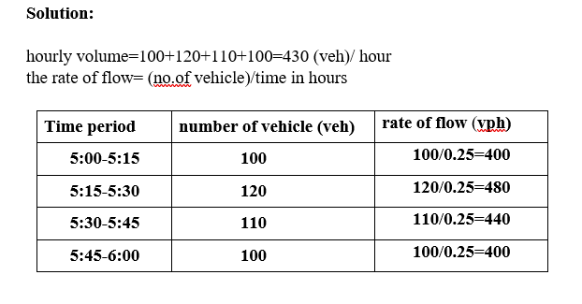
Lecture 11 Traffic Engineering Assistant Lecturer: Areej Muhy

Slide 8
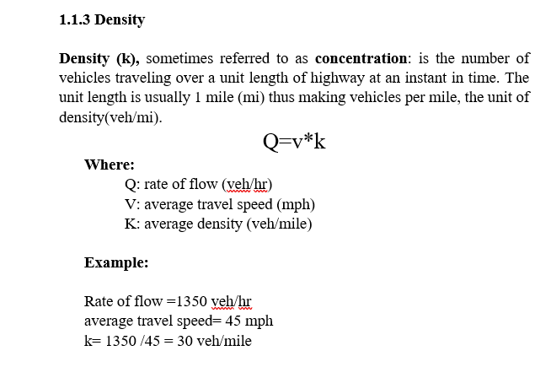
Lecture 11 Traffic Engineering Assistant Lecturer: Areej Muhy

Slide 9
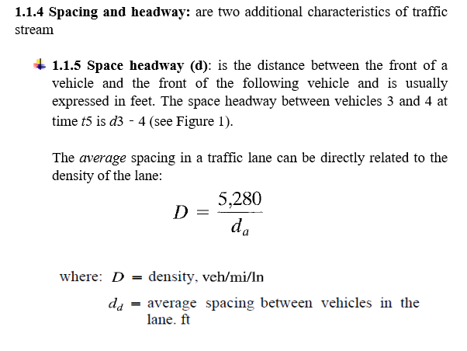
Lecture 11 Traffic Engineering Assistant Lecturer: Areej Muhy

Slide 10
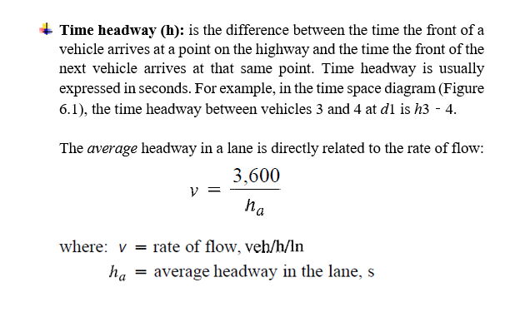
Lecture 11 Traffic Engineering Assistant Lecturer: Areej Muhy

Slide 11
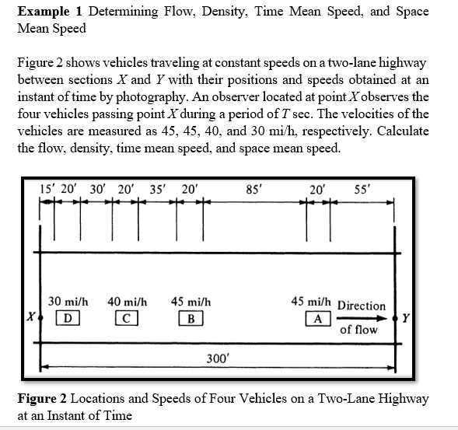
Lecture 11 Traffic Engineering Assistant Lecturer: Areej Muhy

Slide 12
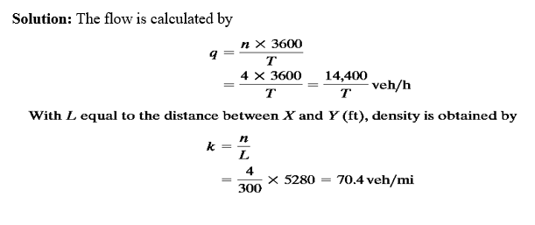
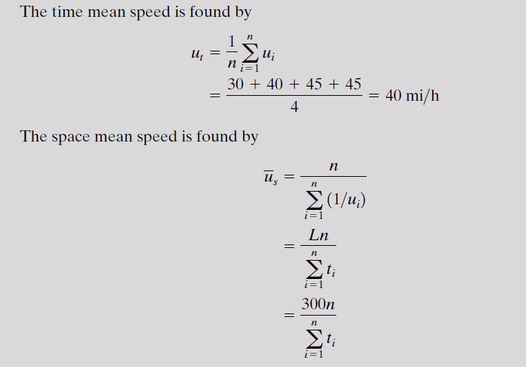
Lecture 11 Traffic Engineering Assistant Lecturer: Areej Muhy

Slide 13
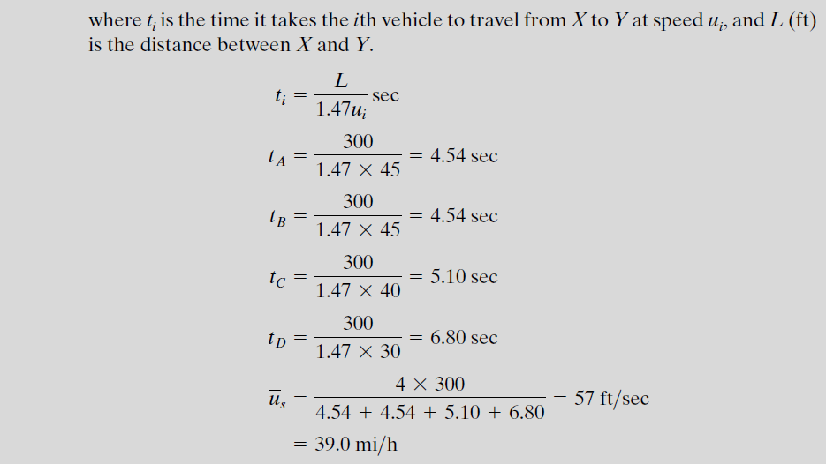
Lecture 11 Traffic Engineering Assistant Lecturer: Areej Muhy

Slide 14
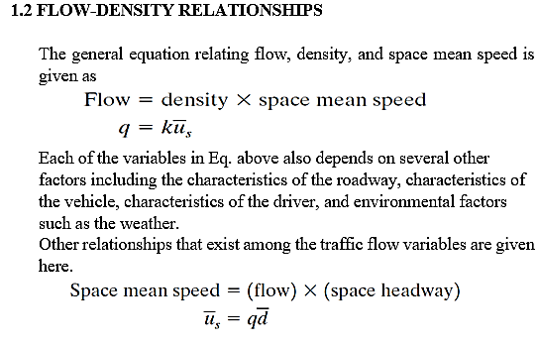
Lecture 11 Traffic Engineering Assistant Lecturer: Areej Muhy

Slide 15
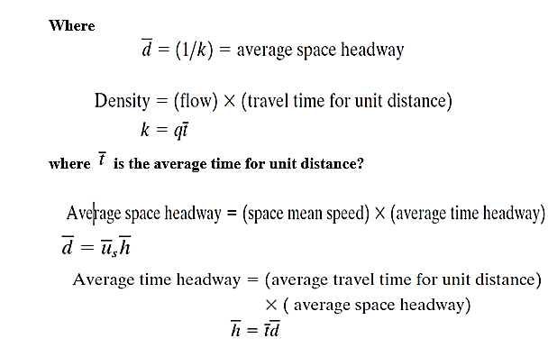
Lecture 11 Traffic Engineering Assistant Lecturer: Areej Muhy

Slide 16
Lecture 11 Traffic Engineering Assistant Lecturer: Areej Muhy

Slide 17
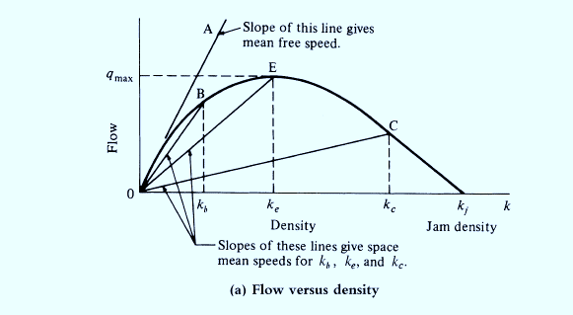
Lecture 11 Traffic Engineering Assistant Lecturer: Areej Muhy

Slide 18
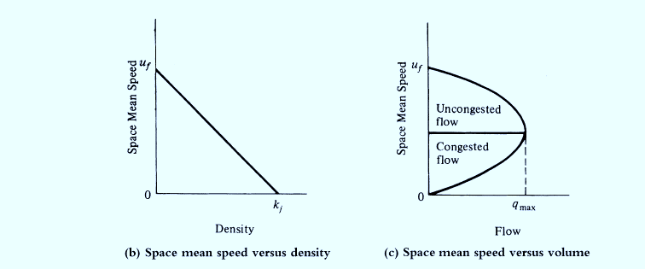
Lecture 11 Traffic Engineering Assistant Lecturer: Areej Muhy
Figure 2 Fundamental Diagrams of Traffic Flow

