Slide 2
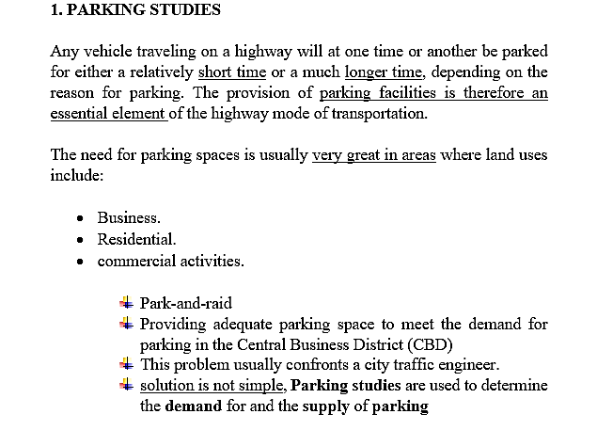
Lecture 10 Traffic Engineering Assistant Lecturer: Areej Muhy

Slide 3
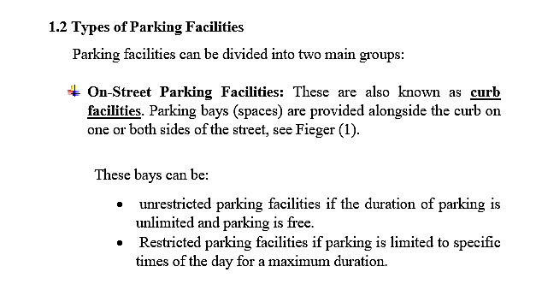
Lecture 10 Traffic Engineering Assistant Lecturer: Areej Muhy

Slide 4
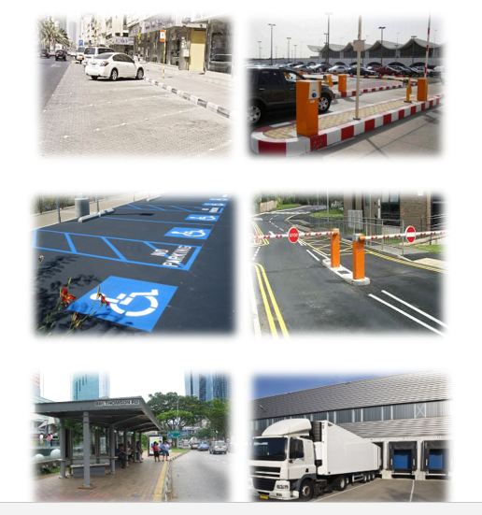
Lecture 10 Traffic Engineering Assistant Lecturer: Areej Muhy
Fieger (1) illustrate On-Street Parking Facilities

Slide 5
Lecture 10 Traffic Engineering Assistant Lecturer: Areej Muhy

Slide 6
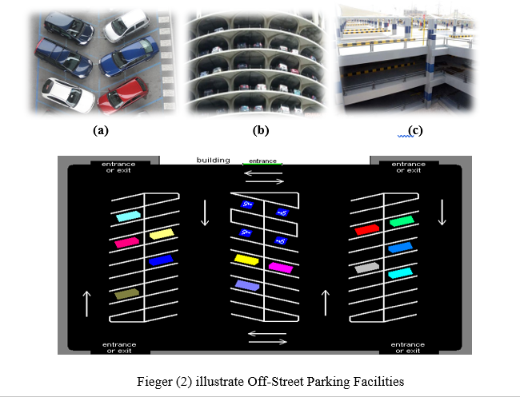
Lecture 10 Traffic Engineering Assistant Lecturer: Areej Muhy

Slide 7
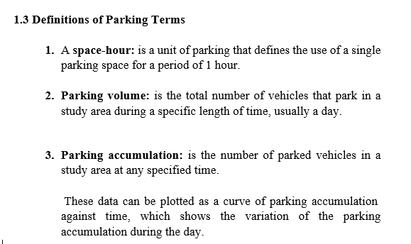
Lecture 10 Traffic Engineering Assistant Lecturer: Areej Muhy

Slide 8
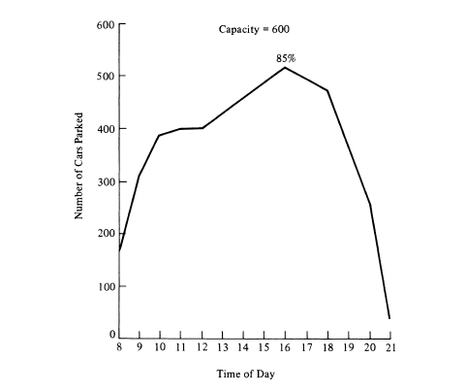
Lecture 10 Traffic Engineering Assistant Lecturer: Areej Muhy

Slide 9
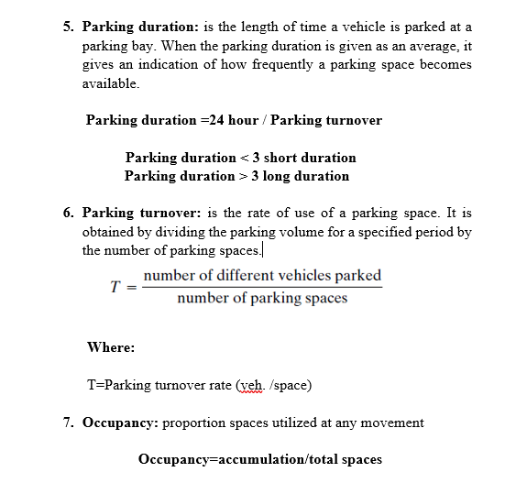
Lecture 10 Traffic Engineering Assistant Lecturer: Areej Muhy

Slide 10
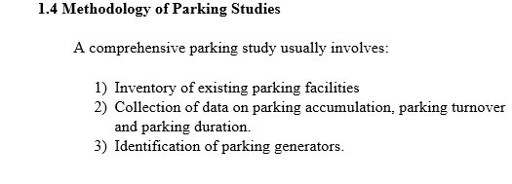
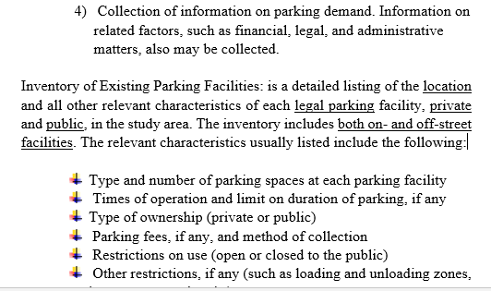
Lecture 10 Traffic Engineering Assistant Lecturer: Areej Muhy

Slide 11
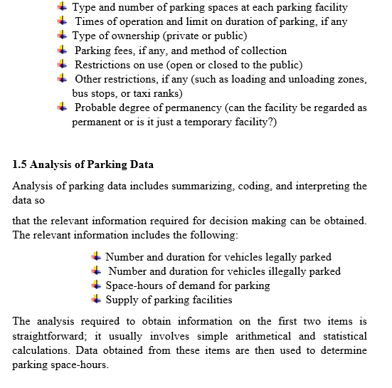
Lecture 10 Traffic Engineering Assistant Lecturer: Areej Muhy

Slide 12
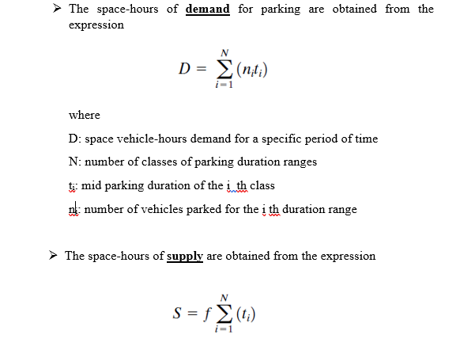
Lecture 10 Traffic Engineering Assistant Lecturer: Areej Muhy

Slide 13
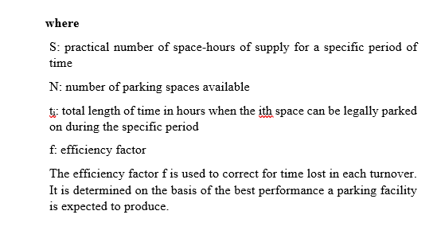
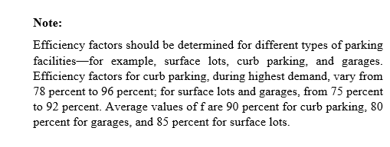
Lecture 10 Traffic Engineering Assistant Lecturer: Areej Muhy

Slide 14
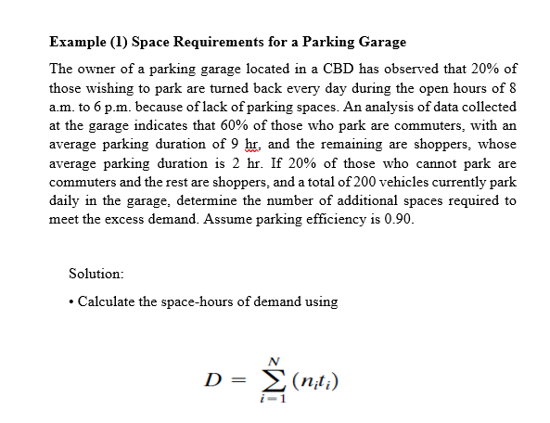
Lecture 10 Traffic Engineering Assistant Lecturer: Areej Muhy

Slide 15
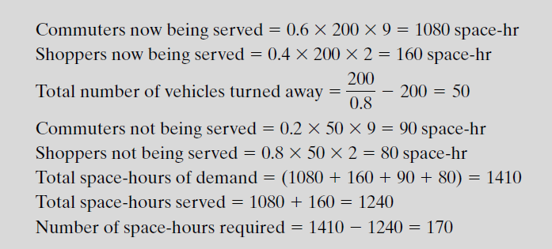
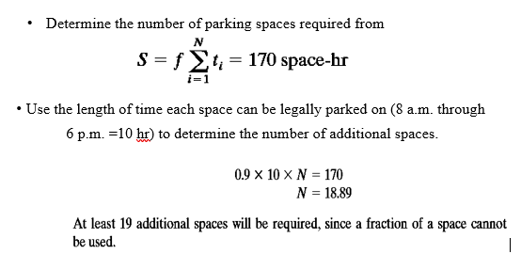
Lecture 10 Traffic Engineering Assistant Lecturer: Areej Muhy

