Slide 1

Pavement Structural Analysis
3rd Stage
Lecture 3
Lecture. Rana Amir Yousif
Highway and Transportation Engineering
Al-Mustansiriyah University
2018-2019

Slide 2
References:
Nicholas J. Garber and Lester A. Hoel.”Traffic and Highway Engineering”, Fourth Edition.
Yoder; E. J. and M. W. Witczak, “Principles of Pavement Design”, A Wiley- Interscience Publication, John Wiley & Sons Inc., U.S.A., 1975.
Yaug H. Huang, “Pavement Analysis and Design”, Prentic Hall Inc., U.S.A., 1993.
“AASHTO Guide for Design of Pavement Structures 1993”, AASHTO, American Association of State Highway and Transportation Officials, U.S.A., 1993.
Oglesby Clarkson H., “Highway Engineering”, John Wiley & Sons Inc., U.S.A., 1975.

Slide 3
Use of Base Course
Early concrete pavements were constructed directly on the subgrade without a base course. As the weight and volume of traffic increased, pumping began to occur, and the use of a granular base course became quite popular. When pavements are subject to a large number of very heavy wheel loads with free water on top of the base course, even granular materials can be eroded by the pulsative action of water. For heavily traveled pavements, the use of a cement-treated or asphalt-treated base course has now become a common practice.
Although the use of a base course can reduce the critical stress in the concrete, it is uneconomical to build a base course for the purpose of reducing the concrete stress .
Because the strength of concrete is much greater than that of the base course, the same critical stress in the concrete slab can be obtained without a base course by slightly increasing the concrete thickness . The following reasons have been frequently cited for using a base course.

Slide 4
a) Control of Pumping
Pumping is defined as the ejection of water and subgrade soil through joints and cracks and along the edges of pavements, caused by downward slab movements due to heavy axle loads . The sequence of events leading to pumping includes the creation of void space under the pavement caused by the temperature curling of the slab and the plastic deformation of the subgrade, the entrance of water , the ejection of muddy water, the enlargement of void space, and finally the faulting and cracking of the leading slab ahead of traffic. Pumping occurs under the leading slab when the trailing slab rebounds, which creates a vacuum and sucks the fine material from underneath the leading slab, as shown in Figure 1.5. The corrective measures for pumping include joint sealing, under sealing with asphalt cements, and muck jacking with soil cement.

Slide 5
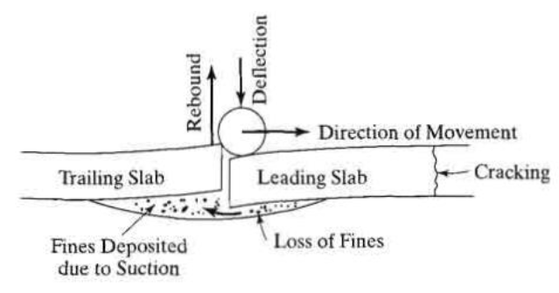
Figure 1.5: Pumping of rigid pavement.

Slide 6
Three factors must exist simultaneously to produce pumping:
The material under the concrete slab must be saturated with free water. If the material is well drained, no pumping will occur. Therefore, good drainage is one of the most efficient ways to prevent pumping.
There must be frequent passage of heavy wheel loads. Pumping will take place only under heavy wheel loads with large slab deflections. Even under very heavy loads, pumping will occur only after a large number of load repetitions.
The material under the concrete slab must be erodible. The credibility of a material depends on the hydrodynamic forces created by the dynamic action of moving wheel loads. Any untreated granular materials, and even some weakly cemented materials, are erodible because the large hydrodynamic pressure will transport the fine particles in the subbase or subgrade to the surface. These fine particles will go into suspension and cause pumping.

Slide 7
b) Control of Frost Action:
Frost action is detrimental to pavement performance. It results in frost heave, which causes concrete slabs to break and softens the subgrade during the frost-melt period. In northern climates, frost heave can reach several inches or more than one foot. The increase in volume of 9% when water becomes frozen is not the real cause of frost heave. For example, if a soil has a porosity of 0 .5 and is subjected to a frost penetration of 3 ft (0 .91 m), the amount of heave due to 9% increase in volume is 0.09 x 3 x 0.5 = 0.135 ft or 1 .62 in . (41 mm), which is much smaller than the 6 in. (152 mm) or more of heave experienced in such climate.
Frost heave is caused by the formation and continuing expansion of ice lenses. After a period of freezing weather, frost penetrates into the pavement and subgrade, as indicated by the depth of frost penetration in Figure 1.6. Above the frost line, the temperature is below the ordinary freezing point for water. The water will freeze in the larger voids but not in the smaller voids where the freezing point may be depressed as low as 23°F(-5°C) .

Slide 8
When water freezes in the larger voids, the amount of liquid water at that point decreases. The moisture deficiency and the lower temperature in the freezing zone increase the capillary tension and induce flow toward the newly formed ice. The adjacent small voids are still unfrozen and act as conduits to deliver the water to the ice. If there is no water table or if the subgrade is above the capillary zone, only scattered and small ice lenses can be formed . If the subgrade is above the frost line and within the capillary fringe of the groundwater table, the capillary tension induced by freezing sucks up water from the water table below. The result is a great increase in the amount of water in the freezing zone and the segregation of water into ice lenses. The amount of heave is at least as much as the combined lens thicknesses.
Three factors must be present simultaneously to produce frost action:
The soil within the depth of frost penetration must be frost susceptible. It should be recognized that silt is more frost susceptible than clay because it has both high capillarity and high permeability.

Slide 9
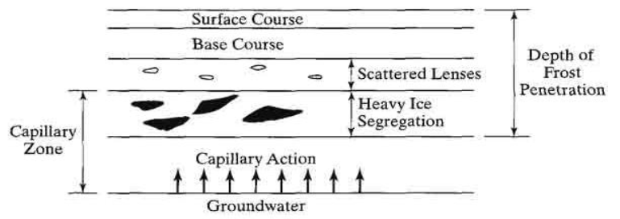
Although clay has a very high capillarity, its permeability is so low that very little water can be attracted from the water table to form ice lenses during the freezing period. Soils with more than 3% finer than 0.02 mm are generally frost susceptible, except that uniform fine sands with more than 10% finer than 0 .02 mm are frost susceptible .
Figure 1.6: Formation of ice lenses, due to frost action .

Slide 10
2. There must be a supply of water. A high water table can provide a continuous supply of water to the freezing zone by capillary action. Lowering the water table by subsurface drainage is an effective method to minimize frost action.
3. The temperature must remain freezing for a sufficient period of time. Due to the very low permeability of frost-susceptible soils, it takes time for the capillary water to flow from the water table to the location where the ice lenses are formed. A quick freeze does not have sufficient time to form ice lenses of any significant size.

Slide 11
c) Improvement of Drainage:
When the water table is high and close to the ground surface, a base course can raise the pavement to a desirable elevation above the water table. When water seeps through pavement cracks and joints, an open-graded base course can carry it away to the road side. Cedergren (1988) recommends the use of an open-graded base course under every important pavement to provide an internal drainage system capable of rapidly removing all water that enters.
d) Control of Shrinkage and Swell:
When moisture changes cause the subgrade to shrink and swell, the base course can serve as a surcharge load to reduce the amount of shrinkage and swell . A dense-graded or stabilized base course can serve as a water proofing layer, and an open-graded base course can serve as a drainage layer. Thus, the reduction of water entering the subgrade further reduces the shrinkage and swell potentials.

Slide 12
e) Expedition of Construction:
A base course can be used as a working platform for heavy construction equipment. Under inclement weather conditions, a base course can keep the surface clean and dry and facilitate the construction work. As can be seen from the above reasoning, there is always a necessity to build a base course. Consequently, base courses have been widely used for rigid pavements.

Slide 13
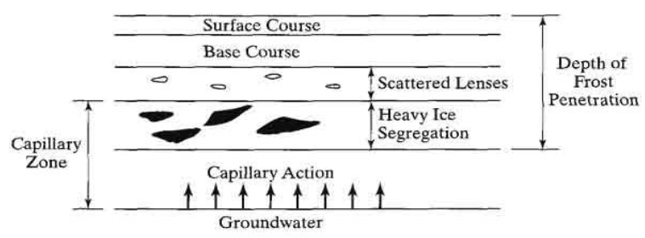
Although clay has a very high capillarity, its permeability is so low that very little water can be attracted from the water table to form ice lenses during the freezing period. Soils with more than 3% finer than 0.02 mm are generally frost susceptible, except that uniform fine sands with more than 10% finer than 0 .02 mm are frost susceptible .
Figure 1.6: Formation of ice lenses, due to frost action .

