Slide 1

Asphalt Chemistry
First Stage
Lecture 12
Lecture. Rana Amir Yousif
Lecture. Sady Abd Tayeh
Highway and Transportation Engineering
Al-Mustansiriyah University
2018-2019

Slide 2
References:
Edwin J. Barth. ”Asphalt Science and Technology”, 1st Ed. ,1962.
James Speight” Asphalt Materials Science and Technology”, 1st Edition 2015.

Slide 3
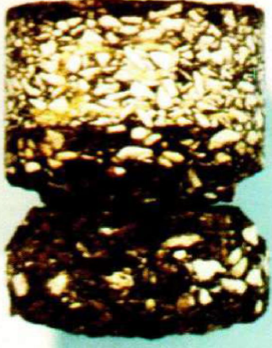
Chemistry of Asphalt Aggregate Interaction
Stripping in Asphalt Pavements:
It is the breaking of the bond between aggregate and asphalt by the action of water.
Stripping due to lack of chemical interaction between asphalt and aggregate / bonding (Adhesion).
It is a surface fenomenon.

Slide 4
Adhesion:
The process of forming chemical bond between the asphalt film and the aggregate surface.
Active Adhesion:
Coating and formation of chemical bond in the presence of water. Presence
Presence of acidic organic compounds in asphalts
Carboxylic acids (RCOOH) and anhydrides.
Acid value (0 to 4 mg KOH/g).
Possible presence of compounds related to naphthenic acids.

Slide 5
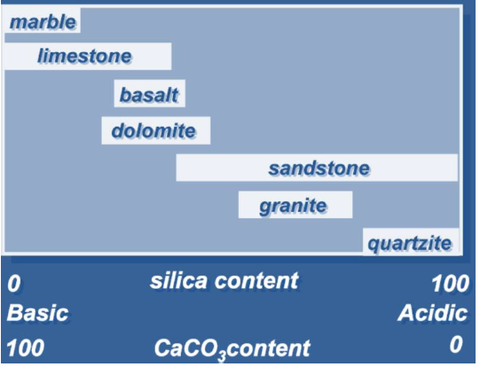
Chemical Nature of Road Aggregates:

Slide 6
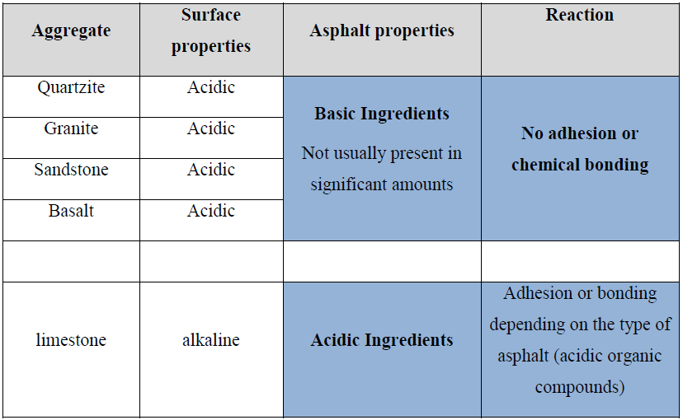
Aggregate and asphalt properties: :
Aggregates with a high CaCO3 content with not pass polish test.
Fines are siliceous material (sadn) and the stripping in the fines is more of a problem.

Slide 7
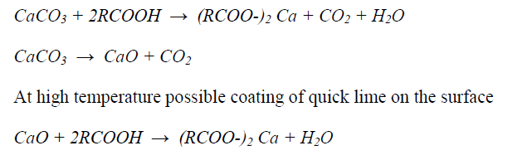
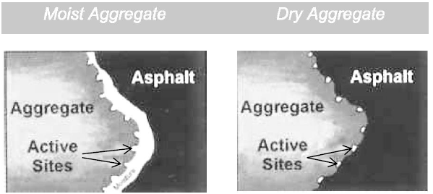
Interaction of alkaline aggregates and asphalt with acidic compounds:
Stripping may occur when there is coating without chemical bonding.

