Slide 1

Asphalt Chemistry
First Stage
Lecture 11
Lecture. Rana Amir Yousif
Lecture. Sady Abd Tayeh
Highway and Transportation Engineering
Al-Mustansiriyah University
2018-2019

Slide 2
References:
Edwin J. Barth. ”Asphalt Science and Technology”, 1st Ed. ,1962.
James Speight” Asphalt Materials Science and Technology”, 1st Edition 2015.

Slide 3
The Relationship with asphalt pavement distresses
The significant failure modes in asphalt pavement that may be related to materials are generally agreed to be:
Permanent deformation
Rutting
Fatigue cracking
Low temperature cracking
Moisture damage
Total loss of adhesion

Slide 4
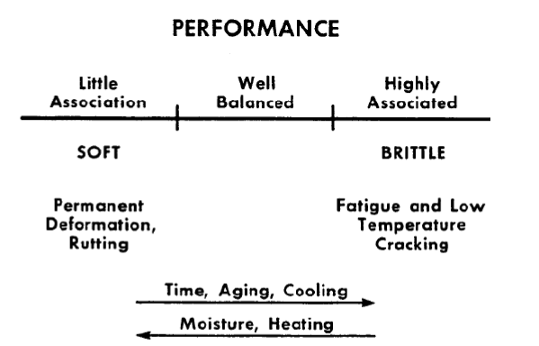
Schematic illustration asphalt pavement performance with the effects of
temperature, time, and oxidation

Slide 5
Aging
Oxidation, or oxidative hardening, imparts permanent hardening in asphalt.
while the hardening from reduced temperature and from molecular organization are reversible.
the hardening resulting from molecular organization can be reversed periodically by recycling pavement.
The events that lead to aging in a pavement are very slow because the driving forces for orientation (dipole of each molecule) are small and the whole medium is quite viscous at road service temperature.

Slide 6
Rutting and Permanent Deformation.
Consider asphalts G, K, and M. Their SEC plots are shown in Figure 3.
Asphalt G is largely the dispersing phase, not much elastic in character. One would expect it to be very compatible as is observed in oxidation and compatibility index studies. Asphalt G is somewhat insensitive to oxidation. It does not harden well which makes it a material that will rut or deform, especially at higher temperatures. It has little of the compositional feature of large molecular size to give it elasticity. Asphalt G is mostly the non-associated material which does tend to organize and harden at low temperature. Therefore G would be expected to be very stiff (susceptible to cracking) at very low temperature.
Asphalt K has a large amount of agglomerated material and would be expected to have a greater elastic modulus at high temperature than asphalt G and not have the propensity to rut; and this is also what is observed.

Slide 7
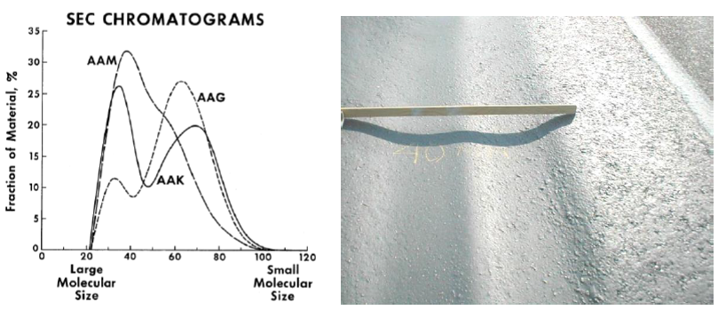
Asphalt M, with its truly high molecular weight, should and does behave somewhat like asphalt K at high temperature. Asphalt M is also a more homogeneous material than K or G. This feature should impart a relatively low temperature susceptibility to M, and this likewise is observed.

Slide 8
Thermal and Fatigue Cracking.
If the molecular network (agglomerate, micelle, colloid, or whatever term is preferred) becomes too rigid, the ability of an asphalt to deform elastically will be lost.
Instead, the asphalt fractures and likely will be separated to a point that healing cannot occur.
The constant working of very rigid matrix will eventually suffer fatigue and crack.
At low temperature, the more neutral materials begin to organize into a more structured form. Now, the asphalt is quite brittle and subject to cracking under stress.
To make matters worse, some cements shrink significantly at low temperature as a result of the organization of low polarity and nonpolar components.
The more linear aliphatic materials show the most pronounced tendency to shrink with decreasing temperature.
related to the compositional feature of aliphatic/aromatic ratio when all other characteristics are equal.

Slide 9
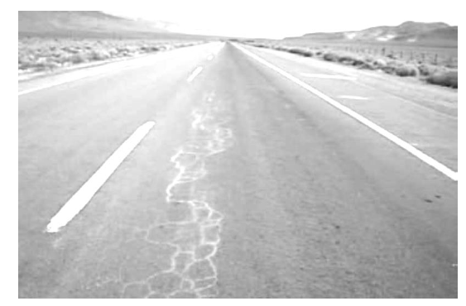

Slide 10
Adhesion and Moisture Damage.
Adhesion and moisture damage go together only to a point.
By definition, it must involve both asphalt and aggregate.
Adhesion of components in asphalt to aggregate appears to be governed as much at the molecular level as at the inter-molecular level.
Specific functional groups (molecular types) seem to be very important. Certainly overall polarity, that is, separation of charge within the organic molecules, promotes attraction of polar asphalt components to the also polar surface of aggregate.
Some aggregates have positive sites, some negative, and some show variation in polarity with moisture content, temperature, etc.
Adhesion arises because of the interaction of the polars in asphalt with the polar surface of an aggregate.
But polarity alone in asphalt may not be sufficient to achieve good adhesion in pavement because asphalt is affected by its environment.

Slide 11
Incorporation of water is measurable as are the effects of the invasion of water into the asphalt aggregate mixtures.
Asphalt has the capability of incorporating and transporting water.
At the molecular level in asphalt it has been observed that basic nitrogen compounds (pyridines) tend to adhere to aggregate surfaces tenaciously.
Carboxylic acid salts, while quite polar, tend to be removed from aggregate more easily, but this varies with the type of salt. Monovalent cation salts, such as sodium or potassium, of acids tend to be removed from aggregate quite easily.
Calcium or other divalent salts of acids are much more resistant to the action of water.
Water, like aggregate, is a highly polar material and to some extent is transported into the asphalt by virtue of attraction of polar water molecules to polar asphalt components. Upon invasion into the asphalt, water will affect the mechanical properties, typically softening it.

Slide 12
From a chemical viewpoint, the action of water is somewhat like the dilution of asphalt with a low molecular weight solvent. This typically results in reduced strength and further results in rutting or other deformation.
Aged or oxidized asphalts, which have greater amounts of polars (oxidation products), tend to incorporate water to a greater extent than new asphalts. This would be expected from polarity considerations. The probability of moisture invasion, from a chemical viewpoint, increases with pavement age.

Slide 13
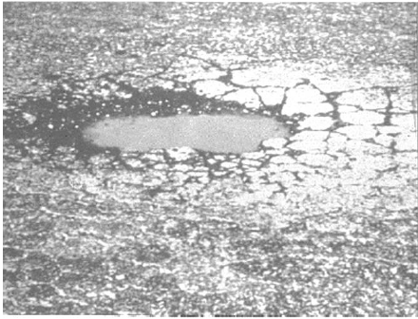
POTHOLES:
Bowl shaped holes of various sizes in the pavement surface with minimum plan dimension 150 mm.
Potholes are caused when moisture enters a crack in the pavement, then freezes and expands in cold temperatures. The expansion puts pressure on the crack, causing the asphalt to break away, resulting in a pothole. Vehicle traffic over the pothole can cause the edges to crumble, which increases the size. Some potholes will require repeated temporary patching until the street dries and permanent patching can be done.

Slide 14
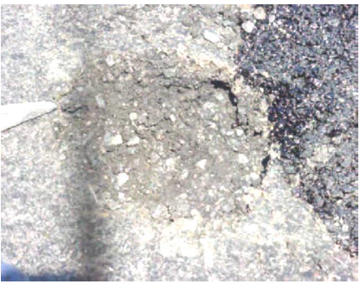
STRIPPING:
The loss of the adhesive bond between asphalt cement and aggregate, most often caused by the presence of water in asphalt concrete, which may result in raveling, loss of stability, and load carrying capacity of the HMA pavement or treated base.

