Slide 1
Asphalt Chemistry
First Stage
Lecture 6
Lecture. Rana Amir Yousif
Lecture. Sady Abd Tayeh
Highway and Transportation Engineering
Al-Mustansiriyah University
2018-2019

Slide 2
References:
Edwin J. Barth. ”Asphalt Science and Technology”, 1st Ed. ,1962.
James Speight” Asphalt Materials Science and Technology”, 1st Edition 2015.

Slide 3
CHEMISTRY LEVELS
It is convenient to divide the chemistry of petroleum asphalt into two parts. The first part is the chemistry at the molecular level and the second part is the chemistry of interaction among all molecular species in asphalt. Much of the physical nature of asphalt can best be described, in terms of composition, as an assembly or matrix of molecular species (building blocks) into large multi-molecular units within the asphalt. Numerous techniques exist to examine asphalt at both the molecular and intermolecular levels. In the following subsection the chemistry of asphalt at the molecular level is reviewed without reference to experimental methods. This is to illustrate what types of "building blocks" are present. The chemistry of interaction among asphalt molecules is reviewed in the second subsection with reference to some of the techniques being used currently in the SHRP program.

Slide 4
1. Molecular Level Extensive research on petroleum composition at the molecular level has been done by many workers for many years. At this point, much of it is essentially textbook material but worth reviewing here.
1.1. Typical Species in Virgin Asphalt.
At the molecular level most of the total mass of neat (tank) asphalt is a mixture of a wide variety of high boiling hydrocarbons. Some are aliphatic (waxy materials), some are aromatic (more like air-blown asphalts) and some molecules have both aliphatic and aromatic carbon. Examples of such molecular fragments are shown in Structures 1 (aliphatic type) and 2 (aromatic type).

Slide 5
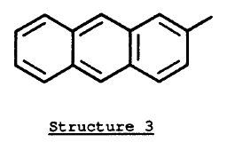
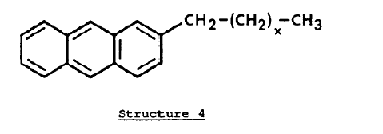
Structure 2 is more commonly represented by Structure 3. Both structures 1 and 3 are only representative molecular fragments of larger molecules that make up asphalts. Structure 1 is shown as a straight chain of carbon atoms, but typically in asphalt there are numerous combinations of aliphatic carbon chains which have one or more branches.
Structure 4 shows a molecule which is a mixture of aliphatic and aromatic carbon.

Slide 6
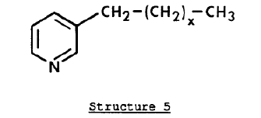
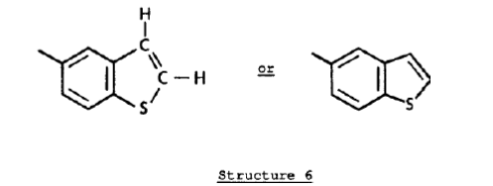
While the major mass of asphalt is hydrocarbon, a large proportion of molecules also contain one or more heteroatoms; nitrogen, sulfur, oxygen and metals. Nitrogen, in the form of a pyridine is shown in Structure 5.
Sulfur, as a benzothiophene, is shown in Structure 6. Structure 6 on the right is a shorthand notation of the one to the left. These are identical molecular fragments.

Slide 7
Both sulfur and nitrogen may appear in any of a variety of sites within molecules. Hence, it is easy to see that tens of thousands of different molecular species may be present in asphalt considering that every different arrangement of elements constitutes a different molecule. It also follows that any definition of properties based on specific molecular species would be a monumental task. It is much more effective to classify the chemistry in terms of the molecular types.

Slide 8
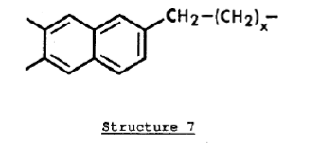
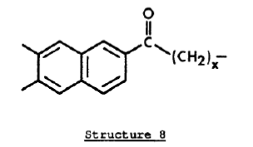
1.2. Oxidation to Form New Molecules
Certain types of carbon in asphalt are susceptible to oxidation. An aliphatic carbon next to an aromatic ring is known as a benzyl carbon and is an example of a readily oxidizable site. Structure 7 is an example of a molecular fragment showing a benzyl carbon in bold type (adjacent to the aromatic ring).
Sites such as these oxidize to form ketones as shown in Structure 8.

Slide 9
Ketones
More severe oxidation may result in formation of carboxylic acids and loss of part of the molecule such as shown by both versions of Structure 9.
Carboxylic acids
Carboxylic acids, whether present in the original crude or formed upon oxidation, may be converted to sodium (Na) salts (Structure 10) or calcium (Ca) salts (Structure 11) by appropriate reaction with sodium or calcium inorganic compounds.

Slide 10
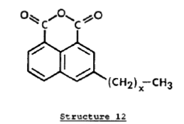
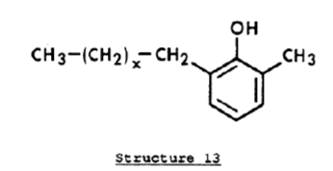
Carboxylic acid anhydrides (typically called anhydrides) may be formed upon oxidation when two benzyl carbons are present on adjacent aromatic rings. An example is Structure 12. .
Anhydrides
Another type of oxygen containing molecule which may be present in asphalt is a class known as phenols where oxygen is attached directly to an aromatic ring. This class is illustrated by Structure 13.

