Slide 1
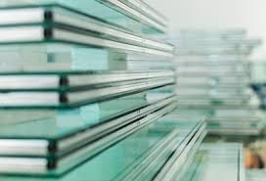
GLASS
LECTURE 7
Heat treatment of Glass
By
Asst. Lect. Shireen Hasan

Slide 2
Heat treatment of Glass
Rapid cooling of the melt is necessary to obtain a glass (avoid crystallization). This rapid cooling will generate constraints within the glass, which will are detrimental for the mechanical properties. These constraints can be relaxed by careful thermal treatment.

Slide 3

6-1 annealing of glass
Glass products sometimes have induced residual stress unlike metal products if cooling is not done at a sufficiently low rate. In order to release the internal stresses the temperature of glass melt is held steady over a long period time. This process is known as annealing.
Annealing is a process of controlled cooling and heating of a material to remove residual stresses. The process may be carried out in a thermally insulated chamber known as a lehr.

Slide 4

Glass contracts as it cools down because of its low thermal conductivity. Moreover, when there is large amount of stress developed inside the glass, it will break automatically to relieve the stress. Therefore slowing down the cooling rate will enable less temperature difference throughout the bulk of material and that will cause less stress. Temperature variation may cause crack or shatter of glass in the absence of annealing process.

Slide 5
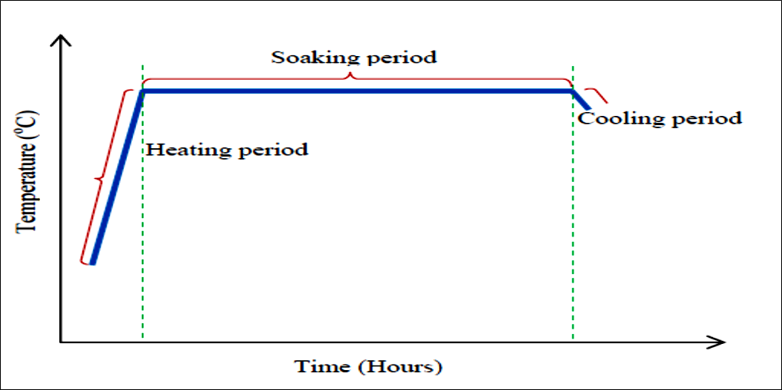

Slide 6
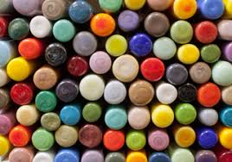

Slide 7
Thank You

