Slide 1


Slide 2
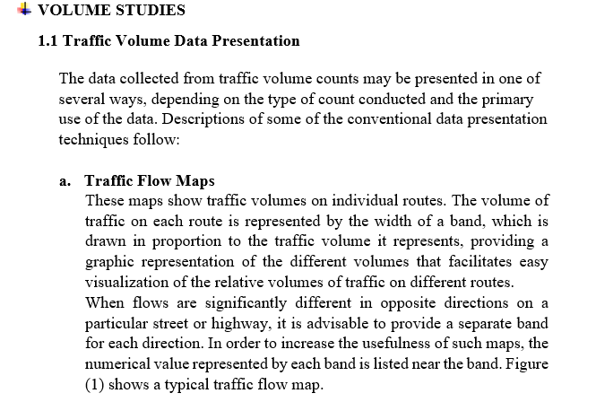
Lecture 9 Traffic Engineering Assistant Lecturer: Areej Muhy

Slide 3
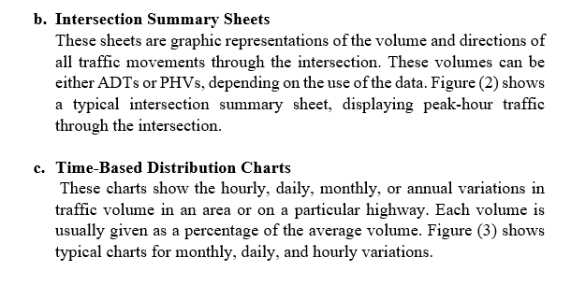
Lecture 9 Traffic Engineering Assistant Lecturer: Areej Muhy

Slide 4
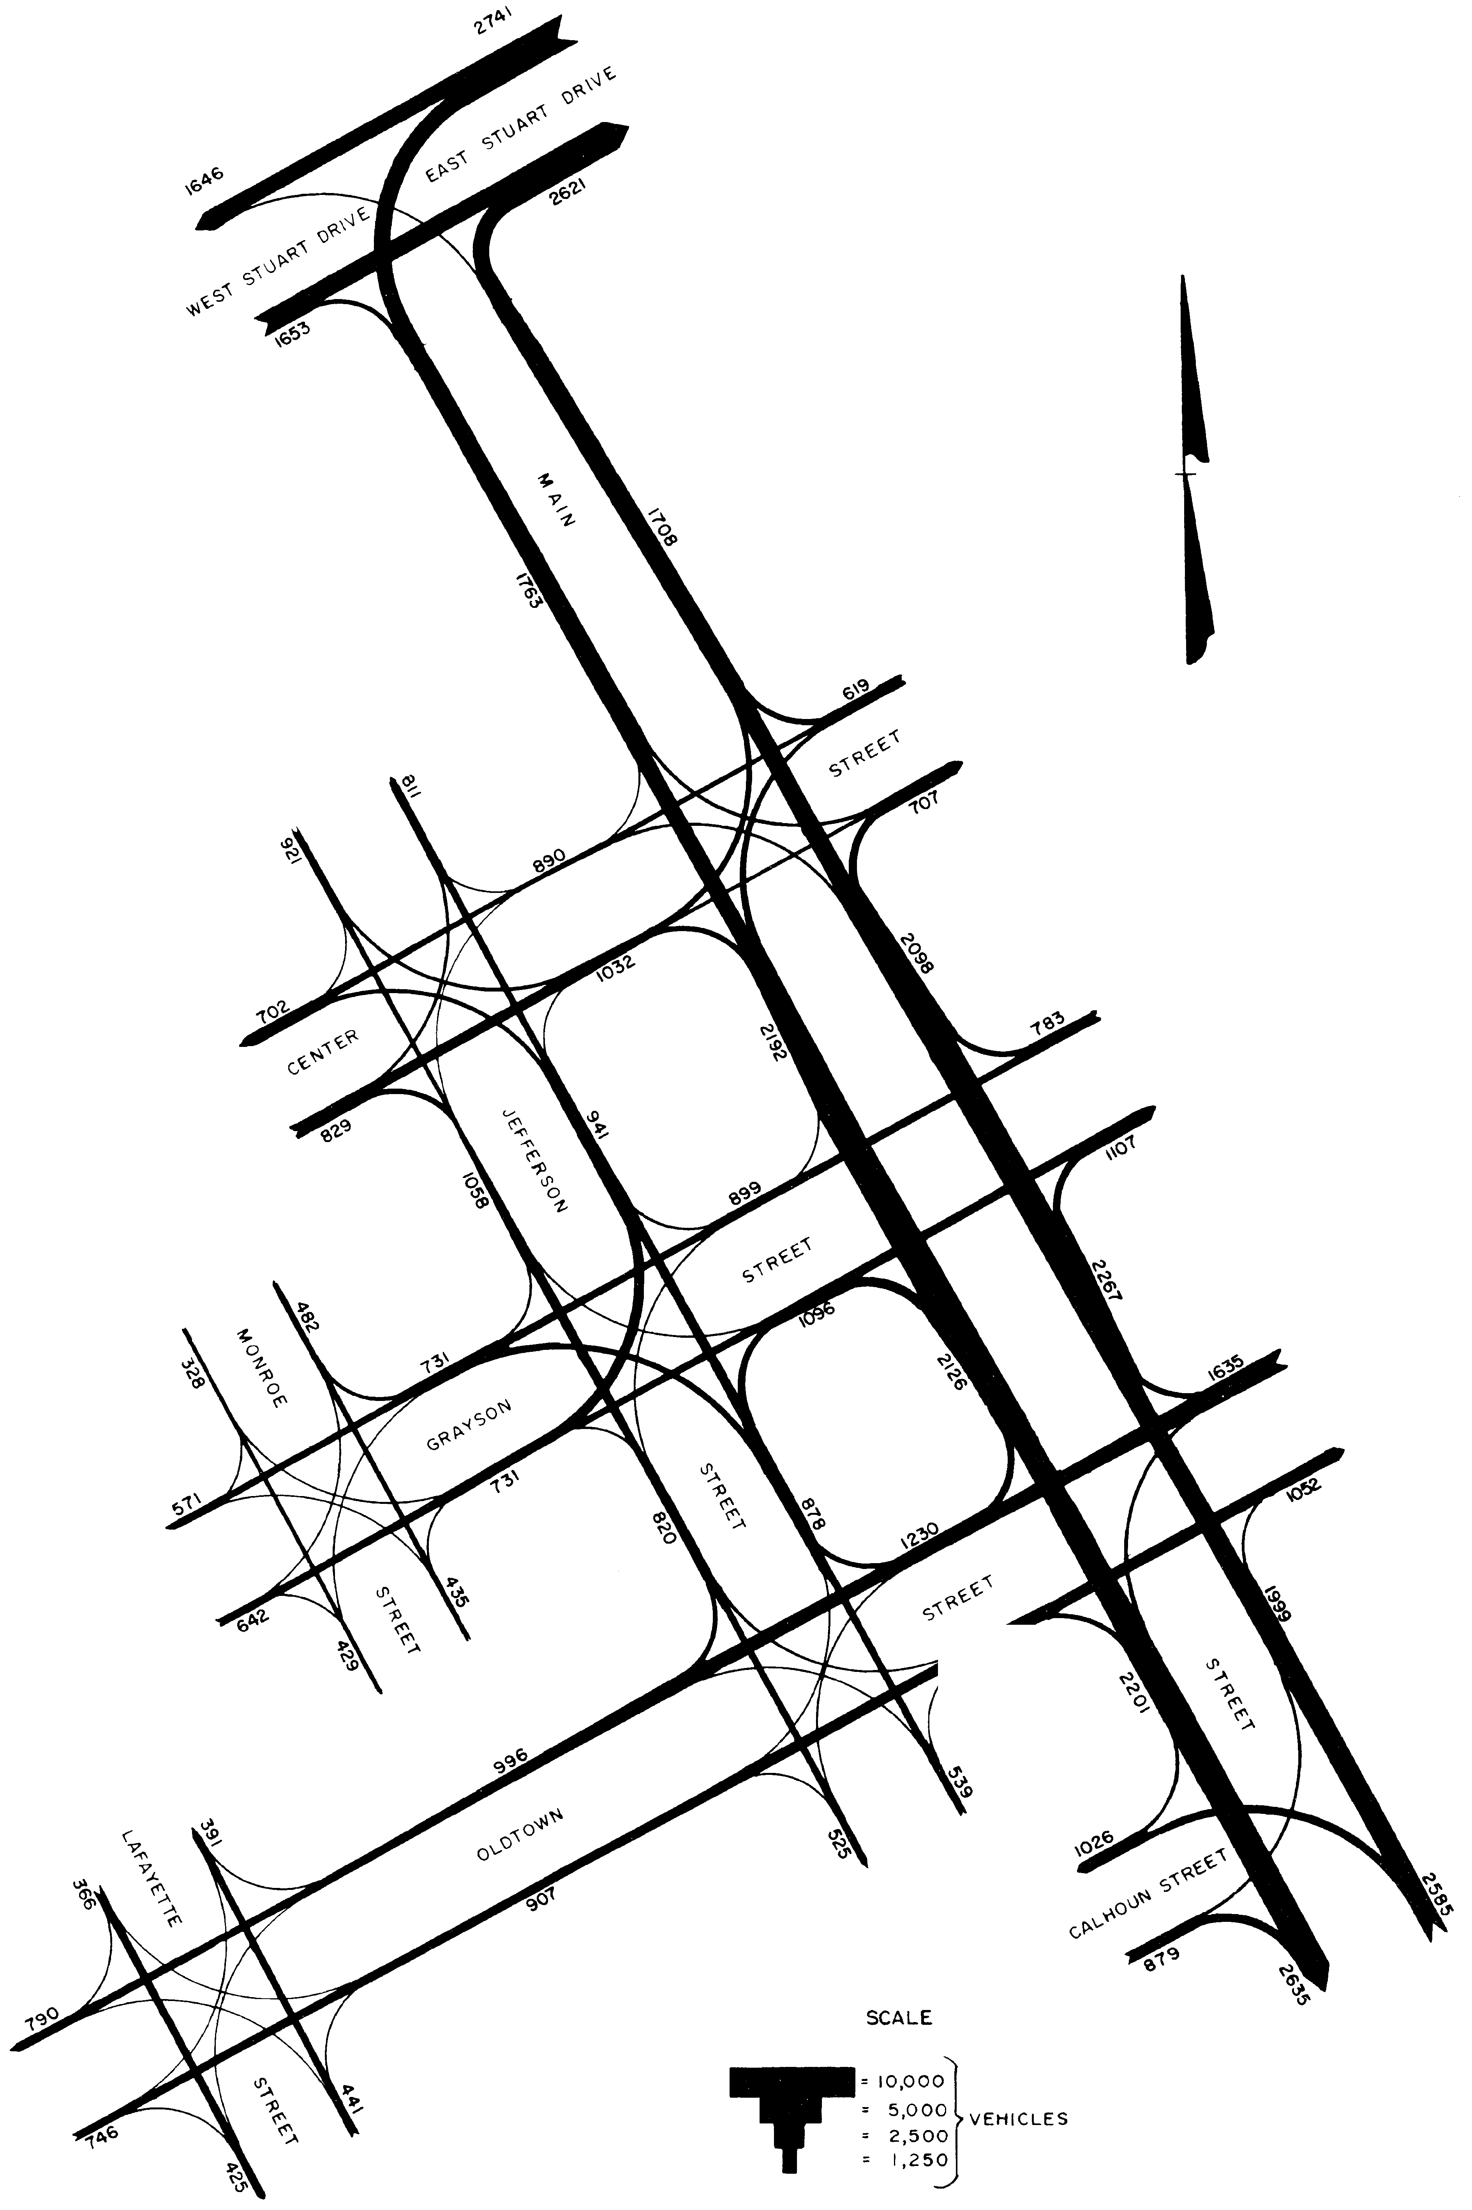
Lecture 9 Traffic Engineering Assistant Lecturer: Areej Muhy
Figure (1) Example of a Traffic Flow Map

Slide 5
Lecture 9 Traffic Engineering Assistant Lecturer: Areej Muhy
Figure (2) Intersection Summary Sheet

Slide 6
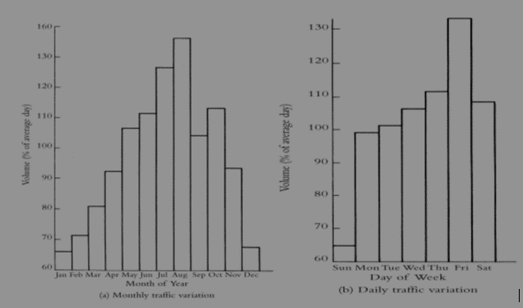
Lecture 9 Traffic Engineering Assistant Lecturer: Areej Muhy

Slide 7
Lecture 9 Traffic Engineering Assistant Lecturer: Areej Muhy
Figure (3): Traffic Volumes on an Urban Highway

Slide 8
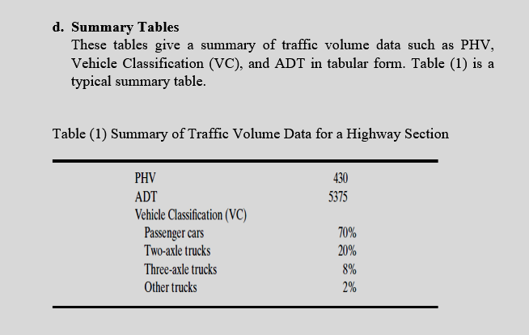
Lecture 9 Traffic Engineering Assistant Lecturer: Areej Muhy

Slide 9
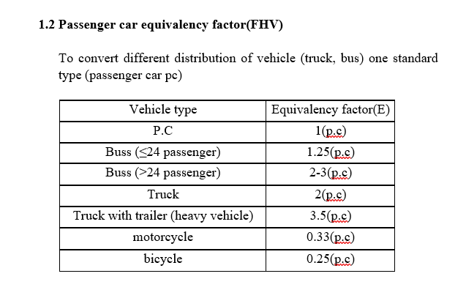
Lecture 9 Traffic Engineering Assistant Lecturer: Areej Muhy

Slide 10
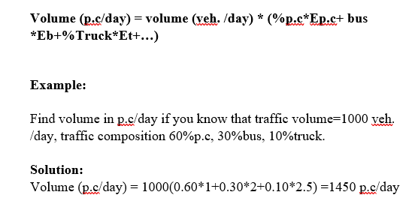
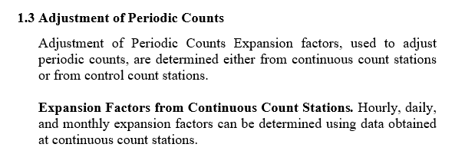
Lecture 9 Traffic Engineering Assistant Lecturer: Areej Muhy

Slide 11
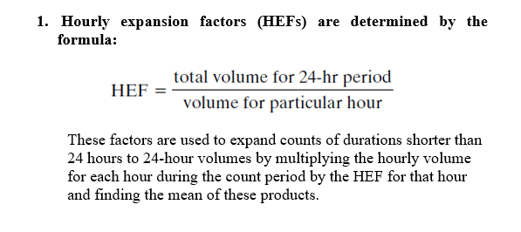
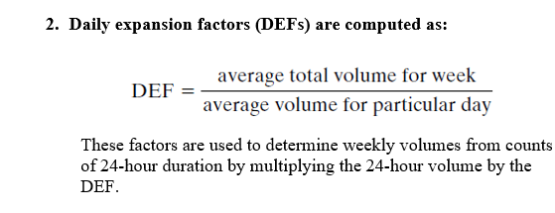
Lecture 9 Traffic Engineering Assistant Lecturer: Areej Muhy

Slide 12
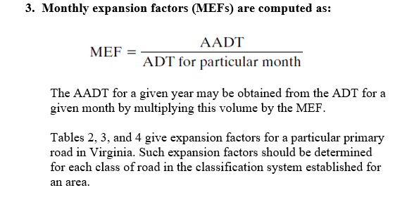
Lecture 9 Traffic Engineering Assistant Lecturer: Areej Muhy

Slide 13
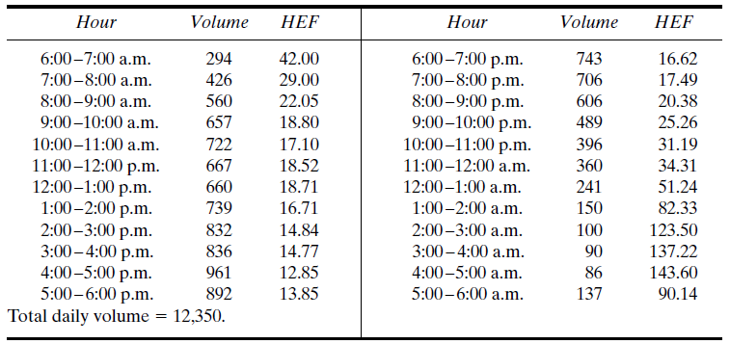
Lecture 9 Traffic Engineering Assistant Lecturer: Areej Muhy
Table 2 Hourly Expansion Factors for a Rural Primary Road

Slide 14
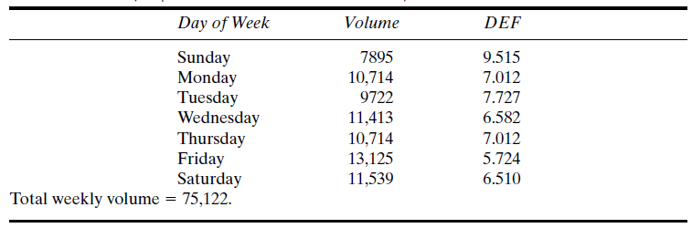
Lecture 9 Traffic Engineering Assistant Lecturer: Areej Muhy
Table 3 Daily Expansion Factors for a Rural Primary Road

Slide 15
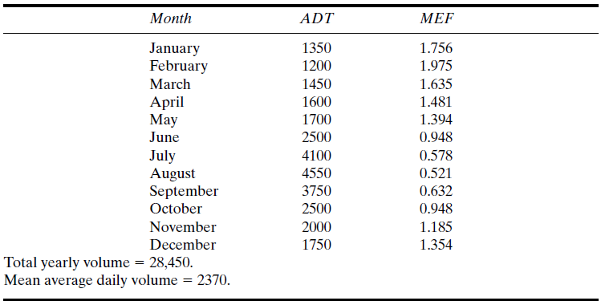
Lecture 9 Traffic Engineering Assistant Lecturer: Areej Muhy
Table 4 Monthly Expansion Factors for a Rural Primary Road

Slide 16
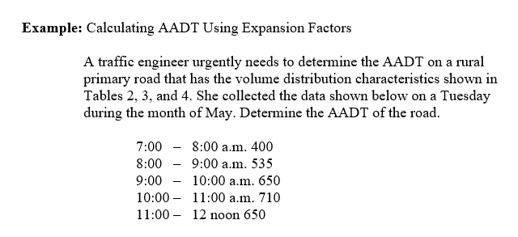
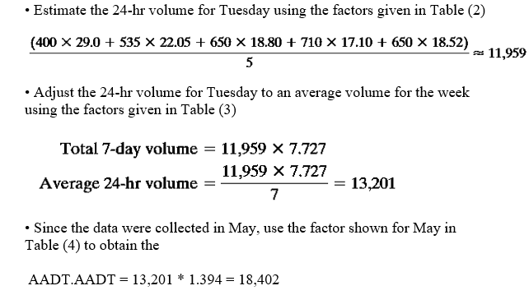
Lecture 9 Traffic Engineering Assistant Lecturer: Areej Muhy
Solution:

Slide 17
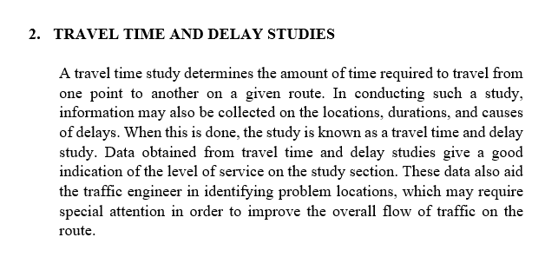
Lecture 9 Traffic Engineering Assistant Lecturer: Areej Muhy

Slide 18
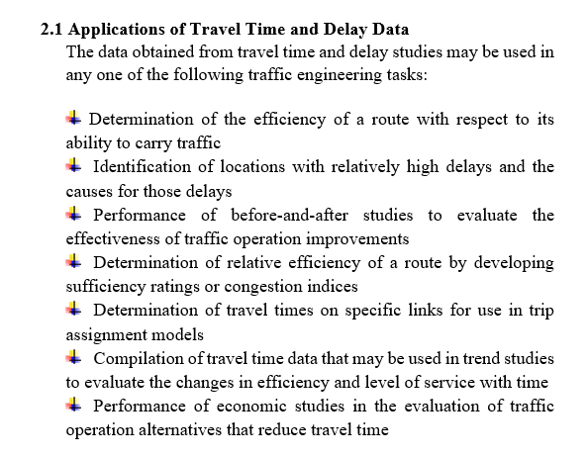
Lecture 9 Traffic Engineering Assistant Lecturer: Areej Muhy

Slide 19
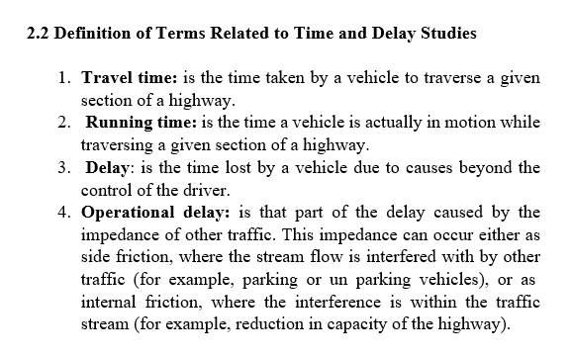
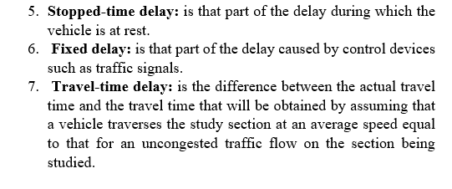
Lecture 9 Traffic Engineering Assistant Lecturer: Areej Muhy

Slide 20
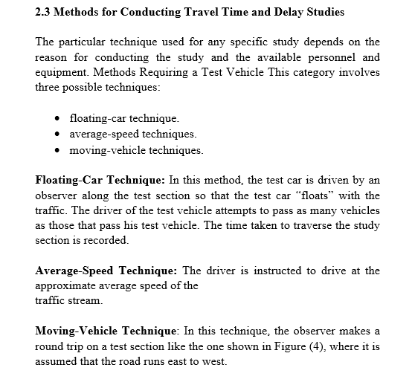
Lecture 9 Traffic Engineering Assistant Lecturer: Areej Muhy

Slide 21
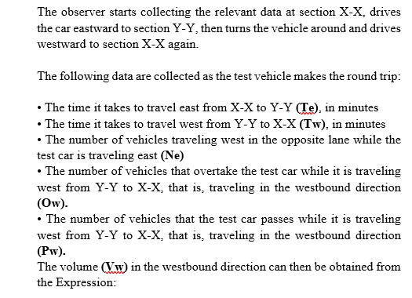
Lecture 9 Traffic Engineering Assistant Lecturer: Areej Muhy
Figure 4. Test Site for Moving-Vehicle Method

Slide 22
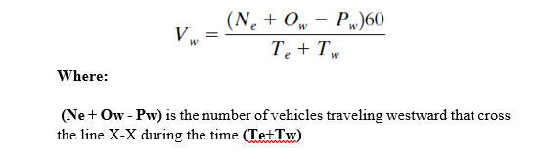
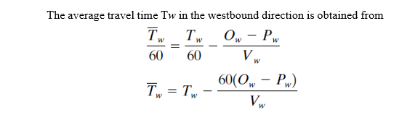
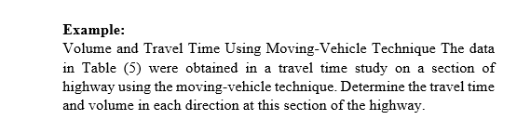
Lecture 9 Traffic Engineering Assistant Lecturer: Areej Muhy

Slide 23
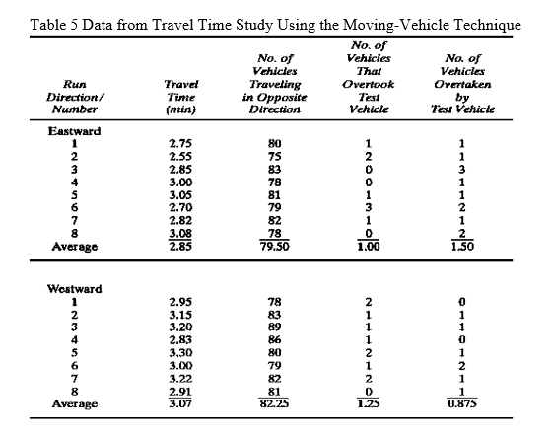
Lecture 9 Traffic Engineering Assistant Lecturer: Areej Muhy

Slide 24
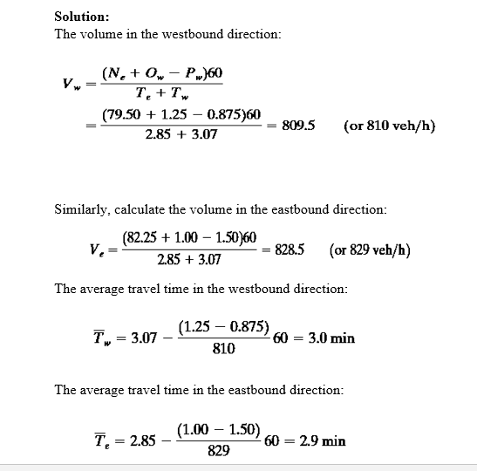
Lecture 9 Traffic Engineering Assistant Lecturer: Areej Muhy

