Slide 1
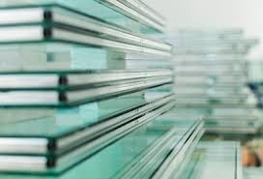
GLASS
LECTURE 6
Glass Forming
By
Asst. Lect. Shireen Hasan

Slide 2
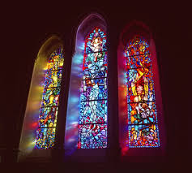
Glass forming
Glass forming is an intermediate stage in glass manufacturing process. It comes in between glass melting and annealing. Manufacturing of almost all commercial glass comprises of different stages.
In forming stage of glass manufacturing, viscosity of molten glass changes gradually with temperature. Glass forming permits molten glass to be shaped into flat sheets and filaments by controlling the viscosity.

Slide 3
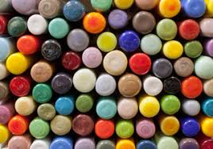
Depending upon the applications, there are different processes of forming the glass. The most common type of glass forming process can be categorized as: Blowing, rolling, stretching and casting. Methods for shaping glass are quite different from those used for traditional and new ceramics.
So the Shaping processes to fabricate the glass products can be grouped into three categories:
A- Discrete processes for piece ware (bottles, jars, plates, light bulbs).
B- Continuous processes for making flat glass (sheet and plate glass) and tubing (laboratory ware fluorescent lights).
C- Fiber-making processes to produce fibers (for insulation and fiber optics).

Slide 4

A- Shaping of Piece Ware
Ancient methods of hand-working glass included glass blowing. Handicraft methods are still used today for making glassware items of high value in small quantities. However, most modern glass shaping processes are highly mechanized technologies for producing discrete pieces such as jars, bottles, and light bulbs in high quantities.
A1- Spinning –similar to centrifugal casting of metals
A2- Pressing –for mass production of flat products such as dishes, bake ware, and TV tube faceplates
A3- Press-and-blow –for production of wide-mouth containers such as jars
A4- Blow-and-blow - for production of smaller-mouth containers such as beverage bottles and incandescent light bulbs
A5- Casting –for large items such as large astronomical lenses that must cool very slowly to avoid cracking

Slide 5

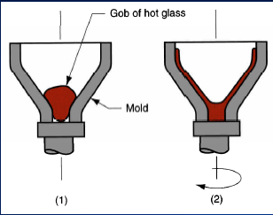
A1- Spinning
Glass parts such as back sections of cathode ray tubes for TVs and computer monitors are manufacturing as following:
(1) Gob of glass dropped into mold; and
(2) Rotation of mold to cause spreading of molten glass on mold Surface.

Slide 6
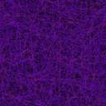
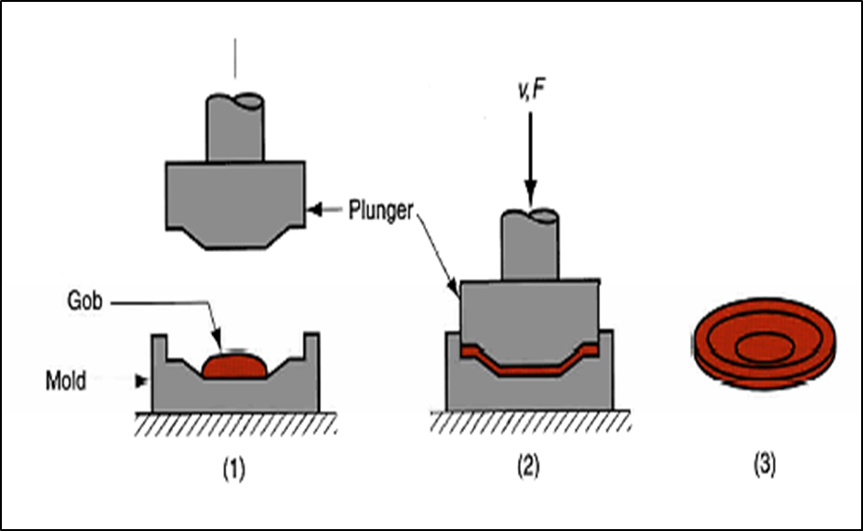
A2- Pressing
(1) Glass gob is fed into mold from furnace;
(2) Pressing into shape by plunger; and
(3) Plunger is retracted and finished product is removed symbols V and F indicate motion (velocity) and applied force.

Slide 7
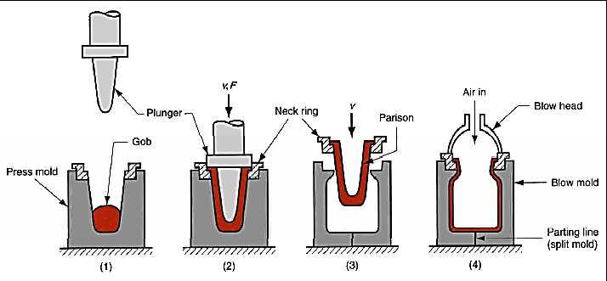
A3- Press-and-blow
(1) Molten gob is fed into mold cavity;
(2) Pressing to form a parison;
(3) The partially formed parison, held in a neck ring, is transferred to the blow mold, and (4) blown into final shape

Slide 8

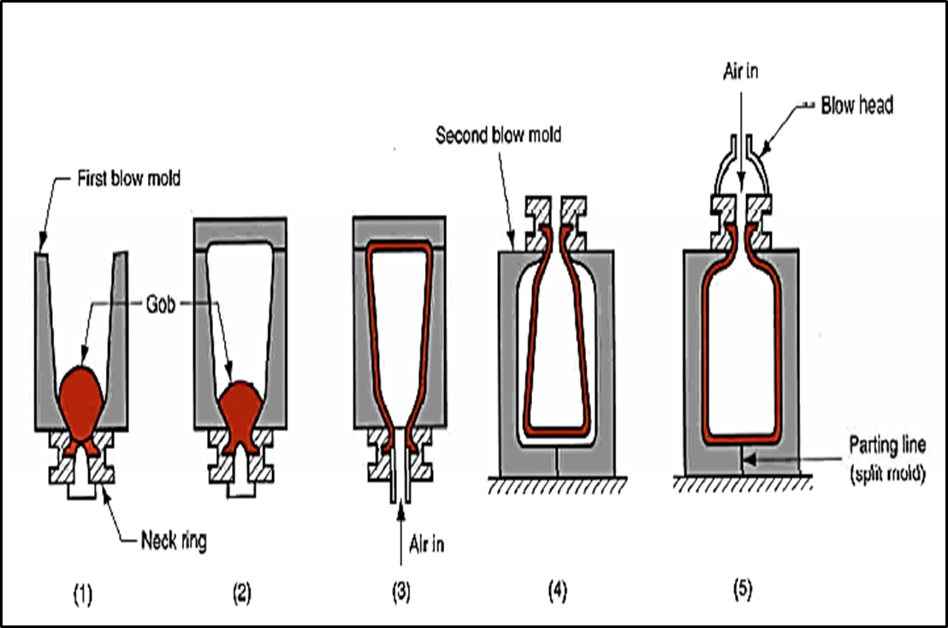
A4- Blow-and-blow
(1) Gob is fed into inverted mold cavity;
(2) Mold is covered;
(3) First blowing step;
(4) Partially formed piece is reoriented and transferred to second blow mold, and (5) Blown to final shape.

Slide 9
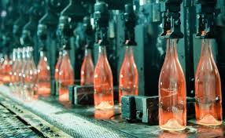
A5- Casting
If molten glass is sufficiently fluid, it can be poured into a mold
•Relatively massive objects, such as astronomical lenses and mirrors, are made by this method
•After cooling and solidifying, the piece must be finished by lapping and polishing
•Casting of glass is not often used except for special jobs
•Smaller lenses are usually made by pressing.

Slide 10
B- Shaping of Flat and Tubular Glass
Processes for producing flat glass such as sheet and plate glass:
B1- Rolling of flat plate
B2- Float process
•Process for producing glass tubes:
B3- Danner process

Slide 11
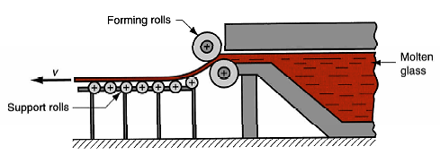
B1- Rolling of Flat Plate
Starting glass from melting furnace is squeezed through opposing rolls whose gap determines sheet thickness followed by grinding and polishing for parallelism and smoothness

Slide 12
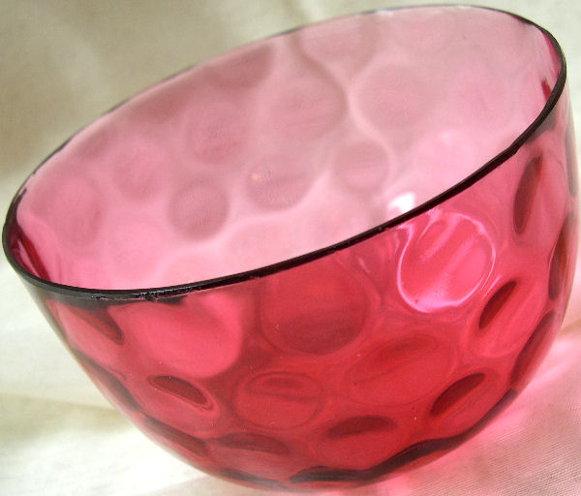
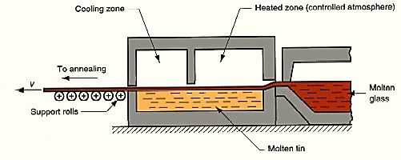
B2- Float Process
Molten glass flows onto the surface of a molten tin bath, where it spreads evenly across the surface, achieving a uniform thickness and smoothness - no grinding or polishing is needed

Slide 13
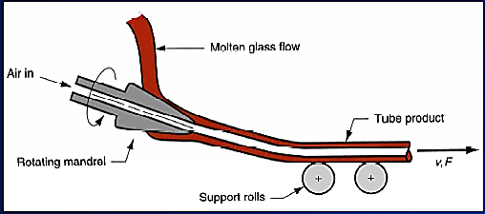
B3- Danner Process
Molten glass flows around a rotating hollow mandrel through which air is blown while the glass is drawn

Slide 14
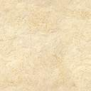
C- Forming of Glass Fibers
Glass fiber products can be divided into two categories, with different production methods for each:
1. Fibrous glass for thermal insulation, acoustical insulation, and air filtration, in which the fibers are in a random, wool-like condition
C1- Produced by centrifugal spraying
2. Long continuous filaments suitable for fiber reinforced plastics, yarns, fabrics, and fiber optics
C2- Produced by drawing

Slide 15
C1- Centrifugal Spraying
• In a typical process for making glass wool, molten glass flows into a rotating bowl with many small orifices around its periphery
•Centrifugal force causes the glass to flow through the holes to become a fibrous mass suitable for thermal and acoustical insulation

Slide 16
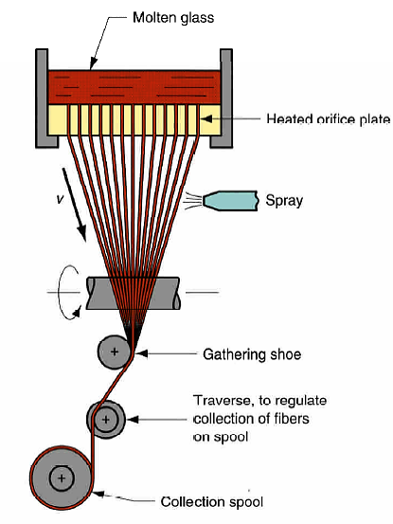
C2- Drawing of Glass
Continuous glass fibers of small diameter (lower limit is about
0.0025 mm) are produced by drawing (pulling) strands of molten glass through small orifices in a heated plate made of a platinum alloy

Slide 17
Thank You

