Slide 1
GLASS
LECTURE 4
Glass melt
By
Asst. Lect. Shireen Hasan

Slide 2
4.2 Glass melt
In Previous lectures, the preparation of the batch has been described, from the selection of the raw materials and their structures to the charging of the batch in the furnace.
The modern glass container factories are three-part operations: the batch house, the hot end, and the cold end. The batch house handles the raw materials; the hot end handles the manufacture proper, annealing ovens, and forming machines; and the cold end handles the product-inspection and packaging equipment.

Slide 3
4.2.1 Furnace types
Different furnace types and designs exist, depending on the quantity of glass to be produced, the type of glass production, plus economic (and logistic) factors.
The main types of furnaces include:
1-Pot furnaces (discontinuous).
2-Day tanks (semi-continuous).
3-Recuperative / unit type melters.
4-Cross-fired regenerative furnaces.
5-End-port fired regenerative furnaces.
6-Oxygen-fired unit melters.
7-Special (segmented) melter.
8-All-electric furnaces.

Slide 4
1- Discontinuous furnace (day tanks and pot furnaces)
The following actions take place (generally in a one-day cycle) within discontinuous melting furnaces:
Melting tank or pot is charged with mixed raw material batch. This batch is heated to the desired temperature. The glass is melted, fined, homogenized and subsequently cooled down to the working temperature to allow forming by the craftsman or semi-automatic machines taking portions (gobs) of glass from the glass melt pot.

Slide 5
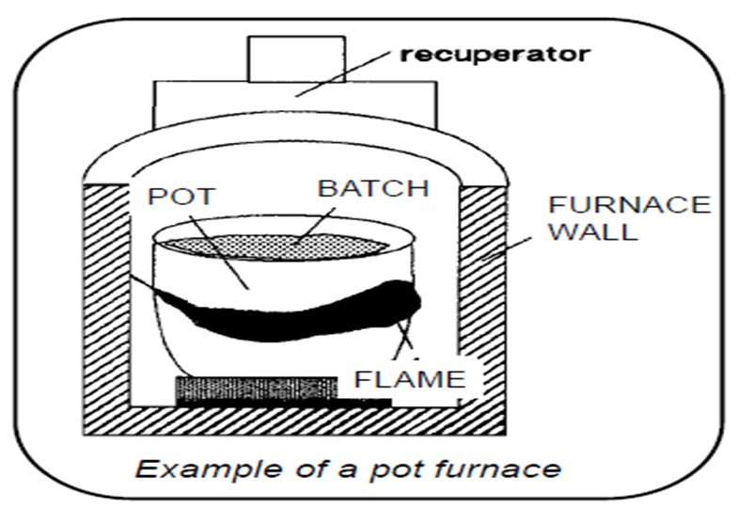

Slide 6
2- Continuous glass furnaces
Usual synonyms for a continuous furnace are glass-melting tank or tank furnace.
These furnaces are applied for
Container glass production
Flat glass (Float & Rolled) production
Most tableware glass production
Fiber & glass wool production
Most specialty glass production (tubes, display glass, glass-ceramics, lighting bulbs, . .).

Slide 7
These furnaces not applied for:
Most hand-made glass
Vitreous silica
Optical glass fibers
Continuous glass furnaces characteristics
Tank of refractory material, continuously charged with mixed batch
All basis process steps in different zones or sections of furnace
These furnace types are suitable for the mass production of glass

Slide 8
4. The furnace melting capacity (glass pull) usually is expressed in the number of (metric) tons of glass melted per day (24 hours). Depending on the furnace and type of glass produced, the pull can vary from ~ 20 tons per day (TPD) up to > 700 TPD
5. Extra mixing by the application of bubbling or electrodes
6. Possibility to boost energy input using electrodes

Slide 9
A melting furnace consists of:
Melting tank (glass melt bath)
Superstructure (combustion chamber)
Throat as connection between the melting end and the riser that brings the molten glass in the refiner, working end or distributor
Neck in case of float glass production, between the melting end and working end
Working chamber (working end, gathering end, nose, refiner)
Heat exchangers: regenerators or recuperators

Slide 10
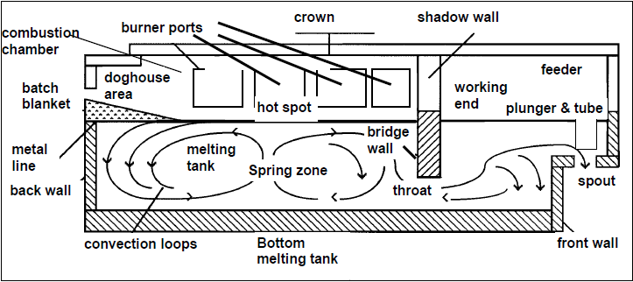

Slide 11
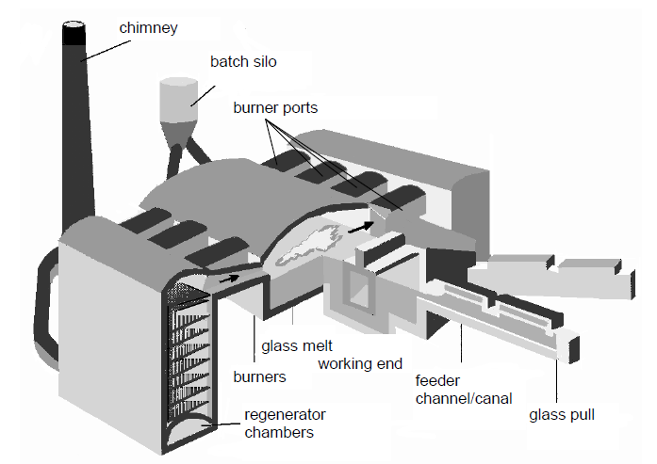

Slide 12
3- Regenerative furnaces
A regenerator consists of a regenerator chamber in which a checkerwork (or just checkers) of refractory bricks has been stacked. In one cycle the checker is heated up by flue gases, subsequently in the following stage (20-30 minutes) the heat is transferred to combustion air. These furnaces are provided with 2 or more (an even number) regenerators.
In principle the optimum half-cycle time depends on the pull of the melting tank (thermal load). During the burner reversal, lasting about 30 - 60 seconds, there are no flames within the furnace. The reversal period (no-firing interval) should be as short as possible to avoid too much cooling down of the furnace.

Slide 13
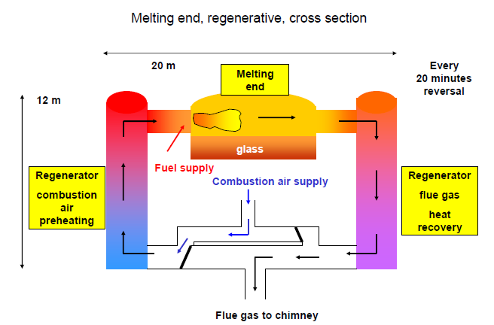

Slide 14
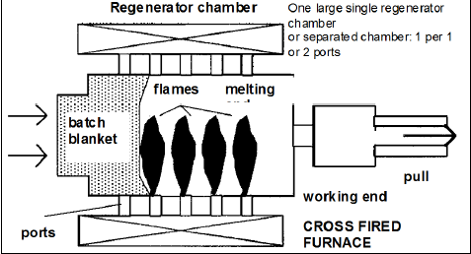
4- Cross-fired regenerative furnaces
The regenerators are placed on the side of the furnace. The furnace can be equipped on both sides with 4 up to 8 burner ports (per side) depending on furnace size.
The profile of heating (fuel distribution among the burners located along the sidewalls) determines location and size of the hot spot area (primary fining zone) in the glass melt.

Slide 15
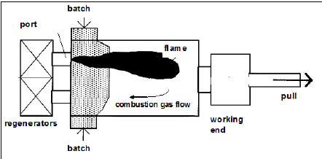
5- End port-fired (or U-flame) regenerative furnaces
Burners (2 to 4 burners at each port) and the regenerator chambers are connected at the back wall side of the superstructure. The combustion of fuel & preheated air from one regenerator chamber takes place: flames starting from the burner nozzles and extending almost over the length of the furnace. Less structural heat losses compared to cross fired regenerative furnaces (combustion gases have longer residence time)

Slide 16
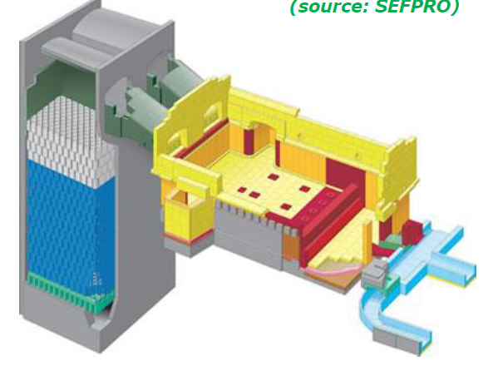

Slide 17
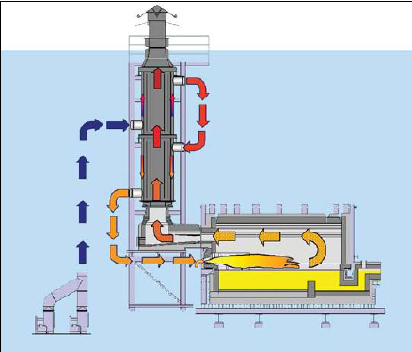
6- Recuperative furnaces
Recuperators are used to pre-heat the combustion air. The hot flue gases are send through the recuperator to heat the combustion air. Jh

Slide 18
Recuperator: heat exchanger in which heat is transferred from the flue gases to the combustion air in co-current or in counter-current flow. Recuperative furnaces are provided with one or two recuperators. Most recuperators are made from high temperature resistant steels, like chrome nickel steel (or chromium-nickel-aluminum steels).
Because heat transmission in this type of recuperators is based mainly on radiation, these heat exchangers are called radiation recuperators.

Slide 19
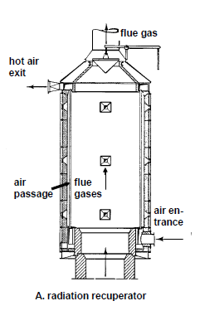

Slide 20
Recuperative furnaces characters
A-Investment costs are relatively low
B- No cycle (firing reversal) system, therefore continuous process conditions
C- Controllable temperature profile along the length, due to the large number of burners which might be controlled independently (5-15 burners per side)
D- The furnace is easily accessible (also for an end-port fired regenerative furnace the side-walls can easily provided with peepholes)
E- The combustion chamber has a relatively simple construction and it can be sealed reasonably well (no large burner port), But: preheating of the combustion air is less efficient than for regenerative furnaces

Slide 21
7- Oxygen-fuel fired furnaces (Oxy-fuel
The fuel is fired without nitrogen in the applied oxidant (pure oxygen) (lower volumes of flue gases, less diluted). In general, oxy-fuel glass furnaces have the same basic design as recuperative glass melters, with multiple lateral burners and a limited number of exhaust port(s).
Advantages:
cheaper furnace designs
lower specific NOx emissions (in kg NOx/ton molten glass);
smaller flue gas volumes
smaller footprints for furnace system
reduction in fuel consumption

Slide 22
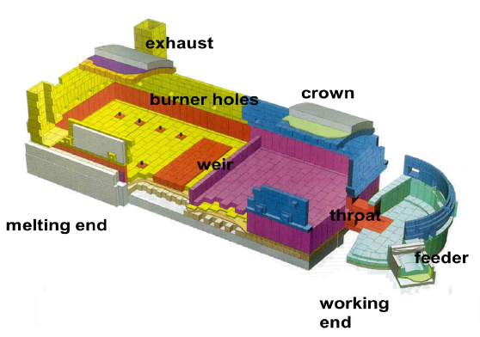
Drawbacks
oxygen costs may exceed the reduction in fuel costs
oxygen-firing require higher refractory quality superstructures

Slide 23
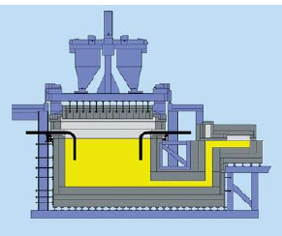
8- All-electric melting
The heating is not provided by combustion systems, but by electric energy provided by electrodes plunging in the melt. Below is an example of an all-electric furnace with top electrodes (Sorg)

Slide 24
Thank You

