Slide 1
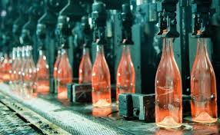
GLASS
LECTURE 3
Glass Processing
By
Asst. Lect. Shireen Hasan

Slide 2
Glass Processing
The main procedure of glass production is melting of the batch components at elevated temperature. It always involves the selection of raw materials, calculation of the relative proportions of each component to use in the batch and weighing and mixing the raw materials to provide homogeneous starting material. This section will first deal with the raw materials, batch calculation, and then batch melting.

Slide 3
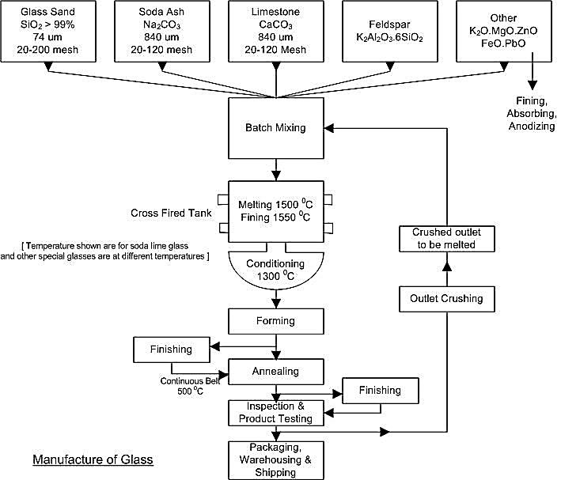

Slide 4
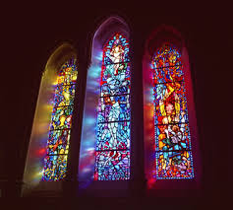
4.1.1 Preparation of Raw materials
The raw materials can be divided in different ways. Whether the starting materials of any glass batch components are with high purity or not, they are divided into five categories on the basic of their role in the batch and the process as well:
-A- Glass formers
-B- Fluxes
-C- Property modifiers
-D- Colorants
- E- Fining agents

Slide 5
-A- The most essential components are that serve as glass structure sources .they are called network formers , glass- forming oxides besides the glass formers. The glasses are named after the glass formers. if most of the glass formers present in specific sample is silicate ,for example ,that glass is called a silicate .

Slide 6
if a significant amount of boric oxide is also present in addition to silicate ,the sample is termed a borosilicate glass .the primary glass formers in commercial oxide glasses are silica ( SiO₂ ) ,boric oxide (B₂O₃) and phosphor oxide (P₂O₅ ) that all readily form single component glasses. A large number of other compounds may act as glass formers under certain circumstances, including GeO_{2,} B₂O₃, As₂O₃ , Sb₂O_{3 ,} TeO_{2 ,} A1₂O_{3 ,}Ge₂O_{3 ,}and V₂O₅ . Although halide glasses can be made in many systems, with many different compounds acting as glass formers, the two most common halide glass formers are BeF_{2 ,}andZrF_{4 .}

Slide 7
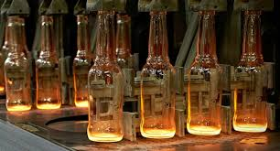
Table 1 Division of the oxides into glass former, intermediates, and modifiers
Glass formers | Intermediates | Modifiers
B₂O₃ SiO₂ GeO₂ P₂O₅ V₂O₃ | TiO₂ ZnO PbO₂ Al₂O₃ BeO | Y₂O₃ MgO CaO PbO Na₂O

Slide 8
B- Fluxes
- Fluxes are used mainly to reduce the processing temperatures to within practical limits .silica forms an excellent glass with a wide range of applications. The use of pure silica glass for bottles, windows, and other bulk commercial applications would be expensive, due to the high melting temperature (> 2000 ᵒC) required to produce vitreous silica.
. Therefore sodium oxide Na₂O is added to the silica to reduce the melting temperature to around 1600 ᵒC. heavy metals

Slide 9
The most common fluxes are the alkali oxides, especially Na₂O ( soda) and PbO. Potassium oxide is also used extensively in commercial glasses, while lithium oxide is used in a number of commercial glass-ceramics
PbO which is an excellent flux, is becoming much more limited in use due to concerns regarding toxicity of heavy metals
PbO is especially useful in dissolving any refractory or other impurity particles which might otherwise result in flaws in the final glass .Addition of large amounts of alkali oxides results in serious degradation in many properties. This degradation in properties can be encountered by adding of property modifiers.

Slide 10

Li2O (Lithia) Lithia is a very effective flux, especially when used in conjunction with potash and soda feldspars. It is a valuable constituent in certain glasses having low thermal expansion because it permits the total alkali content to be kept at a minimum. Glasses containing lithia are much more fluid in the molten state than those containing proportionate amount of sodium or potassium. Therefore, much smaller amounts are required to produce a glass of the necessary viscosity for working without sacrificing the desired physical and chemical properties

Slide 11
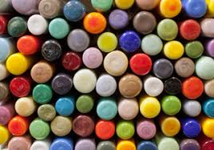
(ZnO) Zinc oxide reduces the coefficient of thermal expansion, thus making possible the production of glass products of high resistance to thermal shock. It imparts high stability against deformation under stress (i.e. higher elasticity). As a replacement flux for the more soluble alkali constituents, Specific heat is decreased and conductivity increased by the substitution of zinc oxide for BaO and PbO.

Slide 12
-C- Property modifiers include the alkaline earth and transition metal oxides and most importantly, aluminum oxide (alumina).While these oxides partially counter the reduction in processing temperature obtained by addition of fluxes, in addition they improve many of the properties of the resulting glasses. The properties are thus modified, or adjusted by careful control of the amount and concentration of these oxides to obtain precisely the desired results.

Slide 13
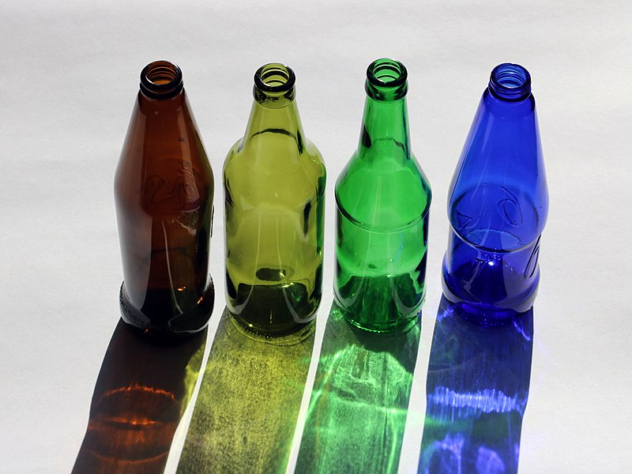
-D- Colorants are used to control the color of the final glass .colorants are only used if control of the color of the glass is desired and are usually present in small quantities . when colorants are used to counteract the effect of other colorants to produce a slightly gray glass, they are referred to as decolorants .

Slide 14
-E- Fining agents are added to glass forming batches to promote the removal of bubbles from the melt. Fining agents include the arsenic and antimony oxides, potassium and sodium nitrates, NaCl , fluorides such as CaF_{2 ,} NaF ,and Na₃AlF₆ , and a number of sulfates. These materials are usually present in very small quantities (< 1 wt%). Their presence is essential in many commercial glasses, which would be expensive to produce without the aid of fining agents in reducing the content of unwanted bubbles in the final product.

Slide 15
4-1-2 Batch calculation
No single system exists for designating the composition of inorganic glasses. Compositions may be expressed in terms of mole, weight, or atomic fraction or percentages. Oxide glass compositions were expressed in terms of weight percentages ( wt %) of the oxide components , in what is known as oxide formulations. In either case oxide formulations suggest that the components of the glass somehow exist as distinct, separate oxides in the melt or glass ,which is certainly not the case .

Slide 16
4.1.3 Mixing of Raw Materials
Raw materials for making glass are mixed in batches, usually under computer control. Mixed materials are then usually stored in silos for distribution at the proper speed into the automated glassmaking processes. The primary hazards associated with the mixing process are loss of computer control and breakdown of mixing equipment.

Slide 17
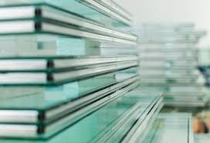
Thank You

