Slide 1
GLASS
LECTURE 2
Structure of Glass
By
Asst. Lect. Shireen Hasan

Slide 2
3-Structure of glass
Structure is knowledge of atom positions
Glass forming oxides: most inorganic glasses are based on the glass forming oxide. Silica is most widely used as glass forming constituent.
The fundamental subunit in silica based glasses is SiO₄ tetrahedron in which a silica si⁴ atom ion in the tetrahedron is covalently ironically >.bonded to four oxygen atoms ions as shown in fig. below.
In crystalline silica cristobalite the si-o tetrahedra are joined corner to corner in a regular arrangement, producing long – range order as idealized in fig ( 2.b) .
In a simple silica glass the tetrahedra are joined corner to corner to from a loose network with no long –range order fig (2.c ) .

Slide 3
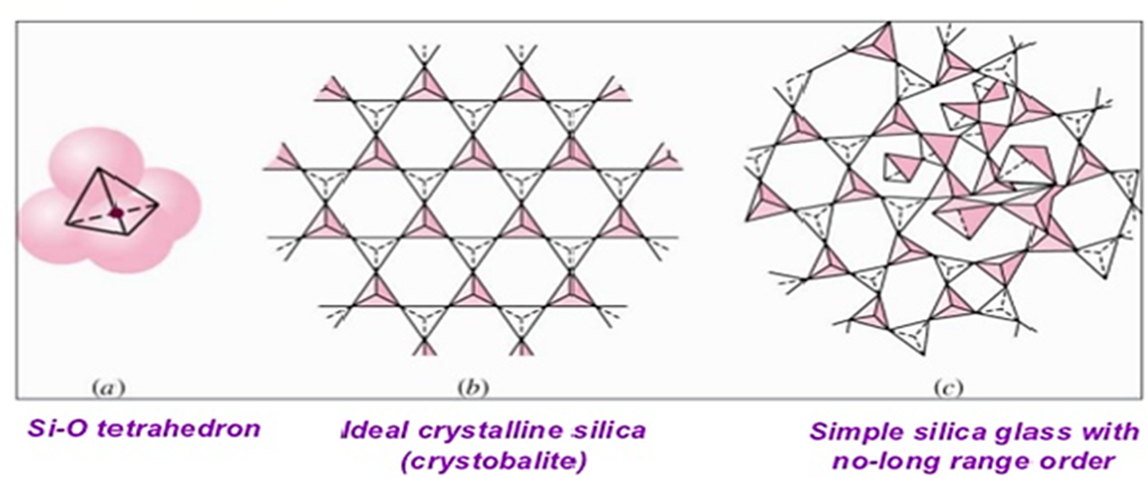

Slide 4
The oxide components added in to a glass batch may be sub-divided as:
Glass formers.
B. Intermediated.
C. Modifiers.
Table 1 Division of the oxides into glass former, intermediates, and modifiers
Glass formers | Intermediates | Modifiers
B₂O₃ SiO₂ GeO₂ P₂O₅ V₂O₃ | TiO₂ ZnO PbO₂ Al₂O₃ BeO | Y₂O₃ MgO CaO PbO Na₂O

Slide 5
A- Glass formers
Glass formers and network formers include oxides such as SiO_{2 ,}B₂O_{3 ,} GeO₂ , P₃O_{5 ,} V₂O₅ and AS₂O₃ which are indispensable in the formation of glass since they form the basis the random three dimensional network of glass.
Boron oxide, B₂O_{3 ,}is a glass- forming oxide and by itself from subunit that are flat triangle with boron atom slightly out of the plane of the oxygen atoms
Boron oxide is an important addition to many types of commercial glass such as borosilicate and aluminoborosilicate glasses.

Slide 6
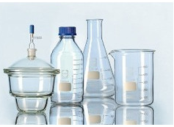
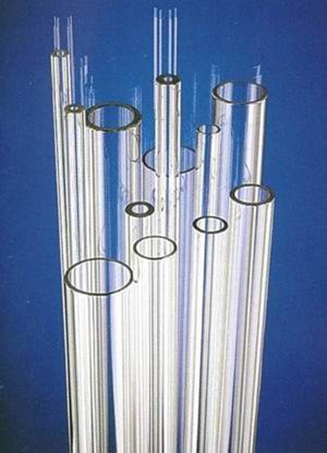
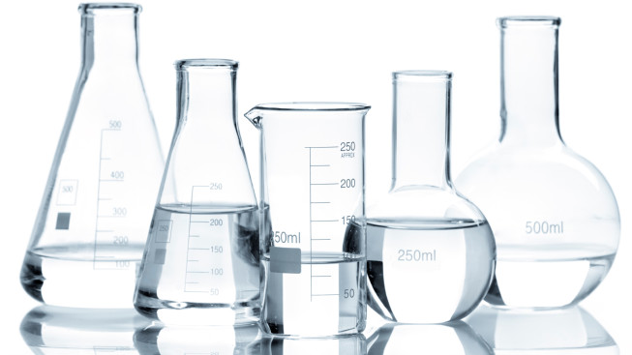

Slide 7
B- Intermediate oxide in glasses
Intermediates include AL₂O₃ ,Sb₃O_{2 ,}ZrO_{2 ,}TiO_{3 ,}PbO, and ZnO , these oxides are added in high proportion for linking up with the basic glass network to retain structural continuity .
Some oxides cannot from a glass network by themselves but can join into an existing network. These oxides are known as intermediate oxides.
For example, aluminum oxides, silica network as AlO₄tetrahedra replacing some of the SiO₄ gropes (fig .3b) . However since the valence of Al is 3 instead of the necessary 4 for the tetrahedral , alkali cantions must supply the necessary other electrons to produce electrical neutrality .
Intermediate oxides are added to silica glass to obtain special properties. For example Alaminosicate glasses can withstand higher temperature than common glasses.

Slide 8
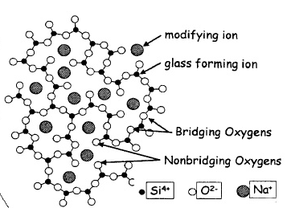
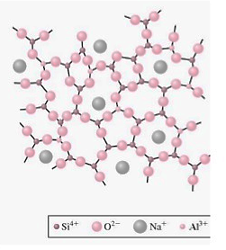
Depending on the composition of the glass, intermediate oxides may sometimes act as network modifiers as well as taking part in the network of the glass .
figure 3: (a) network modified glass (soda-limeglass); note that the metallic (Na+)ions do not form part of the network (b)intermediate oxides glass(alumina-silica) glass ; note that the small metallic (Al⁺³) ions form part of the network

Slide 9
C- Glass – modifying oxides:
Modifiers include MGO ,Li₂O ,BaO , CaO ,SrO , Na₂O , and K₂O . the oxides are added to modify the properties of glass oxides that break up the glass network are know as network modifiers.
Alkali oxides such as Na₂O and K₂O and alkaline earth oxides such as CaO and MgO are added to silica glass to lower its viscosity so that it can be worked and formed more easily.
The oxygen atoms from these oxide enter the silica network at points joining the tetrahadra and break up the network, producing oxygen atoms with an unshared electron ( fig .4a) .
The Na and K ions from the Na₂O and K₂O do not enter the network but remain as metal ions ionically bonded in the interstices of the network.by filling some of the interstices, these ions promote crystallization of the glass .

Slide 10
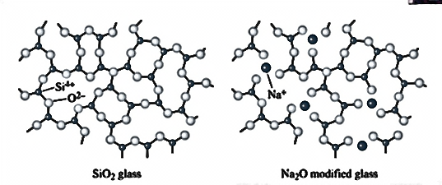
Modifiers break up the silica network if the oxygen to silica ratio (O:Si) increases significantly when Na₂O is added , the sodium ions enter holes within the network , rather then becoming part of the network ,however , the oxygen ion that enters with Na₂O does become part of the network as shown in fig (fig 4 ).
Figure 4: the effect of Na₂O on the silica glass network. Sodium oxide is a modifier disrupting the glassy network and reducing the ability to form a glass.

Slide 11
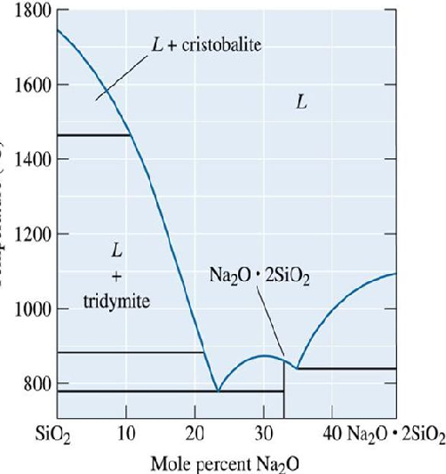
The other addition in glass are the fluxes which lower the fusion temperature of the glass batch and render the molten glass workable at reasonable temperature , modification lower the melting point and viscosity of silica, making it possible to produce glass at lower temperature .
The effect of Na₂O .addition to silica is shown in ( fig5 ) the addition of Na₂O produces eutectics with very low melting temperature .

Slide 12
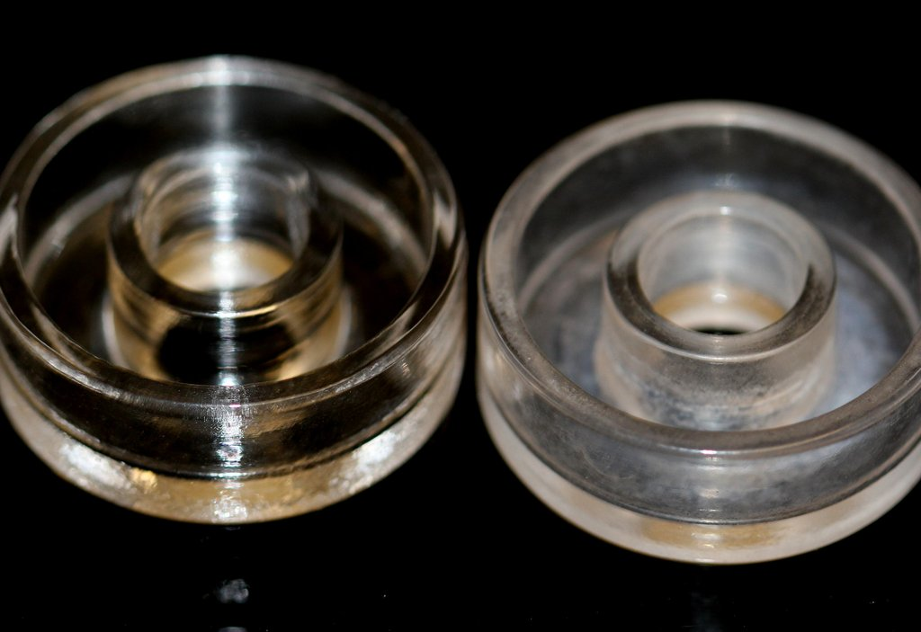
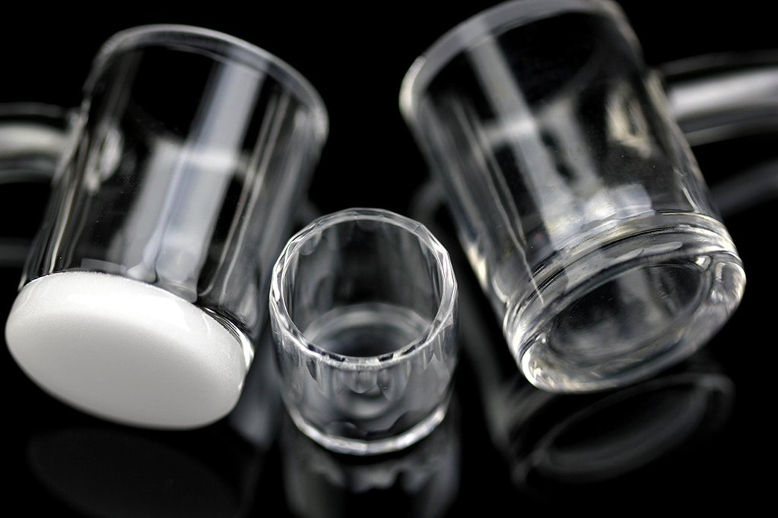
Modifiers fluxes may reduce the resistance of glass to chemical attack, render it water soluble or make it subject to partial or complete devitrification. Devitrified glass is undesirable since the crystalline areas are externally weak and brittle, stabilizers are therefor, added to the glass batch overcome these problems.
Adding CaO which reduces the solubility of the glass in water further modifies these glasses.

Slide 13
Structure of some glasses
Silicate glasses
Vitreous silica is the disordered structure of the ordered silica. The building blocks of vitreous silica are tetraherdra of SiO_{4,} which link together by oxygen ions at the tetraherda corners. These oxygens are called bridging oxygens.

Slide 14
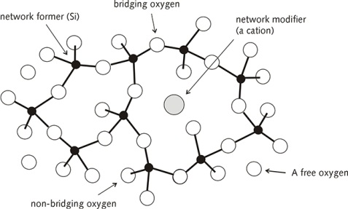

Slide 15
Bonding angels in this structure are distributing over a wide range. Structure analysis indicates that the shortest Si-O distance in this structure is ≈ 0.162 nm and that the shortest O-O distance is ≈ 0.265 nm. While the bond of two silicon atoms is 0.312 nm. These distributions of atom-atom distances can be explained by assuming a distribution in the Si-O-Si bond angles. The maximum in this distribution occurs at ≈ 144ͦ, with a range in angles from 120 ͦ to 180 ͦ.

Slide 16
Introduction of alkali oxides like Na₂O , K₂O etc. leads to lowering the melting temperatures by forming non bridging oxygen .each non bridging oxygen must be associated with a nearby alkali ion to maintain local charge neutrality see in fig(3). These alkali ions occupy the interstices in the network, reducing the unoccupied free-volume of the structure.
Ternary glasses containing alkaline earth oxides in combination with silica and alkali oxides, which are commonly called soda -lime-silica glasses, usually contain 10-20%mol alkali oxide, primarily in the form of Na₂O or soda, 5-15% mol CaO or lime, and 70-75% mol silica .the replacement of the more mobile alkali ions by the less mobile divalent alkaline earth ions reduces the net mobility of modifier ions through the structure, improving the chemical durability and reducing the ionic contributing to the electrical conductivity of the glass.

Slide 17
Aluminosilicate glasses
Aluminum and gallium ions routinely occur in both tetrahedral and octahedral coordination in crystalline materials. Since these ions assumed to have the same coordination in glass structure, the following explanation is applicable for both the glasses that contain aluminum and gallium ions.
It is generally assumed that most of the aluminumin these glasses will occur in aluminum - oxygen tetrahedral, so long as the total concentration of alkali and /or alkaline earth oxides equals or exceed that of aluminum i.e [Al₂O₃/M₂O]≤ 1. These tetrahedra substitute directly into the network for silicon-oxygentetrahedra.it follows that alumina, which does not readily form a glass by it self, can; however, easily replace silica in the vitreous network. Oxides which act in this manner are said to be intermediate in behavior between glass formers and modifier oxides.
. If the [Al₂O₃/M₂O] ratio>1, aluminum enters the glass network as modifier.

Slide 18
boric glasses
Triangles of boron ions and oxygen ions form the building units of the boric glass vitreous structure. All such triangles are connected by BO at all three corners to form a completely linked network. Basic building block of this network is planar 2D rather than 3D, the 3D linkage, which occurs in a network of tetrahedra, does not exist for vitreous boric oxide.
A 3Dstructure is developed by "crumpling" of the network, in much the same way that two dimensional drawing on sheet of paper develops a third dimension when the paper is crumpled into ball.

Slide 19
Since the primary bonds exist only within the plane of the paper, bonds in third dimension (van der waals bonds) are very weak and the structure is easily disrupted.one result of this structure, for example, can be found in the glass transformation temperature (T_{g}) of vitreous boric oxide, which is only ≈ 260 ͦ C, as opposed to the T_{g} of vitreous silica , which is ≈ 1100 ͦ C.

Slide 20
Addition of alkali oxides to vitreous silica result in the formation of NBO. Examination of property trends for alkali silicate versus alkali borate glasses suggests that this is not the cases for alkali borate glasses.
Small addition to silica causes a decrease in T_{g} while similar additions to boric oxide cause an increase in T_{g}. conversely, small additions alkali oxides to silica cause an increase in the thermal expansion coefficient, while similar additions to boron oxide cause a decrease in the thermal expansion coefficient. The reason is that the boron coordination in existence of alkalis will be changed from [BO₃] to [BO₄].

Slide 21
Thank You

