Slide 1
GLASS
LECTURE 1
Introduction on Glass
By
Asst. Lect. Shireen Hasan

Slide 2
Define of Glass
A glass is a ceramics material in that it is made from inorganic material at high temperatures. According to the American Society for Testing and Materials (ASTM), glass can be defined as "an inorganic product of fusion which has been cooled to a rigid condition without crystallization".

Slide 3
Another Define of glass
Glass is an amorphous, hard, brittle, transparent or translucent, super-cooled liquid, obtained by fusing a mixture of a number of metallic silicates, most commonly Na, K, Ca and Pb”. It possesses no sharp melting point, crystalling structure and definite formula.

Slide 4
General properties of glass
A glass has special properties not found in other engineering materials. These properties are:
1- Transparency and hardness at room temperature.
2- Sufficient strength and excellent corrosion resistance to most normal environments.
3- Glass is essential for various types of electrical industry because of its insulated properties and ability to provide a vacuum tight enclose.
In the electronics industry electron tubes also require the vacuum tight enclose provided by glass along with its insulated properties for lead in connectors.

Slide 5
4- The high chemical resistance of glass makes it useful for laboratory apparatus and for corrosion resistance liners for pipes and reaction vessel in the chemical industry.
5- Amorphous (non-crystalline) materials like glass lack any long-range translational periodicity and possess a high degree of short-range order (“super cooled liquid”). Therefore, the melting point is not fixed, with softening occurring in wider temperature ranges. The glass melting point is between 500°C and 1650°C, depending on its structure.
6- Glass can be shaped with different techniques like blowing, rolling, stretching and casting.

Slide 6
Glass transition temperature (T_{g})
Glassy or non-crystalline materials do not solidify in the same sense as do those that are crystalline. Upon cooling a glass become more and more viscos in a continuous manner with decreasing temperature there is no definite temperature at which the liquid transforms to a solid as with crystalline materials. One of the distinctions between crystalline and non-crystalline materials lies the in the dependence of specific volume (or volume per unit mass, the reciprocal of density) on temperature. As illustrated in figure 1.

Slide 7
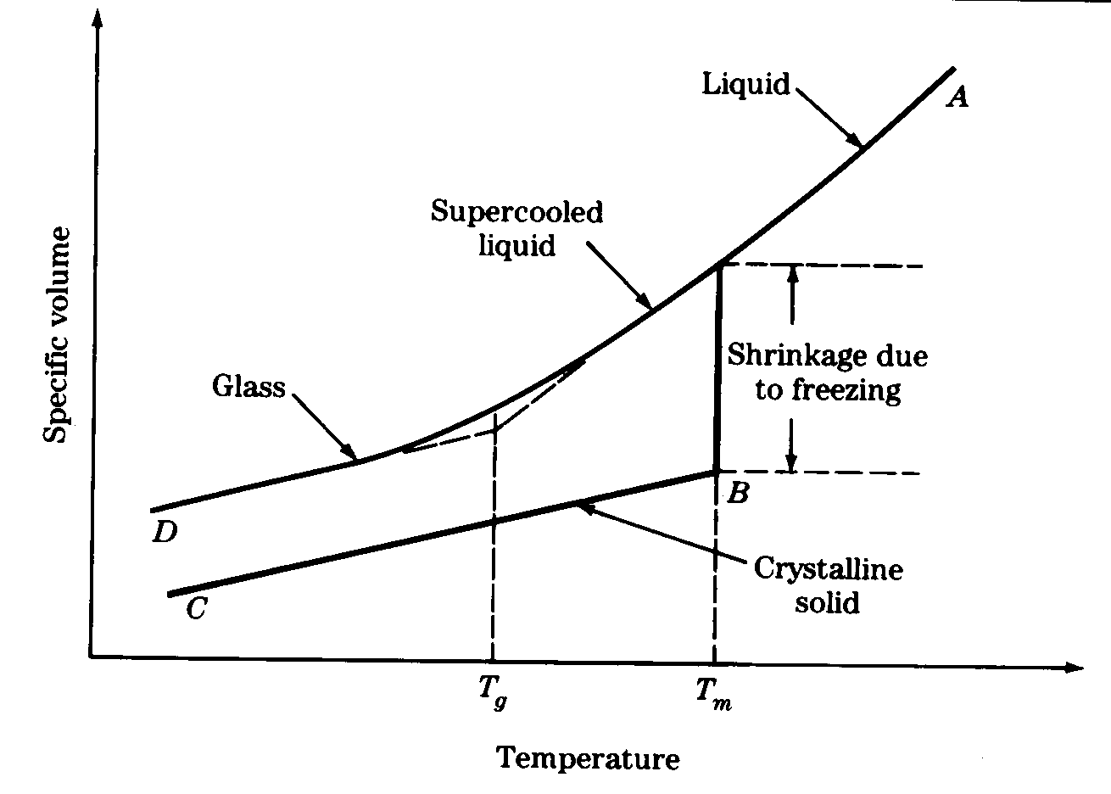

Slide 8
Raw Materials of Glass
Usually raw materials for glass production come in shape of salts/have salt structures .They can divide in two large groups:
- Base materials (glass makers, melts, stabilizers) and
- Auxiliary materials (fining agents, dyes, discoloration agents, opal glass and melting accelerators).
The basic materials for glass production are:
Quartz sand (silicon oxide(SiO2)),
Soda (sodium carbonate (Na2CO3)),
Limestone (calcium carbonate(CaCO3)),
Potash (potassium carbonate(K2CO3)),

Slide 9
Dolomite (calcium magnesium carbonate (MgCa(CO3)2)),
Crushed glass forms 25-30% of the whole mixture and has to be of the right size; the crushed glass pieces must not be too large and also not too small, since the latter make the clarification process more difficult
Auxiliary materials are added to basic materials:
Materials for glass discoloring and clarification of glass mixture (manganese dioxide), Materials for coloring are metal oxides,
Materials for opaque glass texture (titanium and zirconium oxide).

Slide 11
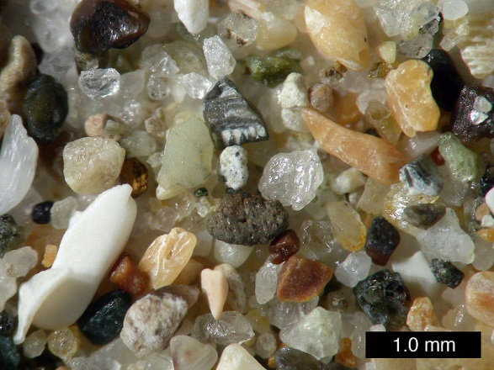
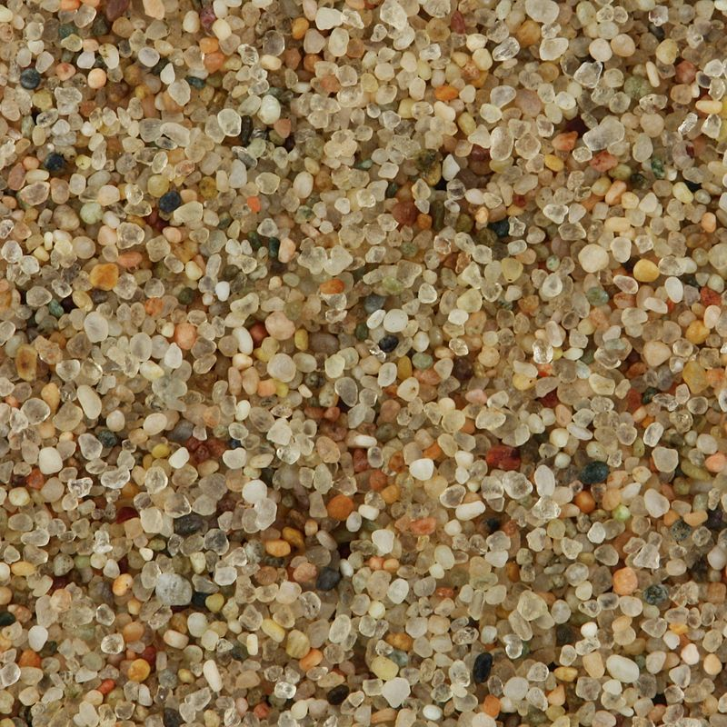
Quartz sand

Slide 12
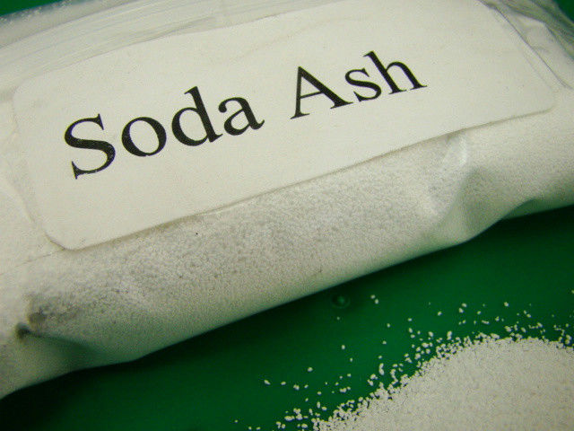
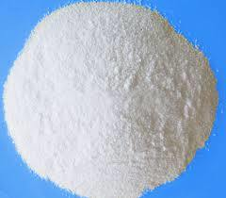
Soda

Slide 13
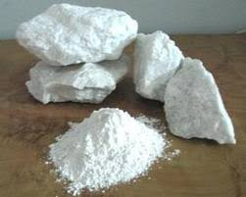
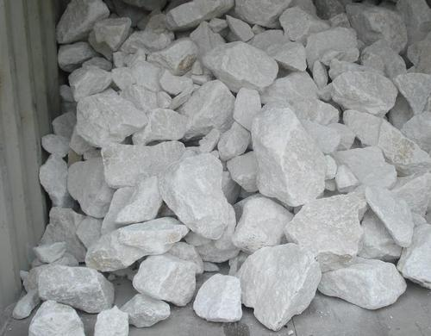
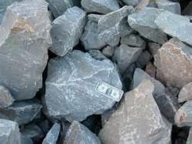
Limestone

Slide 14
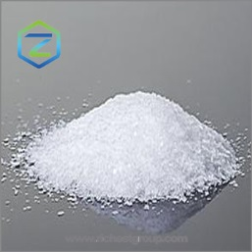
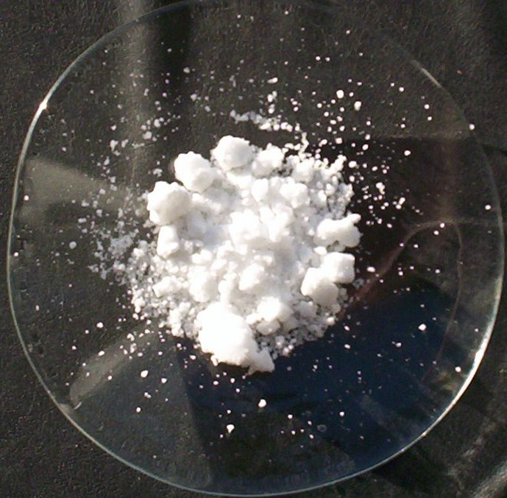
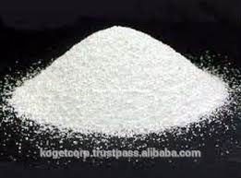
Potash

Slide 15
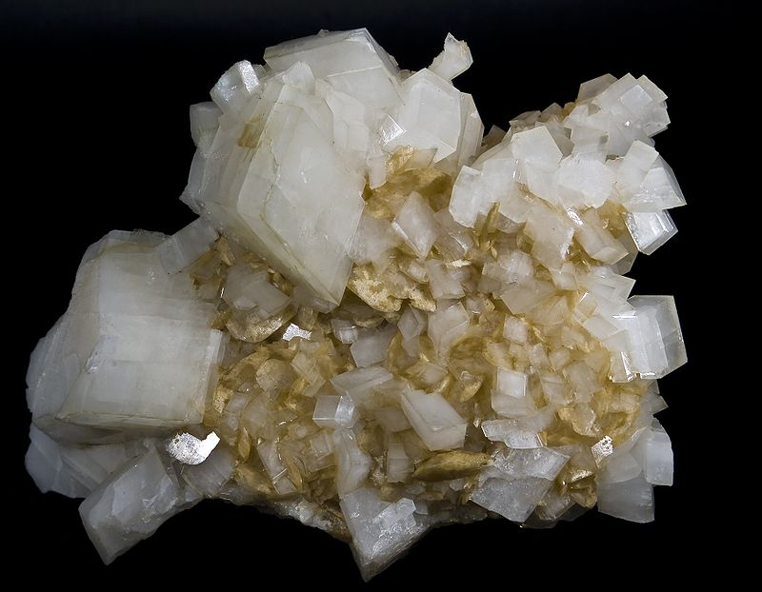
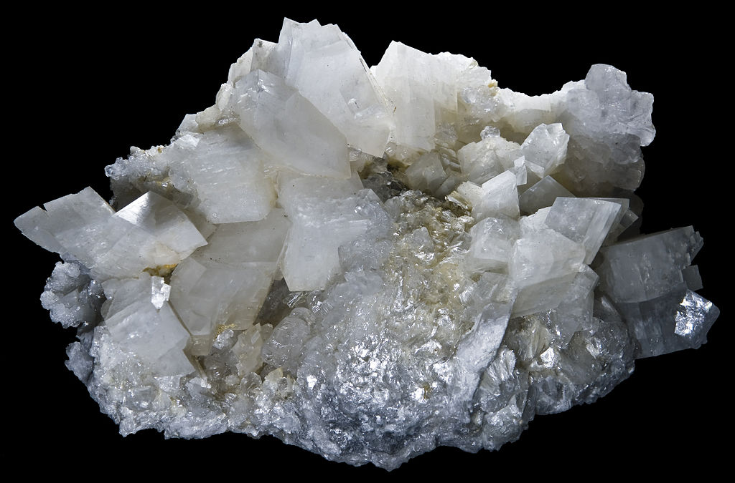
Dolomite

Slide 16
To be considered as an ingredient for a specific technological process, material needs to meet the following conditions:
- It has to contain a high percentage of compounds, which serve as part of a new matter being produced,
- It has to have a constant chemical composition,
- It has to contain the lowest possible amount of impurities, which could harm the quality of the product or make the production procedure more difficult,
- The supplies need to be large enough to allow an undisturbed production for a long period of time,
- The price must ensure profitable production.
- Materials for glass must be of suitable grain size of 0,1 – 0,3 mm.

Slide 17
Thank You

