Slide 1
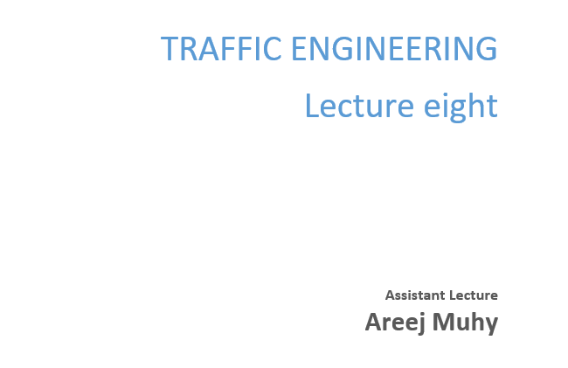

Slide 2
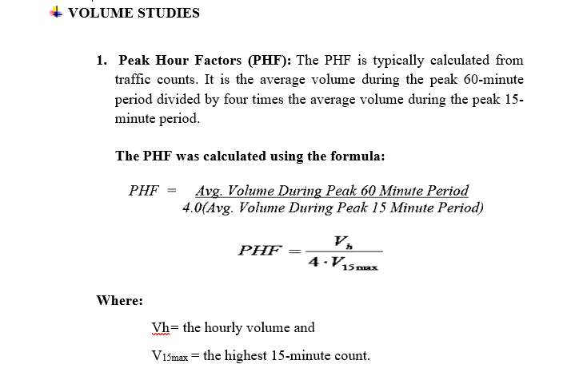
Lecture 8 Traffic Engineering Assistant Lecturer: Areej Muhy

Slide 3
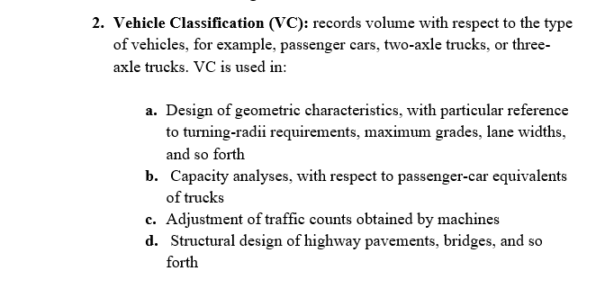
Lecture 8 Traffic Engineering Assistant Lecturer: Areej Muhy

Slide 4
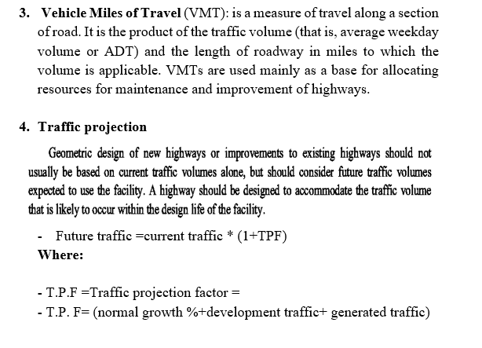
Lecture 8 Traffic Engineering Assistant Lecturer: Areej Muhy

Slide 5
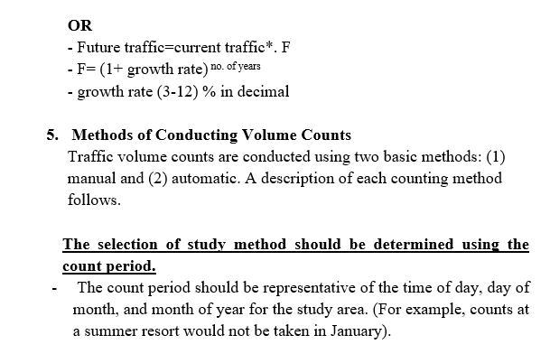
Lecture 8 Traffic Engineering Assistant Lecturer: Areej Muhy

Slide 6
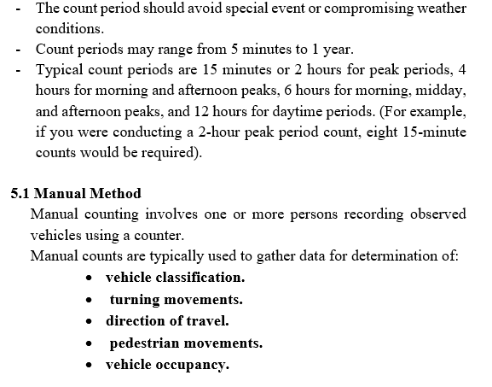
Lecture 8 Traffic Engineering Assistant Lecturer: Areej Muhy

Slide 7
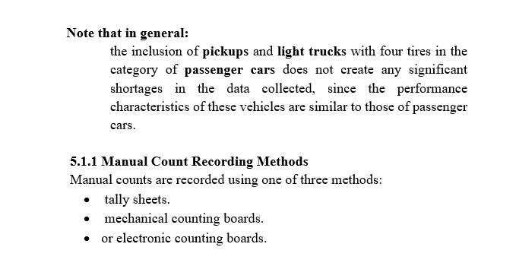
Lecture 8 Traffic Engineering Assistant Lecturer: Areej Muhy

Slide 8
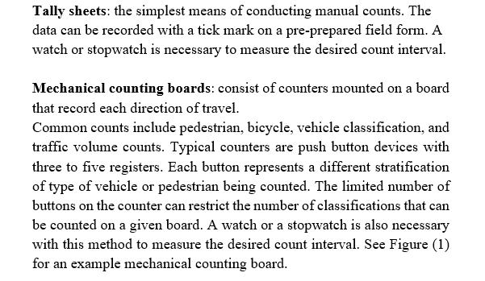
Lecture 8 Traffic Engineering Assistant Lecturer: Areej Muhy

Slide 9
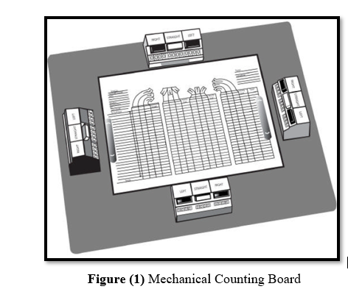
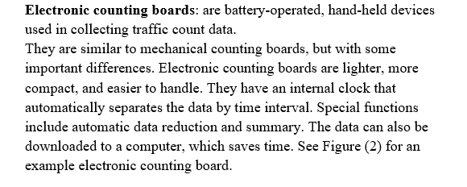
Lecture 8 Traffic Engineering Assistant Lecturer: Areej Muhy

Slide 10
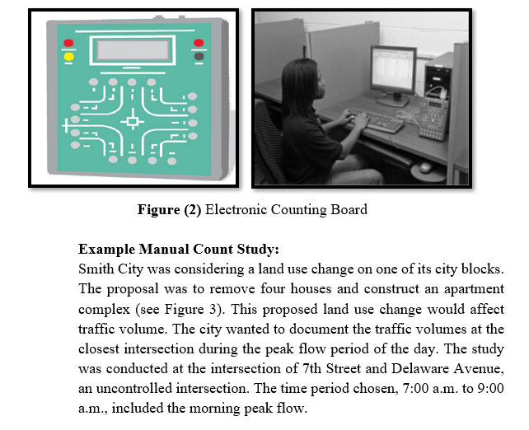
Lecture 8 Traffic Engineering Assistant Lecturer: Areej Muhy

Slide 11
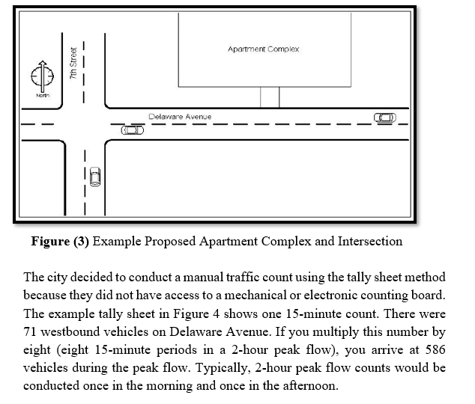
Lecture 8 Traffic Engineering Assistant Lecturer: Areej Muhy

Slide 12
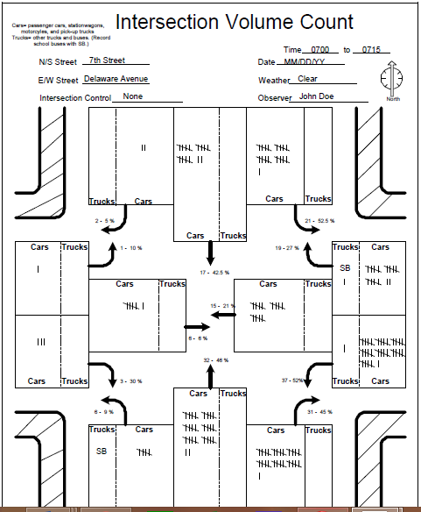
Lecture 8 Traffic Engineering Assistant Lecturer: Areej Muhy
Figure (4) Example Manual Intersection Volume Count Tally Sheet

Slide 13
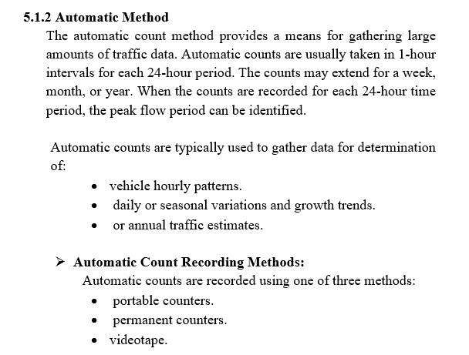
Lecture 8 Traffic Engineering Assistant Lecturer: Areej Muhy

Slide 14
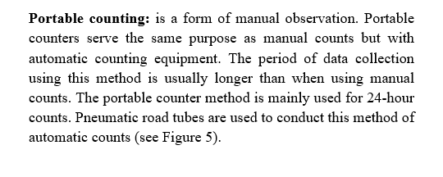
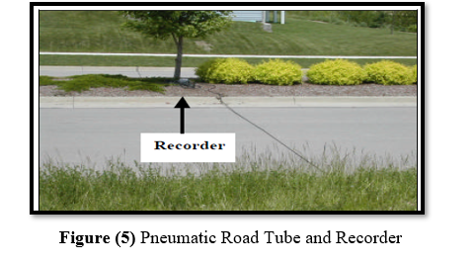
Lecture 8 Traffic Engineering Assistant Lecturer: Areej Muhy

Slide 15
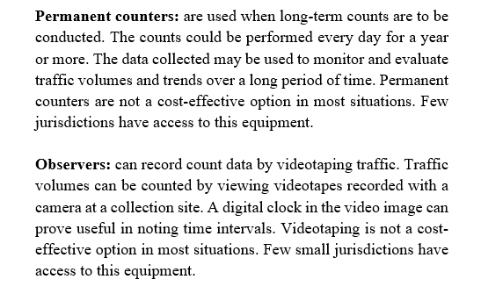
Lecture 8 Traffic Engineering Assistant Lecturer: Areej Muhy

Slide 16
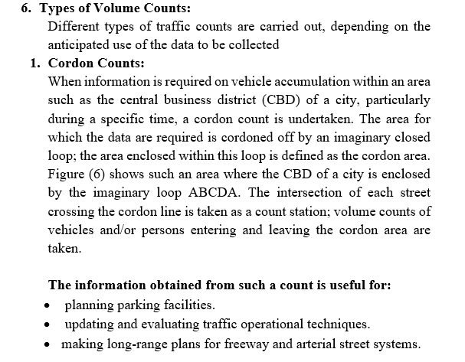
Lecture 8 Traffic Engineering Assistant Lecturer: Areej Muhy

Slide 17
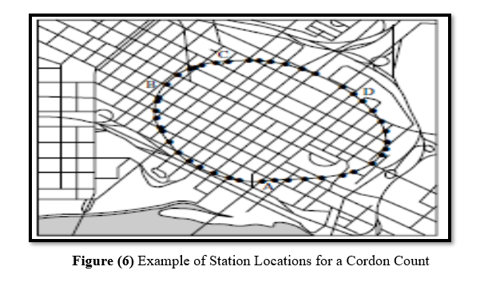
Lecture 8 Traffic Engineering Assistant Lecturer: Areej Muhy

Slide 18
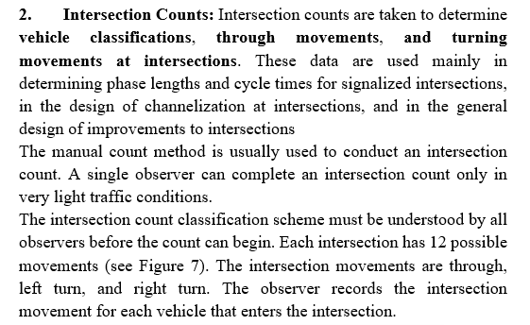
Lecture 8 Traffic Engineering Assistant Lecturer: Areej Muhy

Slide 19
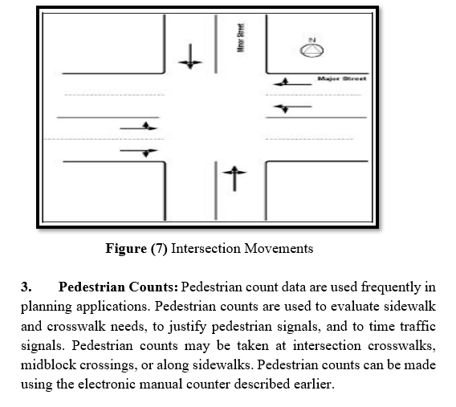
Lecture 8 Traffic Engineering Assistant Lecturer: Areej Muhy

Slide 20
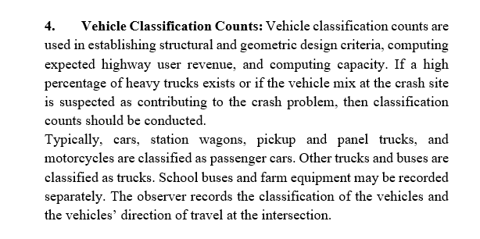
Lecture 8 Traffic Engineering Assistant Lecturer: Areej Muhy

Slide 21
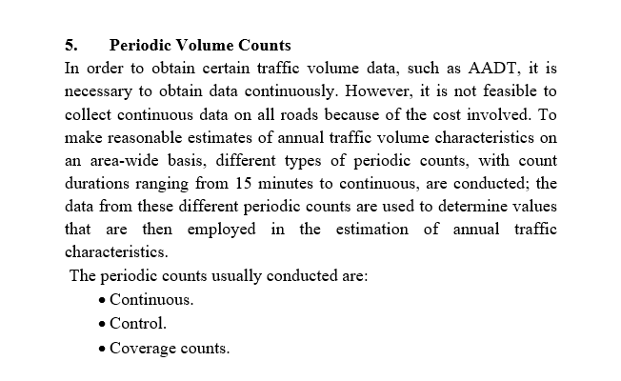
Lecture 8 Traffic Engineering Assistant Lecturer: Areej Muhy

