Slide 1
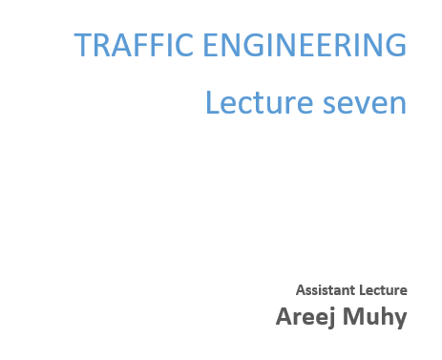

Slide 2
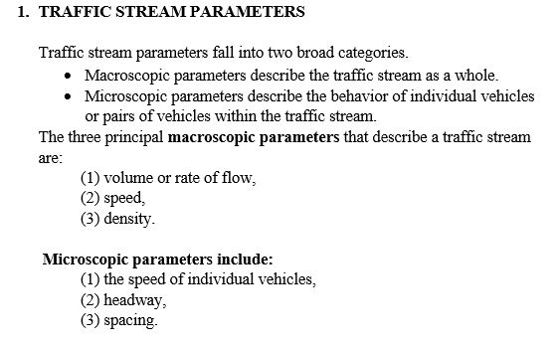
Lecture 7 Traffic Engineering Assistant Lecturer: Areej Muhy

Slide 3
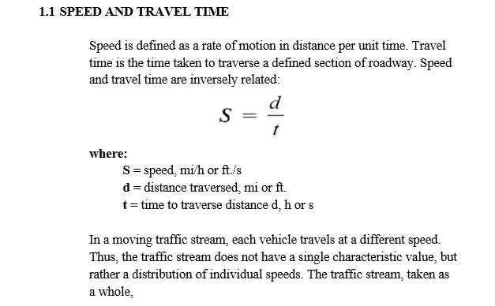
Lecture 7 Traffic Engineering Assistant Lecturer: Areej Muhy

Slide 4
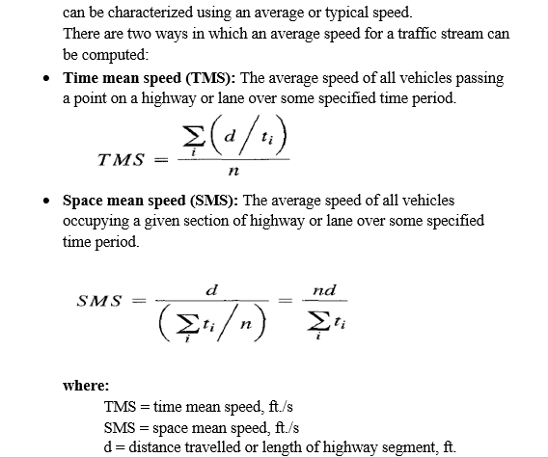
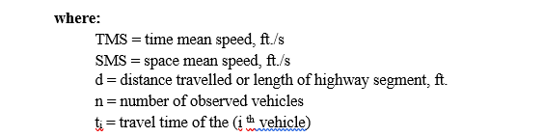
Lecture 7 Traffic Engineering Assistant Lecturer: Areej Muhy

Slide 5
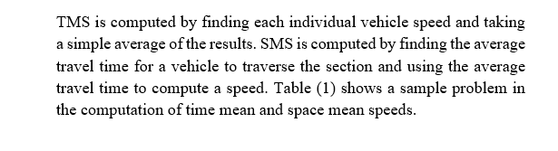
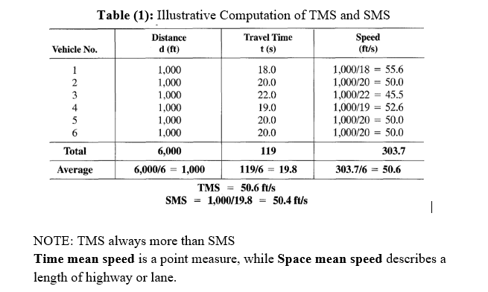
Lecture 7 Traffic Engineering Assistant Lecturer: Areej Muhy

Slide 6
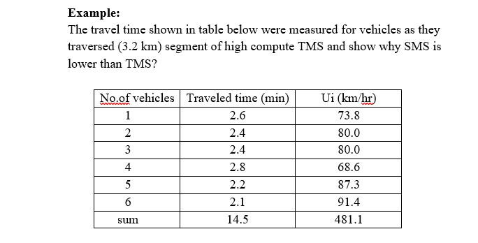
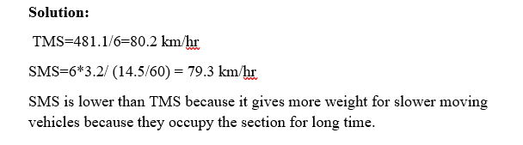
Lecture 7 Traffic Engineering Assistant Lecturer: Areej Muhy

Slide 7
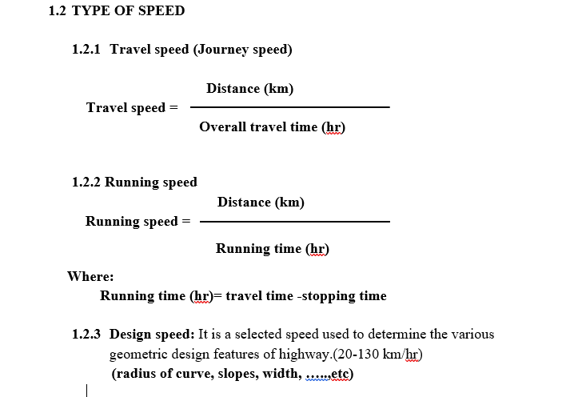
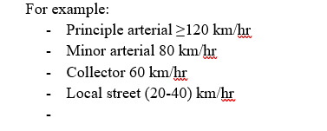
Lecture 7 Traffic Engineering Assistant Lecturer: Areej Muhy

Slide 8
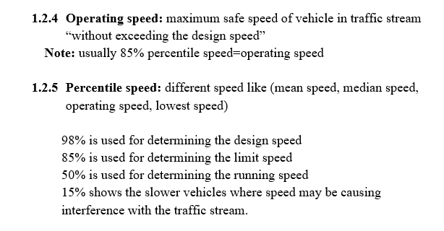
Lecture 7 Traffic Engineering Assistant Lecturer: Areej Muhy

Slide 9
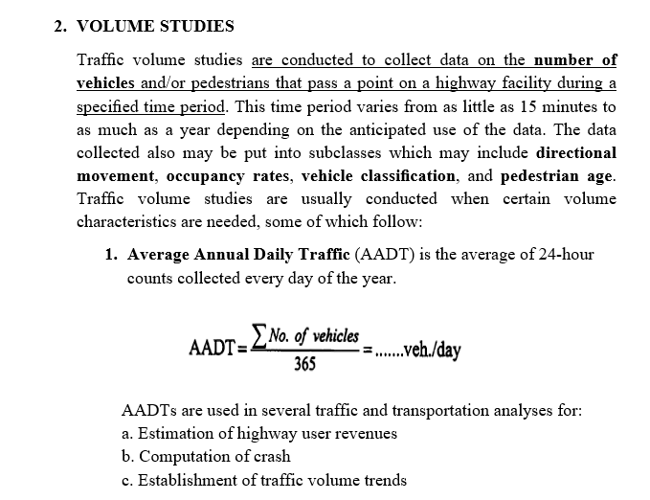
Lecture 7 Traffic Engineering Assistant Lecturer: Areej Muhy

Slide 10

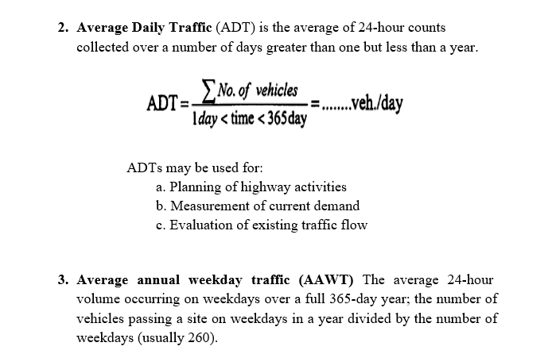
Lecture 7 Traffic Engineering Assistant Lecturer: Areej Muhy

Slide 11
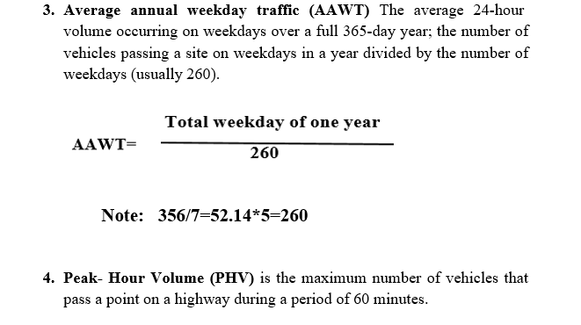
Lecture 7 Traffic Engineering Assistant Lecturer: Areej Muhy

Slide 12
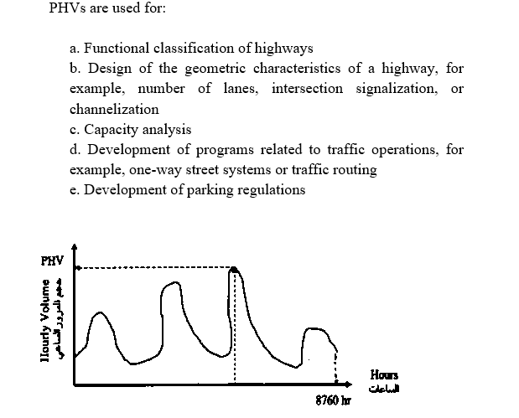
Lecture 7 Traffic Engineering Assistant Lecturer: Areej Muhy

Slide 13
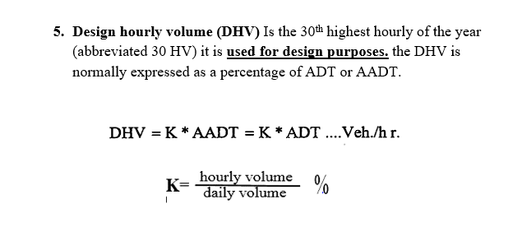
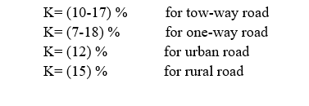
Lecture 7 Traffic Engineering Assistant Lecturer: Areej Muhy

Slide 14
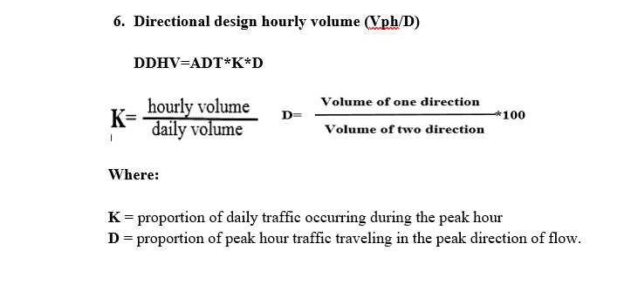
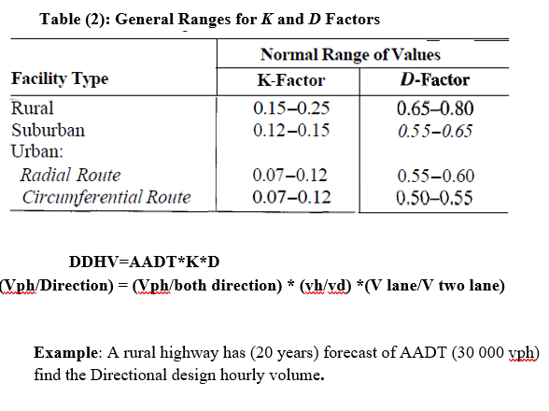
Lecture 7 Traffic Engineering Assistant Lecturer: Areej Muhy

Slide 15
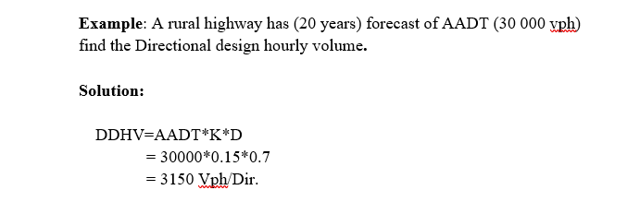
Lecture 7 Traffic Engineering Assistant Lecturer: Areej Muhy

