Slide 2
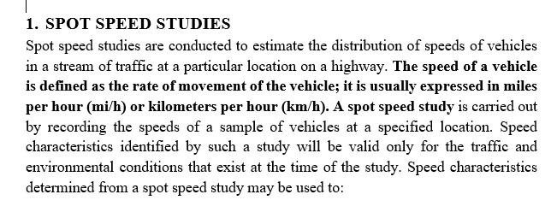
Lecture 6 Traffic Engineering Assistant Lecturer: Areej Muhy

Slide 3
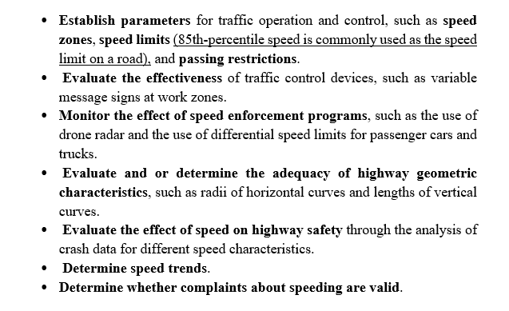
Lecture 6 Traffic Engineering Assistant Lecturer: Areej Muhy

Slide 4
Lecture 6 Traffic Engineering Assistant Lecturer: Areej Muhy

Slide 5
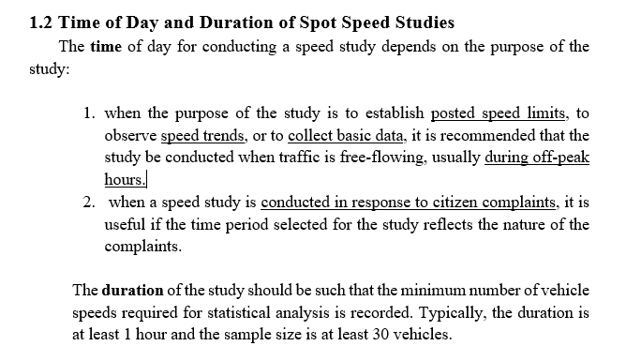
Lecture 6 Traffic Engineering Assistant Lecturer: Areej Muhy

Slide 6
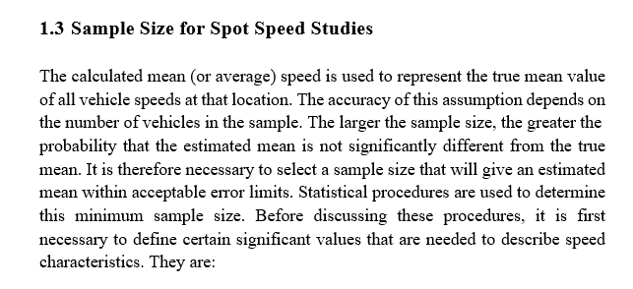
Lecture 6 Traffic Engineering Assistant Lecturer: Areej Muhy

Slide 7
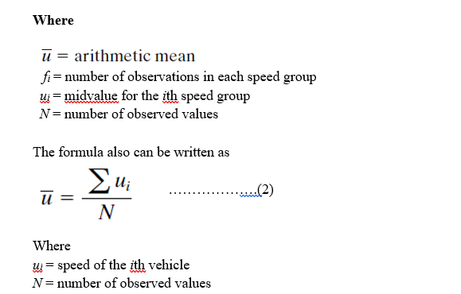
Lecture 6 Traffic Engineering Assistant Lecturer: Areej Muhy

Slide 8
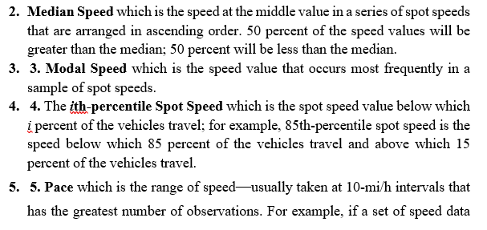
Lecture 6 Traffic Engineering Assistant Lecturer: Areej Muhy

Slide 9
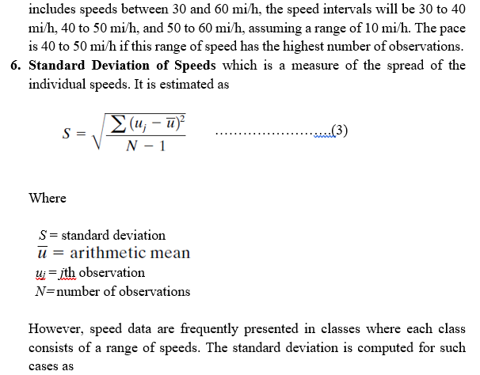
Lecture 6 Traffic Engineering Assistant Lecturer: Areej Muhy

Slide 10
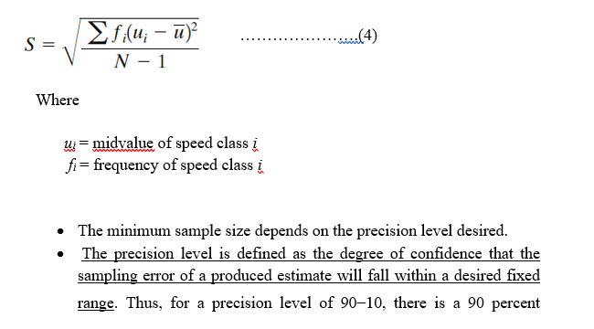
Lecture 6 Traffic Engineering Assistant Lecturer: Areej Muhy

Slide 11
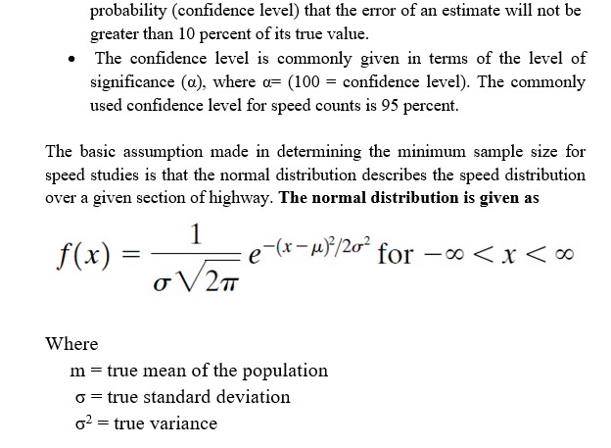
Lecture 6 Traffic Engineering Assistant Lecturer: Areej Muhy

Slide 12
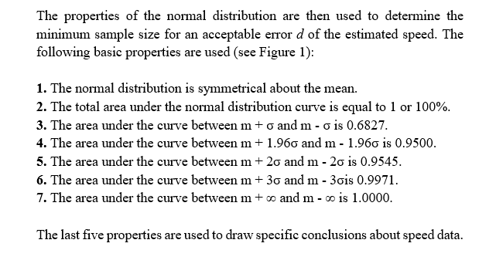
Lecture 6 Traffic Engineering Assistant Lecturer: Areej Muhy

Slide 13
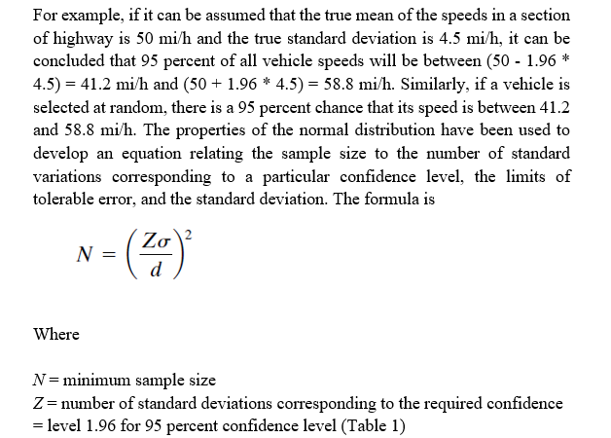
Lecture 6 Traffic Engineering Assistant Lecturer: Areej Muhy

Slide 14
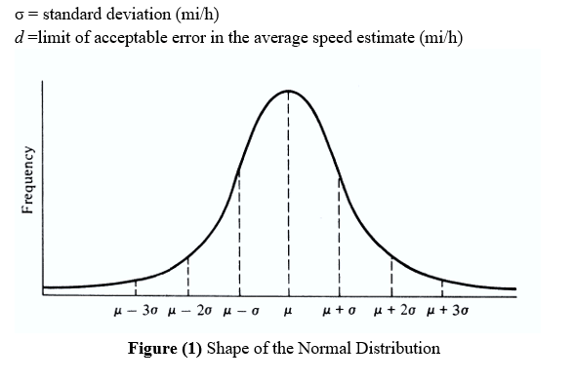
Lecture 6 Traffic Engineering Assistant Lecturer: Areej Muhy

Slide 15
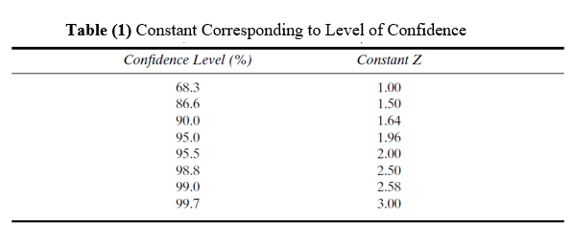
Lecture 6 Traffic Engineering Assistant Lecturer: Areej Muhy

Slide 16
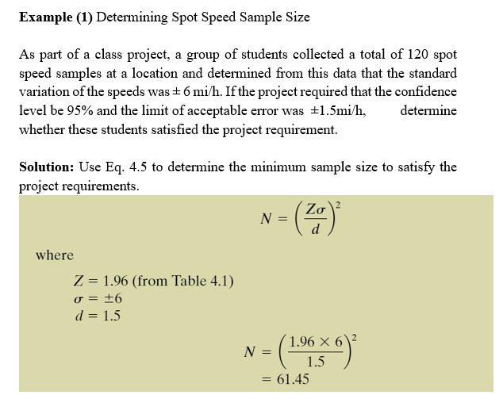
Lecture 6 Traffic Engineering Assistant Lecturer: Areej Muhy

Slide 17
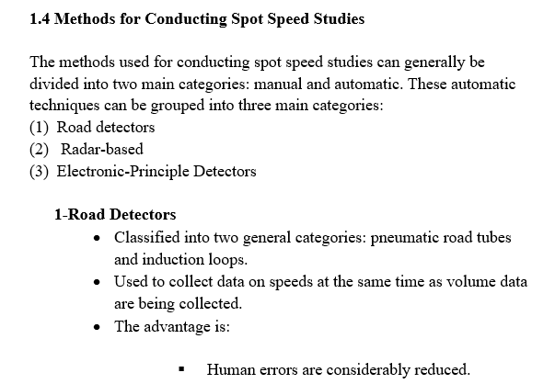
Lecture 6 Traffic Engineering Assistant Lecturer: Areej Muhy

Slide 18
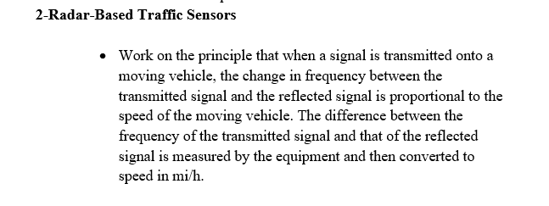
Lecture 6 Traffic Engineering Assistant Lecturer: Areej Muhy

Slide 19
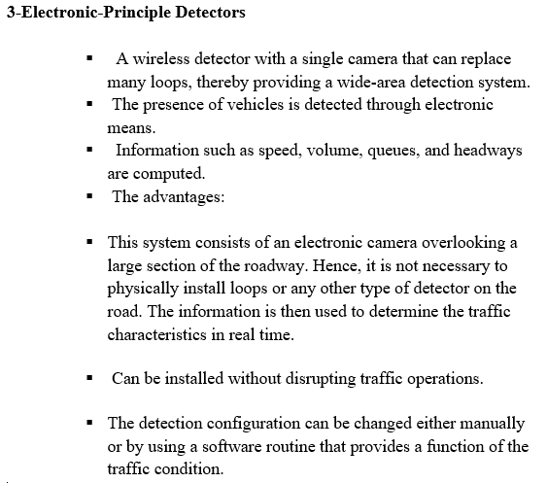
Lecture 6 Traffic Engineering Assistant Lecturer: Areej Muhy

Slide 20
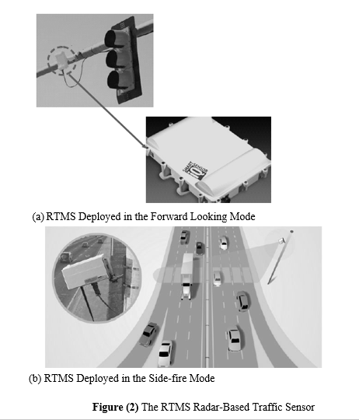
Lecture 6 Traffic Engineering Assistant Lecturer: Areej Muhy

Slide 21
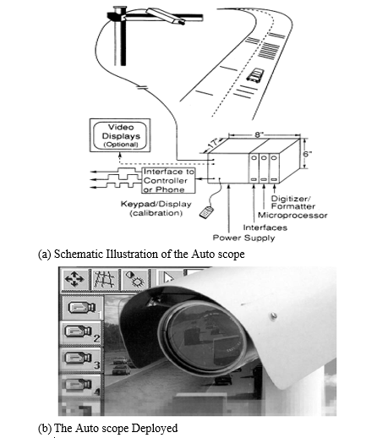
Lecture 6 Traffic Engineering Assistant Lecturer: Areej Muhy
Figure (3) The Auto scope

Slide 22
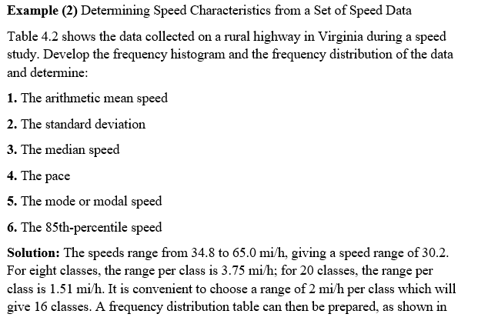
Lecture 6 Traffic Engineering Assistant Lecturer: Areej Muhy

Slide 23
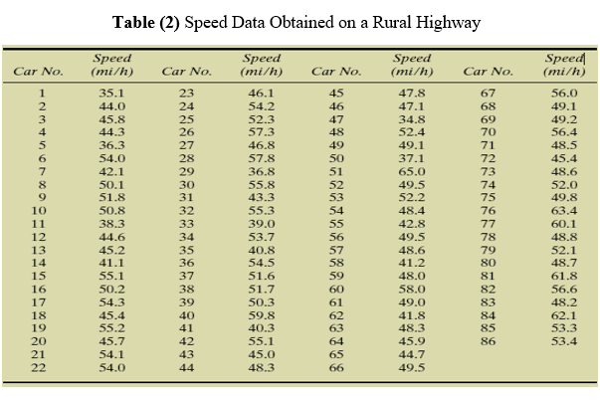
Lecture 6 Traffic Engineering Assistant Lecturer: Areej Muhy

Slide 24
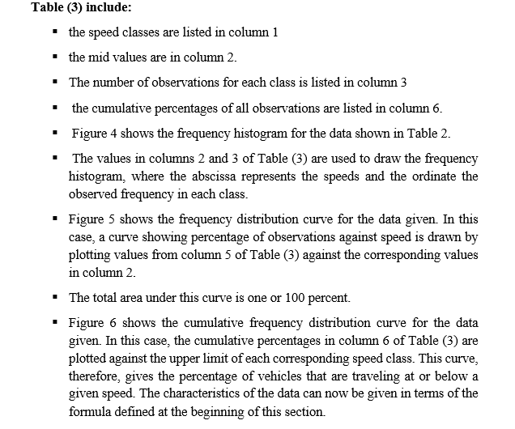
Lecture 6 Traffic Engineering Assistant Lecturer: Areej Muhy

Slide 25
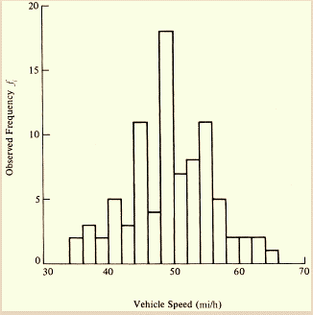
Lecture 6 Traffic Engineering Assistant Lecturer: Areej Muhy

Slide 26
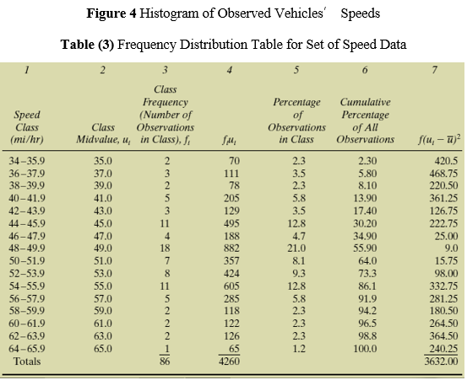
Lecture 6 Traffic Engineering Assistant Lecturer: Areej Muhy

Slide 27
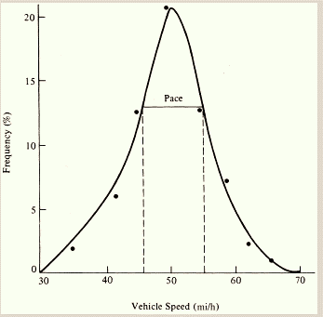
Lecture 6 Traffic Engineering Assistant Lecturer: Areej Muhy
Figure 5 Frequency Distribution

Slide 28
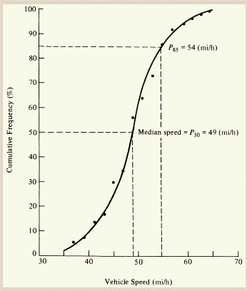
Lecture 6 Traffic Engineering Assistant Lecturer: Areej Muhy
Figure 6 Cumulative Distribution

Slide 29
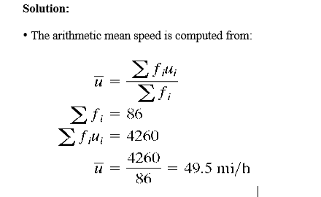
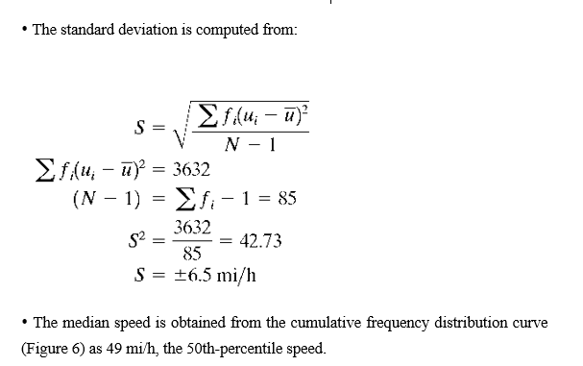
Lecture 6 Traffic Engineering Assistant Lecturer: Areej Muhy
• The pace is obtained from the frequency distribution curve (Figure 5) as 45 to 55 mi/h.

Slide 30
Lecture 6 Traffic Engineering Assistant Lecturer: Areej Muhy

