Slide 1
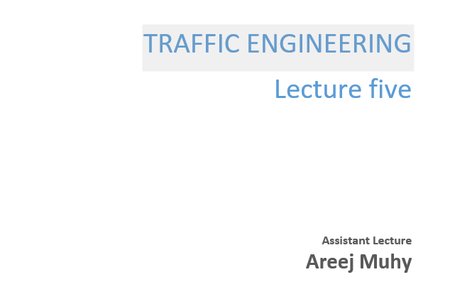

Slide 2
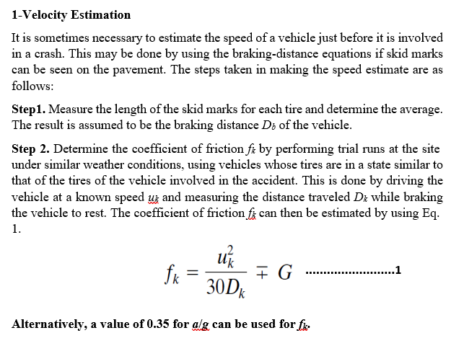
Lecture 5 Traffic Engineering Assistant Lecturer: Areej Muhy

Slide 3
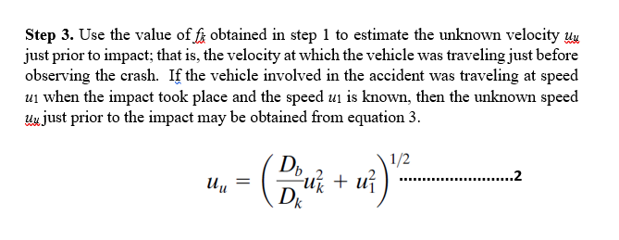
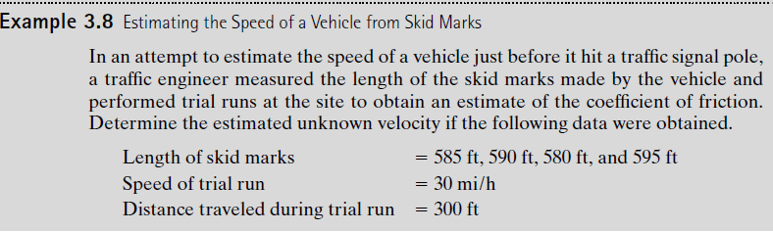
Lecture 5 Traffic Engineering Assistant Lecturer: Areej Muhy

Slide 4
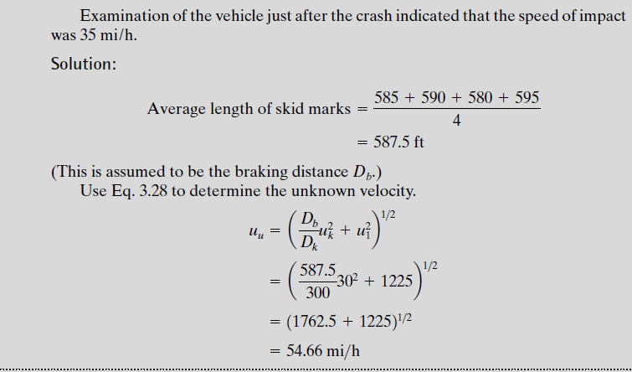
Lecture 5 Traffic Engineering Assistant Lecturer: Areej Muhy

Slide 5
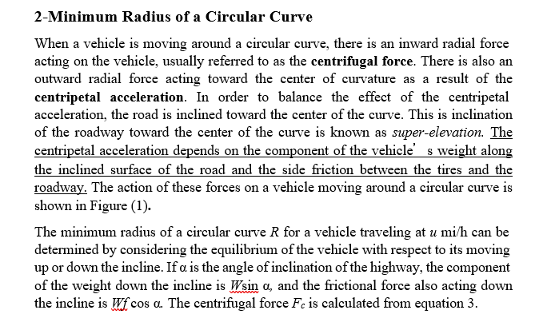
Lecture 5 Traffic Engineering Assistant Lecturer: Areej Muhy

Slide 6
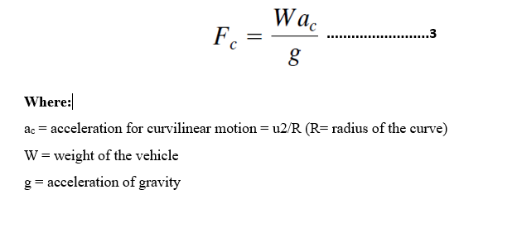
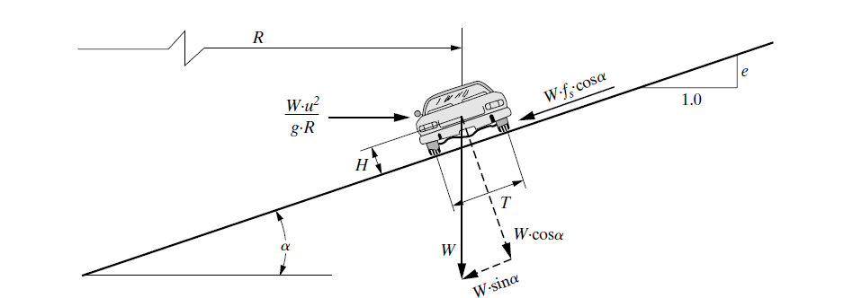
Lecture 5 Traffic Engineering Assistant Lecturer: Areej Muhy

Slide 7
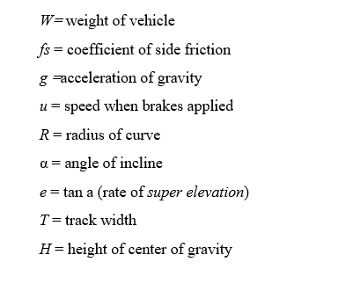
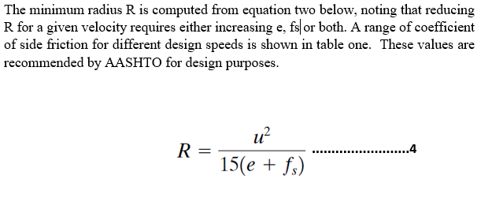
Lecture 5 Traffic Engineering Assistant Lecturer: Areej Muhy

Slide 8
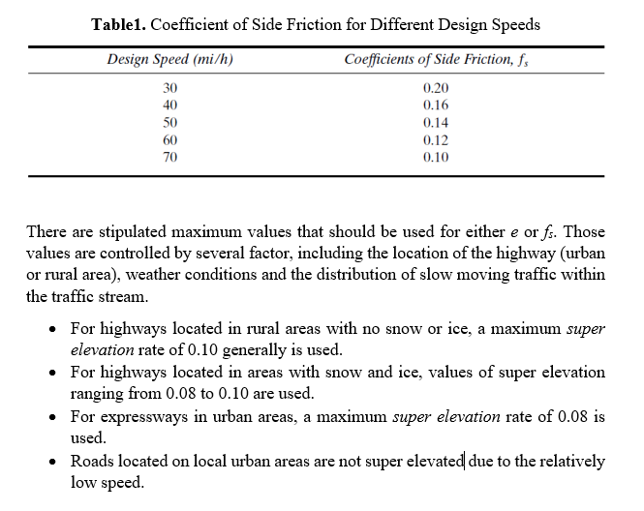
Lecture 5 Traffic Engineering Assistant Lecturer: Areej Muhy

Slide 9
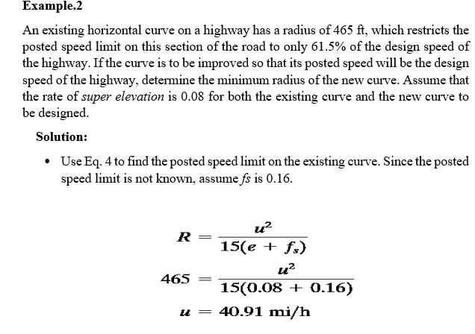
Lecture 5 Traffic Engineering Assistant Lecturer: Areej Muhy

Slide 10
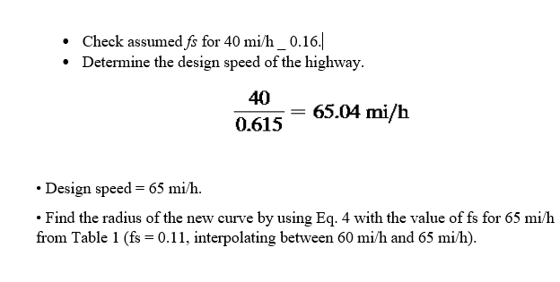
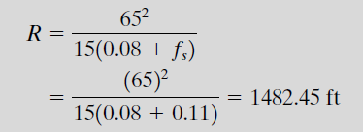
Lecture 5 Traffic Engineering Assistant Lecturer: Areej Muhy

Slide 11
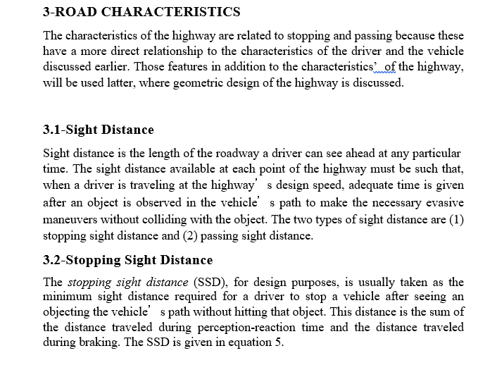
Lecture 5 Traffic Engineering Assistant Lecturer: Areej Muhy

Slide 12
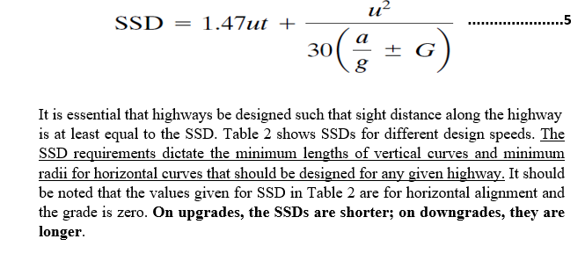
Lecture 5 Traffic Engineering Assistant Lecturer: Areej Muhy

Slide 13
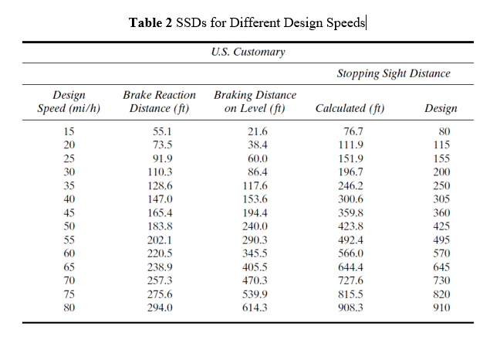
Lecture 5 Traffic Engineering Assistant Lecturer: Areej Muhy

Slide 14
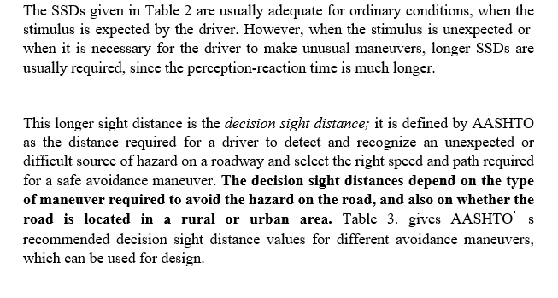
Lecture 5 Traffic Engineering Assistant Lecturer: Areej Muhy

Slide 15
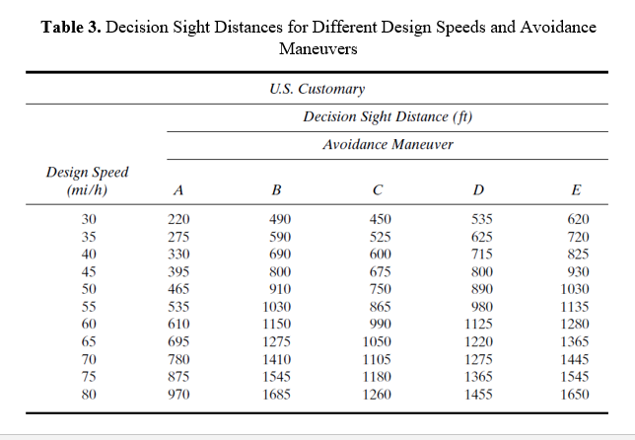
Lecture 5 Traffic Engineering Assistant Lecturer: Areej Muhy

Slide 16
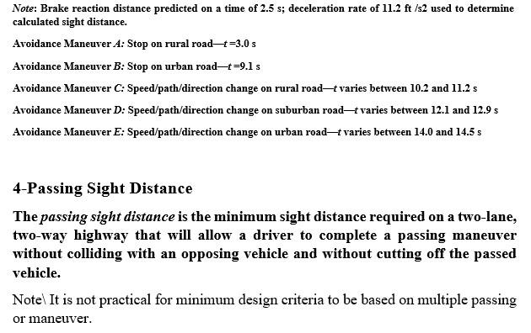
Lecture 5 Traffic Engineering Assistant Lecturer: Areej Muhy

Slide 17
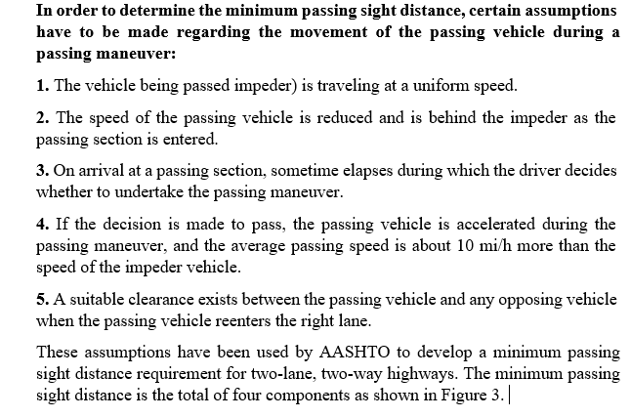
Lecture 5 Traffic Engineering Assistant Lecturer: Areej Muhy

Slide 18
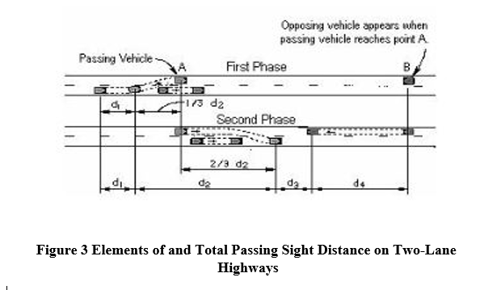
Lecture 5 Traffic Engineering Assistant Lecturer: Areej Muhy

Slide 19
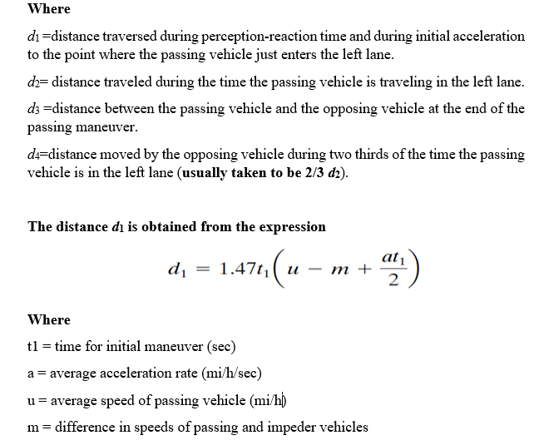
Lecture 5 Traffic Engineering Assistant Lecturer: Areej Muhy

Slide 20
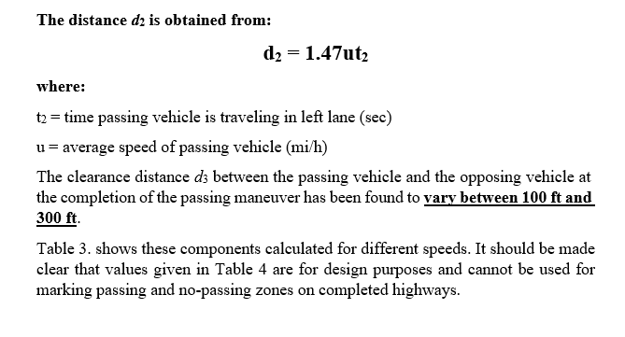
Lecture 5 Traffic Engineering Assistant Lecturer: Areej Muhy

Slide 21
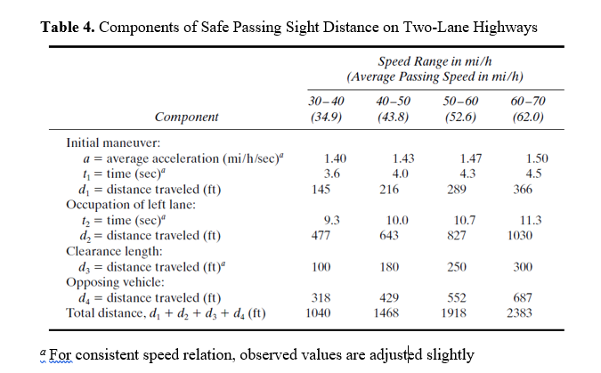
Lecture 5 Traffic Engineering Assistant Lecturer: Areej Muhy

