Slide 2
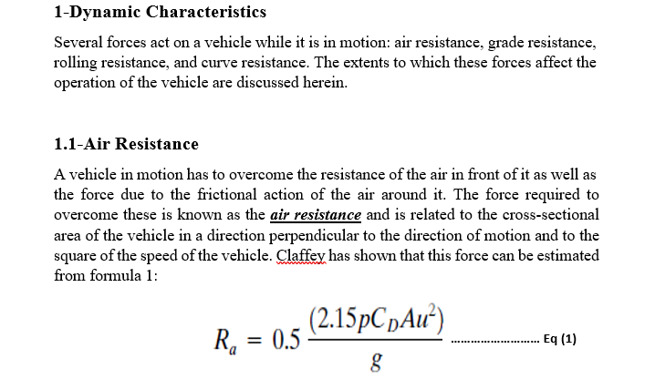
Lecture Four Traffic Engineering Assistant Lecturer: Areej Muhy
2015-2016

Slide 3
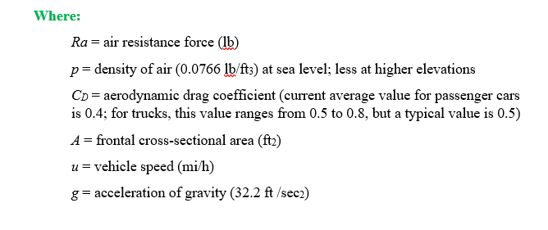
Lecture Four Traffic Engineering Assistant Lecturer: Areej Muhy
2015-2016

Slide 4
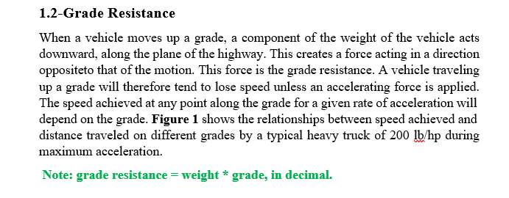
Lecture Four Traffic Engineering Assistant Lecturer: Areej Muhy
2015-2016

Slide 5
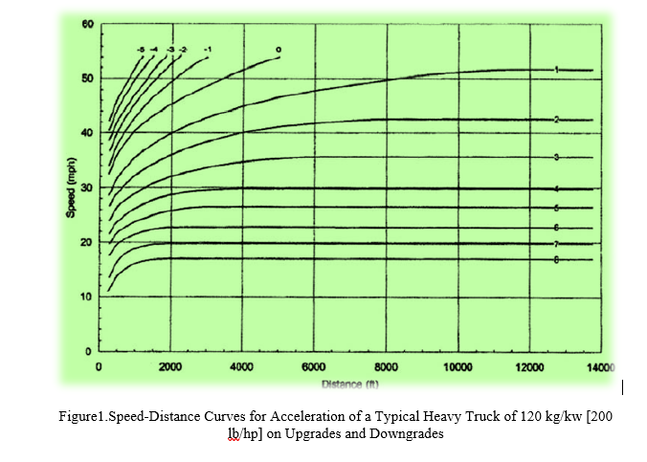
Lecture Four Traffic Engineering Assistant Lecturer: Areej Muhy
2015-2016

Slide 6
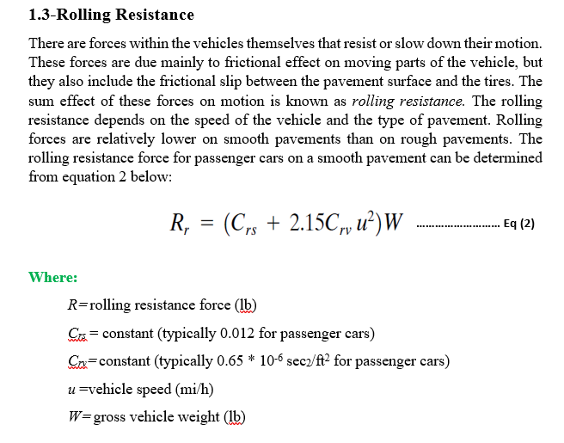
Lecture Four Traffic Engineering Assistant Lecturer: Areej Muhy
2015-2016

Slide 7
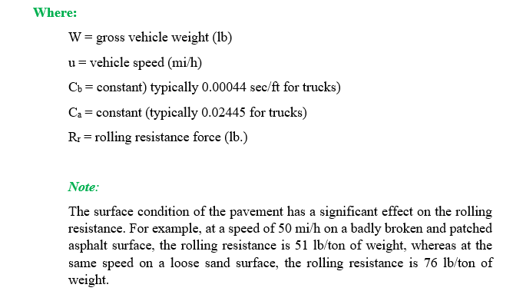
Lecture Four Traffic Engineering Assistant Lecturer: Areej Muhy
2015-2016

Slide 8
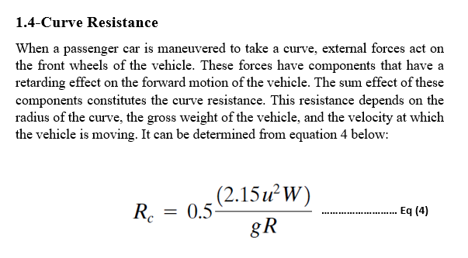
Lecture Four Traffic Engineering Assistant Lecturer: Areej Muhy
2015-2016

Slide 9
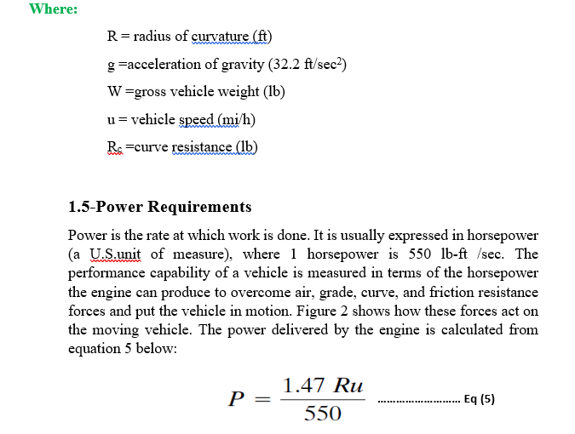
Lecture Four Traffic Engineering Assistant Lecturer: Areej Muhy
2015-2016

Slide 10
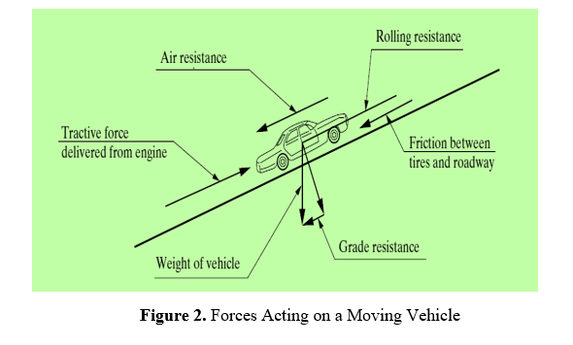
Lecture Four Traffic Engineering Assistant Lecturer: Areej Muhy
2015-2016

Slide 11
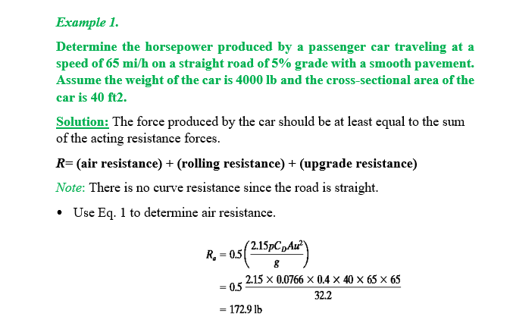
Lecture Four Traffic Engineering Assistant Lecturer: Areej Muhy
2015-2016

Slide 12
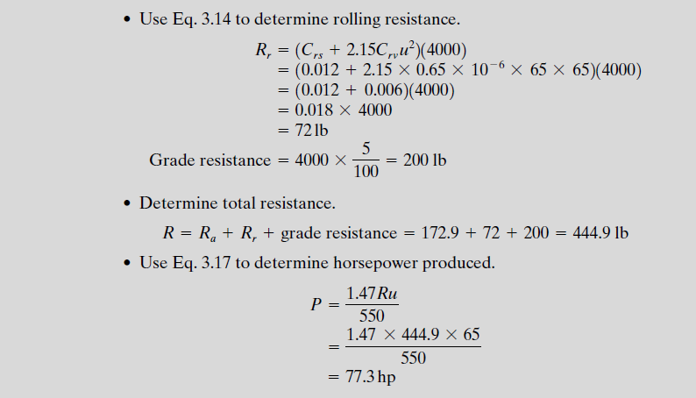
Lecture Four Traffic Engineering Assistant Lecturer: Areej Muhy
2015-2016

Slide 13
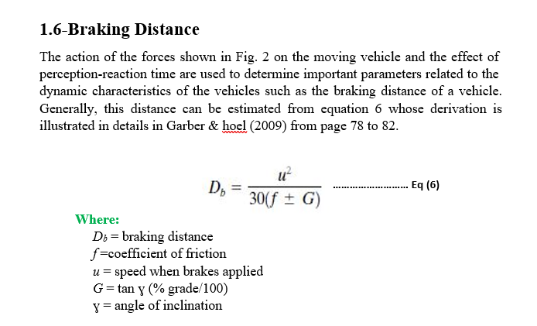
Lecture Four Traffic Engineering Assistant Lecturer: Areej Muhy
2015-2016

Slide 14
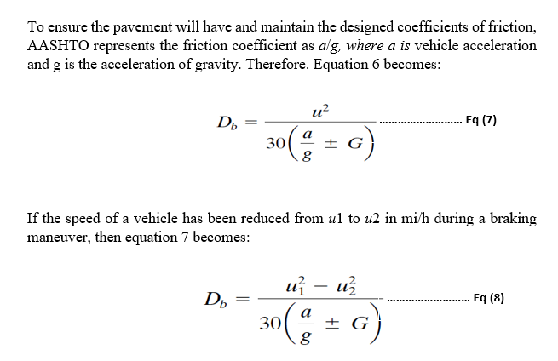
Lecture Four Traffic Engineering Assistant Lecturer: Areej Muhy
2015-2016

Slide 15
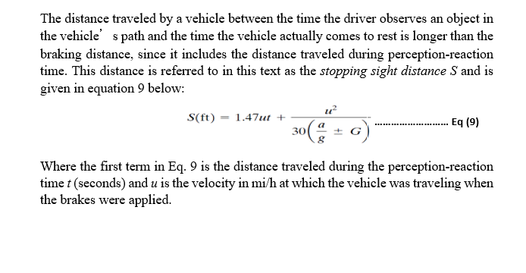
Lecture Four Traffic Engineering Assistant Lecturer: Areej Muhy
2015-2016

Slide 16
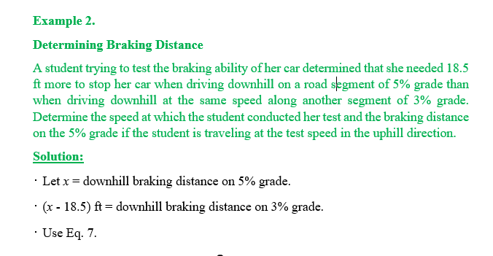
Lecture Four Traffic Engineering Assistant Lecturer: Areej Muhy
2015-2016

Slide 17
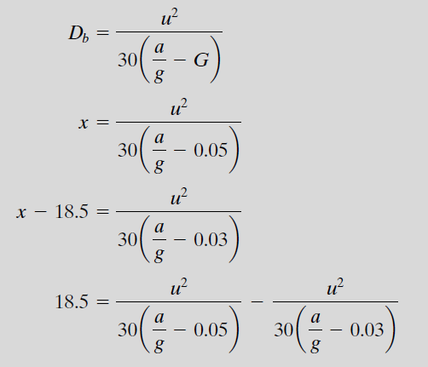
Lecture Four Traffic Engineering Assistant Lecturer: Areej Muhy
2015-2016

Slide 18
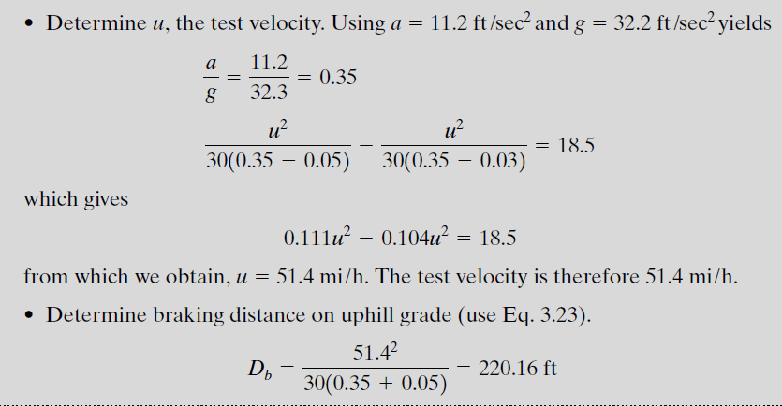
Lecture Four Traffic Engineering Assistant Lecturer: Areej Muhy
2015-2016

Slide 19
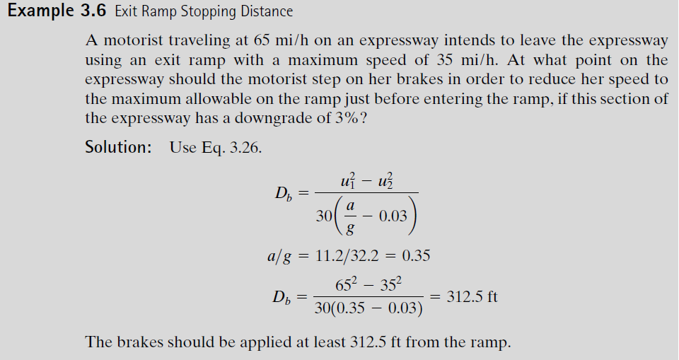
Lecture Four Traffic Engineering Assistant Lecturer: Areej Muhy
2015-2016

Slide 20
Lecture Four Traffic Engineering Assistant Lecturer: Areej Muhy
2015-2016

