Slide 2
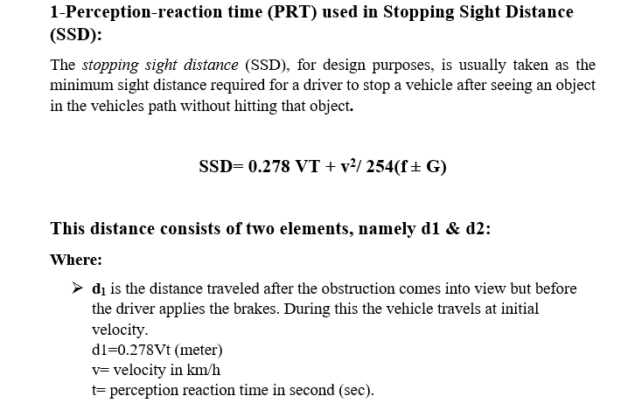
Lecture 2 Traffic Engineering Assistant Lecturer: Areej Muhy

Slide 3
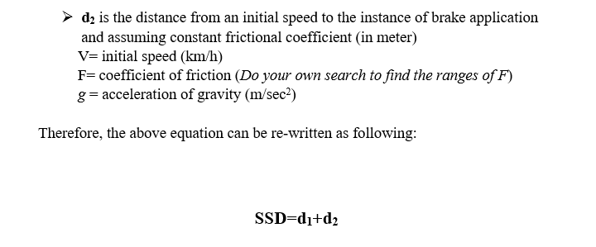
Lecture 2 Traffic Engineering Assistant Lecturer: Areej Muhy

Slide 4
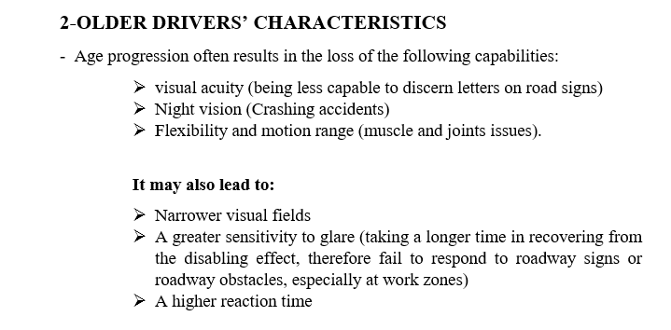
Lecture 2 Traffic Engineering Assistant Lecturer: Areej Muhy

Slide 5
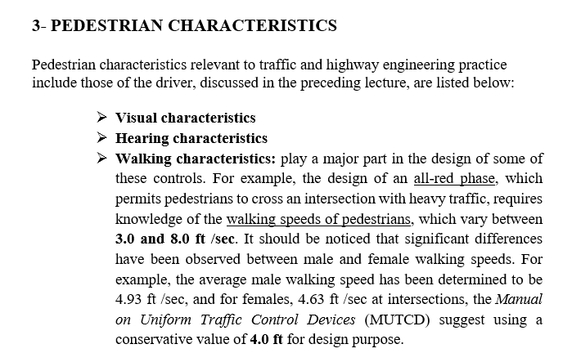
Lecture 2 Traffic Engineering Assistant Lecturer: Areej Muhy

Slide 6
Lecture 2 Traffic Engineering Assistant Lecturer: Areej Muhy

Slide 7
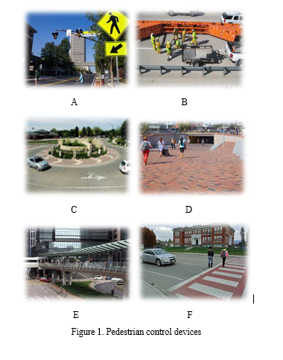
Lecture 2 Traffic Engineering Assistant Lecturer: Areej Muhy

Slide 8
Lecture 2 Traffic Engineering Assistant Lecturer: Areej Muhy

Slide 9
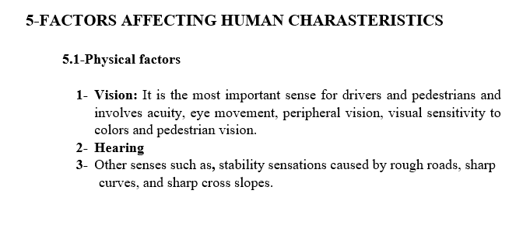
Lecture 2 Traffic Engineering Assistant Lecturer: Areej Muhy

Slide 10
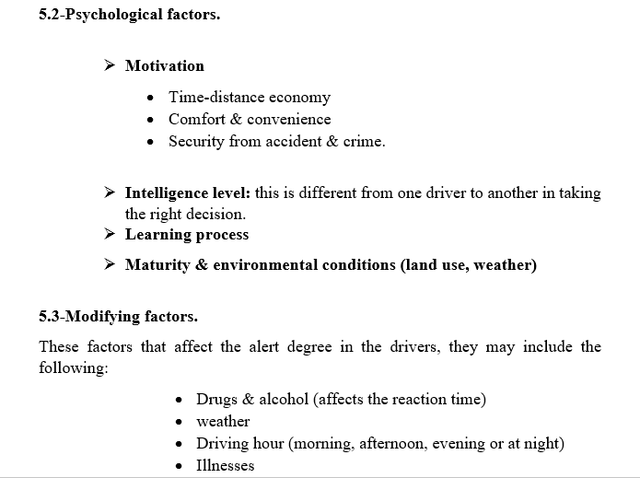
Lecture 2 Traffic Engineering Assistant Lecturer: Areej Muhy

