Slide 1
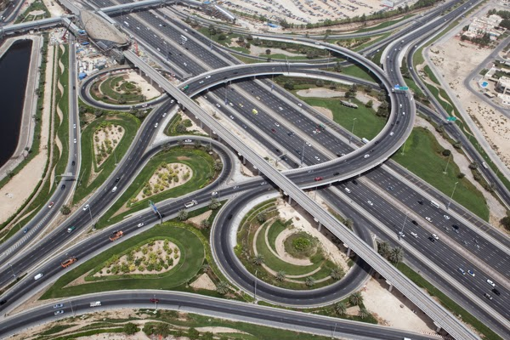
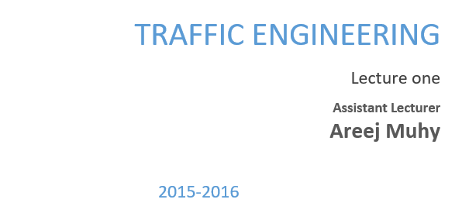

Slide 2
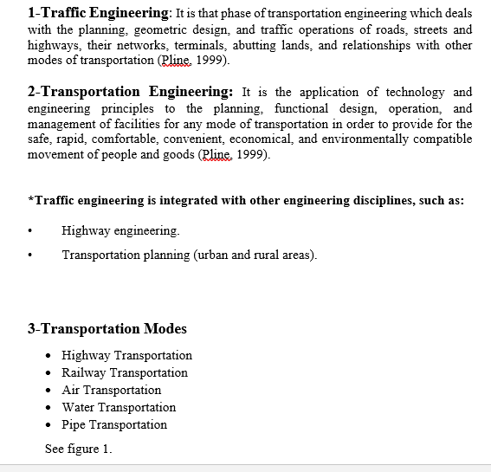
Lecture 1 Traffic Engineering Assistant Lecturer: Areej Muhy

Slide 3
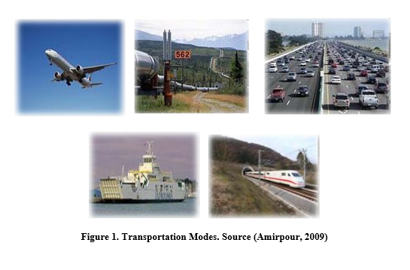
Lecture 1 Traffic Engineering Assistant Lecturer: Areej Muhy

Slide 4
Lecture 1 Traffic Engineering Assistant Lecturer: Areej Muhy

Slide 5
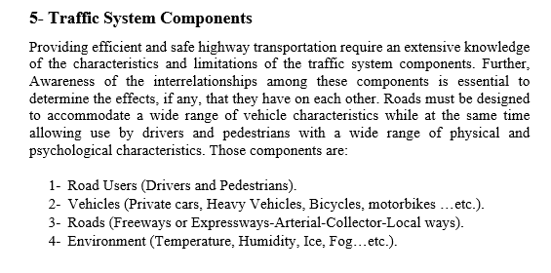
Lecture 1 Traffic Engineering Assistant Lecturer: Areej Muhy

Slide 6
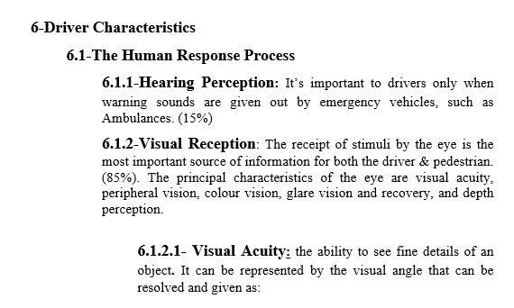
Lecture 1 Traffic Engineering Assistant Lecturer: Areej Muhy

Slide 7
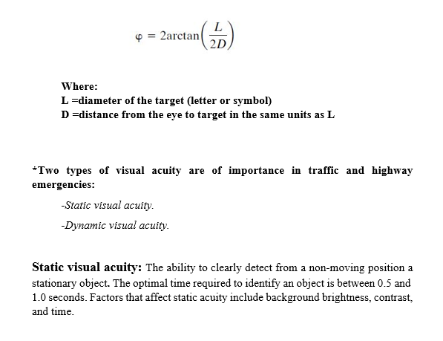
Lecture 1 Traffic Engineering Assistant Lecturer: Areej Muhy

Slide 8
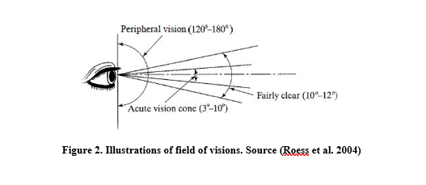
Lecture 1 Traffic Engineering Assistant Lecturer: Areej Muhy

Slide 9
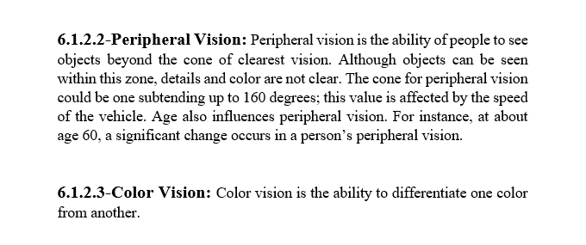
Lecture 1 Traffic Engineering Assistant Lecturer: Areej Muhy

Slide 10
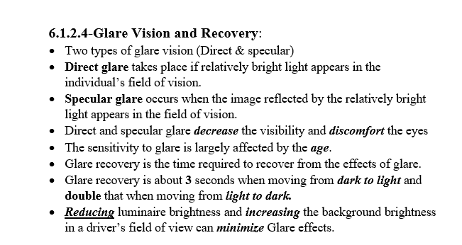
Lecture 1 Traffic Engineering Assistant Lecturer: Areej Muhy

Slide 11
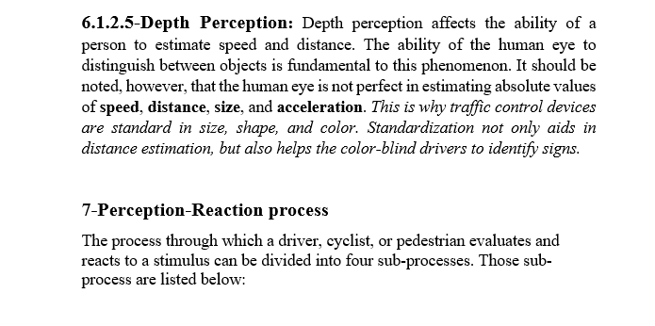
Lecture 1 Traffic Engineering Assistant Lecturer: Areej Muhy

Slide 12
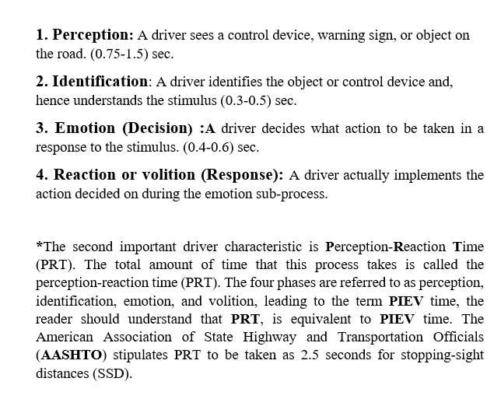
Lecture 1 Traffic Engineering Assistant Lecturer: Areej Muhy

Slide 13
Lecture 1 Traffic Engineering Assistant Lecturer: Areej Muhy

Slide 14
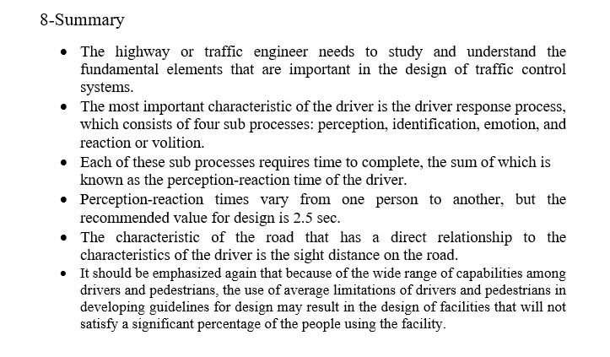
Lecture 1 Traffic Engineering Assistant Lecturer: Areej Muhy

