Slide 1
Experiment No. (1) - an introduction to MATLAB
College of engineering | Third class
Computer engineering department | Digital signal process

Slide 2
Introduction
The name MATLAB stands for Matrix Laboratory.
MATLAB is a high-performance language for technical computing.
MATLAB is a modern programming language environment: it has sophisticated data structures, contains built-in editing and debugging tools, and supports object-oriented programming.

Slide 3
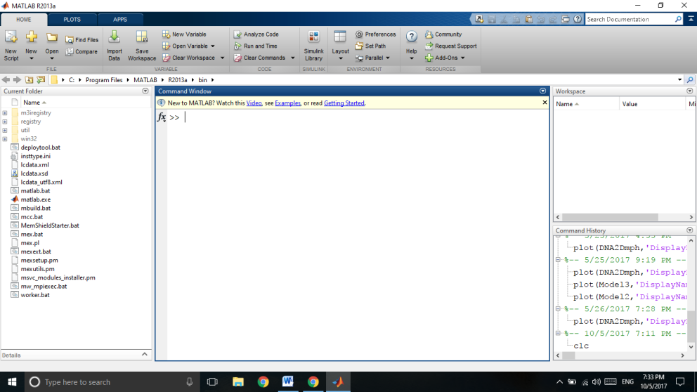
You get MATLAB to do things for you by typing in commands in the command line.
When you start MATLAB, a special window called the MATLAB desktop appears.

Slide 4
The major tools within or accessible from the desktop are:
• The Command Window
• The Command History
• The Workspace
• The Current Directory
• The Help Browser
• The Start button
Using MATLAB as a calculator
To do some simple calculations with the MATLAB desktop on our computers, which contains the prompt (>>) in the Command Window.
For example, let’s suppose you want to calculate the expression, 1 + 2 × 3.
>> 1+2*3
ans =
7

Slide 5
Variables
Variables in MATLAB are named objects that are assigned using the equals sign (=) They are limited to 31 characters.
It may consist only of the letters a–z, the digits 0–9 and the underscore ( _ )
It must start with a letter.
Examples of valid variable names are: r2d2, car, pay_day.
Examples of invalid names: pay-day, 2a, name$, _2a.
A variable is created simply by assigning a value to it at the command line or in a program, e.g.
a = 98
MATLAB is case sensitive, which means it distinguishes between upper and lowercase letters. So balance, BALANCE and BaLance are three different variables.

Slide 6
Expressions and statements
The expressions are such as u*t - pi/2
Expressions are constructed from a variety of things, such as numbers, variables, and operators.
The statements, such as: y = x + y
General commands and Special characters and variables
Command | Explanation
whos | lists more information about each variable in the work space
pi | π =3.1415 9
i, j | value of variables.
format | format long , format short.
Clc | this command remove everything from the workspace.
, | b=cos(a),
; | a=7;
Help | Display help text in Command Window.
inf | Infinity
NaN | stands for “not a number”; e.g., the result of 0/0
Rand

Slide 7
Arithmetic operators
operation | Algebraic form | MATLAB
addition | a + b | a + b
subtraction | a-b | a - b
multiplication | a x b | a * b
Right division | a/b | a / b (e.g. 10/5 is 2)
Left division | b/a | a \ b (e.g. 5\10 is 2)
power | ªb | a ^ b
Relational operators
The command | explanation
<, <=, >, >= | usual relational operators
== | equality operator
~= | inequality operator

Slide 8
Precedence of operators
precedence | operator
1 | Parentheses (round brackets)
2 | Power, left to right
3 | Multiplication and division, left to right
4 | Addition and subtraction, left to right
Example1: to evaluate the following equation, this is computed correctly by the MATLAB command:
>> TC = (5/9)*(TF-32)

Slide 9
The input statement
It is used to read a variable’s value during the runtime.
The general form is:
Variable_name = input ( ' message ')
For example
Age = input (' Enter the age of the person in question: ')
The M-Files
for more complex commands we can store the typed input into a file and tell MATLAB to get its input from the file.
Such files must have the extension “.m”. called m-files.
If an m-file contains MATLAB statements just as you would type them into MATLAB, they are called scripts.
M-files can also accept input and produce output, in which case they are called functions.

Slide 10
Procedure:
Write a MATLAB code to evaluate the following:
1.5 * 10⁻⁴ +2.5 * 10⁻²
$$\frac{1}{2+32 }+ \frac{4}{5}∗ \frac{6}{7 }$$
Write the following
help database.close
a=5; b=6, c=7,
Use the command who
format short ; 2 * sin(1.4)
format long ; 2 * sin(1.4)
clock = 1; rand(sum(3*clock))

Slide 11
MATLAB is a programming environment which has gained popularity due to its ease of use. MATLAB provides an interactive environment that makes this easy: you type a command, and it executes it.
If there is a problem, it will let you know, and you can try again. It executes and works with variables without the need to declare variables first.
Q) Write M file to solve this equation and print the value of y :
y=1.5 * 10⁻⁴ +2.5 * 10⁻²?

