Slide 1
Fluid Mechanics Lectures 2nd year/1st semister/2018-2019/Al-Mustansiriyah unv./College of engineering/Highway &Transportation Dep.Lec.5

Slide 2
. Buoyancy(Archimedes principle)
An important aspect of hydrostatic pressure deals with determining the net force that is exerted on an entire body that is either completely submerged or floating in a partially submerged position. In case of either completely submerged or floating there is a net upward pressure acting on the body. This force called the buoyancy force, occurs because pressure increase with depth. Thus the pressure acting upward on a bottom surface area is greater than the pressure acting downward. On the other hand the net horizontal pressure force on a completely submerged or floating body equals zero.

Slide 3
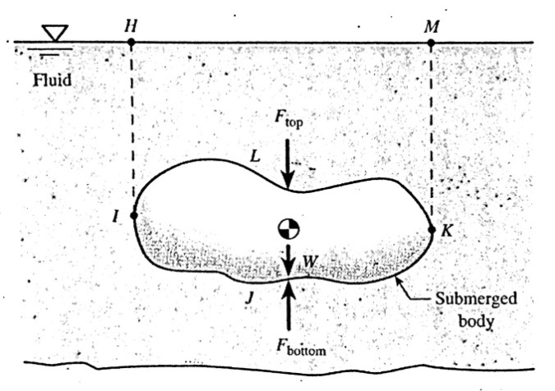
Completely submerged body
The weight W of the submerged body occupying the volume IJKLI.
The vertical force Ftop acting downward on the top surface of the body that equals the weight of the fluid in the volume HILKMH:
Ftop =γfluid*Vfluid
3-Thevertical force Fbottom acting upward on the surface of the body that equals the weight of the fluid that would occupy the volume HIJKMH if the body were not present:
Fbottom=γfluid *Vfluid
Since Fbottom is greater than Ftop there is a net upward pressure force (Fbottom-Ftop) acting on the submerged body. Since Fbottom-Ftop) equals the weight of fluid having a volume equal to volume of the body:
F_{B}=γfluid*Vfluid.
F_{B} is called buoyancy force.
.

Slide 4
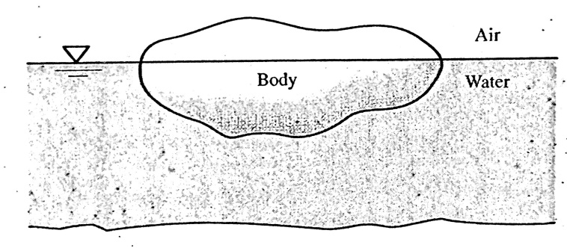
When a person gets weighed the recorded weight called apparent weight really equals the actual weight minus the weight of the atmospheric air displaced by the personꞌs body. Thus the measured weight of a person equals the weight of the person in a perfect vacuum minus the weight of atmospheric air displaced by the person:
Apparent body weight=γbody*Vbody-γair*Vbody.

Slide 5
Examples
Ex.1:The weight of a person is 180 lb where the specific weight of the atmospheric air is 0.0765 lb/ft³. If the persons total volume is 2.95 ft³. What is the persons actual weight and average specific weight?
Apparent weight=actual W-γair*Vperson
180=actual W-(0.0765)*(2.95)
Actual W=180.23 lb.
Persons average density =actual W/Vol.
=180.23/2.95 =61.1lb/ft³
(human beings have an average specific weight of about 61 lb/ft³ and thus can theoretically float in water because the specific weight of water is 62.4 lb/ft³)

Slide 6
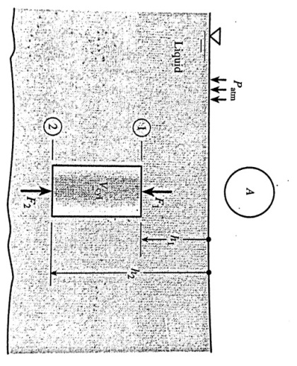
Ex.2: Using pressure height relation(P=γh) show that the buoyancy force a completely submerged circular cylinder equals the weight of the liquid displaced by the cylinder
F_{B}=F2-F1=P2A-P1A
F_{B}=(Patm+γluquid*h2)A-(Patm+γ liquid*h1)A
F_{B}= γluquid(h2-h1)A
F_{B}= γluquid V cyl.= weight of the displaced liquid.
)
-

Slide 7
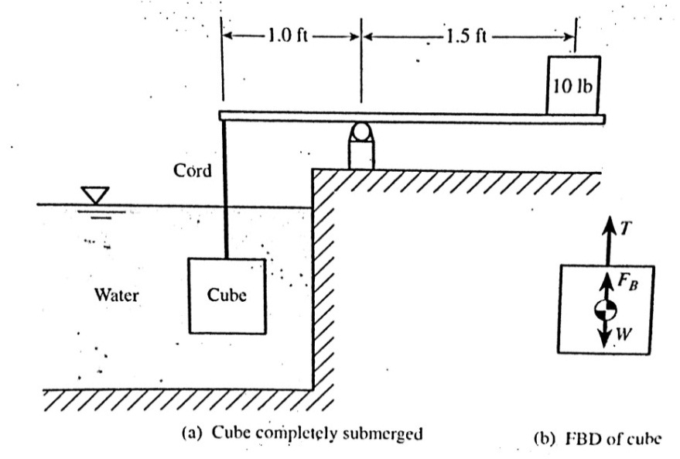
Ex.3:A 6 in cube completely submerged in water is balanced by a 10lb weight on the beam scale, determine the specific gravity of the cube material
T(tension)*1=10 *1.5
T=15lb
T+F_{B}-W=0
F_{B}=γ water *V disp.water=γ water *V cube
=62.4*6³*1/1728=7.8 lb
W=T+FB
=15+7.8=22.8 lb
γ cube=W cube/V cube
=22.8/6³*(1/1728)=182 lb/ft³
S.G=γ cube/ γ water=182/62.4=2.92 .

Slide 8
Thanks

