Slide 1
Fluid Mechanics Lectures 2nd year/1st semister/2018-2019/Al-Mustansiriyah unv./College of engineering/Highway &Transportation Dep.Lec.4

Slide 2
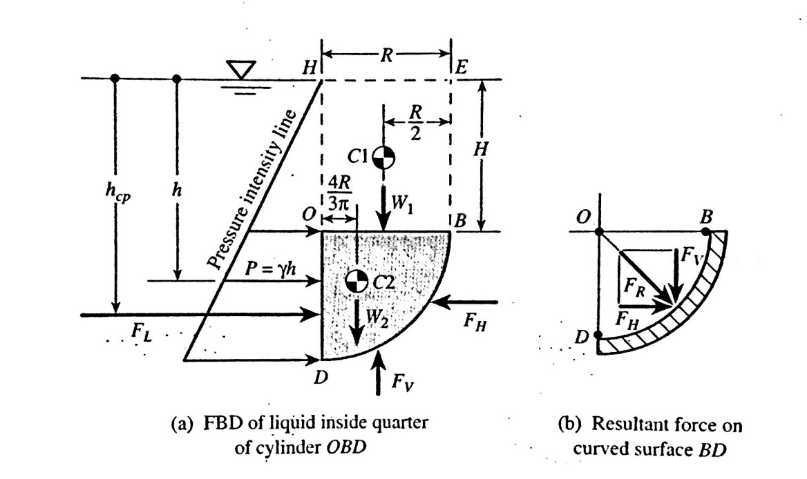
.
Curved surfaces submerged in liquids
If we want to find the total resultant force acting on the right half of the tank (fig.) semicylindrical bottom BD due to liquid hydrostatic pressure. The first step is to draw a free-body diagram of the liquid contain in the right half of the tank bottom. There are five external forces (W₁, W₂, F_{L}, F_{H} and F_{V})

Slide 3
1-W₁:weight of the liquid above the surface OB=γ *vol of the liquid, the location of W1 is at the center of OB.
2-W₂:is the weight of liquid inside the quarter-cylinder:
W₂+γ*V=(γ($\frac{πR ^{2}}{4}×L)$
The location of W2 is at the centroid of the liquid inside the quarter-cylinder (2D/3π).
3-F_{L}:the horizontal force acting on the left side of the body , note that the force FL is the resultant force acting on the submerged vertical plane surface OD:
F_{L}=γhA
FL=γ(H+R/2)RL
The location of FL is at the center of pressure of the submerged vertical plane surface OD :
H_{cp}=$\frac{Ix}{hA}+h$
4-F_{H}=is the horizontal component of the resultant force FR that the curved bottom BD of the tank exerts on the liquid.
5-F_{V}= is the vertical component of the resultant force FR that the curved bottom BD of the tank exerts on the liquid.
F_{R}=$\sqrt{F _{H}^{2}+F _{V}^{2}}$
.

Slide 4
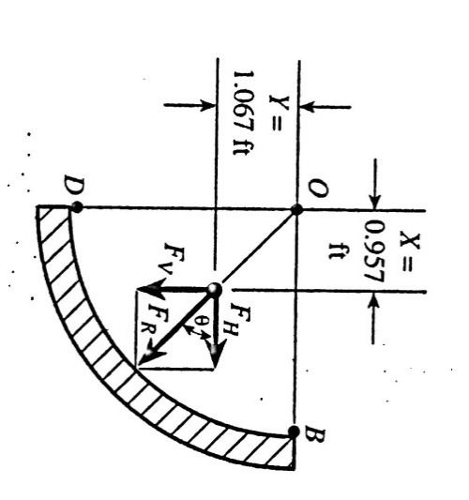
Examples
Ex.1:determine the magnitude of the total resultant pressure force acting on the right half of the semicylindrical bottom surface BD of the tank (fig.2). Show that the line of the action of this force goes through point O , the center of curvature of quarter circular arc BD , the following data are given:

Slide 5
γ=62.4lb/ft³, R=2ft, H(head of water above the top)=4ft, L(length of tank)=8ft.
Fig.2
F_{H}=γhA
=γ(H+R/2)RL=62.4*5*16=4990 lb.
h_{cp}=Ix/hA+h
h_{cp}=5.33/5*16+5=0.067+5=5.067ft
F_{V}=W1+W2
=γv1+γv2
=γ R H L +γ(πR² /4*L)
=62.4*2*4*8+62.4(π/4*4*8)
5560lb
Fv(x)=W1(R/2)+W2(4R/3π)
5560(X)=3990(2/2)+1570(4*2/3π)
X=0.957 ft
F_{R}= F_{R}=$\sqrt{F _{H}^{2}+F _{V}^{2}}$
=$\sqrt{\left(4990\right) ^{2}+(5560) ^{2}}$
=7470 lb
∑Mo=Fv(X)-Fh(Y)
=5560(0.957)-4990(1.067) =0 thus the action of resultant force does go through point O

Slide 6
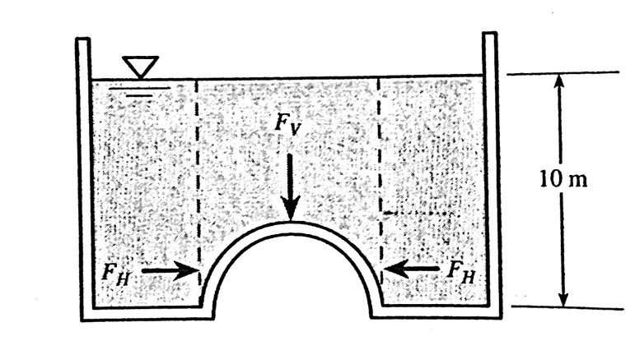
Ex.2:A hemispherical dome is built into bottom of a large tank of water, (fig.). Determine the total net force acting on the dome if its diameter 2.5m?
The horizontal force is zero because the left component and the right component are equal.
Fv=γ(vol. of cylinder –vol. of hemisphere)
=9800(π/4(2.5)²(10)-1/2*4/3*π*2.5²/2)
=9800(49.06-4.09)=441000N
-

Slide 7
Ex.3: Gate AB is a quarter circle 10 ft wide into the paper and hinged at B (fig.). Find the force F just sufficient to keep the gate opening?(neglect the weight)
F_{H}=γhA=62.4((8+0)/2)(8*10)=19968lb
The location of F_{H} is 2/3or 2.667ft above point B .
Fv=F1-F2=62.4((10*8*8)-62.4(10*π*8²/4)=39936-31366=8570lb
The location of Fv is by taking moments about point B :
8570x=(39936*8/2)-(31366(8-4*8/3π)
X=1.787ft
∑M_{B}=0
8F-(2.667)(19968)-(1.787)(8570)=0
F=8571lb down

Slide 8
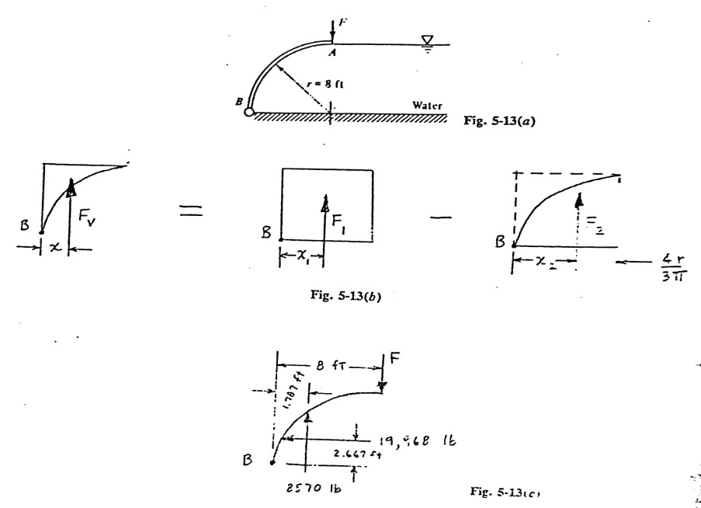
Ex.3

Slide 9
.
Ex.4:Gate AB (fig.)is a quarter circle 8ft wide, hinged at B and resting against wall at A, Compute the vertical and horizontal forces and there locations?
.
F_{H}=γhA
=64*(12-5/2)*(5*8)
=24320lb
e=Ix/hA
=$\frac{8∗5 ^{3}/12}{(12−5/2)(5∗8)}$
=0.219 ft
H_{cp}=5/2-0.219=2.28ft
Fv=64((8*12*5)-(5²π/4-8)
=20667 lb
The location of Fv is by taking moment about A in fig.2
∑M_{A}=
30720*2.5-10053*(4/3)*(5/π)=20667x
X=2.684ft.

Slide 10
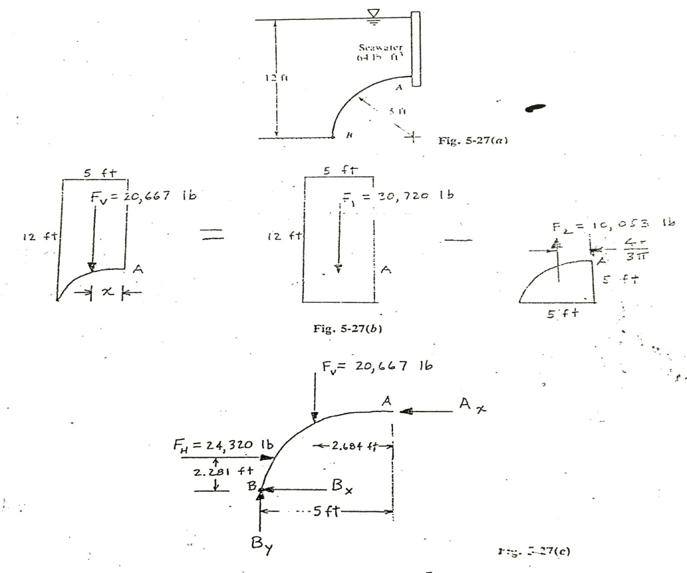
.
Ex.4

Slide 11
Thanks

