Slide 1

Fluid Mechanics Lectures
2nd year/1st semister/2018-2019/Al-Mustansiriyah unv./College of engineering/Highway &Transportation Dep.Lec.3

Slide 2
.
Force considerations
When a body is submerged in a static fluid the fluid pushes on all of the body with pressure . The pressure force acting on the surface of a submerged body determine whether the body will sink or float.

Slide 3
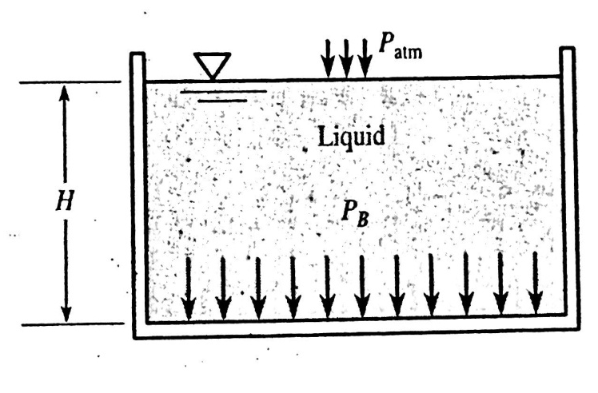
Horizontal plane surfaces submerged in liquids
All points on a horizontal plane surface have the same elevation.(fig.). So, the pressure is constant :
Fig.1
P=γH
So F=PA F=γ*V
.

Slide 4
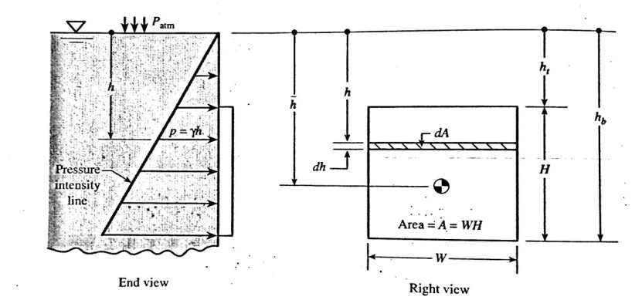
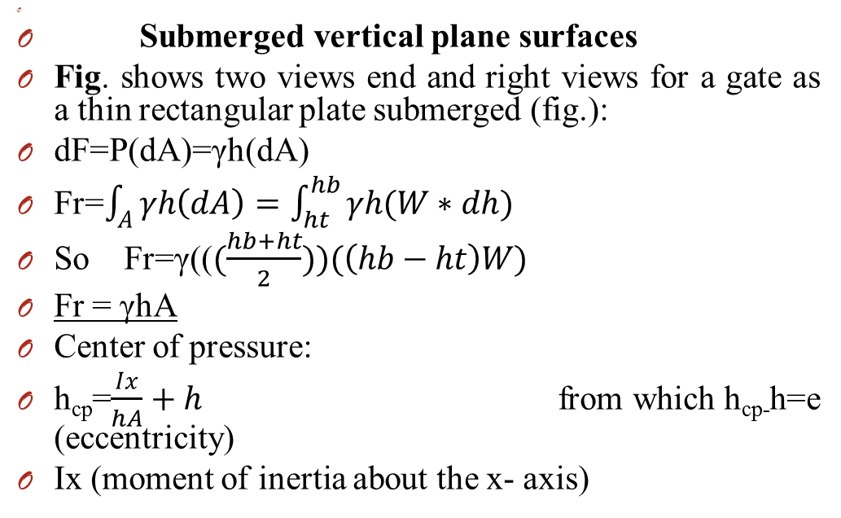
Submerged vertical plane surfaces
Fig. shows two views end and right views for a gate as a thin rectangular plate submerged (fig.):
dF=P(dA)=γh(dA)
Fr=$\int_{A}^{ }{γh\left(dA\right)=\int_{ht}^{hb}{γh(W∗dh)}}$
So Fr=γ(($(\frac{hb+ht}{2}))(\left(hb−ht\right)W)$
Fr = γhA
Center of pressure:
h_{cp}=$\frac{Ix}{hA}+h$ from which h_{cp-}h=e (eccentricity)
Ix (moment of inertia about the x- axis)

Slide 5
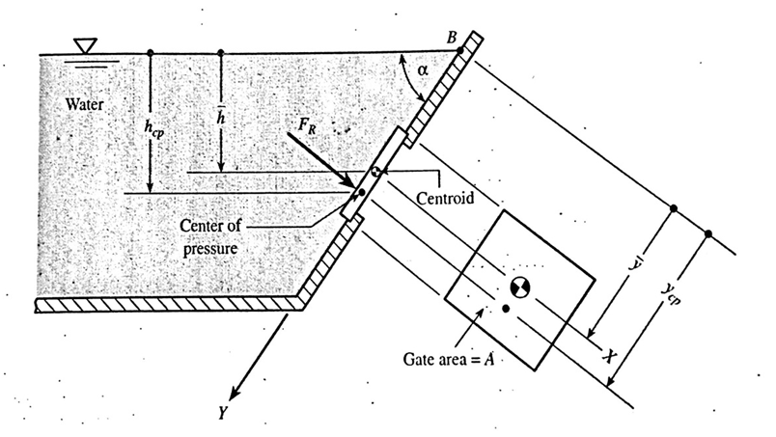

Submerged inclined plane surfaces
The following three equations employed for inclined plane surfaces:
F_{R}= PA=γ h A
F_{R}= γ y A sinα
Y_{cp =} $\frac{Ix}{yA}+y$

Slide 6
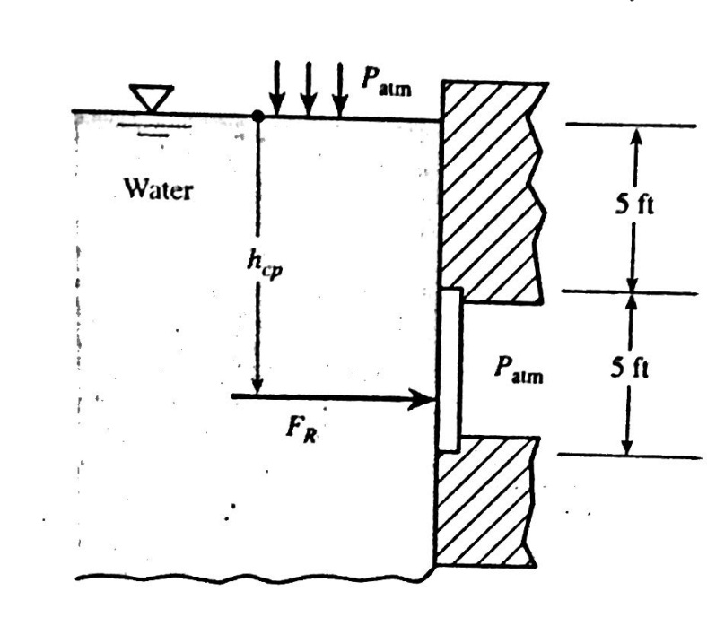
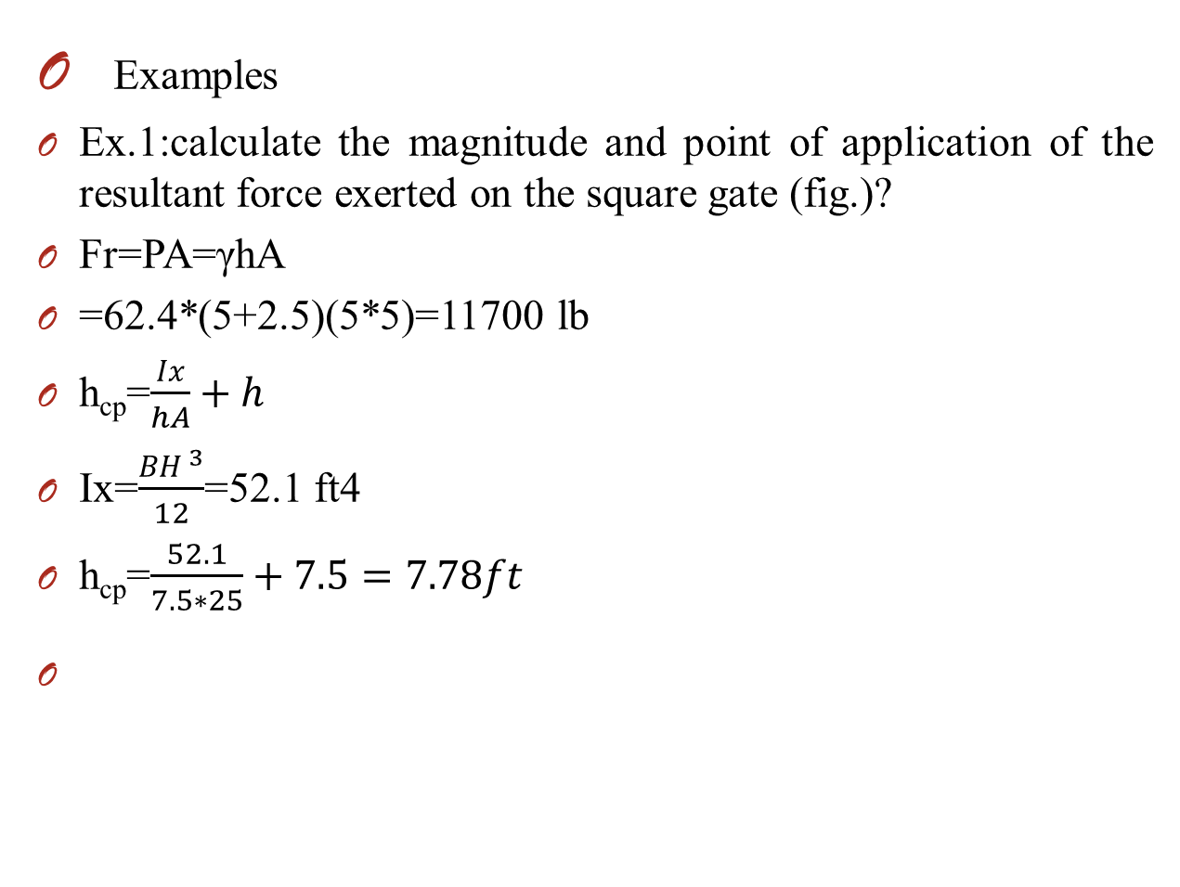
Examples
Ex.1:calculate the magnitude and point of application of the resultant force exerted on the square gate (fig.)?
Fr=PA=γhA
=62.4*(5+2.5)(5*5)=11700 lb
h_{cp}=$\frac{Ix}{hA}+h$
Ix=$\frac{BH ^{3}}{12}$=52.1 ft4
h_{cp}=$\frac{52.1}{7.5∗25}+7.5=7.78ft$
-

Slide 7
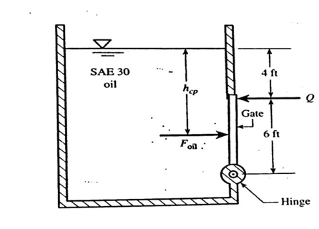

Ex.2:a rectangular gate of dimensions 6 ft high and 4 ft wide is mounted in a vertical wall of an open rectangular tank(fig.) the tank is filled with oil . Determine the minimum force Q to keep the gate closed if the gate is hinged at the bottom?
Foil =γh A
=57*7*24=9580 lb
H_{cp}=$\frac{Ix}{hA}+h=\frac{4∗6 ^{3}/12}{7∗24}+7=7.43 ft$
∑M hinge=0
Foil(10-h_{cp})-Q*6=0
Q=4100lb.

Slide 8
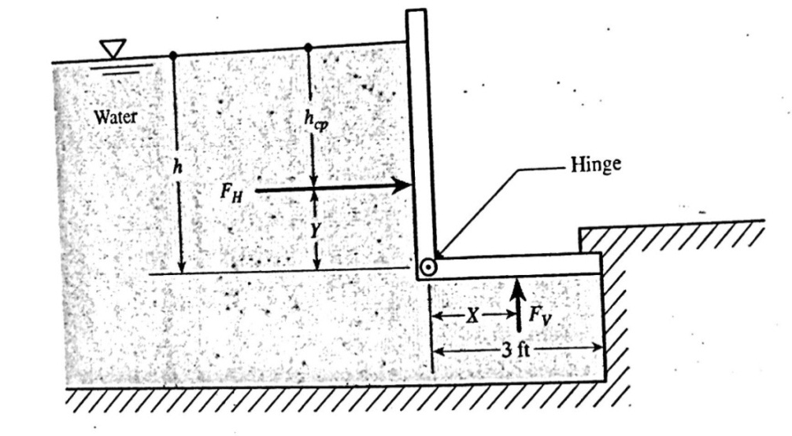

Ex.3:find the minimum hight h of water that will cause the rectangular L-shape gate (fig.6)to open . The gate is hinged where the vertical rectangular section and the horizontal section are connected, thus the L-shape gate is free to rotate. The gate has a constant width W is exposed to the atmosphere (neglect the weight of the gate)?
Fh=γ h Av=$\frac{γ h{ W}^{2}}{2}$
h_{cp}=$\frac{Ix}{h Av}+h=\frac{\frac{1}{12}∗Wh ^{3}}{\frac{h}{2}∗(Wh)}$+$\frac{h}{2}$ =2/3h
so y=h/3 ft.
Fv=γh A_{H}=γh(3W)=3γhW
Fv is act at the center of the section thus X=3/2 ft
∑ M hinge=0
Fh(Y) – Fv(X) =0
$\frac{γh ^{2 }W(\frac{h}{3})}{2}−3γhW\frac{3}{2}$=0 h=5.2ft

Slide 9
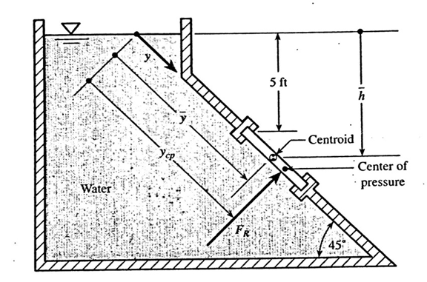

.
Ex.4:determine the force acting on the circular gate located in the inclined wall of the open tank (fig.)the gate diameter is 2 ft ?
Fr=γ h A
=62.4*(5+1*sin 45)*$\frac{π}{4}\left(4\right)=1120lb$
y=$\frac{Ix}{yA}+y$
Y=$\frac{h}{\sin{45}}$=5.71/sin45=8.08ft
Ix=$\frac{πD ^{4}}{64}=0.785 ft ^{4}$
A=$\frac{πD ^{2}}{4}$=3.14 ft²
Y_{cp}=$\frac{0.785}{8.08∗3.14}+8.08$=8.111 ft.
.

Slide 10

Thanks

