Slide 1
Introduction to Nanotechnology
Dr. Raouf Mahmood Raouf
Notes:
Introduction to Nanotechnology:
Last updated February 1, 2008.
Biography of Dr. Alberto Quiñonez:
Alberto Quiñonez is a Professor of Electronics Technology and Assistant Department Chair for the Department of Electronics and Advanced Technologies at Austin Community College (ACC). Dr. Quiñonez joined ACC after 10 years in the Semiconductor Industry. Alberto worked as a Process Engineer at SEMATECH and as a Senior Field Process Engineer at SVG/Thermco (now Avisa Technology).
As a Field Process Engineer, Quiñonez was responsible for worldwide process startup and qualification of furnace capital equipment at customer sites. Alberto enjoys teaching students the skills they need to be successful in high-tech manufacturing. Alberto is co-project investigator for the Nanoelectronics Project Grant. Alberto has been involved in recruiting college students from across the state for Nanoscholar internship opportunities to be held at SEMATECH the nation’s premier Nanoelectronics Research Consortium located in Austin, Texas. In addition, Alberto and the team from ACC have put together presentations that introduce educators and students to the emerging nanotechnology field.
Alberto received his Bachelor of Science in Electronics Engineering Technology from Devry University, his Master of Science in Industrial Manufacturing Technology from Texas State University and his Ph.D. in Higher Education Administration with a concentration in Community College Leadership.

Slide 2
Current and Future Trends, Research and Applications
The ability to see Nano-sized materials has opened up a world of possibilities in a variety of industries and scientific endeavours. Because nanotechnology is essentially a set of techniques that allow manipulation of properties at a very small scale, it can have many applications, such as the ones listed below.
1.Drug delivery. Today, most harmful side effects of treatments such as chemotherapy are a result of drug delivery methods that don't pinpoint their intended target cells accurately. Researchers at Harvard and MIT (Massachusetts Institute) have been able to attach special RNA strands, measuring about 10 nm in diameter, to nanoparticles and fill the nanoparticles with a chemotherapy drug. These RNA strands are attracted to cancer cells. When the nanoparticle encounters a cancer cell it adheres to it and releases the drug into the cancer cell. This directed method of drug delivery has great potential for treating cancer patients while producing less side harmful effects than those produced by conventional chemotherapy.

Slide 3
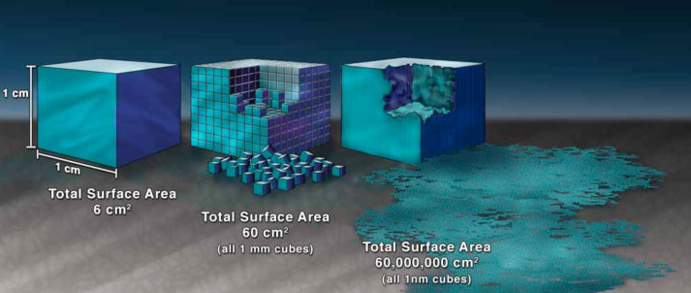
Current and Future Trends, Research and Applications
2.Fabrics. The properties of familiar materials are being changed by manufacturers who are adding Nano-sized components to conventional materials to improve performance. For example, some clothing manufacturers are making water and stain repellent clothing using Nano-sized whiskers in the fabric that cause water to bead up on the surface.
Reactivity of Materials. The properties of many conventional materials change when formed as nano-sized particles (nanoparticles). This is generally because nanoparticles have a greater surface area per weight than larger particles; they are therefore more reactive to some other molecules. For example studies have shown that nanoparticles of iron can be effective in the clean-up of chemicals in groundwater because they react more efficiently to those chemicals than larger iron particles.

Slide 4
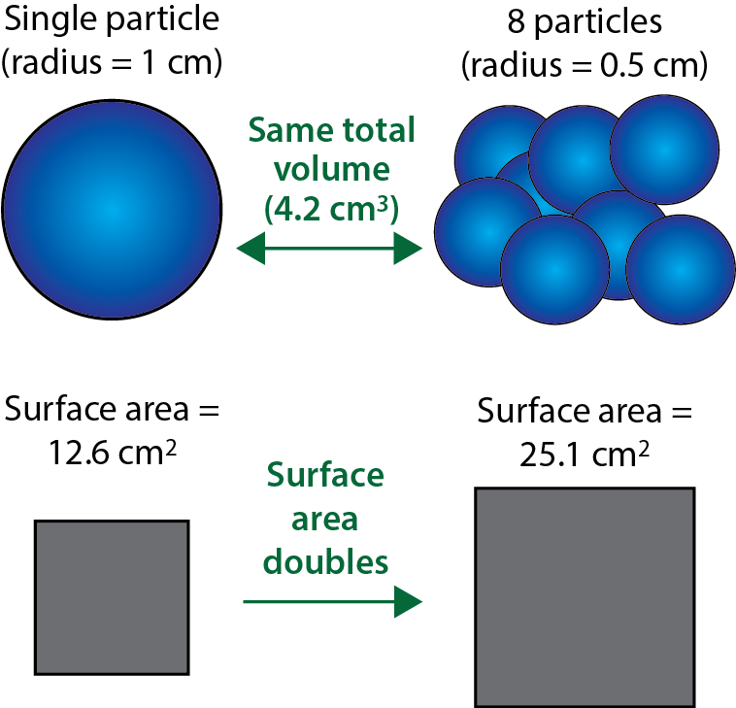
Current and Future Trends, Research and Applications
20
For a fixed total volume, decreasing the radius by a factor of two doubles the surface
Crushing a 1cm particle into nano particles increases the surface area thousands of times!

Slide 5
Current and Future Trends, Research and Applications
21
1 nm particles → 10¹⁰ m²
1 micron particles → 10⁷ m²
1 cm particles → 10³ m²
nano

Slide 6
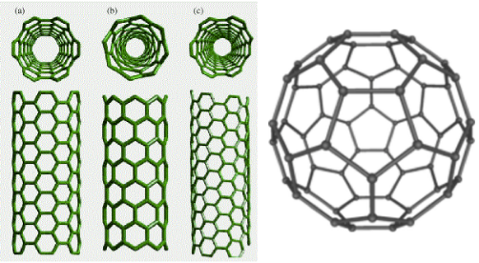
Current and Future Trends, Research and Applications
Strength of Materials. Nano-sized particles of carbon, (for example nanotubes and bucky balls) are extremely strong. Nanotubes and bucky balls are composed of only carbon and their strength comes from special characteristics of the bonds between carbon atoms. One proposed application that illustrates the strength of Nano sized particles of carbon is the manufacture of t-shirt weight bullet proof vests made out of carbon nanotubes.

Slide 7
Current and Future Trends, Research and Applications
3.Micro/Nano Electro-Mechanical Systems. The ability to create gears, mirrors, sensor elements, as well as electronic circuitry in silicon surfaces allows the manufacture of miniature sensors such as those used to activate the airbags in your car. This technique is called MEMS (Micro-Electro Mechanical Systems). The MEMS technique results in close integration of the mechanical mechanism with the necessary electronic circuit on a single silicon chip, similar to the method used to produce computer chips. Using MEMS to produce a device reduces both the cost and size of the product, compared to similar devices made with conventional methods. MEMS is a stepping stone to NEMS or Nano-ElectroMechanical Systems. NEMS products are being made by a few companies, and will take over as the standard once manufacturers make the investment in the equipment needed to produce nano-sized features.

Slide 8
Current and Future Trends, Research and Applications
4.Molecular Manufacturing (MM) means the ability to build devices, machines, and finally whole products with every atom in its specified place. Today the theories for using mechanical chemistry to directly fabricate Nano scale structures are well-developed and waiting progress in enabling technologies. Assuming all this theory works—and no one has established a problem with it yet—exponential general-purpose molecular manufacturing appears to be inevitable. MM can be built into a self-contained, personal factory (PN) that makes cheap products efficiently at molecular scale. The time from the first fabricator to a flood of powerful and complex products may be less than a year. The potential benefits of such a technology are huge. Unfortunately, the risks are also immense. Researchers believe that raw materials can be used to reproduce almost any non-living object using this method.

Slide 9
Current and Future Trends, Research and Applications
The goal of molecular manufacturing (MM) is to build complex products with almost every atom in its proper place. This requires creating large molecular shapes and then assembling them into products. The molecules must be built by some form of chemistry. Many MM proposals assume that building shapes of the required variety and complexity will require robotic placement (covalent bonding) of small chemical pieces. Once the molecular shapes are made, they must be combined to form structures and machines. Again, this is probably done most easily by robotic assembly. Theoretical studies have shown that it should be possible to build diamond lattice by mechanically guided chemistry, or mechanochemistry. By building the lattice in various directions, a wide variety of parts can be made—parts that would be familiar to a mechanical engineer, such as levers and housings. A robotic system used to build the molecular parts could also be used to assemble the parts into a machine. In fact, there is no reason why a robotic system can't build a copy of itself. In sharp contrast to conventional manufacturing, only a few (chemical) processes are needed to make any required shape. And with each atom in the right place, each manufactured part will be precisely the right size—so robotic assembly plans will be easy to program. A small nano-robotic device that can use supplied chemicals to manufacture nanoscale products under external control is called a fabricator.

Slide 10
Nanotechnology Language
Home work
Define
Nanoscale
Nano bio
Nanodots
Nanowires
Nanoelectronics
Nanobots
Nano materials
6
Notes:
Nanotechnology Language:
Many similar yet differing definitions about nanotechnology exist.
For example, it would not be unrealistic to receive hundreds of hits from a search engine after typing the key words “nanotechnology” in the search field and executing a search.
You probably would end up with key words such as nanobio, nanodots, nanowires, nanoelectronics, nanobots, nanomaterials, nanochondria, etc. (Nanotechnology Now, 2007).
Fig. 1.4 – ACC Instructional Development Services.

Slide 11
Scale of Things—Nanometers
Figure 1.5: National Nanotechnology Initiative.
8
Notes:
Scale of Things—Nanometers:
Hence, nanotechnology refers to the process, act or ability to work with materials or matter at the scale of 1 to 100 nanometers. The ability of working at this scale renders novel benefits to numerous products and applications such as those found in the semiconductor manufacturing, material science, medicine, etc.
However, what is the size of 1 nanometer? Albert Einstein estimated that the size of 1 sugar molecule was equal to 1 nanometer. One nanometer would also be equal to the linear size of 10 hydrogen atoms stacked side by side (Roueckes, et al., 2002). It is the same as one-billionth of a meter – a single bacterium is a few hundred nanometers in diameter and a DNA strand is approximately 2-12 nanometers across (NNI, 2007). The un-aided human eye can see down to about 10,000 nanometers (Ratner & Ratner, 2003).
A popular diagram found at www.nano.gov shows size comparisons of natural and manmade things relative to the nanometer.
Fig. 1.5 - http://www.nano.gov/html/facts/The_scale_of_things.html.

Slide 12
References
American Ceramic Society (2006, March). Overview of Safety, Risks. American Ceramic Society Bulletin. Vol. 85 Issue 3.
Booker, Richard & Boysen, Earl (2005). Nanotechnology for Dummies. NJ: Wiley Publishing Inc.
Diott, D.D. (2006, April). Thinking big (and small) about energetic materials. Material Science and Technology. Vol. 22 Issue 4. p. 463.
Drexler, K. Eric (1986). Engines of Creation: The Coming Era of Nanotechnology. New York: Anchor Books.
Henderson, Donald (2006). Bioterrorism: Interview with Donald Henderson. Asia Pacific Biotech News. Vol. 10, Issue 1, p.18.
Lane, Neal & Kalil, Thomas (2005). The National Nanotechnology Initiative: Present at the creation. Issues in Science & Technology; Summer 2005. Vol 21, p49.
Mukherjee, Priyabrata (2006, January). The use of Microorganisms for the formation of metal nanoparticles and their application. Applied Microbiology and Biotechnology. Vol. 69 Issue 5, p. 485.
Notes:
References Cited:
American Ceramic Society (2006, March). Overview of Safety, Risks. American Ceramic Society Bulletin. Vol. 85 Issue 3, p6, 1/6 p.
Booker, Richard & Boysen, Earl (2005). Nanotechnology for Dummies. NJ: Wiley Publishing Inc.
Diott, D.D. (2006, April). Thinking big (and small) about energetic materials. Material Science and Technology. Vol. 22 Issue 4. p. 463, 11p.
Drexler, K. Eric (1986). Engines of Creation: The Coming Era of Nanotechnology. New York: Anchor Books.
Henderson, Donald (2006). Bioterrorism: Interview with Donald Henderson. Asia Pacific Biotech News. Vol. 10, Issue 1, p.18, 9p.
Intel (2007). Moore’s Law. Retrieved 7/02/2007 from http://www.intel.com/technology/mooreslaw/index.htm
Lane, Neal & Kalil, Thomas (2005). The National Nanotechnology Initiative: Present at the creation. Issues in Science & Technology; Summer 2005. Vol 21, p49, 6p.
Lieberman, Marya (2007). Self-assembled monolayers and multilayers of phthalocyanines. University of Notre Dame: Department of Chemistry and Biochemistry. Retrieved 7/02/2007 from http://www.nd.edu/~mlieberm/
Mandal, Deendayal; Bolander, Mark E.; Mukhopadhyay, Debrabrata; Sarkar, Gobinda;
Mukherjee, Priyabrata (2006, January). The use of Microorganisms for the formation of metal nanoparticles and their application. Applied Microbiology and Biotechnology. Vol. 69 Issue 5, p. 485, 8p.
Mostow, Jonathan (Director). (2003). Terminator 3: Rise Of The Machines [Motion Picture]. United States: Warner Bros. Pictures.
Murday, James F. (2005). Nanotechnology: Hype and Hope in Aerospace Applications. Advanced Materials and Processes. Vol. 163, Issue 12, P. 21, 2p.
Nanotechnology at UT Austin (2007). Graduate Portfolio Program. Retrieved 6/27/2007 from http://www.cnm.utexas.edu/graduateportfolio.html
Nanotechnology Now (2006, March). Nanotechnology documentary to be filmed at nanoTX'06. Retrieved 7/02/2007 from http://www.nanotech-now.com/news.cgi?story_id=14281
National Nanotechnology Initiative - NNI (2007). What is Nanotechnology? Retrieved 6/25/2007 from http://www.nano.gov/html/facts/whatIsNano.html
Rappaport, Tatiana Gabriela (2006). Semiconductors: Nanostructures and applications in spintronics and quantum computation. Vol. 809 issue 1, p.326, 17p.
Ratner, Mark & Ratner, Daniel (2003). Nanotechnology: A Gentle Introduction to the Next Big Idea. New Jersey: Prentice Hall PTR.
Rouekes, M. L., Fritz, S., Stix, G., Whiteside, G.M., Love, J.C., Alivisatos, A.P. et al. (2002). Understanding Nanotechnology: Scientific American. New York: Warner Books.
Terra, Richard P. (2000, March). National Nanotechnology Initiative in FY2001 Budget: Clinton Administration Requests $497 million for NT-Related R&D Funding. Foresight Nanotech Institute. Retrieved 4/02/2007 from http://www.foresight.org/Updates/Update40/Update40.1.html
UNL News Releases (2006, December). Self-assembling nano-ice discovered at UNL; structure resembles DNA. Retrieved 6/28/2007 from http://ucommxsrv1.unl.edu/unlnews/public/fmpro?-db=unlnews.fp5&-format=newsrelease.shtml&-lay=unlnews&-recid=33994&-find=
Wikipedia (2007). Moore’s Law. Retrieved 7/02/2007 from http://en.wikipedia.org/wiki/Moore%27s_law
Wikipedia (2007). Nature. Retrieved 7/05/2007 from http://en.wikipedia.org/wiki/Category:Nature
Wong, H.S. Philip (2006, March). Nanoelectronics – Opportunities and Challenges. International Journal of High Speed Electronics and Systems. Vol. 16, Issue 1, p. 83, 12p.
Yamaguchi, Tomohiko; Epstein, Irving; Shimomura, Masatsugu; & Kunitake, Toyoki (2005, December). Vol. 15, Issue 4, p. N, 3 p.
Zyvex: Nanotechnology Website: There’s Plenty of Room at the Bottom. Retrieved 6/27/2007 from http://www.zyvex.com/nanotech/feynman.html.
12

Slide 13
References
Murday, James F. (2005). Nanotechnology: Hype and Hope in Aerospace Applications. Advanced Materials and Processes. Vol. 163, Issue 12, P. 21.
Rappaport, Tatiana Gabriela (2006). Semiconductors: Nanostructures and applications in spintronics and quantum computation. Vol. 809 issue 1, p.326.
Wong, H.S. Philip (2006, March). Nanoelectronics – Opportunities and Challenges. International Journal of High Speed Electronics and Systems. Vol. 16, Issue 1, p. 83, 12p.
Yamaguchi, Tomohiko; Epstein, Irving; Shimomura, Masatsugu; & Kunitake, Toyoki (2005, December). Vol. 15, Issue 4, p. N, 3 p.
Notes:
References, Continued:
See Slide 23 for full reference citations.
13

