Slide 1
Introduction to Nanotechnology
Dr. Raouf Mahmood Raouf
Notes:
Introduction to Nanotechnology:
Last updated February 1, 2008.
Biography of Dr. Alberto Quiñonez:
Alberto Quiñonez is a Professor of Electronics Technology and Assistant Department Chair for the Department of Electronics and Advanced Technologies at Austin Community College (ACC). Dr. Quiñonez joined ACC after 10 years in the Semiconductor Industry. Alberto worked as a Process Engineer at SEMATECH and as a Senior Field Process Engineer at SVG/Thermco (now Avisa Technology).
As a Field Process Engineer, Quiñonez was responsible for worldwide process startup and qualification of furnace capital equipment at customer sites. Alberto enjoys teaching students the skills they need to be successful in high-tech manufacturing. Alberto is co-project investigator for the Nanoelectronics Project Grant. Alberto has been involved in recruiting college students from across the state for Nanoscholar internship opportunities to be held at SEMATECH the nation’s premier Nanoelectronics Research Consortium located in Austin, Texas. In addition, Alberto and the team from ACC have put together presentations that introduce educators and students to the emerging nanotechnology field.
Alberto received his Bachelor of Science in Electronics Engineering Technology from Devry University, his Master of Science in Industrial Manufacturing Technology from Texas State University and his Ph.D. in Higher Education Administration with a concentration in Community College Leadership.

Slide 2
Topics
Introduction
What is Nano?
Why Nano Technology?
Scope of Applications
How do properties change at the Nano scale?
Current and Future Trends, Research and Applications
Notes:
Topics:
The topics of this module will provide an overview of nanotechnology terms and definitions, history of nanotechnology, and both current and future trends, research and applications.
The work of this module intends to develop the knowledge and interest of individuals who aspire to become more aware or involved with nanotechnology.
It is recommended that nanotechnology novices read the introductory module prior to reading modules 2 through 12.
Module 1 serves to prepare the reader for the subsequent modules.

Slide 3
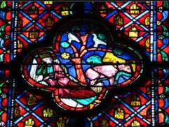
Introduction
Nanomaterials are not new
Nanomaterials have been produced and used by humans for hundreds of years. However, the understanding of certain materials as nanostructured materials is relatively recent, made possible by the advent of advanced tools that are capable of resolving information at nanoscale.
• We now know that the beautiful ruby red colour of some ancient glass paintings is due to gold and silver nanoparticles trapped in the glass matrix.

Slide 4
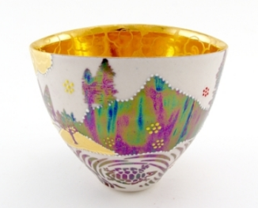
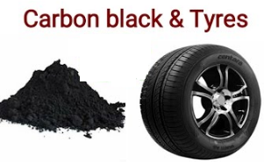
Introduction
• The decorative glaze or metallic film known as ‘luster’,
found on some medieval pottery, contains metallic
spherical nanoparticles dispersed in a complex way
in the glaze, which gives rise to special optical properties.
• Carbon black is a nanostructured material that is used in car tyres to increase the life of the tyre and impart black colour. This material was discovered in the 1900s.

Slide 5
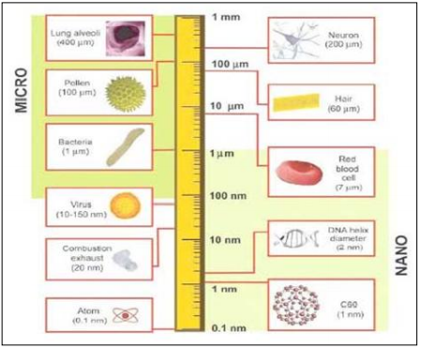
Introduction
In 1959, the physicist Professor Richard Feynman gave the first illuminating talk on nano technology, which was entitles as: (There’s Plenty of Room at the Bottom). He explored the possibility of “direct manipulation” of the individual atoms to be effective as a more powerful form of ‘synthetic chemistry’. Feynman talked about a number of interesting results of a ‘general ability’ to manipulate matter on an atomic scale.
Notes:
Objective:
The objective of this module is to introduce the emerging nanotechnology field to novices of nanotechnology including, but not limited to, students, educators, business and community members, government workers and representatives.

Slide 6
Introduction
Scientists have been studying and working with nanoparticles for centuries, but the effectiveness of their work has been hampered by their inability to see the structure of nanoparticles. In recent decades the development of microscopes capable of displaying particles as small as atoms has allowed scientists to see what they are working with.
They was particularly interested in the possibility of denser computer circuitry and microscopes that could see things much smaller than is possible using (Scanning Electron Microscope). The IBM research scientists created today’s (atomic force microscope) and (Scanning Tunnelling Microscope), and there are other important examples. Feynman proposed that it could be possible to develop a (general ability) to manipulate things on an atomic scale with a (top → down) approach.

Slide 7
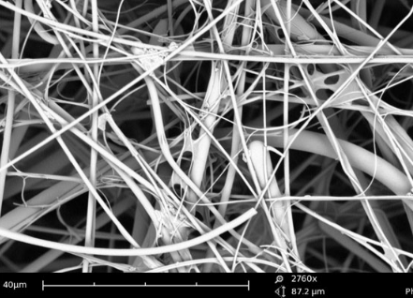
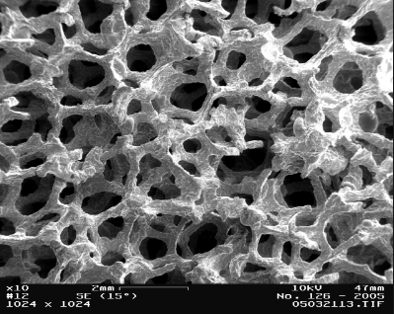
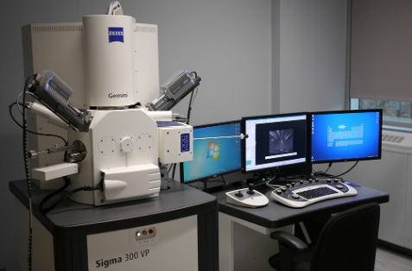
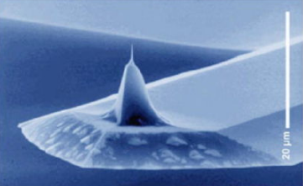
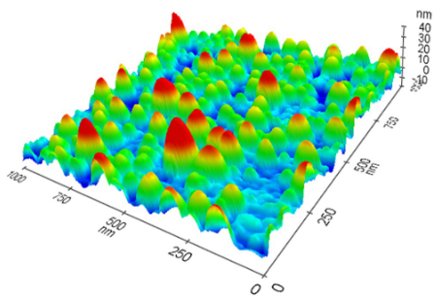
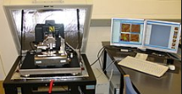
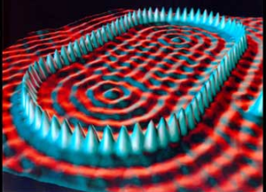
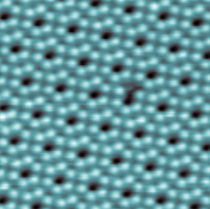
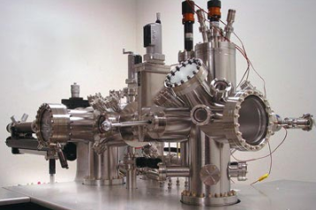
Introduction

Slide 8
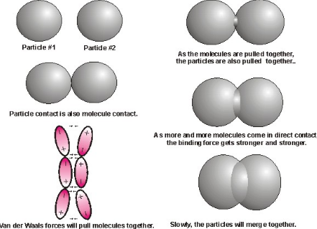
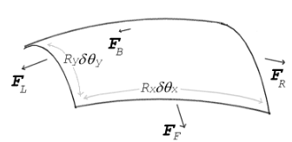
Introduction
We can continue with this particular trend of down-scaling until the tools are able to directly manipulate atoms, which will require redesign of the tools periodically, as different forces and effects come into play. Thus, the effect of gravity will decrease, and the effects of surface tension and Van der Waals attraction will be enhanced.

Slide 9
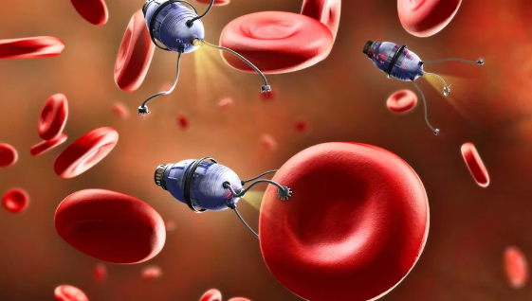
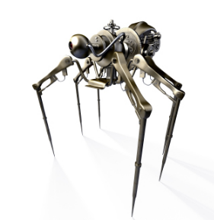
Introduction
Although Feynman’s talk did not explain the full concept of nano technology, it was K. E. Drexler who envisioned self-replicating (nanobots), i.e., self-replicating robots at the molecular scale, in Engines of Creation: The Coming Period of Nano Technology in 1986.

Slide 10
References
Murday, James F. (2005). Nanotechnology: Hype and Hope in Aerospace Applications. Advanced Materials and Processes. Vol. 163, Issue 12, P. 21.
Rappaport, Tatiana Gabriela (2006). Semiconductors: Nanostructures and applications in spintronics and quantum computation. Vol. 809 issue 1, p.326.
Wong, H.S. Philip (2006, March). Nanoelectronics – Opportunities and Challenges. International Journal of High Speed Electronics and Systems. Vol. 16, Issue 1, p. 83, 12p.
Yamaguchi, Tomohiko; Epstein, Irving; Shimomura, Masatsugu; & Kunitake, Toyoki (2005, December). Vol. 15, Issue 4, p. N, 3 p.
Notes:
References, Continued:
See Slide 23 for full reference citations.
10

