Slide 1
Fluid Mechanics Lectures 2nd year/1st semister/2018-2019/Al-Mustansiriyah unv./College of engineering/Highway &Transportation Dep.Lec.1

Slide 2
.
Introduction
Definition:
Fluid mechanics is a study of behavior of fluids (liquid and gases)and applications where fluid systems are used. Fluid mechanics is divided in to two subjects fluid statics and fluid dynamics. Statics deals with fluid systems where the fluid at rest, whereas dynamics deal with flowing fluids.
Fluid:
Is a substance that cannot resist a shearing force and cannot remain at rest.The term fluid refers to both gases and liquids. In liquids the space between adjacent molecules is much larger than that for solids. Thus liquids molecules move much more freely than solids. In gases the space between adjacent molecules is much larger than that for liquids, thus gases flow more readily than liquids and also very compressible.

Slide 3
Fundamental units:
Two primary systems are widespread the U.S. system and International System (SI)
.
Fundamental units | symbol | U.S | SI
Length | L | Ft | M
Force | F | Ib | N
Mass | M | Slug | Kg
time | T | s | s

Slide 4
Force and weight versus mass:Depending on the Newtons law in motion , force equals mass tines acceleration F=M*g, but all objects are pulled toward the center of Earth by force of attraction, this force is called the weight of the object :
W= F = M*g
Table below gives an abbreviated listing of the conversion factors:
parameter | U.S. | SI
length | 1ft | 0.3048 m
force | 1lb | 4.448 N
mass | 1 slug | 14.59 kg
length | 1ft=12 in
mass | 1slug = 32.2 lb
Vol. | 1000 liter | 1 m³
mass | 1lb | 0.4536 kg
force | 1 lb/in² (psi) | 6894.4 N/m²
Weight |  | 1 N=kg.m/s²

Slide 5
Properties of fluids
1-Specific weight (γ): is defined as weight per unit volume
γ=WV (N/m³) or (lb/ft³⁾
2-Specific gravity (S.g): is defined as the specific weight of the fluid divided by the specific weight of water at 4◦ C
S.g =γγw or Ƿ/Ƿ_{w} (without unit)
3-Density (Ƿ):is defined as its mass per unit volume
Ƿ=MV (kg/m³) or (slug/ft³)
Thus:
W=M*g
γV=ǷV*g Ƿ=γ/g

Slide 6
4-Pressure (P): is defined as the magnitude of this normal force per unit area of the contacting surface.
P= $\frac{F}{A}$ (N/m²)(Pa.) or ( lb/ft²)(psf)
5-Bulk modulus (β): is defined as how much does the volume and the density of a fluid change when the pressure changed?. The higher the value of the bulk modulus the less compressible and thus stiffer the fluid.
β=$\frac{−ΔP}{ΔV/V}$
β=bulk modulus (lb/in²) or (N/m²)
V=original volume (in³) or (m³)
ΔP=change in pressure (lb/in²) or (N/m²)
ΔV=change in volume (in³) or (m³)
-

Slide 7
6-Discharge (Q): is defined as the volume of fluid that flow in a certain time.
Q= velocity* area or volume / time (ft³/s) or (m³/s)
7-Viscosity :is that property as such it is a measure of the sluggishness with which a fluid flows. When the viscosity is low indicative of a thin fluid like water and the fluid flows easily, conversely, the thickest fluids such as certain types of oil, are the most viscous and do not flow readily. The cause of viscosity is the molecular attraction between adjacent layers of fluid. When fluid is at rest there is no resistance to an applied shear force.
a-absolute viscosity(dynamic viscosity):
µ=N.s/m²(Pa. s) or (lb.s/ft²)
1N.s/m²= 10 poise, 1poise =0.1 Pa.s and 1 centipoise(cp)=0.001 pa.s
b-Kinematic viscosity (ν)
ν=m²/s or ft²/s
1 m²/s =10⁴ stokes.
ν=µ/Ƿ
8-Shear stress (τ):is tangent force acting tangentially on fluid surface area
Τ=F/A (N/m²).

Slide 8
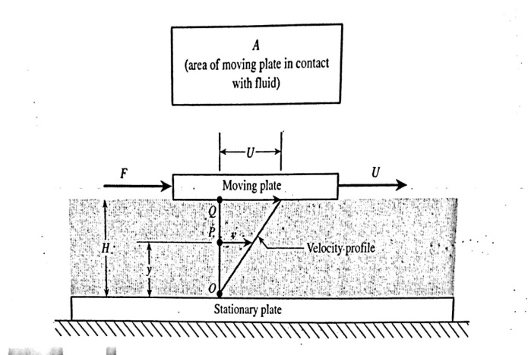
Shear stress and velocity gradient
F/A is the shear stress developed in the fluids and acting on the bottom surface of the moving plate in the direction opposing the plate motion . The slope of the velocity profile is also called the velocity gradient (fig.1) :
Fig.1
µ= $\frac{shear stress}{velocity gradient}= \frac{τ}{v/y}$
τ=µ$\frac{dv}{dy}$
information:
Ƿ_{w}=1000kg/m³=1.94 slug/ft³, γ_{w}=9800 N/m³=62.4lb/ft³, g=9.81m/s²=32.2 ft/s².

Slide 9
.
.
Examples:
Ex.1
A quart of SAE oil weighs about 1.85 lb. Calculate the oils specific weight, density and specific gravity?
V=$\frac{231 in ^{3}×1 ft ^{3}}{4×1782in ^{3}}$=0.0334 ft³ since 1 quart=1gal/4=231in³/4
γ=W/V=1.85/0.0334=55.4 lb/ft³
^{Ƿ}=γ/g=55.4/32.2=1.72 slug/ft³
s.g=γ_{oil}/γ_{w}=55.4/62.4=0.888

Slide 10
Ex.2
Knowing that the viscosity of water is 1 cp, calculate thr corresponding :absolute viscosity in lb.s/ft², and kinematic viscosity in ft²/s ? the density of water is 1.94 slug/ft³.
1 cp=0.001 N.s/m² thus
µ= 0.001*(0.3048)³/4.448 = 2.09*10⁻⁵lb.s/ft²
ν=µ/Ƿ
ν=2.09*10⁻⁵/1.94=1.08*10⁻⁵ft²/s.
.

Slide 11
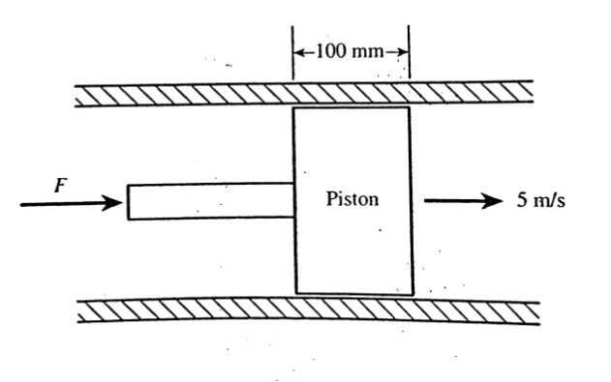
Ex.3:
A piston move inside a cylinder at a velocity of 5 m/s (fig.2), the 150mm diameter piston is centrally located within 150.2 mm inside diameter. The film of oil separating the piston from the cylinder has an absolute viscosity of 0.4 N.s/m². Assuming a linear velocity profile, find
a-Shear stress, b-force F required to maintain the given motion and c- factor by which the required force would change if the viscosity increased by factor 2?
τ=µdvdy
=0.4*5/0.0001=20000 N/m²
F=τ*A=20000*π*0.15*0.1=942 N
The shear stress would increase by 2 thus the force would also increase by 2.

Slide 12
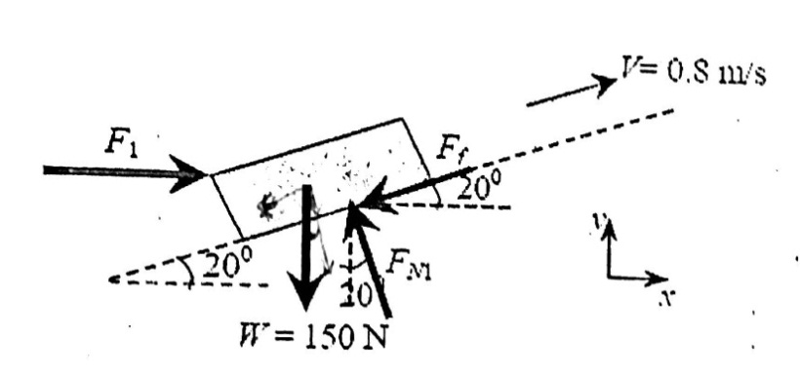
Ex4.
A block of dimensions 300mm*300mm*300mm and weight 150 N slides down a plane inclined at 20◦ to the horizontal , a thin film of oil is between the block and surface with viscosity 2.3*10⁻³pa.s. Determine the film thickness if the speed is 0.8m/s?
τ=µ$\frac{dv}{dy}$
F= µ$\frac{dv}{dy}$ *A F=W sin 20◦
150 * sin 20◦=2.3*10⁻³(0.8/dy)(0.3*0.3)
dy=0.0032 mm.

Slide 13
Thanks

