Slide 1
Instantaneous Power in AC Circuit

Slide 12
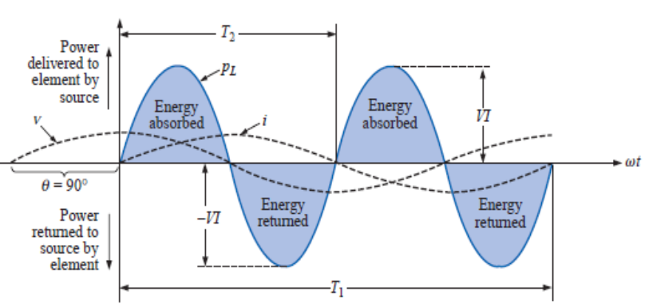

Slide 14
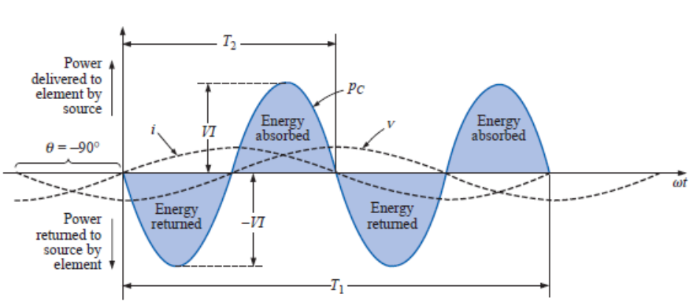
Fig. (3) The capacitive (reactive power) waveform.

Slide 15
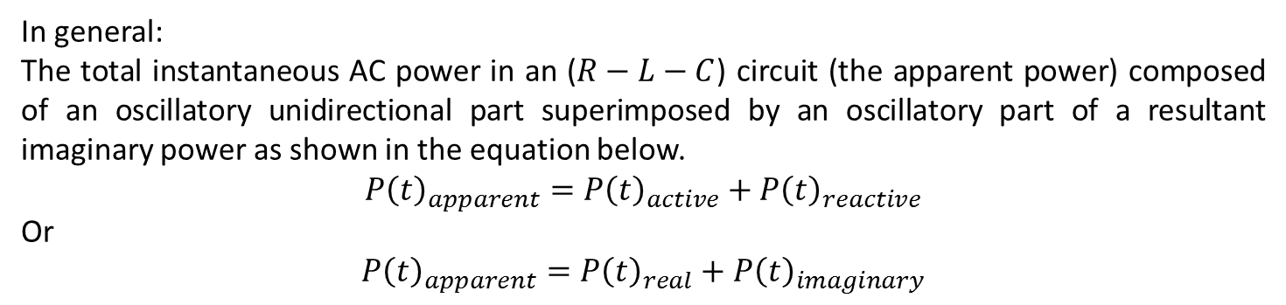
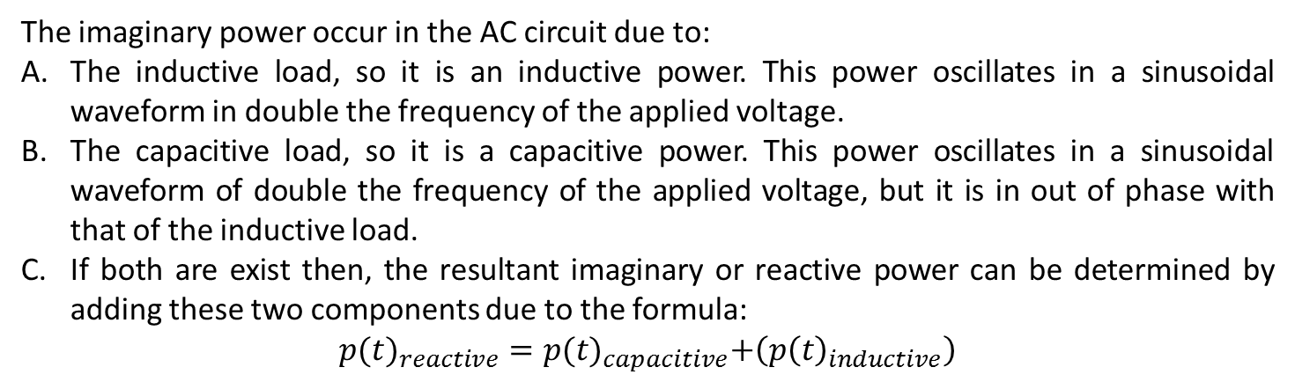
From the previous analysis it is clear that there are two types of power in AC circuits:
A power transfers from the source to the load during all the time of the cycle. This power due to the existence of the resistive part and is called the real power. Hence, it is an oscillatory unidirectional part of the AC power.
The power that transfer alternatively from source to load and from load to source at each quarter cycle, hence it oscillate at double frequency of the applied voltage. This is called the imaginary power. Hence, it is a bidirectional part of the AC power.
The imaginary power occur in the AC circuit due to:
The inductive load, so it is an inductive power. This power oscillates in a sinusoidal waveform in double the frequency of the applied voltage.
The capacitive load, so it is a capacitive power. This power oscillates in a sinusoidal waveform of double the frequency of the applied voltage, but it is in out of phase with that of the inductive load.
If both are exist then, the resultant imaginary or reactive power can be determined by adding these two components due to the formula:
$${p(t)}_{reactive}=p{(t)}_{capacitive}+\left(p{\left(t\right)}_{inductive}\right)$$
In general:
The total instantaneous AC power in an ($R−L−C$) circuit (the apparent power) composed of an oscillatory unidirectional part superimposed by an oscillatory part of a resultant imaginary power as shown in the equation below.
$${P\left(t\right)}_{apparent}={P\left(t\right)}_{active}+{P\left(t\right)}_{reactive}$$
Or
${P\left(t\right)}_{apparent}={P\left(t\right)}_{real}+{P\left(t\right)}_{imaginary}$

Slide 16

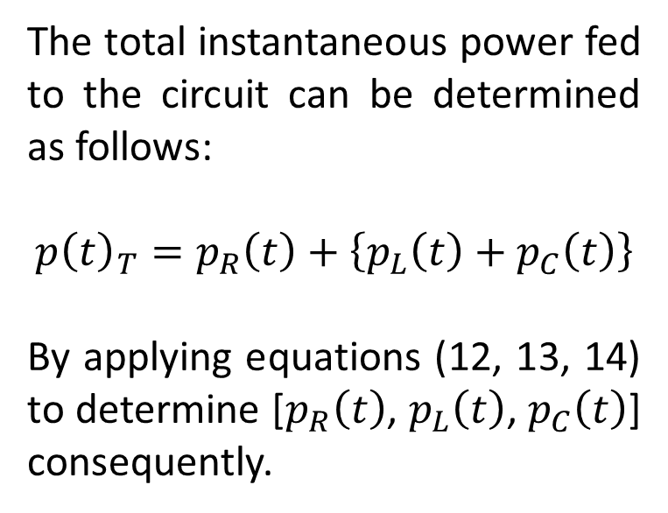



Ex.1: For the circuit shown below determine the instantaneous apparent (total) power, assume that the sinusoidal waveform current of frequency= (50Hz) passing through the circuit and of an rms value= 2A, by summation of the instantaneous power on each element.
The total instantaneous power fed to the circuit can be determined as follows:
$${p\left(t\right)}_{T}=p_{R}\left(t\right)+\left\{p_{L}\left(t\right)+p_{C}\left(t\right)\right\}$$
By applying equations (12, 13, 14) to determine [$p_{R}\left(t\right)$, $p_{L}\left(t\right)$, $p_{C}\left(t\right)$] consequently.
$R=10$Ω
$$X_{L}=10Ω$$
$$X_{C}=30Ω$$
$$P_{T}$$
The following waveforms show each one of these powers as a function of time

Slide 17
  $$p_{r}\left(t\right)=V_{R_{rms}}I_{rms}−V_{R_{rms}}I_{rms}\cos\left(2ωt\right)$$
$$V_{R_{rms}}=R×I_{rms}$$

Slide 18

$$p_{L}\left(t\right)=−V_{L_{rms}}I_{rms}\sin\left(2ωt\right)$$
$$V_{L_{rms}}=X_{L}I_{rms}$$

Slide 19

$$p_{C}\left(t\right)=V_{C_{rms}}I_{rms}\sin\left(2ωt\right)$$
$$V_{C_{rms}}=X_{C}I_{rms}$$

Slide 20

$$p_{reactive}\left(t\right)=p_{C}\left(t\right)+p_{L}\left(t\right)$$

Slide 21
$${p\left(t\right)}_{T}=p_{R}\left(t\right)+\left\{p_{L}\left(t\right)+p_{C}\left(t\right)\right\}$$

Slide 23
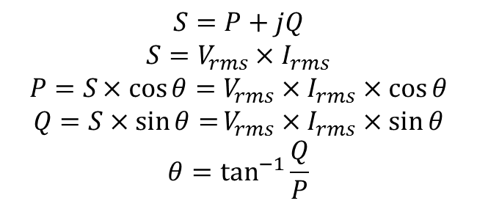


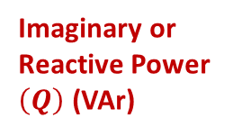


The Power Triangle
Axis of the average real power- ${(P}_{av−real})$
CCW
$$S=P+jQ$$
$$S=V_{rms}×I_{rms}$$
$$P=S×cos{θ=V_{rms}×I_{rms}×\cos{θ}}$$
$$Q=S×\sin{θ=}V_{rms}×I_{rms}×\sin{θ}$$
$$θ=\tan^{−1}{\frac{Q}{P}}$$
CCW
Imaginary or Reactive Power $\left(Q\right)$ (VAr)
Apparent Power $\left(S\right)$ (VA)
$$θ$$
Real or Active Power $\left(P\right)$(W)
This is known as a power triangle: It is a phasor diagram representing the instantaneous value of the complex power. It rotates CCW around a center of (0.0, +$P_{av−real}).$

Slide 24
t | t (ms) | P res =P real | Pind | Pcap | Preac=Pimag | P appparent
0 | 0 | 0 | 0 | 0 | 0 | 0
0.0005 | 0.5 | 0.978868 | -6.18033 | 18.541 | 6.180335 | 7.159203
0.001 | 1 | 3.819654 | -11.7557 | 35.26709 | 11.7557 | 15.57535
0.0015 | 1.5 | 8.244282 | -16.1803 | 48.54099 | 16.18033 | 24.42461
0.002 | 2 | 13.81964 | -19.0211 | 57.06337 | 19.02112 | 32.84076
0.0025 | 2.5 | 19.99997 | -20 | 60 | 20 | 39.99997
0.003 | 3 | 26.18031 | -19.0211 | 57.06342 | 19.02114 | 45.20145
0.0035 | 3.5 | 31.75567 | -16.1804 | 48.54109 | 16.18036 | 47.93604
0.004 | 4 | 36.18031 | -11.7557 | 35.26722 | 11.75574 | 47.93605
0.0045 | 4.5 | 39.02112 | -6.18039 | 18.54116 | 6.180385 | 45.2015
0.005 | 5 | 40 | -5.3E-05 | 0.000159 | 5.31E-05 | 40.00005
0.0055 | 5.5 | 39.02115 | 6.180284 | -18.5409 | -6.18028 | 32.84086
0.006 | 6 | 36.18038 | 11.75565 | -35.267 | -11.7557 | 24.42472
0.0065 | 6.5 | 31.75576 | 16.1803 | -48.5409 | -16.1803 | 15.57546
0.007 | 7 | 26.18041 | 19.02111 | -57.0633 | -19.0211 | 7.159303
0.0075 | 7.5 | 20.00008 | 20 | -60 | -20 | 7.96E-05
0.008 | 8 | 13.81974 | 19.02116 | -57.0635 | -19.0212 | -5.20142
0.0085 | 8.5 | 8.244368 | 16.18039 | -48.5412 | -16.1804 | -7.93602
0.009 | 9 | 3.819716 | 11.75578 | -35.2673 | -11.7558 | -7.93607
0.0095 | 9.5 | 0.978901 | 6.180436 | -18.5413 | -6.18044 | -5.20153
0.01 | 10 | 2.82E-10 | 0.000106 | -0.00032 | -0.00011 | -0.00011
0.0105 | 10.5 | 0.978835 | -6.18023 | 18.5407 | 6.180234 | 7.159069
0.011 | 11 | 3.819591 | -11.7556 | 35.26683 | 11.75561 | 15.5752
0.0115 | 11.5 | 8.244196 | -16.1803 | 48.5408 | 16.18027 | 24.42446
0.012 | 12 | 13.81954 | -19.0211 | 57.06327 | 19.02109 | 32.84063
0.0125 | 12.5 | 19.99987 | -20 | 60 | 20 | 39.99987
0.013 | 13 | 26.18021 | -19.0212 | 57.06352 | 19.02117 | 45.20138
0.0135 | 13.5 | 31.75559 | -16.1804 | 48.54127 | 16.18042 | 47.93601
0.014 | 14 | 36.18025 | -11.7558 | 35.26748 | 11.75583 | 47.93608
0.0145 | 14.5 | 39.02108 | -6.18049 | 18.54146 | 6.180486 | 45.20157
0.015 | 15 | 40 | -0.00016 | 0.000478 | 0.000159 | 40.00016
0.0155 | 15.5 | 39.02118 | 6.180183 | -18.5406 | -6.18018 | 32.841
0.016 | 16 | 36.18044 | 11.75557 | -35.2667 | -11.7556 | 24.42487
0.0165 | 16.5 | 31.75585 | 16.18024 | -48.5407 | -16.1802 | 15.57561
0.017 | 17 | 26.18051 | 19.02107 | -57.0632 | -19.0211 | 7.159437
0.0175 | 17.5 | 20.00019 | 20 | -60 | -20 | 0.000186
0.018 | 18 | 13.81984 | 19.02119 | -57.0636 | -19.0212 | -5.20135
0.0185 | 18.5 | 8.244454 | 16.18046 | -48.5414 | -16.1805 | -7.936
0.019 | 19 | 3.819779 | 11.75587 | -35.2676 | -11.7559 | -7.93609
0.0195 | 19.5 | 0.978934 | 6.180537 | -18.5416 | -6.18054 | -5.2016
0.02 | 20 | 1.13E-09 | 0.000212 | -0.00064 | -0.00021 | -0.00021

