Slide 1
Fundamentals of Alternating Current (AC) Circuits
What is the need for an AC circuit?
The generation of single phase voltage.
The relation between time and angle.
The maximum, average and effective value.
The form factor and peak factor.
Phasor representation of sinusoidal waveform.
Voltage and current relationship in pure resistive, inductive and capacitive circuit at Steady State.
Analysis of single phase AC circuit resistance, reactance and impedance, conductance–susceptance and admittance.

Slide 2
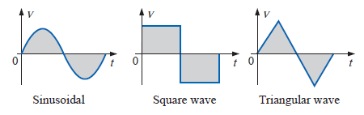
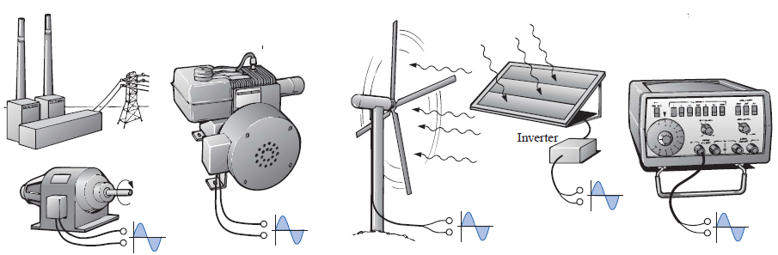
Why the AC generated? What is the need for an AC circuit?
Alternating Current Waveforms
Different (Alternating) Sinusoidal Current Waveform Generators

Slide 3
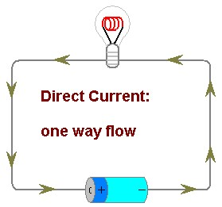
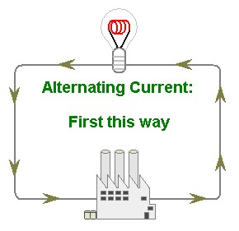
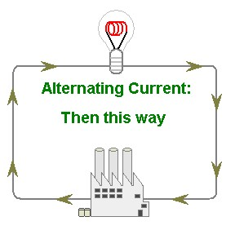
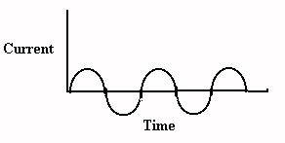
There are 2 types of Current
DC = Direct Current - current flows in one direction
AC = Alternating Current- current reverses direction 100 times per second (50 Hz).

Slide 4

Electricity
D.C.
Direct Current
A.C.
Alternating Current

Slide 5
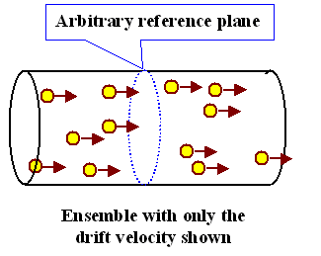
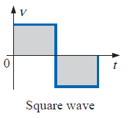
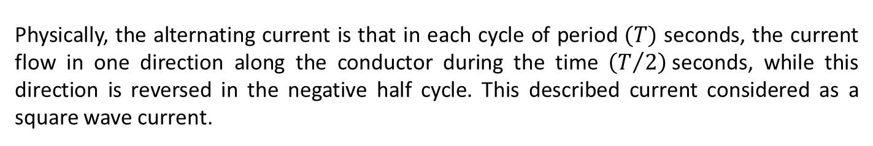



In Positive Half Cycle The Charge Direction Is as Indicated
In Negative Half Cycle The Charge Direction is Reversed
Physically, the alternating current is that in each cycle of period $(T)$ seconds, the current flow in one direction along the conductor during the time $\left(T/2\right)$seconds, while this direction is reversed in the negative half cycle. This described current considered as a square wave current.
$$I$$
$$T$$
$$\frac{T}{2}$$

Slide 6
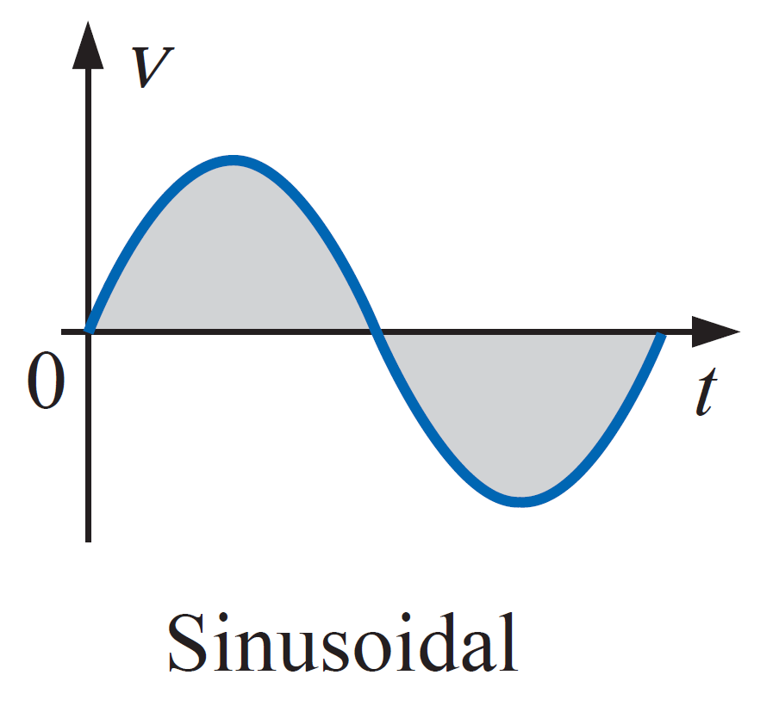








$$I$$
$$I_{max}$$
$$T$$
$$\frac{3T}{4}$$
$$\frac{T}{4}$$
$$\frac{T}{2}$$
$${−I}_{max}$$
$${−I}_{max}$$

Slide 7
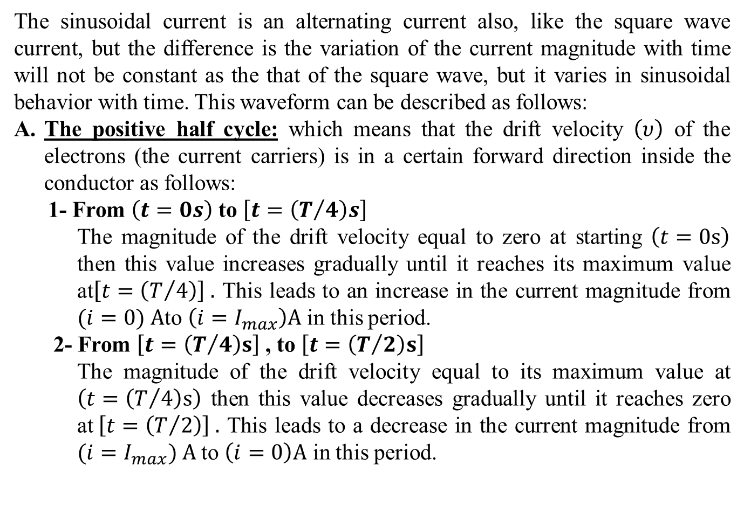
The sinusoidal current is an alternating current also, like the square wave current, but the difference is the variation of the current magnitude with time will not be constant as the that of the square wave, but it varies in sinusoidal behavior with time. This waveform can be described as follows:
The positive half cycle: which means that the drift velocity $\left(υ\right)$ of the electrons (the current carriers) is in a certain forward direction inside the conductor as follows:
1- From $\left(t=0s\right)$ to $\left[t=\left(T/4\right)s\right]$
The magnitude of the drift velocity equal to zero at starting $\left(t=0s\right)$ then this value increases gradually until it reaches its maximum value at$\left[t=\left(T/4\right)\right] .$ This leads to an increase in the current magnitude from $(i=0) A$to $\left(i=I_{max}\right)A$ in this period.
2- From $\left[t=\left(T/4\right)s\right]$, to $\left[t=\left(T/2\right)s\right]$
The magnitude of the drift velocity equal to its maximum value at $\left(t=\left(T/4\right)s\right)$ then this value decreases gradually until it reaches zero at$\left[t=\left(T/2\right)\right] .$ This leads to a decrease in the current magnitude from $(i=I_{max}) A$ to $\left(i=0\right)A$ in this period.

Slide 8
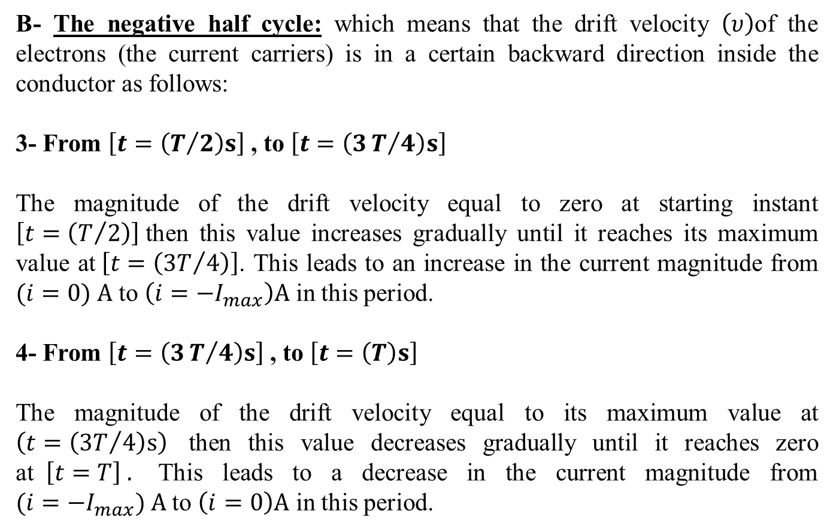
B- The negative half cycle: which means that the drift velocity $\left(υ\right)$of the electrons (the current carriers) is in a certain backward direction inside the conductor as follows:
3- From $\left[t=\left(T/2\right)s\right]$, to $\left[t=\left(3T/4\right)s\right]$
The magnitude of the drift velocity equal to zero at starting instant $\left[t=\left(T/2\right)\right]$then this value increases gradually until it reaches its maximum value at$\left[t=\left({3T}/4\right)\right]$. This leads to an increase in the current magnitude from $(i=0) A$ to $\left(i=−I_{max}\right)A$ in this period.
4- From $\left[t=\left(3T/4\right)s\right]$, to $\left[t=\left(T\right)s\right]$
The magnitude of the drift velocity equal to its maximum value at $\left(t=\left({3T}/4\right)s\right)$ then this value decreases gradually until it reaches zero at$\left[t=T\right] .$ This leads to a decrease in the current magnitude from $(i=−I_{max}) A$ to $\left(i=0\right)A$ in this period.

Slide 9
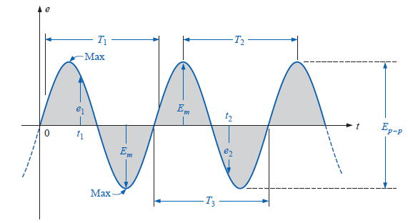
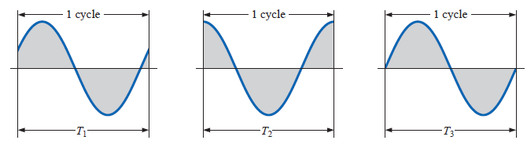

Definition of the Instantaneous, Maximum, Peak to Peak and the Frequency.
$$f=\frac{1}{T}$$

Slide 10
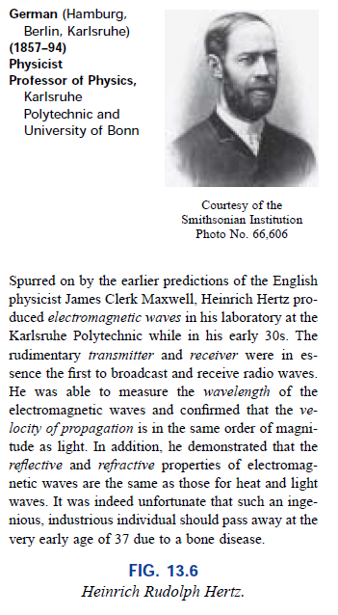
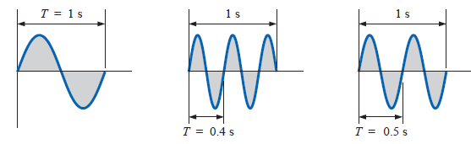
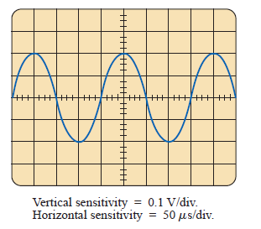

Slide 11
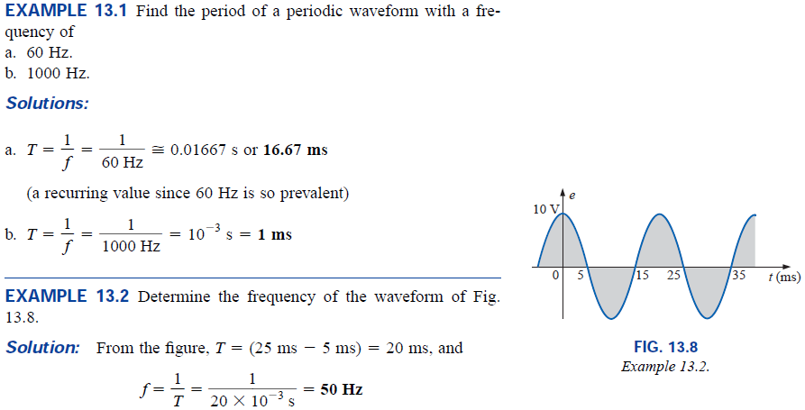
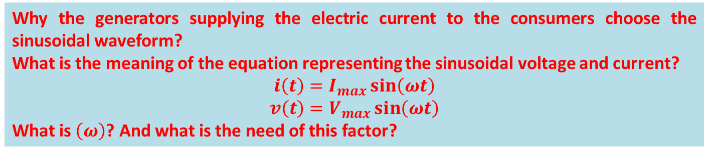
Why the generators supplying the electric current to the consumers choose the sinusoidal waveform?
What is the meaning of the equation representing the sinusoidal voltage and current?
$$i\left(t\right)=I_{max}\sin\left(ωt\right)$$
$$v\left(t\right)=V_{max}\sin\left(ωt\right)$$
What is $\left(ω\right)$? And what is the need of this factor?

Slide 12
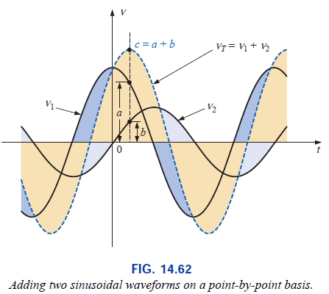
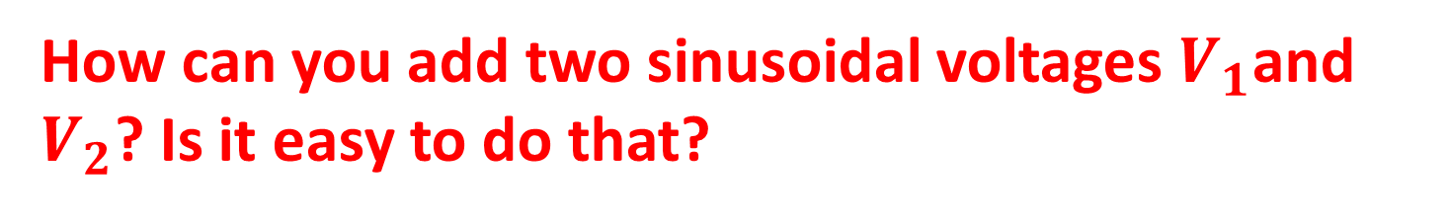
How can you add two sinusoidal voltages $V_{1}$and $V_{2}$? Is it easy to do that?

Slide 13






$$v_{T}$$
$$v_{1}$$
$$v_{2}$$
$$t_{2}$$
The case at $t=0$
This means that you can easily add two sinusoidal varying scalar quantities by using vector summation method!!!!
c
a
b
The case at $t=t_{2}$

Slide 14

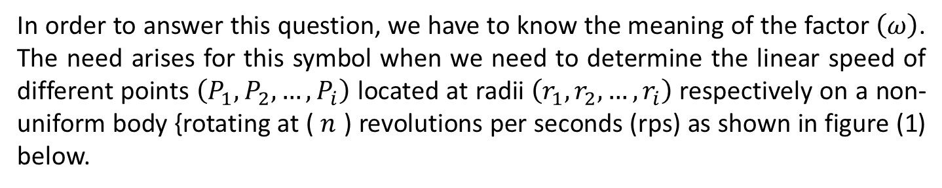
What is the radian angle?
In order to answer this question, we have to know the meaning of the factor $\left(ω\right)$. The need arises for this symbol when we need to determine the linear speed of different points $\left(P_{1}, P_{2}, …, P_{i}\right)$ located at radii $\left(r_{1}, r_{2}, …, r_{i}\right)$respectively on a non-uniform body {rotating at ( $n$ ) revolutions per seconds (rps) as shown in figure (1) below.
Non uniform body rotating around certain center of rotation.
P_{i}, r_{i}
p₂, r₂
Direction of rotation
p₁, r₁
$$θ$$
Fig. (1)
Center of rotation

Slide 16
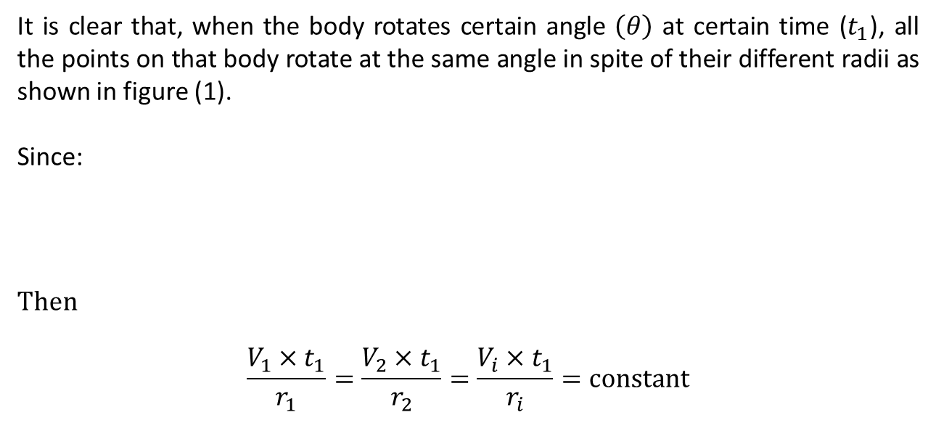
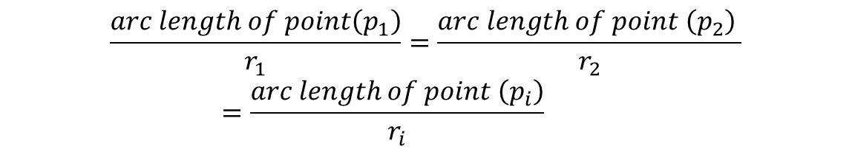

It is clear that, when the body rotates certain angle $\left(θ\right)$ at certain time ($t_{1}$), all the points on that body rotate at the same angle in spite of their different radii as shown in figure (1).
Since:
Then
$$\frac{V_{1}×t_{1}}{r_{1}}=\frac{V_{2}×t_{1}}{r_{2}}=\frac{V_{i}×t_{1}}{r_{i}}=constant$$
$$\frac{arc length of point\left(p_{1}\right)}{r_{1}}=\frac{arc length of point \left(p_{2}\right) }{r_{2}}=\frac{arc length of point \left(p_{i}\right)}{r_{i}}$$
It is clear now that the ratio of the arc length in front of the angle $\left(θ\right)$ to the corresponding radius for any point ($p_{i}$) is a constant quantity.
Now, if the factor $ω$ is analyzed as follows:
$$ω=2πn=2π\frac{1}{T}$$

Slide 19
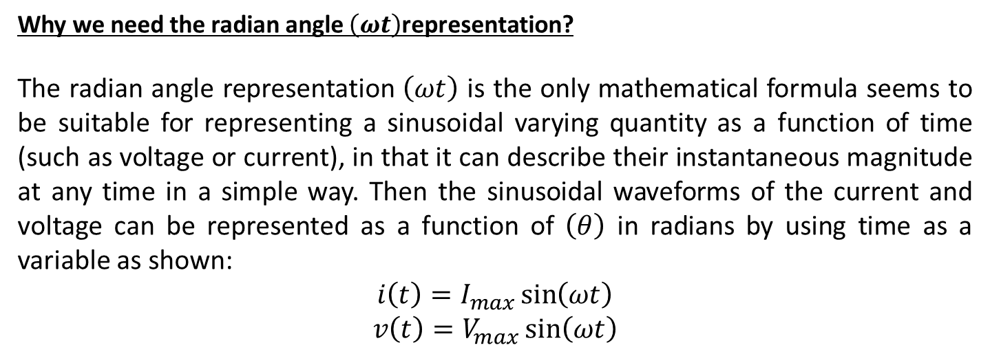
Why we need the radian angle $\left(ωt\right)$representation?
The radian angle representation $\left(ωt\right)$ is the only mathematical formula seems to be suitable for representing a sinusoidal varying quantity as a function of time (such as voltage or current), in that it can describe their instantaneous magnitude at any time in a simple way. Then the sinusoidal waveforms of the current and voltage can be represented as a function of $\left(θ\right)$ in radians by using time as a variable as shown:
$$i\left(t\right)=I_{max}\sin\left(ωt\right)$$
$$v\left(t\right)=V_{max}\sin\left(ωt\right)$$

Slide 20
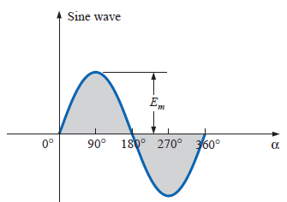
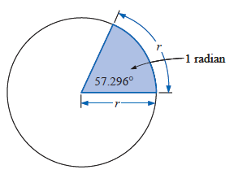
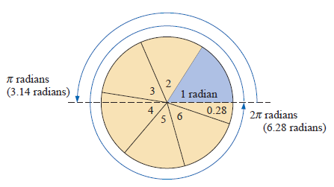

Slide 21
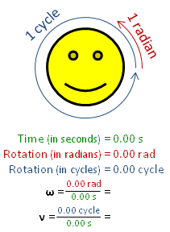
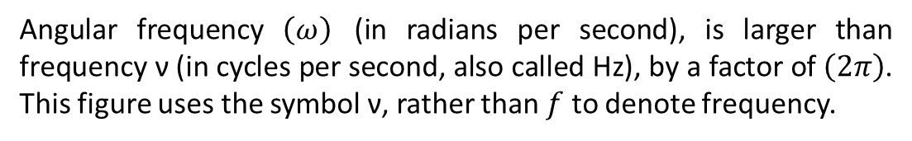
Angular frequency $\left(ω\right)$ (in radians per second), is larger than frequency ν (in cycles per second, also called Hz), by a factor of $\left(2π\right)$. This figure uses the symbol ν, rather than $f$ to denote frequency.

Slide 22
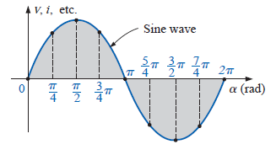
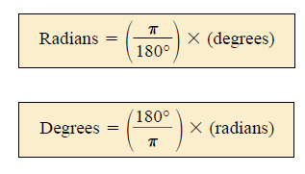


Slide 23
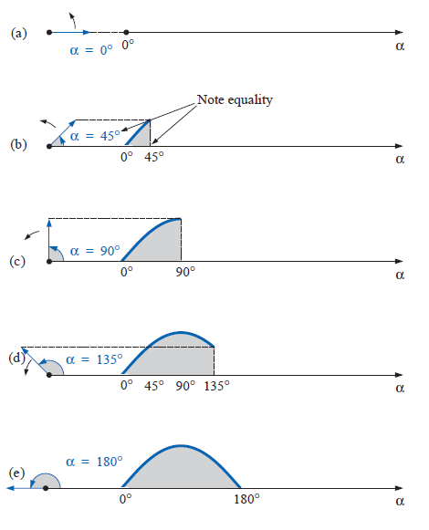
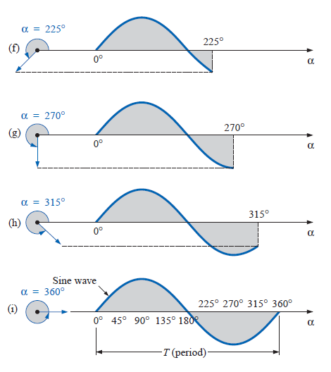

Slide 24

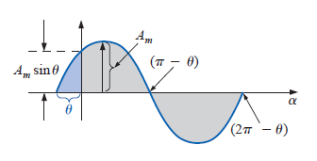
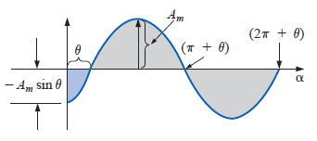


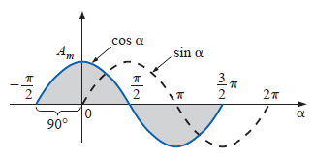



Slide 25
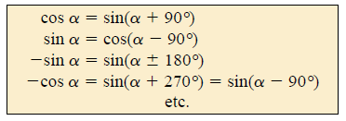

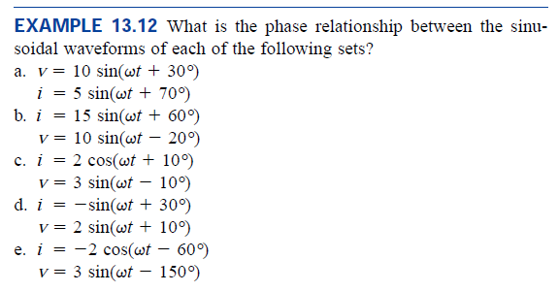

Slide 26
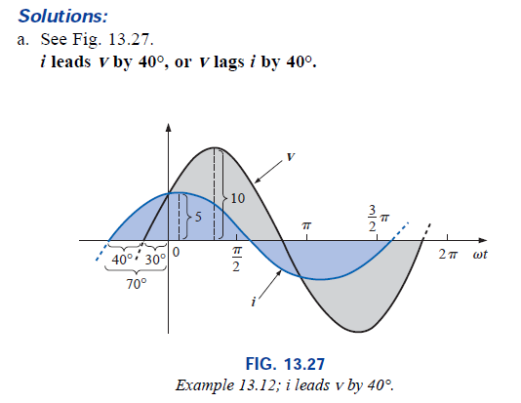

Slide 27
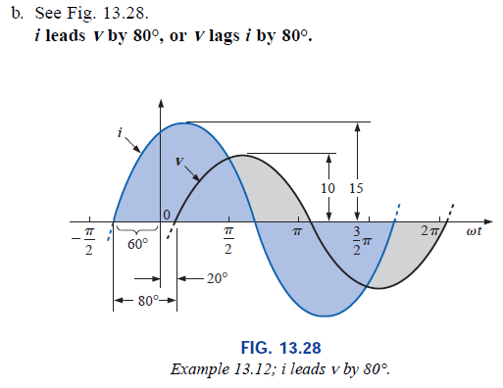

Slide 28
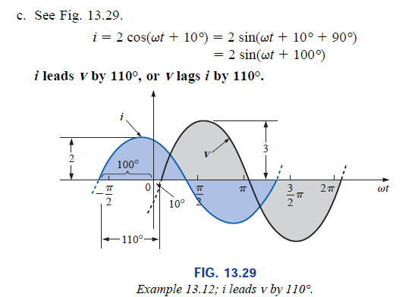

Slide 29
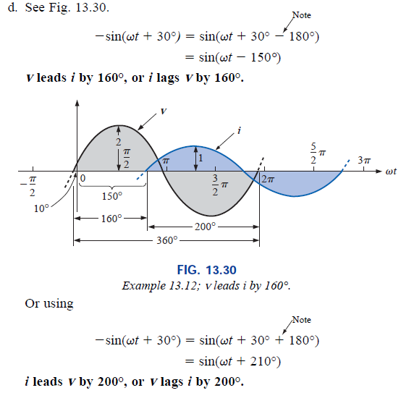

Slide 30
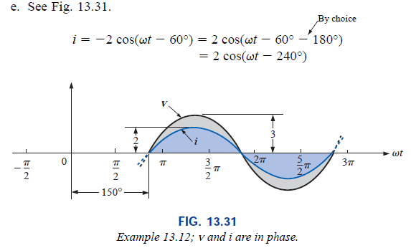

Slide 31
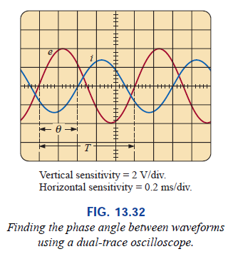



Slide 32
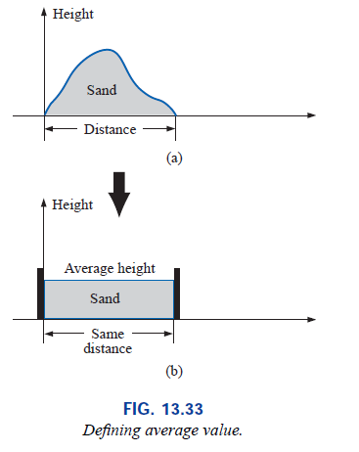
The Average Value

Slide 33
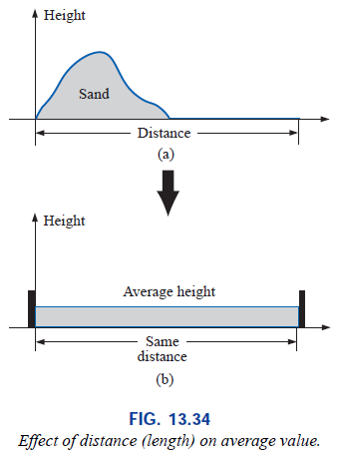
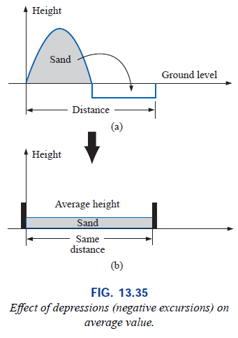

Slide 34
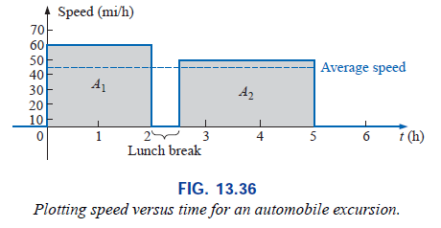

Slide 35


Slide 36





Slide 37






Slide 38



Slide 39






Slide 40



Slide 41

The Effective (rms) Value

Slide 42



To explain this equation let:
$$I_{m}=1A, and R=1Ω$$
Then
$$P_{ac}=\frac{1}{2}−\frac{1}{2}\cos{2ωt}$$
Since the average value of the second term $\left(\frac{1}{2}\cos{2ωt}\right)$ equal to zero, then the only constant term $\left({{I^{2}}_{m}^{}R}/2\right)$ will represent the dissipated power during the heating process time.

Slide 43

Note:
Three processes are done on the AC current in the above derivation to find its effective value, these are:
The AC current is squared.
The average value of the squared current is adopted.
The effective current determined by finding the square root of the mean of the squared current.
Hence, the effective value of the AC sinusoidal current is “the root of the mean of its square value, so it is known as the rms value”.

Slide 44

Example:
Let us consider the behavior of an Ironing Machine ( المكواة) as a pure resistive load of 1kW power supplied by a single phase AC voltage of (220V, 50Hz) for domestic application.
The supplied voltage can be represented mathematically as:
$$v\left(t\right)=V_{max}\sin\left(ωt\right)$$
Since its rms value is 220V, then its maximum value ($V_{max}$) is:
  $$V_{rms}=\frac{V_{max}}{\sqrt{2}}$$
  $$V_{max}=220×\sqrt{2}=311.127V$$
  Then
  $$v\left(t\right)=311.127\sin\left(ωt\right)$$
  Since,
      $$P=\frac{({V_{rms}^{})}^{2}}{R}$$
      $$R==\frac{({V_{rms}^{})}^{2}}{P}=\frac{{\left(220\right)}^{2}}{1000}=48.4Ω$$
      Then
      $$I_{rms}=\frac{V_{rms}}{R}=\frac{220}{48.4}=4.546A$$
      The time domain function of the current $i\left(t\right)$ is already known as:

Slide 45

  $$i\left(t\right)=I_{max}\sin\left(ωt\right)$$
  Then
  $$I_{max}=\sqrt{2}×I_{rms}=\sqrt{2}×4.546=6.429A$$
  $$i\left(t\right)=6.429\sin\left(ωt\right)$$
  In time domain and due to Kirchhoff's Voltage Law (KVL) in a closed circuit
  $$V_{source}+V_{load}=0$$
  Also,
  $$v_{source}\left(t\right)+v_{load}\left(t\right)=0$$
  Or
  $$v_{load}\left(t\right)=−v_{source}\left(t\right)$$
  Then
  $$v_{load}\left(t\right)=−311.127\sin\left(ωt\right)$$
  And from the previous derivation, the time domain function of the power is:
  $$p_{ac}\left(t\right)=\frac{{I_{max}}^{2}R}{2}−\frac{{I_{max}}^{2}R}{2}\cos{2ωt}$$
  $$p_{ac}\left(t\right)=\frac{{\left(6.429\right)}^{2}×48.4}{2}−\frac{{\left(6.429\right)}^{2}×48.4}{2}\cos{2ωt}$$
  $$p_{ac}\left(t\right)=1000−1000\cos{2ωt}$$
  Now, the time domain functions or the instantaneous values of:
  the source and load voltages
  the supplied current
  the consumed power
  Are determined and can be represented as follows:

Slide 46




$$V_{R}$$
$$I_{R}$$
$$V_{s}$$
$$P_{dc}=P_{ac}=I^{2}×R$$
$$={\left(4.546\right)}^{2}×\left(48.4\right)=1000W$$

Slide 47

The Form Factor and Peak Factor
Since, the effective value or the (rms) value is
$$X_{rms}=\sqrt{\frac{1}{T}\int_{t_{o}}^{t_{o}+T}{{\left[x\left(t\right)\right]}^{2}dt}}$$
And the average value is:
$$X_{av}=\frac{1}{T}\int_{t_{o}}^{t_{o}+T}{\left|x\left(t\right)\right|}dt$$
Then the Form Factor $\left(k_{f}\right)$ is:
$$k_{f}=\frac{X_{rms}}{X_{av}}$$
Also, the Peak Factor or Crest Factor$\left(C_{f}\right)$=$\frac{Peak Value}{rms Value}=\frac{X_{max}}{X_{rms}}$
Hence, for any sinusoidal function like AC current or Voltage
$k_{f}=\frac{I_{rms}}{I_{av}}=\frac{0.707I_{max}}{0.637I_{max}}=1.11$
$C_{f}=\frac{I_{max}}{I_{rms}}=\frac{I_{max}}{0.707I_{max}}=1.414$

Slide 48




Slide 49


Slide 50




Slide 51



Slide 52




IMPEDANCE AND THE PHASOR DIAGRAM
Resistive Elements
The angle $∠0^{°}$of the resistance means that “the resistance in an AC circuit causes a zero phase shift between the current passing through it and the supplied voltage”.

Slide 53



Note:
The physical meaning of representing the resistance as a vector of magnitude $\left|R\right|$ and of angle $\left(∠0^{°}\right)$ is due to a truth that “the current passes through the resistance is in-phase with the voltage of the source supplying it ”. This representation is suitable to treat the sinusoidal quantities (voltage and current) using vector algebra.

Slide 54



Slide 55

What is the Inductance?
When a conducting wire wound in the manner shown in figure beside, it will be a “Coil” and it will be called “an inductor” (مُحِثْ) because it behaves as “an inductance” (مَحاثّه).
The questions arise here are:
“What is this winding (لَفْ) do?”
“What it will induce?”
“What happen when it is connected to a DC source?”
“What happen when it is connected to an AC source?”

Slide 56



Let us connect the coil to a DC source, then a current of constant magnitude $\left(I\right)$pass through its wire, this will lead to generate a magnetic flux lines (in three dimensions 3-D), with a magnetic polarity as shown by the “blue arrows” in figure. They looks as if they rotate around the wire, while they are fixed in space.
The free charges of the conductor will not be affected by this magnetic flux in this case, because, “the free charge is not affected by a constant stationary magnetic field”, then it will act as a resistance only.
If this coil supplied by a sinusoidal current from an AC source, this current will generate a magnetic flux lines (in three dimensions), with variable magnitude and polarity.
The free charges of the conductor will be affected by this magnetic flux in this case, because, “the free charge is affected by a variable stationary magnetic field”. This effect will be explained due to both Faraday’s and Lenz’s theorems as follows:
$$I$$
$$t$$
DC

Slide 57

Faraday states that the variation of the magnitude of magnetic flux with time, affecting the coil leads to induce a terminal voltage $\left(E\right). Also,$ he prove experimentally that the magnitude of this induced voltage is quantitatively determined due to the formula:
$$E=−N\frac{dφ}{dt}$$
This Empirical Formula can be written as:
$$E=−\frac{dψ}{dt}$$
Or in the form:
$$E=−\frac{dλ}{dt}$$
Since, $\left(λ=ψ=Nφ\right)=$ Flux Linkage.
Lenz (1843) states that: “If an induced current flows, its direction is always such that it will oppose the change which produced it.”
Also, it may be found as: “when an emf is generated by a change in magnetic flux according to Faraday's Law, the polarity of the induced emf will produces a current that it's magnetic field opposes the change which produces it”.
Due to the above rules, it is clear that when a test charge exist in a place subjected to a variable magnetic field, this will cause that charge to move in a sense such that it will appose the change which produce this motion, as follows:

Slide 58




Eddy Currents
$$B$$
$$B$$
Y
x
z
When the flux decreasing
$\left(\frac{dφ}{dt}\right)<0$
The induced current rotates CW in a plain $⊥^{r}$ to $\left(B\right)$ in order to oppose the reduction in flux.
When the flux increasing
$\left(\frac{dφ}{dt}\right)>0$
The induced current rotates CCW in a plain $⊥^{r}$ to $\left(B\right)$ in order to oppose the increase in flux.
These induced currents are known as “eddy currents” (التيارات الدوامة). Their motion in a short circuited loops in the conducting medium are the source of a heat and considered as:
“eddy current losses”.

Slide 59


Due to Lenz’s law, an eddy currents will be induced inside a copper wire of the coil affected by the stationary variable flux of the coil itself. The direction of the induced eddy current will be opposite to that of the supplied current when it increasing, and it will be in its direction when it is decreasing.
Due to Faraday’s Law, the induced voltage across the coil $\left(E=−N\frac{dφ}{dt}\right)$will be out of phase with the applied AC voltage across that coil.
Hence, both Faraday and Lenz discuss the operation of the coil in that “the induced emf causes an induced current (eddy currents) inside the coil due to its flux, leads to resist the current variation in it”.
To explain the behavior of an air-cored coil in an AC circuit, consider the following example:
If an air-cored coil of $\left(N\right)$turns supplied by a sinusoidal current $\left[i_{L}\left(t\right)\right]$from an AC source by a sinusoidal voltage $\left[v_{s}\left(t\right)\right]$, then the steady state rms value of the supplied current is $\left(I\right)$. Hence, the steady state current formula is:
$$i_{L}\left(t\right)=\sqrt{2}∙I∙\sin\left(ωt\right)$$
Or

Slide 60




$$i_{L}\left(t\right)=I_{max}∙\sin\left(ωt\right)$$
Since, the relation between the flux $φ\left(t\right)$ and the current $i\left(t\right)$ is linear in an air-cored coil due to the relations
$$μ_{o}=\frac{B}{H}$$
Then in general
$$B=Φ/A$$
And
$$H=\frac{NI}{l}$$
Hence,
$$μ_{o}={\left(Φ/A\right)}/{\left({NI}/l\right)}$$
$$μ_{o}\frac{NI}{l}=\frac{Φ}{A}$$
$$Φ=\frac{μ_{o}NAI}{l}$$
Since the current varies with time, then the flux varies with time too, then substitute $\left[i\left(t\right)\right]$ and $\left[φ\left(t\right)\right]$in the above equation results in:
$$φ\left(t\right)=\frac{μ_{o}NA}{l}i\left(t\right)$$
Substitute $\left[φ\left(t\right)\right]$ and $\left[i\left(t\right)\right]$in Faraday’s Law
$$v\left(t\right)=−N\frac{dφ\left(t\right)}{dt}$$
$$i_{L}$$
$$v_{s}$$
$$v_{L}$$

Slide 61





Results that
$$v_{L}\left(t\right)=−\frac{μ_{o}N^{2}A}{l}×\frac{di\left(t\right)}{dt}$$
$$v_{L}\left(t\right)=−\frac{μ_{o}N^{2}A}{l}×\frac{d}{dt}\left(I_{max}\sin\left(ωt\right)\right)$$
$$v_{L}\left(t\right)=−\frac{μ_{o}N^{2}A}{l}×I_{max}×ω×\cos\left(ωt\right)$$
It is clear that the factor $\left[\frac{μ_{o}N^{2}A}{l}\right]$ represents the coil parameters, and can be denoted by the letter $\left(L\right)$, then:
$$v_{L}\left(t\right)=−ωLI_{max}\cos\left(ωt\right)$$
The factor $\left(ωL\right)$will be denoted by $\left(X_{L}\right)$, then:
$$v_{L}\left(t\right)=−X_{L}I_{max}\cos\left(ωt\right)$$
$$v_{L}\left(t\right)=−V_{max}\cos\left(ωt\right)$$
$L≡$known as the self inductance of the coil (H)
$X_{L}≡$is the inductive reactance of the coil (Ω)
$$i_{L}$$
$$v_{s}$$
$$v_{L}$$
The last equation represents the induced voltage across the coil denoted as $\left[v_{L}\left(t\right)\right]$, which must be equal in magnitude and out of phase with the voltage source $\left(v_{s}\right)$ in steady state. It is clear now that the current of the pure inductive load lags the source voltage by $\left({90}^{°}\right)$, and leads that across the inductance by $\left({90}^{°}\right)$.
Due to its behavior, the inductive reactance $\left[X_{l}=ωL\right]$ denoted as $\left[X_{l}=\left|X_{l}\right|∠{90}^{°}=jX_{l}\right]$ because it leads the current through it to lag the supplied voltage by ${90}^{°}$.

Slide 62







To understand the behavior of the inductor during a complete cycle, let us consider the coil shown in figure with a steady state sinusoidal current $\left[i_{L}\left(t\right)\right]$passing through it,
$$i_{L}\left(t\right)=I_{max}∙\sin\left(ωt\right)$$
This current will induce variable flux inside the coil affecting on the free charges in the material of the coil itself leads to induce current as follows:
In the period from $0^{°}$ to ${90}^{°}$as shown in figure:
The current will be increased from zero to $I_{max}$. The direction of this current will be [CW] due to the [R.H.R.], hence, the north pole of the coil will be downward. The current will generate an increasing flux of $\left[\left({dφ}/{dt}\right)>0\right]$. This varying flux will affect on the free charges in the copper wire of the coil itself leading to a [CCW] motion of these charges due to Lenz’s Law. This motion will be against the direction of $i_{L}$ and lead to reduce it and generates a back emf $v_{L}=−N\left({dφ}/{dt}\right)=−L\left({di}/{dt}\right)$.
Then, as shown before:
$v_{L}=−$ $V_{max}\cos\left(ωt\right)$
Hence, this voltage must be equal in magnitude and opposite in polarity w.r.t. the applied voltage $v_{s}$, then it must be described as:
$v_{s}=$ $V_{max}\cos\left(ωt\right)$
$$i_{L}$$
S
$$v_{s}$$
$$v_{L}$$
N
From $0^{°}$ to ${90}^{°}$
The diagram and waveforms shown below, describe the behavior of the inductance during a complete cycle of current with its four periods at steady state.

Slide 63






















Flux rate
Inc.
Dec.
Inc.
Dec.
AC Source
Source
Load
Source
Load
Load
Load
Source
Load
Source
Power
$$i_{L}$$
S
$$i_{L}$$
S
$$i_{L}$$
$$i_{L}$$
N
N
$$v_{s}$$
$$v_{L}$$
$$v_{s}$$
$$v_{L}$$
$$v_{s}$$
$$v_{L}$$
$$v_{s}$$
$$v_{L}$$
N
N
S
S
From $0^{°}$ to ${90}^{°}$
From ${90}^{°}$ to ${180}^{°}$
From ${180}^{°}$ to ${270}^{°}$
From ${270}^{°}$ to ${360}^{°}$

Slide 64






From the above analysis it seems clear the power will
From $\left(t=0\right)$ to $\left(t=\frac{T}{4}\right)$: the power transferred from source to load.
From $\left(t=\frac{T}{4}\right)$ to $\left(t=\frac{T}{2}\right)$: the power transferred from load to source.
From $\left(t=\frac{T}{2}\right)$ to $\left(t=\frac{3T}{4}\right)$: the power transferred from source to load.
From $\left(t=\frac{3T}{4}\right)$ to $\left(t=T\right)$: the power transferred from load to source, and so on.
The net transferred power equal to zero in a pure inductive load.
$$I$$
$$I_{max}$$
$$T$$
$$\frac{3T}{4}$$
$$\frac{T}{4}$$
$$\frac{T}{2}$$
$${−I}_{max}$$
Discussion:
This behavior of the inductance means that it will resist the flow of the current during halftime of the cycle (when it considered as a load) and it will assist him to flow during the rest of the time of the cycle (when it considered as a source). Hence, its behavior is not like that of the resistor.
The net power consumed by the inductance is zero.

Slide 65

The operation of an Iron-Cored AC Fed Coil
Iron Core

Slide 66

Moving domain walls in a grain of silicon steel caused by an increasing external magnetic field in the "downward" direction, observed in a Kerr microscope. White areas are domains with magnetization directed up, dark areas are domains with magnetization directed down.

Slide 67

An animation showing how magnetostriction works. A changing external magnetic field causes the magnetic dipoles to rotate, changing the dimensions of the crystal lattice. This motion leads to a heat and considered as:
“Hysteresis Losses”

Slide 68


Slide 69
Variation of the flux density $\left(B\right)$ due to the variation of the alternating exciting current (AC) fed to the coil winding, which leads to a variation in the magnetizing force $\left(H\right)$

Slide 70




  $B_{R}:$ Is the residual magnetization.
  $B_{max}:$ Is the maximum or saturation flux density.
  $H_{s}:$ Is the saturation magnetizing force.
  $H_{c}:$ Is the coercive force.
$${−H}_{c}$$
$$H_{c}$$
Typical Hysteresis Loop

Slide 71


Slide 72

Formation of the (B-H) curve using different hysteresis loops

Slide 73

Since, in general
$$φ=\frac{mmf}{S}=\frac{NA}{\left(l/{μ_{o}A}\right)}=\frac{μ_{o}NA}{l}i$$
Now, consider the operation of certain iron cored coil is in the linear region of the (B-H) curve in which the permeability $\left(μ\right)$ is constant, then substitute this value in the above equation, leads to the following:
$$φ=\frac{μNA}{l}i$$
Then applying Faraday’s law leads to:
$$E=−N\frac{d}{dt}\left(\frac{μNA}{l}i \right)$$
$$E=−\left(\frac{μN^{2}A}{l}\right)×\frac{di}{dt}$$
$$E=−L\frac{di}{dt}$$
Where
$$L=\left(\frac{μN^{2}A}{l}\right)$$

Slide 74

Or as a magnitude
$$L=\frac{E}{{di}/{dt}}$$
Also, it can be considered as
$$L=\frac{E}{{dφ}/{dt}}$$
Considering the useful linkage flux $\left(λ\right)$ the self inductance $\left(L\right)$ can be defined as:
$$L=\frac{E}{{dλ}/{dt}}$$
Then the unit of the inductance due to $L=\frac{E}{{di}/{dt}}$is
$$L=\left(\frac{V∙s}{A}\right)$$
This unit is already known as Henry (Named After Joseph Henry) and the symbol of this unit is (H).
$$\left(H=\frac{V∙s}{A}\right)$$

Slide 75

Due to the above derivation, the units of the Reluctance or the Magnetic Resistance can be derived as follows:
Since $μ=\frac{B}{H}$
then
$$μ=\frac{{Wb}/{m^{2}}}{A/m}=\frac{Wb}{m^{2}}×\frac{m}{A}=\frac{Wb}{A∙m}=\frac{V∙s}{A∙m}=\left(\frac{V∙s}{A}\right)∙m^{−1}$$
$$μ =H∙m^{−1}$$
Also, since $S=\frac{l}{μ∙A}$ , then
$$S=\frac{m}{\left(H∙m^{−1}\right)∙m^{2}}=\frac{1}{H}$$
$$S =H^{−1}$$
Then it must be remembered that the unit of the permeability $\left(μ\right)$is $\left(H∙m^{−1}\right)$, and the unit of the reluctance $\left(S\right),$or $\left(ℛ\right)$ is $\left(H^{−1}\right)$.

Slide 76

Energy in Inductance
Energy definition: Is "ability to do work"
Work=Force $×$Displacement (Nm=Joule)
Then quantitatively [Energy=$\sum{(work}$)] (Joule) =$\int{dW}$
Power: Is the rate of change of work. $p={d(work)}/{dt}$
In electrical engineering science$\left[i={dq}/{dt}\right]$ and$\left[v={d(work)}/{dq}\right]$, then $iv=\left(\frac{dq}{dt}\right)×\left(\frac{d(work)}{dq}\right)=\frac{d\left(work\right)}{dt}=p$
Hence $d\left(work\right)=pdt=ivdt$
Since (Energy=$\sum{work}$), then the energy= $\int{work}$ , "In general".
For the coil shown below, the voltage across the coil due to Faraday's law is:
$$v=−N\frac{dφ}{dt}=\frac{dλ}{dt}$$

Slide 77



Since, $Nφ=λ$ (assuming that the magnetic circuit is of linear behavior as shown in the above figure, where $λ$ is a function of current passing through the coil). The electrical energy supplied to the lossless coil shown above as the current increases from 0 to $I_{o}$ must equal to the energy $\left(W_{f}\right)$ stored in the magnetic field of the ferromagnetic core
$$W_{f}=\int_{0}^{t}{ivdt=\int_{0}^{t}{i\left(\frac{dλ}{dt}\right)}}dt=\int_{0}^{λ}{idλ}$$

Slide 78



For the magnetic linear assumption, which means ($λ=Li)$, then ($dλ=Ldi$), which leads to
$$W_{f}=\int_{0}^{I_{o}}{iLdi=\frac{1}{2}}LI_{o}^{2}$$
Hence, in a sinusoidal waveform current passing through a coil, the stored or returned energy at each quarter cycle is:
$$W_{f}=\int_{0}^{I_{max}}{iLdi=\frac{1}{2}}LI_{max}^{2}$$

Slide 79



$$AC$$

Slide 80




Slide 81



Slide 82


Slide 83



Consider the circuit shown in the figure beside, if the switch is closed (ON), then the current will flow in the capacitor in a random oscillatory behavior for a period known as a “transient state”, until it reaches a “steady state” in which its oscillation damped. The steady state operation of the capacitor in an AC circuit is of our interest in this course of steady.
Switch
$$V_{s}$$
$$V_{c}$$
AC source
Capacitor
The steady state current of the lossless capacitive load is a sinusoidal current leads the voltage supplying it by $\left({90}^{°}\right)$.

Slide 84

To understand the capacitor behavior in AC circuit at steady state, let us start from the first principles:
It is already known that by definition:
$$Q=CV$$
Since, in AC circuit both $\left(Q\right)$ and $\left(V\right)$ are function of time, then differentiating both sides of the above equation results in:
$$\frac{dq}{dt}=C\frac{{dv}_{s}\left(t\right)}{dt}$$
Where $v_{s}\left(t\right)$ is the source voltage supplying the current to the capacitor $\left(C\right)$, then:
$$i\left(t\right)=C\frac{dv_{s}\left(t\right)}{dt}$$
Then
$$Cdv_{s}\left(t\right)=i\left(t\right)dt$$
Or
$$dv_{s}\left(t\right)=\frac{1}{C}i\left(t\right)dt$$
Integrate both sides results in
$$v_{s}\left(t\right)=\frac{1}{C}\int_{0}^{t}{i\left(t\right)}dt$$
If
$$i_{c}\left(t\right)=I_{m}\sin{ωt}$$
Then

Slide 85

$$v_{s}\left(t\right)=\frac{1}{C}\int_{0}^{t}{I_{m}\sin\left(ωt\right)}dt$$
$$v_{s}\left(t\right)=\frac{I_{m}}{ωC}\left[−\cos\left(ωt\right)\right]$$
$$v_{s}\left(t\right)={−V}_{m}\cos{ωt}$$
Hence
$$V_{m}=\frac{1}{ωC}I_{m}$$
Which means that:
$$X_{C}=\frac{1}{ωC}$$
In a steady state condition of the above circuit, the source voltage ${[v}_{s}\left(t\right) ]$ and the capacitor voltage${[v}_{c}\left(t\right) ]$must be equal in magnitude and opposite in polarity always, then this means that the capacitor voltage in this case must be:
$$v_{c}\left(t\right)=−v_{s}\left(t\right)=V_{m}\cos{ωt}$$
The capacitive reactance $X_{C}$ represented as a vector of magnitude $\left|X_{C}\right|$ and angle $\left({∠−90}^{°}\right)$ in order to treat the sinusoidal quantities (voltage or current) using vector algebra. The physical meaning of this representation due to the truth “The current passing through a pure capacitance leads the voltage supplying it by $\left({90}^{°}\right)$”.
Then, the figure shown below describe the behavior of the capacitor in an AC circuit.

Slide 86






















$$v_{c}$$
$$v_{c}$$
$$i_{c}$$
$$i_{c}$$
$$v_{s}$$
$$v_{s}$$
AC Source
Load
Source
Load
Source
Capacitor
Source
Load
Source
Load
Power
$$i_{c}$$
$$i_{c}$$
$$i_{c}$$
$$i_{c}$$
$$v_{c}$$
$$v_{s}$$
$$v_{c}$$
$$v_{s}$$
$$v_{c}$$
$$v_{s}$$
$$v_{c}$$
$$v_{s}$$
From $0^{°}$to ${90}^{°}$
From ${90}^{°}$to ${180}^{°}$
From ${180}^{°}$to ${270}^{°}$
From ${270}^{°}$to ${360}^{°}$

Slide 87

Behavior of the Capacitor in an AC Circuit
In DC circuit the capacitor considered as an open circuit at steady-state condition. Hence, no current will circulate in such circuit, but when it supplied by an AC voltage its behavior will be as follows:
From $\left(t=0\right)$ to $\left(t=\frac{T}{4}\right)$: the power transferred from source to load.
From $\left(t=\frac{T}{4}\right)$ to $\left(t=\frac{T}{2}\right)$: the power transferred from load to source.
From $\left(t=\frac{T}{2}\right)$ to $\left(t=\frac{3T}{4}\right)$: the power transferred from source to load.
From $\left(t=\frac{3T}{4}\right)$ to $\left(t=T\right)$: the power transferred from load to source, and so on.
$$I$$
$$I_{max}$$
$$T$$
$$\frac{3T}{4}$$
$$\frac{T}{4}$$
$$\frac{T}{2}$$
$${−I}_{max}$$

Slide 88
Discussion:
This behavior of the capacitance means that it will resist the flow of the current during halftime of the cycle (when it considered as a load) and it will assist him to flow during the rest of the time of the cycle (when it considered as a source). Hence, its behavior is not like that of the resistor, and it's not like that of the inductance too, in that its action as a source or as a load occurs at the inverse time periods during the cycle w.r.t. that of the inductance.
This means that the steady state current in the capacitor is flowing continuously during the AC cycle and it will never stop as the case in the DC circuit in which the capacitor is considered as an open circuit.
The net transferred power equal to zero in a pure capacitive load.

Slide 89



Slide 90




Slide 91



Slide 92


Slide 93





Impedance Diagram

Slide 94




Slide 95



Slide 97




Slide 98


