Slide 1


Slide 2
Polymer
Structure
(1)
Dr. Raouf Mahmood

Slide 3
Polymers
What is a polymer?
Very Large molecules structures chain-like in nature.
Poly mer
        many repeat unit
repeat
unit
repeat
unit
repeat
unit
H
H
H
H
H
H
H
H
H
H
H
H
H
H
H
H
H
H
C
C
C
C
C
C
C
C
C
C
C
C
C
C
C
C
C
C
H
H
H
H
H
H
H
Cl
H
Cl
H
Cl
H
CH₃
H
CH₃
H
CH₃
Polyethylene (PE)
Polyvinyl chloride (PVC)
Polypropylene (PP)
Adapted from Fig. 14.2, Callister 7e.

Slide 4
Ancient Polymer History
Originally natural polymers were used
  Wood – Rubber
  Cotton – Wool
  Leather – Silk

Slide 5
Polymer Composition
Most polymers are hydrocarbons
– i.e. made up of H and C
Saturated hydrocarbons
  Each carbon bonded to four other atoms
  C_{n}H_{2n+2}

Slide 7
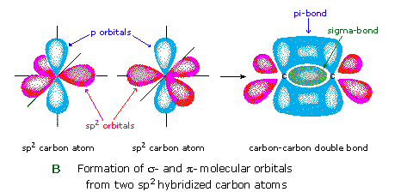
Unsaturated Hydrocarbons
Double & triple bonds relatively reactive – can form new bonds
  Double bond – ethylene or ethene - C_{n}H_{2n}
    4-bonds, but only 3 atoms bound to C’s

Slide 8
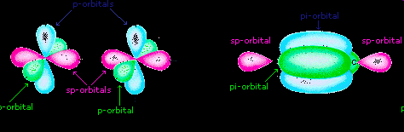
Unsaturated Hydrocarbons
  Triple bond – acetylene or ethyne - C_{n}H_{2n-2}

Slide 9
Unsaturated Hydrocarbons
An aromatic hydrocarbon (abbreviated as AH) or arene is a hydrocarbon, of which the molecular structure incorporates one or more planar sets of six carbon atoms that are connected by delocalised electrons numbering the same as if they consisted of alternating single and double covalent bonds

Slide 10
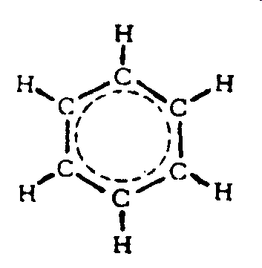
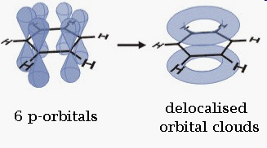
Unsaturated Hydrocarbons
Benzene, C6H6, is the simplest and first recognized aromatic hydrocarbon

Slide 11
Unsaturated Hydrocarbons
What is actually found is that all of the bond lengths in the benzene rings are 1.397 angstroms
This is roughly intermediate between the typical lengths of single bonds (~1.5 angstroms) and double bonds (~1.3 angstroms)

Slide 12
Isomerism
Isomerism
  two compounds with same chemical formula can have quite different structures/atomic arrangement
  Ex: C₈H₁₈
    n-octane
    2-methyl-4-ethyl pentane (isooctane)
⇓

Slide 13
Chemistry of Polymers
Free radical polymerization
Initiator: example - benzoyl peroxide

Slide 14
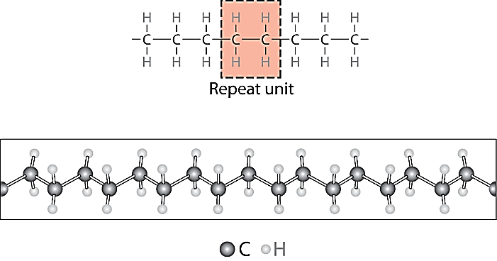
Chemistry of Polymers
Adapted from Fig. 14.1, Callister 7e.
Note: polyethylene is just a long HC
  - paraffin is short polyethylene
Notes:
Polymer- can have various lengths depending on number of repeat units

Slide 15
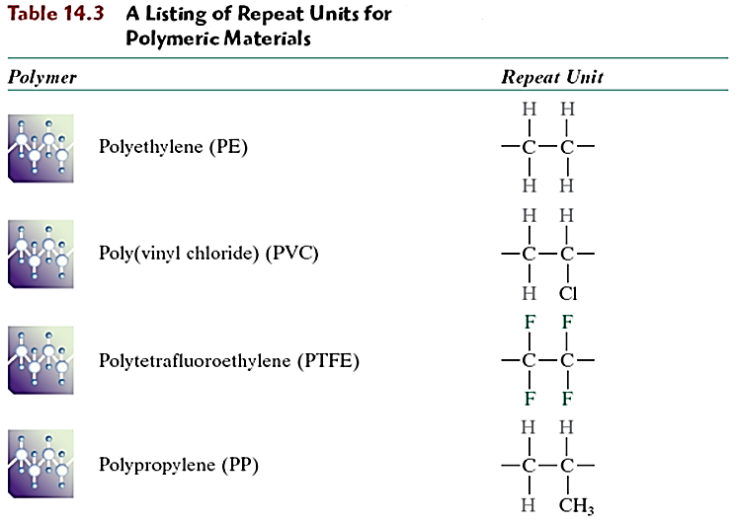
Bulk or Commodity Polymers
Notes:
Relatively few polymers responsible for virtually all polymers sold – these are the bulk or commodity polymers

Slide 19
Range of Polymers
Traditionally, the industry has produced two main types of synthetic polymer – plastics and rubbers.
Plastics are (generally) rigid materials at service temperatures
Rubbers are flexible, low modulus materials which exhibit long-range elasticity.

Slide 20
Range of Polymers
Plastics are further subdivided into thermoplastics and thermosets

Slide 21
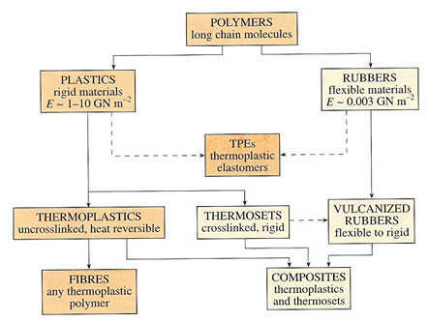
Range of Polymers

Slide 22
