Slide 1
Shared Memory.
Distributed Memory.
Hybrid Distributed-Shared Memory.

Slide 2
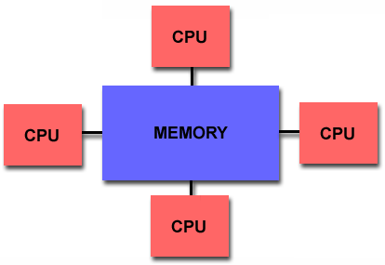
Shared Memory
Shared memory parallel computers vary widely, but generally have in common the ability for all processors to access all memory as global address space.
Multiple processors can operate independently but share the same memory resources.
Changes in a memory location effected by one processor are visible to all other processors.
Shared memory machines can be divided into two main classes based upon memory access times: UMA and NUMA.
Uniform Memory Access (UMA):
Non-Uniform Memory Access (NUMA)

Slide 3
Shared Memory : UMA vs. NUMA
Uniform Memory Access (UMA):
Most commonly represented today by Symmetric Multiprocessor (SMP) machines
Identical processors
Equal access and access times to memory
Sometimes called CC-UMA - Cache Coherent UMA. Cache coherent means if one processor updates a location in shared memory, all the other processors know about the update. Cache coherency is accomplished at the hardware level.
Non-Uniform Memory Access (NUMA):
Often made by physically linking two or more SMPs
One SMP can directly access memory of another SMP
Not all processors have equal access time to all memories
Memory access across link is slower
If cache coherency is maintained, then may also be called CC-NUMA - Cache Coherent NUMA

Slide 4
Shared Memory MIMD machine
Processor
A
Processor
B
Processor
C
MEMORY
MEMORY
MEMORY
BUS
BUS
BUS
Global Memory System
Comm: Source PE writes data to GM & destination retrieves it
Easy to build, conventional OSes of SISD can be easily be ported
Limitation : reliability & expandibility. A memory component or any processor failure affects the whole system.
Increase of processors leads to memory contention.
Ex. : Silicon graphics supercomputers....

Slide 5
Uniform Memory Access - UMA
Processor
Processor
Processor
Cache
Cache
Cache
Global Memory System
typical:
1 cycle to local cache
20 cycles to remote cache
100 cycles to memory
Symmetric Multiprocessor SMP
Memory: centralized with uniform access time (“UMA”) and bus interconnect, I/O
Examples: Dell Workstation 530, Sun Enterprise, SGI Challenge

Slide 6
I/O
I/O
I/O
I/O
Channel
Channel
Channel
Channel
CPU x 4
CPU x 4
CPU x 4
CPU x 4
Cache
Cache
Cache
Cache
Memory
Memory
Memory
Memory
Non-Uniform Memory Access - NUMA
Examples: DASH/Alewife/FLASH (academic), SGI Origin, Compaq GS320, Sequent (IBM) NUMA-Q

Slide 7
Shared Memory: Pros and Cons
Advantages
Global address space provides a user-friendly programming perspective to memory
Data sharing between tasks is both fast and uniform due to the proximity of memory to CPUs
Disadvantages:
Primary disadvantage is the lack of scalability between memory and CPUs. Adding more CPUs can geometrically increases traffic on the shared memory-CPU path, and for cache coherent systems, geometrically increase traffic associated with cache/memory management.
Programmer responsibility for synchronization constructs that insure "correct" access of global memory.
Expense: it becomes increasingly difficult and expensive to design and produce shared memory machines with ever increasing numbers of processors.

Slide 8
Distributed Memory
Like shared memory systems, distributed memory systems vary widely but share a common characteristic. Distributed memory systems require a communication network to connect inter-processor memory.
Processors have their own local memory. Memory addresses in one processor do not map to another processor, so there is no concept of global address space across all processors.
Because each processor has its own local memory, it operates independently. Changes it makes to its local memory have no effect on the memory of other processors. Hence, the concept of cache coherency does not apply.
When a processor needs access to data in another processor, it is usually the task of the programmer to explicitly define how and when data is communicated. Synchronization between tasks is likewise the programmer's responsibility.
The network "fabric" used for data transfer varies widely, though it can can be as simple as Ethernet.

Slide 9
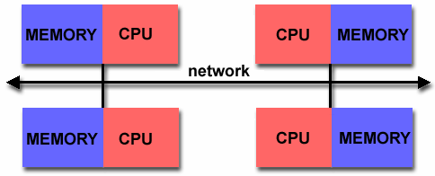
Distributed Memory MIMD
IPC
channel
Processor
A
Processor
B
Processor
C
MEMORY
MEMORY
MEMORY
BUS
BUS
BUS
Memory
System A
Memory
System B
Memory
System C

Slide 10
Distributed Memory: Pro and Con
Advantages:
Memory is scalable with number of processors. Increase the number of processors and the size of memory increases proportionately.
Each processor can rapidly access its own memory without interference and without the overhead incurred with trying to maintain cache coherency.
Cost effectiveness: can use commodity, off-the-shelf processors and networking.
Disadvantages
The programmer is responsible for many of the details associated with data communication between processors.
It may be difficult to map existing data structures, based on global memory, to this memory organization.
Non-uniform memory access (NUMA) times

Slide 11
Distributing memory among processing nodes has 2 pluses:
It’s a great way to save some bandwidth
With memory distributed at nodes, most accesses are to local memory within a particular node
No need for bus communication
Reduces latency for accesses to local memory
It also has 1 big minus!
Have to communicate among various processors
Leads to a higher latency for intra-node communication
Also need bandwidth to actually handle communication

Slide 12
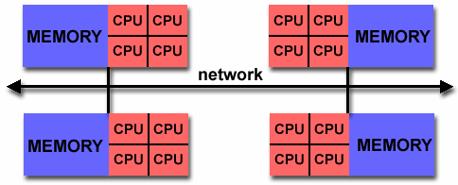
Hybrid Distributed-Shared Memory
The largest and fastest computers in the world today employ both shared and distributed memory architectures.
The shared memory component is usually a cache coherent SMP machine. Processors on a given SMP can address that machine's memory as global.
The distributed memory component is the networking of multiple SMPs. SMPs know only about their own memory - not the memory on another SMP. Therefore, network communications are required to move data from one SMP to another.
Current trends seem to indicate that this type of memory architecture will continue to prevail and increase at the high end of computing for the foreseeable future.
Advantages and Disadvantages: whatever is common to both shared and distributed memory architectures.

Slide 13
Hybrid Distributed-Shared Memory
Summarizing a few of the key characteristics of shared and distributed memory machines
Comparison of Shared and Distributed Memory Architectures
Architecture | CC-UMA | CC-NUMA | Distributed
Examples | SMPs Sun Vexx DEC/Compaq SGI Challenge IBM POWER3 | Bull NovaScale SGI Origin Sequent HP Exemplar DEC/Compaq IBM POWER4 (MCM) | Cray T3E Maspar IBM SP2 IBM BlueGene
Communications | MPI Threads OpenMP shmem | MPI Threads OpenMP shmem | MPI
Scalability | to 10s of processors | to 100s of processors | to 1000s of processors
Draw Backs | Memory-CPU bandwidth | Memory-CPU bandwidth Non-uniform access times | System administration Programming is hard to develop and maintain
Software Availability | many 1000s ISVs | many 1000s ISVs | 100s ISVs

Slide 14
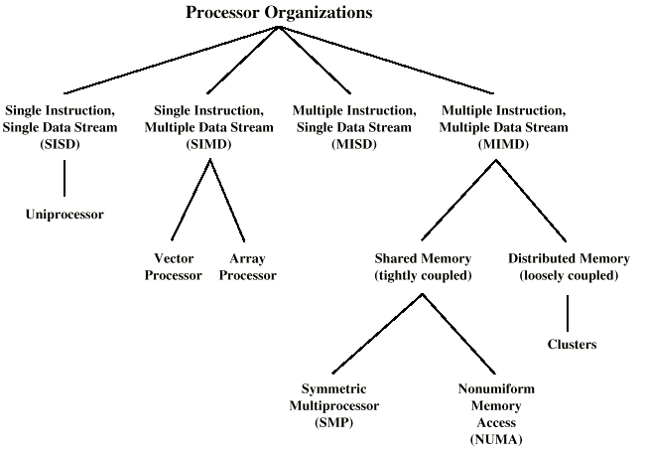
Taxonomy of Parallel Processor Architectures

Slide 15
More detail on cache coherency protocols with some examples…

Slide 16
More on centralized shared memory
Its worth studying the various ramifications of a centralized shared memory machine
(and there are lots of them)
Later we’ll look at distributed shared memory…
When studying memory hierarchies we saw…
…cache structures can substantially reduce memory bandwidth demands of a processor
Multiple processors may be able to share the same memory

Slide 17
More on centralized shared memory
Centralized shared memory supports private/shared data
If 1 processor in a multiprocessor network operates on private data, caching, etc. are handled just as in uniprocessors
But if shared data is cached there can be multiple copies and multiple updates
Good b/c it reduces required memory bandwidth; bad because we now must worry about cache coherence

Slide 18
Cache coherence – why it’s a problem
Time | Event | Cache contents for CPU A | Cache contents for CPU B | Memory contents for location X
0 |  |  |  | 1
1 | CPU A reads X | 1 |  | 1
2 | CPU B reads X | 1 | 1 | 1
3 | CPU A stores 0 into X | 0 | 1 | 0
Assumes that neither cache had value/location X in it 1st
Both a write-through cache and a write-back cache will encounter this problem
If B reads the value of X after Time 3, it will get 1 which is the wrong value!

Slide 19
Coherence in shared memory programs
Must have coherence and consistency
Memory system coherent if:
Program order preserved (always true in uniprocessor)
Say we have a read by processor P of location X
Before the read processor P wrote something to location X
In the interim, no other processor has written to X
A read to X should always return the value written by P
A coherent view of memory is provided
1st, processor A writes something to memory location X
Then, processor B tries to read from memory location X
Processor B should get the value written by processor A assuming…
Enough time has past b/t the two events
No other writes to X have occurred in the interim

Slide 20
Coherence in shared memory programs (continued)
Memory system coherent if: (continued)
Writes to same location are serialized
Two writes to the same location by any two processors are seen in the same order by all processors
Ex. Values of A and B are written to memory location X
Processors can’t read the value of B and then later as A
If writes not serialized…
One processor might see the write of processor P2 to location X 1st
Then, it might later see a write to location X by processor P1
(P1 actually wrote X before P2)
Value of P1 could be maintained indefinitely even though it was overwritten

Slide 21
Coherence/consistency
Coherence and consistency are complementary
Coherence defines actions of reads and writes to same memory location
Consistency defines actions of reads and writes with regard to accesses of other memory locations
Assumption for the following discussion:
Write does not complete until all processors have seen effect of write
Processor does not change order of any write with any other memory accesses
Not exactly the case for either one really…but more later…

Slide 22
Caches in coherent multiprocessors
In multiprocessors, caches at individual nodes help w/ performance
Usually by providing properties of “migration” and “replication”
Migration:
Instead of going to centralized memory for each reference, data word will “migrate” to a cache at a node
Reduces latency
Replication:
If data simultaneously read by two different nodes, copy is made at each node
Reduces access latency and contention for shared item
Supporting these require cache coherence protocols
Really, we need to keep track of shared blocks…

